Slide 1

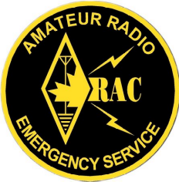
CITY WIDE TELEPHONE SYSTEM FAILURE
EMERGENCY MEASURES RADIO GROUP
OTTAWA ARES
Two Names - One Group - One Purpose
Presentation to EMRG/ Ottawa ARES meeting Jan 27 2007
Notes:
Audio clip from CBC National Radio News

Slide 2
CITY WIDE COMMUNICATIONS OUTAGE
FRIDAY OCTOBER 20, 2006 COMMUNICATIONS FAILED IN
SAINT JOHN’S FOR 5 HOURS.
WHAT IF IT WAS LONGER?
WHAT IF IT WAS HERE?
Notes:
What time span separates a glitch from a problem from an emergency from a disaster?

Slide 3
CITY WIDE COMMUNICATIONS OUTAGE
In Newfoundland, it was a fire in some DC bus cables.
It could as easily be a software bug, power surge or big weather event.
Murphy always finds a way in.
The actual cause doesn’t concern us.
We (most of us) don’t design telephone systems for a living.
Notes:
A connector in a wiring bundle overheated, failed and burned. This cable was one of several in a tray, carrying DC to the primary and backup equipment on that floor. To fight the fire, it was necessary to shut down all DC to the floor. Restoration involved venting the area, cleaning and re-insulating the cables, then replacing the failed connectors.

Slide 4
CITY WIDE COMMUNICATIONS OUTAGE
Suppose the communications failed in the middle of the day, in the middle of the week.
What are the consequences?
What is the response of the City of Ottawa?
Where does EMRG fit in?
Between the 1998 ice storm and the Y2K scare, the city has looked at this possibility.
Phones could be out for minutes, hours or days..
Notes:
The city emergency plan isn’t a plan to cope with every possible problem, but each department has their own plans to deal with their area.

Slide 5
CITY WIDE COMMUNICATIONS OUTAGE
What are the consequences?
-Some broadcast services would be affected.
-Any residual telephone capacity would be overloaded.
-ATMs would stop dispensing cash, since they can’t communicate back to head office.
-Internet would go out for most people
-People will still need to contact police, fire, ambulance
-People will be puzzled, then annoyed, then scared.
-In these circumstances people often call 911 so the problem can “snowball”
Notes:
If a studio to transmitter link goes by leased telco lines, it could go down. If a satellite feed has to get across the city on a telco line, it could go down. There will still be a few stations around that can operate in a local independant mode. Will gas stations be able to function without a link to head office telling them what the price is? How about the grocery store? Some smaller or smarter places still keep mechanical charge card imprinting machines around. People with satellite tv and internet may still get service, but not if the billing is through a telephone back channel.

Slide 6

CITY WIDE COMMUNICATIONS OUTAGE
From the point of view of the city, this is the same as a failure of the 911 phone system, plus a few additional hurdles. Notification of the public is via whatever mass media are still operating.
NOTE:
It does not require any action on the part of the city to evacuate, shelter or otherwise deal with masses of its residents.
No extra neighbourhood patrols are required.
Notes:
To a city, this is not too serious, at least initially. If the planning department fax goes out, a builder has to take photocopies downtown. Getting purchase orders out the door could become a problem after a while. Recording employee hours and distributing payments could be another weak spot after a while.

Slide 7
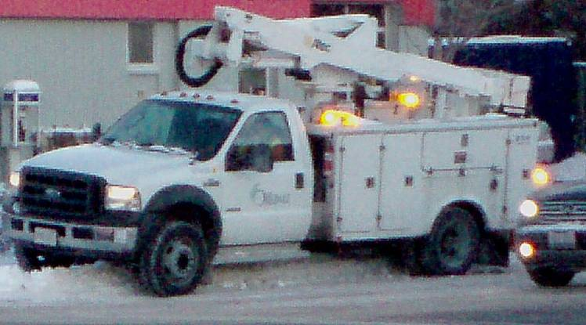
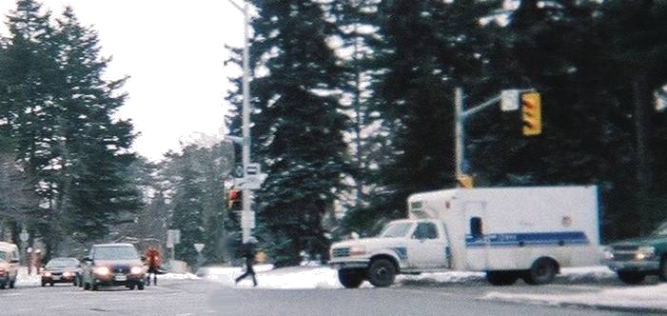
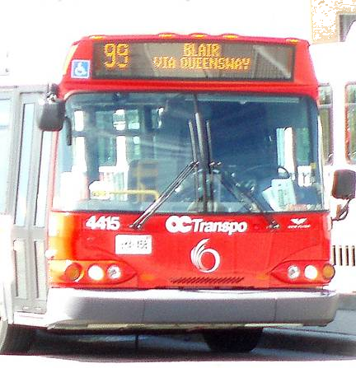
CITY WIDE COMMUNICATIONS OUTAGE
CITY OF OTTAWA EMERGENCY PLAN
What is the response of the city?
-Every radio equipped city vehicle is a contact point.
-City radio systems become tie points between services.
-Departments relying on telephones scale back, work around, or re-locate.
-Calling in staff means knocking on doors.

Slide 8
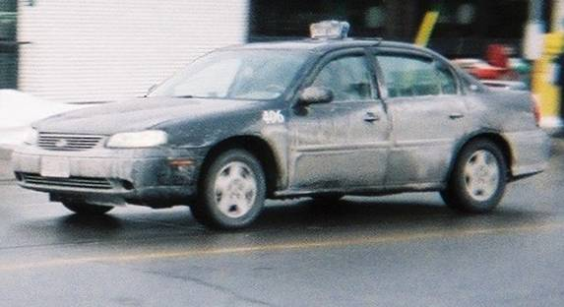
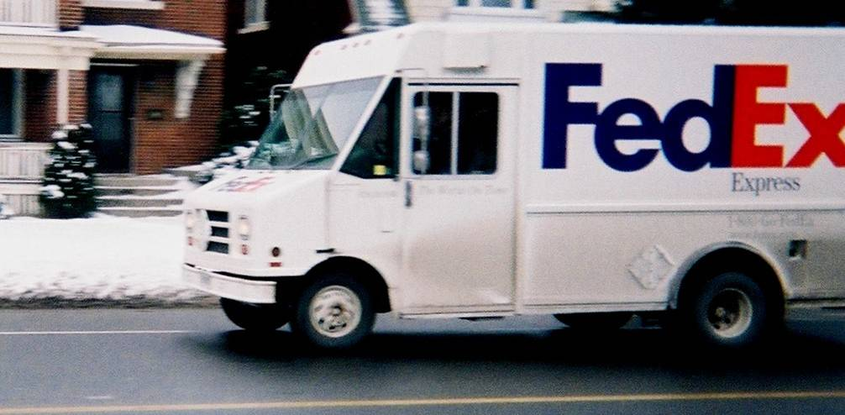
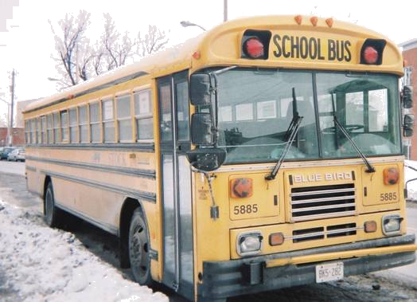
CITY WIDE COMMUNICATIONS OUTAGE
What is the response of the city? ..continued
-As time goes on, other radio equipped fleets (taxi, delivery, utility, etc.) join the contact plan.
Notes:
We become the glue that helps hold systems together in the absence of telephones.

Slide 9
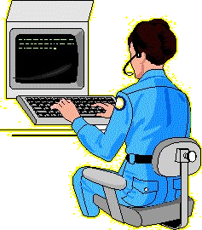

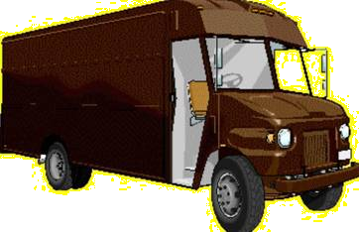

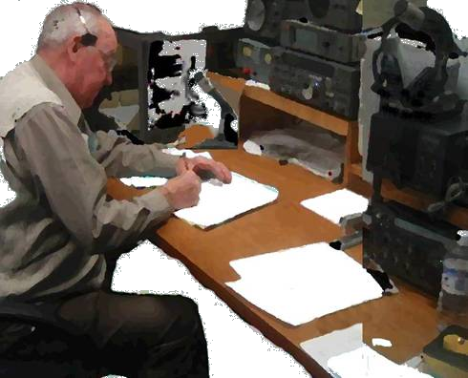
CITY WIDE COMMUNICATIONS OUTAGE
What is the response of the city? ..continued
Where do we fit in?
-The dispatchers of these other fleets won’t have good communications with the 911 system either. Amateurs are well suited to fill that role.
911
Package Co
E M R G
VE3EMV
Notes:
We become the glue that helps hold systems together in the absence of telephones.

Slide 10

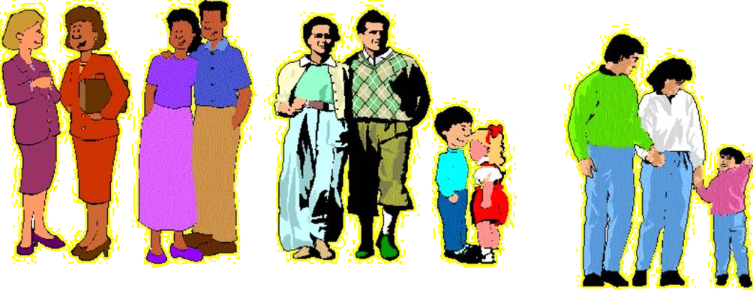

CITY WIDE COMMUNICATIONS OUTAGE
CITY OF OTTAWA EMERGENCY PLAN
Meanwhile...
The public contacts emergency services via any city vehicle or location that has a radio. House bound residents are instructed to use a red ribbon or other device to indicate distress, as they did in the ice storm of 1998. In Saint John’s, they were directed to the
nearest station. Neighbours help each
other.
Notes:
Same plan as for the ice storm.

Slide 11
CITY WIDE COMMUNICATIONS OUTAGE
What is the response of the city? ..continued
Where else do we fit in?
-Other hams, with the time and skills could assist rural patrols if they develop.
-If the city decides to use neighbourhood watch organizations as contact points, hams could keep in
touch with them via FRS or other means.
-Hams are good at gathering information about the big picture beyond the city borders. We can gather more specific information than the “Newsworld” model.
Notes:
We become the glue that helps hold systems together in the absence of telephones.

Slide 12
CITY WIDE COMMUNICATIONS OUTAGE
What do you need?
-As assignments go, this is an easy one. Nearly everything still works.
-Paying for lunch will be your biggest problem, if you haven’t included some cash in your 72 hour emergency kit.
-Bring ’phones, notepad and pencils and you’re in business.
...But don’t go wandering out on your own without being dispatched. “Loose cannons” need not apply.
While on the don’ts, avoid “no problem” reports.
(If it ain’t broke, we don’t need to hear about it)
Notes:
The job will be routine for anyone who has done a few public service events. The harder part will be to keep the nets quiet when nothing is happening.

Slide 13
CITY WIDE COMMUNICATIONS OUTAGE
What do YOU do?
-Prepare to deploy. (we discussed all that before)
-Wait for instructions , LISTEN
-Once deployed: document everything.
When did the call arrive?
Who originated it?
Who was it for?
What was the problem?
-Pass the information on as exactly as you get it,
as soon as you get it.
-Sit back and wait for the next one.
-Write up your notes for the debrief.
Notes:
Standard stuff for hams who do events, (except for the “writing it down” part)

Slide 14


CITY WIDE COMMUNICATIONS OUTAGE
- Wrap Up
Relatively easy, from an amateur point of view
Minimal preparedness required, but it think about it.
Collect feedback for next time.
..ZZZ?
QUESTIONS?
Can we go home now? What’s for lunch? What’s on TV?
Notes:
Can we go home now? What’s for lunch? What’s on TV?

