Slide 1

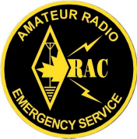
EMERGENCY MEASURES RADIO GROUP
OTTAWA ARES
Two Names - One Group - One Purpose
Yearly Status &
Plans For Fall 2007
Notes:
This training course provides an overview introduction for anyone wanting to know more about EMRG. The course is intended to be reviewed individually, or presented to a group.

Slide 2
Year In Review
City of Ottawa Support
  Yearly Operational Grant - $1000
  UHF 4 bay antenna and Tri-band Antenna Installation - $1400
  EOC Renovation Equipment Changes - $3300
  Office of Emergency Management -Book and pay internal cost monthly for Management Team meeting room.
  Ottawa Fire Service - Access to Fire Training Centre, repeater sites, the EMRG communications room and space for equipment storage.

Slide 3
Year In Review continued
Equipment Donations
  UHF Repeater: Used GE Low band UHF Repeater, cabinet, duplexer, 30A power supply/charger, 100AH Battery
  Cabinets & Radios: 3 matching equipment cabinets and shelf hardware, 2 VHF 99 channel radios, 2 10A Power supplies with battery backup.
  Two commercial equipment shipping boxes with radio equipment, suitable for shelter kit.

Slide 4
Year In Review continued
Repeater & Antenna Changes
  VE3OCE VHF Voice (146.880 -): New equipment (Motorola MTR2000) and antenna (210C-4, on top of 120 ft tower)
  VE3OCE VHF Data (145.030): New equipment (Motorla Spectra) and antenna (210C-4, on top of 120 ft tower)
  VE3OCE UHF Voice (443.800+): New repeater (Kenwood TKR-850) and antenna (310C-4, on tower at 105 ft)
  VA3OFS UHF Voice (444.950+): New repeater (Kenwood TKR-850) using a Diamond Tri-band antenna at 30 ft. (To Be Installed)
  Diamond Tri-Band (144/220/440) antenna for EMRG communications room installed on side of tower at 55 ft.

Slide 5
EXPECTATIONS
Vs. CAPACITY
By the end of 2005 it was clear that the first EMRG 1 year plan contained at least 5 years of work.
Now it is clear that the EMRG plan for 2007 includes expectations for meetings, training, exercises and projects, which cannot been achieved.
It is critical that partner expectations align with EMRG capability to deliver, so we need to understand what EMRG can realistically deliver. This includes the yearly training and exercising, plus incremental project work.

Slide 6
IT TAKES WORK
It takes a lot of work to keep EMRG running effectively. Good meetings, training, exercises and projects take a LOT of time to plan, prepare, deliver and wrap up.
If it is worth doing, it is worth doing right!
EMRG will not take on tasks that cannot be done well.
  It is better to not have a newsletter or net, than to produce something that does not provide value.
  It is better to have a few solutions that are well documented, understood and practiced, than a long list of solutions that may not be available.
Notes:
Preparing for 3 hours at the OARC Hamfest requires a couple extra hours on Hamfest day to get in early and set up, then tear down after, plus another 10 to 20 hours to plan and prepare the material for the display.
Preparing for a 3 hour exercise can involve as much as 100 hours of planning and preparation, plus debrief and documenting lessons learned.
EMRG does not have a net, because implementing a net requires a group of people committed to delivering the net. This means there must be a purpose for the net, there must ALWAYS be a prepared net operator, people checking into the must find value in participating, meaning there must be useful information available. Without this level of comittment, the net will be just another check in net.

Slide 7
FOCUS ON SOLUTIONS
There are many things Amateur radio could provide, and there are many things that would be nice to do.
EMRG strategy must prioritize activities based on volunteer availability, funding, equipment and probability of a solution being required.
Probability A Solution Will Be Required
Local FM Voice & Data
HF (Regional & Long Haul), DSTAR, APRS
Solutions Amateur Radio Can Provide

Slide 8
LOCAL EMPHASIS
Emphasis is on local communications because;
  It will always be required
  It will generate almost all of the traffic
  Sending and receiving messages outside the City of Ottawa requires a local communications infrastructure to collect and deliver the message from the local source.
  Satellite has become the long haul backup solution of choice for Emergency Communications.
  There are plenty of HF (long distance) stations in Ottawa that can be used to relay messages if required.

Slide 9
EMRG PLAN
Focus On
Partners Involved In
Humanitarian Support
They need & want our help!

Slide 10
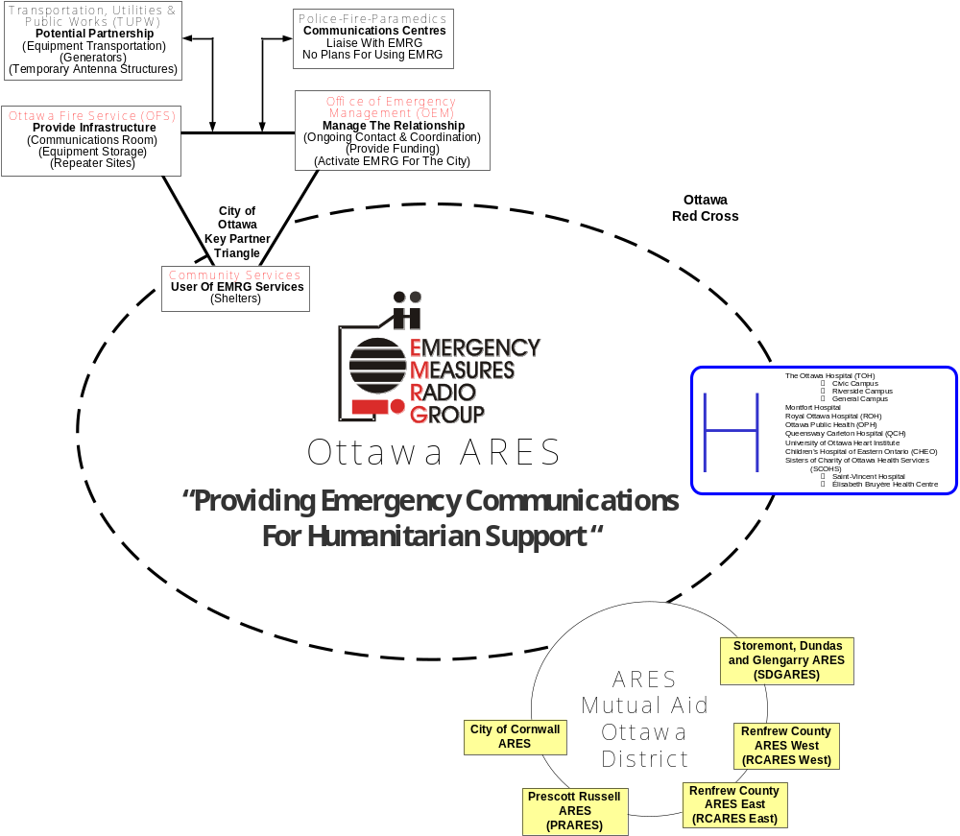
EMRG Key
Partners

Slide 11

City of Ottawa
Transportation, Utilities & Public Works (TUPW)
Police-Fire-Paramedics
Potential Partnership
Communications Centres
(Equipment Transportation)
(Generators)
(Temporary Antenna Structures)
Liaise With EMRG
No Plans For Using EMRG
Office of Emergency Management (OEM)
Ottawa Fire Service (OFS)
Manage The Relationship
Provide Infrastructure
(Communications Room)
(Equipment Storage)
(Repeater Sites)
(Ongoing Contact & Coordination)
(Provide Funding)
(Activate EMRG For The City)
City of Ottawa Key Partner Triangle
Community Services
User Of EMRG Services
(Shelters)

Slide 12
SOLUTION TYPES
Primary Solution
  Amateur Radios “1 to Many” dispatch style communications has significant benefits over telephones and cell phones for linking multiple sites together, such as a series of shelters.
Augmentation Solution
  Amateur radio can provide additional capacity when phones and cell phones are unable to provide the volume of information communications required.
Solution of Last Resort
  Alternative communications solution when telephones and cell phones have failed.
  If this is the only reason for partners to call, there won’t be many calls.

Slide 13
CRITICAL SITES
There are three permanent radio sites that are currently not functional. These must be addressed immediately and plans must be put in place to deliver portable solutions for two other key sites.
EOC
(City Hall)
3
Communications Centre
(OFS Dispatch – Alta Vista)
1
B
Shelters
2
A
Red Cross
(Catherine St.)
Community Services
Command Centre
(Ben Franklin Place)

Slide 14
CHANNEL CAPACITY
VE2CRA
VHF & UHF
Repeaters
VA3EMV/E
EAST VHF
Repeaters
VA3OFS
VHF & UHF
Repeaters
VE3OCE
VHF & UHF
Repeaters
220 Simplex
EOC
(City Hall)
Communications Centre
(OFS Dispatch – Alta Vista)
Shelters
Red Cross
(Catherine St.)
Community Services
Command Centre
(Ben Franklin Place)

Slide 15
WORK TO BE DONE
Communications Room
  Clear out room, remove old counters and equipment cabinets
  Fill holes, paint walls and install new counters
  Re-install radio and computer equipment in new equipment cabinets
  Clean up storage area
Red Cross
  Complete radio installation and wiring of cabinet with 144/220/440 Voice + VHF Packet
  Move antenna for Packet (Shield dual band antenna from others)
  Connect cabinet radios to antenna cables
City of Ottawa EOC
  Prepare and Install 2 inband + 1 crossband repeaters, plus VHF packet with WiFi inside.
  Move antenna for Packet (Shield dual band antenna from others)

Slide 16
FOCUS ON OPERATIONS
With the main VHF & UHF repeaters now in place, completion of the critical radio sites will provide the opportunity to focus EMRG on operational skills, including;
  Training on site operation
  Hands on Practice
  EMRG Exercises
  Partner Exercises
EMRG will not be participating in the annual ARES Simulated Emergency Test (SET) this year. The EMRG local exercise will take place once we have the equipment installations completed.

Slide 17
WORK SESSIONS
In order to complete the work on the critical sites, a series of work sessions will be held on Thursday nights and Saturday mornings from now until the work is completed.
Other times will be selected if they are more convenient for volunteers, to ensure everyone has the opportunity to participate.
PLEASE SIGN UP TO HELP!

Slide 18
www.emrg.ca
The EMRG web site provides information related to Amateur radio emergency communications, specifically as it relates to the City of Ottawa.
  Project Information
  Newsletters
  Upcoming Events
  Documentation
  Links to related information
Team Leader: Peter Gamble - VE3BQP
pgamble@emrg.ca

