Slide 1


EMRG-GM2008-01-19
General Meeting Notes
EMERGENCY MEASURES RADIO GROUP
OTTAWA ARES
Two Names - One Group - One Purpose
GENERAL MEETING
2008-01-19
Date Of Last Change: 2008-01-19
Version: 1.0

Slide 2
WELCOME
Coffee in the end room, help yourself
Washrooms in the hall, through the door
Fire exits at each end of the room. USE THE MAIN ENTRACE unless it is blocked
Sign In sheet by the door – Please sign in
Listen and Participate, respect those around you

Slide 3
TRAINING
Direction and objectives for training come from the Management Team and are part of the overall EMRG strategy.
Tom Zinck (VA3NFA) is the Management Team member responsible for the training plan and ensuring training is developed and delivered.
Training itself may be developed by Tom or a member of the Management Team, an EMRG member or from resources outside EMRG.

Slide 4
Tom is looking for a couple volunteers interested in working as part of a training team.
Training Team will meet and work as a group, to ensure the planning, documentation and training development is completed.
Offloads training effort from Management Team.
Involves more people from within EMRG (Share the load).
If interested contact Tom, mysleft of email training@emrg.ca

Slide 5
Canadian Ski Marthon (CSM)
This year also marks the 35th anniversary of Amateur Radio participation.
Second weekend in February (9th-10th)
The CSM depends on ham radio volunteers to provide important and timely safety and logistical communication for the benefit of the skiers.
The amateur radio CSM web page (http://radio.admin2.ca)
If you would like to volunteer this year, please email Richard VE3UNW (radio1@admin2.ca).

Slide 6
PROJECT WORK SESSIONS
EMRG has a HUGE pile of project work that we need to complete this year.
Examples include;
  EOC Radios
  Community Services Radio solution (design/build)
  Shelter Kits
  Wire DC backup power for Randall Communications room and UHF/Packet Repeaters.
  Barrhaven repeater system (assemble, wire and test)

Slide 7
Last fall multiple sessions held, some Saturday Mornings, some Thursday evenings.
Great opportunity to meet other EMRG members, see the communications room, get an understanding of what equipment EMRG has, new things coming up and learn new skills
Made a lot of progress, need to keep it up!
NO EXPERIENCE REQUIRED
Sign up sheets on the table by the door

Slide 8
EMRG CALLOUT TESTING
EMRG has set a goal to test the Activation Plan at least twice per year.
We need to practice and be good at activation.
First step was to make sure everyone has the same updated version of the membership list.
  Yearly mailing seems to work.
EMRG Activation Plan (EMRG105) was updated (Section 10.0) to provide better information on what information to collect during callouts

Slide 9
ACTIVATION PLAN
Keep track of who you called and what each member’s availability is (See EMRG-512 Activation Worksheet). If there is no answer, or if you left a message, the person is treated the same as if they were never called and may be called again in the next shift.
  COMMENTS CODES .
  1 Available Now
  2 Available in 8 hours
  3 Available in 24 hours
  4 Available on weekend
  5 Available evenings only
  6 Available days only
  99 Unavailable Any Time

Slide 10
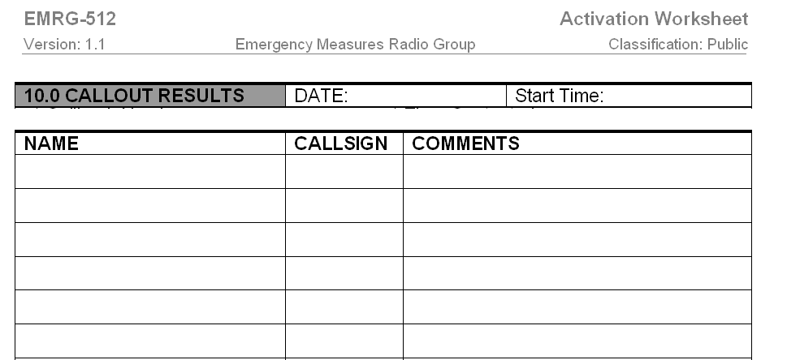
Activation Worksheet
Top Of Page

Slide 11
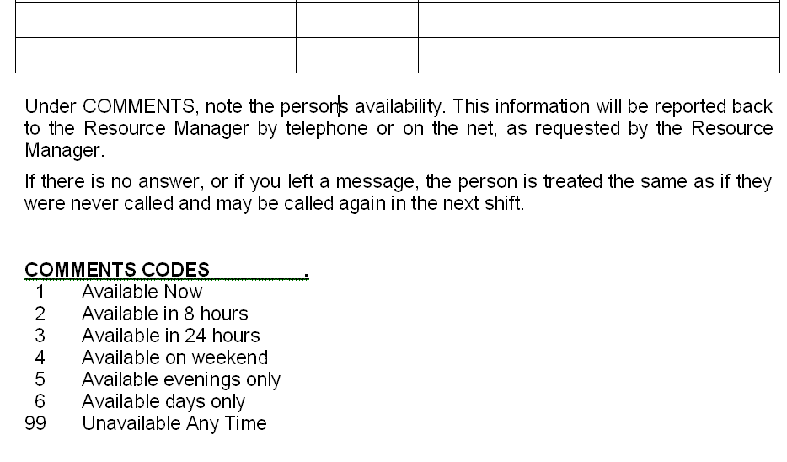
Activation Worksheet
Bottom Of Page

Slide 12
ARES DISTRICT MEETING
Meeting here last Saturday organized by our ARES Assistant District Emergency Coordinator (DEC) Lance Peterson (VA3LP)
Hosted by Ottawa ARES, which included the room, meeting minutes, coffee & pizza, PC projector, packet demo equipment
Participants from as far as Kingston, Pembroke, Cornwall, Perth and Hawkesbury.

Slide 13
Discussing needs and ideas to share information using Data Communications.
Objective to form common approaches where possible.
Great participation! We are on the same path!
Two main solutions in our District;
  BBS based using Outpost
  Winlink based using Airmail, Telpac, Packlink
Using 1200B packet as the wireless portion
Using AGWPE in situations where PC sharing or multiple applications required

Slide 14
www.emrg.ca
The EMRG web site provides information related to Amateur radio emergency communications, specifically as it relates to the City of Ottawa.
  Project Information
  Newsletters
  Upcoming Events
  Documentation
  Links to related information
Information: training@emrg.ca

