Slide 1

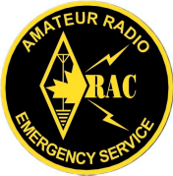
EMRG
General Meeting 2008-05-31
EMERGENCY MEASURES RADIO GROUP
OTTAWA ARES
Two Names - One Group - One Purpose
DISTRICT ARES NEWS
General Meeting 2008-05-31
Date Of Last Change: 2008-05-26
Version: 1.1

Slide 2
ARES DISTRICT MEETING
On April 26, there was an ARES District meeting in Perth at the Lanark County offices, hosted by the Lanark ARES Group.
Representatives from across Eastern Ontario
Continuation of efforts to strengthen Mutual Aid capabilities
Each group provided a short summary of their status and future projects

Slide 3
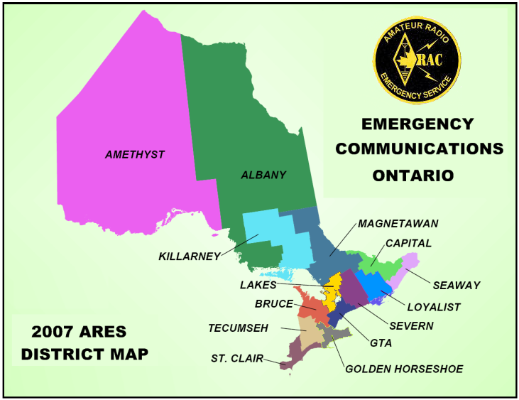

Slide 4
IMPORTANT POINTS
All Groups on same page (They all Get it)
All Groups recognize they need Mutual Aid
All Groups committed to working as a group. There is a good team atmosphere!
All Groups working to standardize as much as possible to make support easier.
All Groups understand that ARES leadership in Ontario and National not adding much value.

Slide 5

www.emrg.ca
The EMRG web site provides information related to Amateur radio emergency communications, specifically as it relates to the City of Ottawa.
  Project Information
  Newsletters
  Upcoming Events
  Documentation
  Links to related information
Information:

