Slide 1

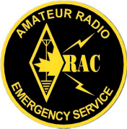
EMRG-{xxx}
Self Study Training Course
EMERGENCY MEASURES RADIO GROUP
OTTAWA ARES
Two Names - One Group - One Purpose
IMS For Amateur Radio
Building On IMS 100
Prepared By: Peter Gamble – VE3BQP
Date Of Last Change: 2011-01-05
Version: 0.3

Slide 2
About This Document -P1
This document, IMS For Amateur Radio, was created for the Emergency Measures Radio Group (EMRG), also known as Ottawa ARES. Website: www.emrg.ca Email: ve3bqp at rac.ca
Once the basic course is ready, it will be presented at the annual ARES District meeting to get input and buy in for district wide implementation.
The document is written by Peter Gamble (VE3BQP). Peter was the EMRG leader for 15 years and works as a consultant in Public Safety, Emergency Management and Business Continuity communications and operations, including ICS/IMS.
The objective for this document is to define an IMS implementation for Amateur Radio that is simple to understand and implement.
Emergency Measures Radio Group (EMRG) - Ottawa ARES

Slide 3
About This Document -P2
IMS For Amateur Radio cannot be just an Amateur Radio view of ICS/IMS. Clients and partners MUST review the plan to help shape it into something that fits with their structure and expectations.
The basic IMS structure for Amateur Radio has been reviewed with the City of Ottawa, Office of Emergency Management, in a detailed review meeting, and they support the proposed structure.
This document is a first draft and has not been edited in detail by the author and has not had peer review for readability, grammar and spelling. There are some sections that are not complete, but hopefully they have enough information for the reader to understand the kind of information that would be contained in the section.
Emergency Measures Radio Group (EMRG) - Ottawa ARES

Slide 4
About This Document -P3
Once this document is complete and has been reviewed across a wider audience, the next step will be to break the information into useable components which includes the following;
  IMS For Amateur Radio training course that would be used in parallel with an ICS/IMS-100 course. The goal is to apply ICS/IMS to amateur radio, not to take on writing an ICS/IMS course.
  Defined set of ICS/IMS forms recommended for Amateur Radio. These will be standard ICS/IMS forms not modified for Amateur radio, but with a set of instructions that are Amateur Radio specific.
  ICS/IMS identification package that includes recommendations and templates for creating ICS/IMS identification.
  Implementation packages for each ICS/IMS position that contains a quick reference guide for the role and responsibilities of the position, plus all the forms required for that position.
Emergency Measures Radio Group (EMRG) - Ottawa ARES

Slide 5
About This Document –P4
This is a long document, with a lot of information included to help get the reader into the right perspective. There are different views within Amateur Radio about where Amateur radio fits in ICS/IMS, who makes decisions and who is accountable for what is delivered.
Anyone who wants to take this information and present it locally is welcome to do so. We appreciate getting credit for what we have done, but you should take credit for moving this forward in your local area.
Comments are welcome: ve3bqp at rac.ca
Emergency Measures Radio Group (EMRG) - Ottawa ARES

Slide 6
Contents
This document is divided into modules, with a review of key points at the end of each module.
Module 1: Introduction
Module 2: Understanding Incidents
Module 3: Managed Services
Module 4: Introduction To IMS
Module 5: Identification
Module 6: Resources
Module 7: Forms
Module 8: Supporting Information
Module 9: Why not ARCT
Emergency Measures Radio Group (EMRG) - Ottawa ARES

Slide 7
1: INTRODUCTION
Emergency Measures Radio Group (EMRG) - Ottawa ARES

Slide 8
ICS - IMS - NIMS
This document will refer to the Incident Management System (IMS) because that is the direction taken by Emergency Management Ontario (EMO) and this document was written in Ontario Canada.
IMS is built on the ICS (Incident Command System) and the names can be easily interchanged. Many will argue that IMS is ICS.
IMS can be thought of as the ICS expanded to include an Emergency Operations Centre (EOC), as well as shelters and multiple organizations and agencies responding, who have each implemented the IMS internally.
National Incident Management System (NIMS) is a US Federal directive to implement a standard Incident Management System Nationally.
Emergency Measures Radio Group (EMRG) - Ottawa ARES

Slide 9
Setting Context
For small incidents, local methods of managing response using memory and a few sheets of paper will work fine. The value of IMS is apparent as the event scales up, the number of resources increases, and resources are brought in from other areas.
In order to understand the need for, and the value of the IMS structure, one needs to think beyond a small localized emergency, and instead think of something that covers a large area with a significant impact, like a Hurricane or Earthquake.
Once IMS for large incidents is understood, it is easy to understand how the IMS can easily be used for small events and how regular use of the IMS builds the skills required for large incidents.
Emergency Measures Radio Group (EMRG) - Ottawa ARES

Slide 10
It’s Not Simple, Initially
There are numerous views about Amateur radio emergency communications and how it fits in with the IMS. Most views simply require Amateur radio operators to take IMS courses and make the clients (Officials) responsible for implementation.
This document takes a different view and outlines why Amateur radio must implement it’s own IMS internally and how that fits in with clients IMS structure, while maintaining a single chain of command. (Green to Green to Green)
Understanding IMS for Amateur radio requires the reader to work through a large amount of information in order to understand where and why Amateur radio fits into the IMS. There is no short answer.
The initial information sets the big picture, making it easier to understand and work with IMS for Amateur Radio.
Emergency Measures Radio Group (EMRG) - Ottawa ARES

Slide 11
ICS/IMS Training
IMS For Amateur Radio (this document) provides a practical look at how Amateur Radio fits into the IMS structure and how Amateur radio can and should use the IMS.
IMS For Amateur Radio should be taken after working through an ICS 100 or IMS 100 course. It will probably take several reviews of the ICS/IMS 100 course and IMS For Amateur Radio, to get a full understanding.
  The ICS/IMS courses are typically focused on forest fire scenarios, making it more difficult for Amateurs to understand how Amateur radio fits into IMS. This document will explain how Amateur radio fits in.
For most Amateurs, the ICS/IMS 100 course, plus this course, IMS for Amateur Radio, will provide the foundation required. Amateurs who will be fulfilling leadership roles should work towards the ICS/IMS 200 level training.
Emergency Measures Radio Group (EMRG) - Ottawa ARES

Slide 12
IMS Is A Guide
The Incident Management System (IMS) is a guide to help manage incidents in a logical manner, allowing the response to scale from very small to very large and to allow resources from different locations or agencies to work together as a single organized response.
IMS is not a set of rules that dictate what to do. Two incident commanders may define different organizational structures for the same incident, based on their experience and understanding of the situation.
By everyone using the same guide, IMS, it is much easier to bring together resources from different areas and quickly form an organizational structure.
Emergency Measures Radio Group (EMRG) - Ottawa ARES

Slide 13
Review
To be added
Emergency Measures Radio Group (EMRG) - Ottawa ARES

Slide 14
2: UNDERSTANDING INCIDENTS
Emergency Measures Radio Group (EMRG) - Ottawa ARES

Slide 15
Expanding Our Horizon
Amateurs often assume the “Incident” will be the “Big One”, with an incident site, an Incident Command post at the perimeter, the EOC is activated, there is a declared state of emergency and communications systems are overwhelmed.
If we wait for the “big one” we may never be called and if we are called, Amateurs and Clients will most likely be confused about how to apply Amateur radio. There are numerous opportunities for Amateur radio to provide value in incidents that are not the Big One, and it is through these smaller incidents that Amateurs and clients build confidence and understanding.
This section provides information to build a broader view of what an incident may look like, in order to build a more comprehensive “big picture”, which is required to appreciate the flexibility and usefulness of the IMS.
Emergency Measures Radio Group (EMRG) - Ottawa ARES

Slide 16
From Public Safety Canada
In Canada, emergency management adopts an all-hazards approach that addresses both natural and human-induced hazards and disasters.
Most emergencies in Canada are local in nature and are managed by the municipalities or at the provincial or territorial level.
Emergency management requires collaboration, coordination and integration to facilitate complementary and coherent action by all partners to ensure the most effective use of emergency management resources and execution of activities.
Lessons learned and knowledge generated from evidence-based and qualitative information is used to develop improved practices, which are shared widely.
Emergency Measures Radio Group (EMRG) - Ottawa ARES

Slide 17
Common Requirements
With an all-hazards approach that addresses both natural and human-induced hazards and disasters, there are many common requirements and solutions.
When Amateur radio provides communications services, it doesn’t matter whether people are in a shelter because of a storm, volcano eruption, chemical spill, bomb explosion, gas leak, or a terrorist attack, the requirements for Amateur radio are the same, provide communications.
The 3rd bullet on the previous page can be changed slightly, to make it define how Amateur Radio must function going forward;
  Amateur Radio must embrace collaboration, coordination and integration to facilitate complementary and coherent action with all partners to ensure the most effective use of emergency management resources and execution of activities.
Emergency Measures Radio Group (EMRG) - Ottawa ARES

Slide 18
Different Views of Incidents
The Incident may start with one or more Incident Sites who identify that the situation requires additional resources, which prompts the EOC (Emergency Operations Centre) to be activated. The EOC supports the Incident Commanders (IC) at the Incident Sites.
The Incident may start with low impact over a wide area, and there may not be any Incident Sites, such as what happened in the Power Outage and the Ice Storm.
Depending on the situation, the EMO (Emergency Management Ontario) PEOC (Provincial Emergency Operations Centre) may be advised. Evacuating a high rise apartment building that had a fire is not a Provincial Emergency.
There may, or may not be a declared state of emergency. The state of emergency is declared when local resources are overwhelmed, or the special powers under a state of emergency are required.
Emergency Measures Radio Group (EMRG) - Ottawa ARES

Slide 19
People Need Assistance
If the situation impacts the general population, and support is required, Emergency Social Services (ESS) will be activated.
In Ottawa, ESS is a virtual organization made up of people from multiple City departments.
Some Municipalities have an MOU with the Red Cross to provide ESS, while some Provinces manage ESS.
ESS in Ottawa has agreements with the Red Cross, Salvation Army and Ottawa ARES, for support services.
Ottawa ARES can be involved in several ways, providing service to ESS directly, or providing service to the Red Cross and Salvation Army.
ESS (Emergency Social Services)
Salvation Army
Red Cross
EMRG–Ottawa ARES
Emergency Measures Radio Group (EMRG) - Ottawa ARES

Slide 20
Emergency Management Communications Support
In many Municipalities, the Emergency Management group only exists in the EOC. There are no multiple sites linked together with communications.
  Incident Sites are managed by Public Safety agencies.
  County EOCs communicating with local Municipal EOCs would be an exception.
Each agency within the Municipality has their own communications capability for communicating with their organization in the field and for communications from their command centre to the EOC. This may be there own radio system, telephones, or cell phones.
If communications into the EOC from the various other EOCs or Command Centres fails, then Amateur Radio could be a solution, but would typically be the exception. This is low probability, and would be adhoc.
Emergency Measures Radio Group (EMRG) - Ottawa ARES

Slide 21
Hospitals & Public Safety
Ottawa ARES has an agreement to provide radio communications for the Hospitals in Ottawa, if their emergency management radio system fails. This would require radio operators in up to 14 locations, including Ottawa Public Health.
While there is no agreement to provide support for Public Safety organizations (Police, Fire, Paramedics), if requested, adhoc solutions would be deployed based on the equipment and people available.
In the event that there are not enough Amateur Radio resources, the City of Ottawa is the Primary Client and the City EOC would be asked to prioritize the communications requirements for Ottawa ARES.
Emergency Measures Radio Group (EMRG) - Ottawa ARES

Slide 22
City EOC - Provincial EOC
The City EOC (Emergency Operations Centre) and Provincial EOC exchange information during the incident.
In the event that all other forms of communication fail, EMRG – Ottawa ARES would relay information from the City EOC to the Provincial EOC, through EMO ARES.
PEOC
Provincial Emergency Operations Centre
Amateur Radio External Service Provider
Amateur radio communications between the City EOC and the PEOC if other communications fails, and if requested.
City of Ottawa
EOC
EMRG–Ottawa ARES External Service Provider
Emergency Measures Radio Group (EMRG) - Ottawa ARES

Slide 23
EMRG Radio Support
The Salvation Army and /or the Red Cross, may request radio communications to support their service delivery to ESS.
ESS may ask the EOC to activate Ottawa ARES. Once activated to support ESS, ESS is the client, not Emergency Management, and Ottawa ARES answers to ESS.
  There is still status reporting from Ottawa ARES to the EOC.
EOC
Status reports of all Amateur Radio Activity
Prioritization if required.
EMRG–Ottawa ARES External Service Provider
ESS (Emergency Social Services)
Internal Service Provider
Salvation Army
External Service Provider
Local Service Delivery.
Incident Site(s)
Red Cross
External Service Provider
Local Service Delivery.
Emergency Measures Radio Group (EMRG) - Ottawa ARES

Slide 24
Amateur Radio Self Activation
If Ottawa ARES is aware of a potential situation, there is a procedure for self activation.
Self activation may only be sending a single person as the Director to the EOC to monitor events.
This can expand up to activation of the Ottawa ARES communications centre, with a NCS (Net Control Station) and Operations Group Coordinator, with a standby activation of the membership (no deployment).
Activation and deployment of Ottawa ARES would come from a client request, such as the City of Ottawa, Red Cross, Salvation Army, Hospitals, or ARES Mutual Aid.
Emergency Measures Radio Group (EMRG) - Ottawa ARES

Slide 25
Potential Requirements Within
The City of Ottawa
The Orange triangles show each of the individual support relationships and points of accountability for Ottawa ARES within the City of Ottawa.
Service delivery to each of these points is managed by Ottawa ARES using the Incident Management System (IMS)
EOC
City of Ottawa Emergency Operations Centre
Status reports of all Amateur Radio Activity
Prioritization if required.
EMRG–Ottawa ARES External Service Provider
ESS (Emergency Social Services)
Internal Service Provider
Salvation Army
External Service Provider
Local Service Delivery
Incident Site(s)
Red Cross
External Service Provider
Local or Mutual Aid Service Delivery.
Hospitals
(Includes OPH)
Police, Fire, Paramedics
No Planned Support
“Best Effort” Adhoc Solutions At The Time, If Requested
City of Ottawa
Emergency Measures Radio Group (EMRG) - Ottawa ARES

Slide 26
Outside The City of Ottawa
There are 3 scenarios where Ottawa ARES may be involved with radio communication outside Ottawa;
Requesting Mutual Aid from neighbouring ARES groups, offers of assistance from out of town Amateurs, and offers of equipment from radio clubs .
Providing Mutual Aid to a neighbouring ARES Group.
Providing radio communications for the Ottawa Red Cross office, to support Red Cross efforts outside Ottawa.
The Red Cross Ottawa office provides support across Eastern Ontario, so Red Cross groups in neighbouring Municipalities may require Amateur radio communications with the Ottawa Office.
EMRG–Ottawa ARES External Service Provider
Amateur Radio Mutual Aid,
Clubs & Volunteers
ARES
Mutual Aid
Red Cross
External Service Provider
Local Service Delivery.
Local Red Cross in Eastern Ontario
Emergency Measures Radio Group (EMRG) - Ottawa ARES

Slide 27
Relationships & Accountability For Ottawa ARES To Manage In An Emergency
PEOC
Provincial Emergency Operations Centre
EMO ARES
External Service Provider
Radio communications between EOC and PEOC if other communications fails, and if requested.
Indicates service delivery interface and accountability point. Which relationships are activated will depend on the situation.
EOC
City of Ottawa Emergency Operations Centre
Status reports of all Amateur Radio Activity
Prioritization if required.
EMRG–Ottawa ARES External Service Provider
Incoming Amateur Radio Mutual Aid,
Clubs & Volunteers
ESS (Emergency Social Services)
Internal Service Provider
EOC
Local Emergency Operations Centre
Salvation Army
External Service Provider
Local Service Delivery
Incident Site(s)
Local or Mutual Aid Service Delivery.
Outgoing ARES
Mutual Aid
Red Cross
External Service Provider
Hospitals
(Includes OPH)
Local Red Cross in Eastern Ontario
Police, Fire, Paramedics
No Planned Support
“Best Effort” Adhoc Solutions At The Time, If Requested
City of Ottawa
Emergency Measures Radio Group (EMRG) - Ottawa ARES

Slide 28
Single Management of Amateur Radio
The previous slide shows the varied and interconnected relationships for Amateur Radio within an area. The communications requirements cannot be served using multiple Amateur Radio organizations working independently.
In order to effectively and efficiently deliver amateur radio communications, there must be a single Amateur Radio management structure for all resources working in an area.
Resources must be allocated based on prioritization of requirements, so resources are not wasted where they are not required.
Delivering service to multiple sites, with proper management of service delivery and shift changes, requires a LOT of people.
Emergency Measures Radio Group (EMRG) - Ottawa ARES

Slide 29
Moving Beyond The Basic Emergency Management ICS/IMS Structure
Most ICS / IMS training, documentation and examples focus on the Incident Site, with some references to the organization of the EOC. The scenarios are typically focused on fires, especially forest fires.
In order to understand IMS for Amateur Radio, we need to expand the ICS / IMS model beyond basic Emergency Management, to include management of service delivery by both Internal and External Service Providers.
Amateur Radio is an External Service Provider, and may be supporting Emergency Management directly, or more likely, providing services to Internal Service Providers, and other External Service Providers such as Red Cross, Salvation Army and Hospitals.
Emergency Measures Radio Group (EMRG) - Ottawa ARES

Slide 30
Moving Beyond The Basic Emergency Management ICS/IMS Structure
Service to Emergency Management
Service to Internal Service Providers
Emergency Management
Internal Service Providers
External Service Providers
EOC
City of Ottawa Emergency Operations Centre
ESS (Emergency Social Services)
EMRG–Ottawa ARES
Police, Fire, Paramedics
Salvation Army
Service to other External Service Providers
Red Cross
Public Health
Hospitals
Public Works
Incident Site(s)
By Law
Contractors
Cranes, Excavators, Tree Cutting, Generators, etc …
Emergency Measures Radio Group (EMRG) - Ottawa ARES

Slide 31
The IC or EOC Director
In a very large incident, the Incident Commander or EOC Director can be thought of as the head of a giant corporation, with the Command Staff and General Staff being the VPs. While the IC or EOC Director are technically accountable for everything that happens, their view at the top is very high level.
The working level control and management is delegated below and the use of Amateur radio may be managed well down in the IMS structure. The client objectives will most likely come from someone within the clients organization who is responsible for support services, not from the Incident Commander, or an EOC director.
Emergency Measures Radio Group (EMRG) - Ottawa ARES

Slide 32
Normal Operations
Each agency manages their normal operations from their offices, or a dedicated operations centre.
The operations centre may be a few desks, or a large facility.
Police
Operations Centre
EOC
Emergency Operations Centre
CLOSED
Transportation
Operations Centre
Fire
Operations Centre
Public Works
Operations Centre
EMS
Operations Centre
Bylaw
Operations Centre
Emergency Measures Radio Group (EMRG) - Ottawa ARES

Slide 33
In An Emergency
When the EOC is opened, each agency sends a representative who will act as the liaison for that Agency.
The agency continues to manages it’s operations from it’s own operations centre.
Police
Operations Centre
EOC
Emergency Operations Centre
Emergency Management
Transportation
Operations Centre
Fire
Operations Centre
Police
Transportation
Fire
Public Works
Public Works
Operations Centre
EMS
Operations Centre
EMS
Public Health
Bylaw
ESS
Emergency Social Services
Bylaw
Operations Centre
Emergency Measures Radio Group (EMRG) - Ottawa ARES

Slide 34
Virtual Operations Centres
Agencies that do not use an operations centre on a daily basis, such as Public Health and ESS, will open their virtual centres in the designated facility, which may normally be used as a meeting room.
Police
Operations Centre
EOC
Emergency Operations Centre
Emergency Management
Transportation
Operations Centre
Fire
Operations Centre
Police
Transportation
Fire
Public Works
Public Works
Operations Centre
EMS
Operations Centre
EMS
Public Health
Bylaw
ESS
Emergency Social Services
Public Health
Operations Centre
Bylaw
Operations Centre
ESS
Operations Centre
Emergency Measures Radio Group (EMRG) - Ottawa ARES

Slide 35
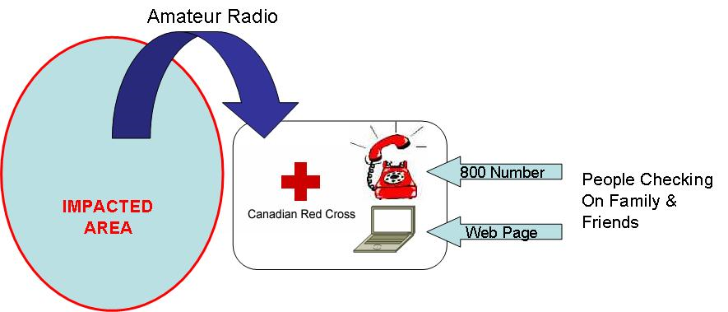
Handling Welfare Traffic in IMS Is Easy, We Don’t!
Ottawa ARES will not handle Welfare traffic from an impacted area to friends and family across the world. In Ottawa, the Red Cross is the designated agency responsible for registration of people and Ottawa ARES will help them collect information from the impacted area.
Registration ensures there is proper assessment, follow up, and a single source for all information.
Emergency Measures Radio Group (EMRG) - Ottawa ARES

Slide 36
What If
The IMS structure defined in this document is flexible to cover different situations that may be encountered by an ARES group. The questions that the IMS structure must support are
There is no declared state of emergency
The EOC is not opened, but there are shelters
The local Municipality does not require emergency radio communications, but the Red Cross, Salvation Army and/or the Hospital(s) do require Amateur Radio support.
The disaster is in a neighbouring Municipality, but through Mutual Aid, you are providing a radio gateway (NCS in non impacted area), or volunteers into the impacted area.
Emergency Measures Radio Group (EMRG) - Ottawa ARES

Slide 37
Review
To be added
Emergency Measures Radio Group (EMRG) - Ottawa ARES

Slide 38
3: MANAGED SERVICE
Amateur Radio Emergency Communications Provides A
Emergency Measures Radio Group (EMRG) - Ottawa ARES

Slide 39
Amateur Radio As A
Managed Service
There are too many combinations and possibilities to define end to end Amateur radio communications solutions in advance, or for clients to select and assign resources.
  Resource components can be pre-defined, then assigned by knowledgeable people who understand the capabilities and limitations of these resources.
  Solutions provided are based on client requirements and the resources available at the time.
Must be able to simultaneously support multiple agencies, with different requirements, boundaries and timelines.
  Red Cross boundaries may go outside the City and their role may continue after other organizations stand down.
  May be EOCs at the County and local Municipal level to support.
Emergency Measures Radio Group (EMRG) - Ottawa ARES

Slide 40
Amateur Radio As A
Managing Resources
Many sites such as the EOC have permanent radios, and during shift changes most temporary sites will require only radio operators (the equipment should not change with each shift, to maintain consistent service level).
Most Amateurs are “entry level” volunteers, so they are not all equal in radio skill, training and physical capability.
  The right resources need to be assigned to the right location, by someone who understands the resources and volunteer capabilities.
Requires amateur radio to be organized as a group, with some equipment owned and operated by the group, such as portable repeaters and other infrastructure.
Emergency Measures Radio Group (EMRG) - Ottawa ARES

Slide 41








Amateur Radio As A
Managed Service
Resources Available
Group Members, Local Amateurs & Mutual Aid Partners
Resources available varies depending on the incident, time of day, week and year.
Clients express their problems in terms of “need to communicate from Site A to Site B”. They do not understand Simplex, Repeaters, HF, etc.
Radio operators will be the limiting factor in how much communication can be provided.
Group & Volunteer Owned Radios
Fixed & Portable Infrastructure
Client Feedback
Transportation
MANAGED COMMUNICATIONS SERVICE - IMS
Action Plans,
Operations, Planning, Logistics
ESS
Red Cross
Salvation Army
Initial Client Assessments
Hospitals
Mutual Aid
“What would you like to accomplish with radio communications?”
Emergency Management
Priorities & Support
Communications Solutions For Clients
Emergency Measures Radio Group (EMRG) - Ottawa ARES

Slide 42
Amateur Resources
There are 4 classifications of amateur radio resources that are required and must be managed for an emergency;
  Radio Operators - Local group members, Mutual Aid, local and out of towm volunteers
  Equipment - Portable, mobile and base station radios
  Infrastructure – Local repeaters, portable repeaters, cross band, Winlink nodes
  Transportation - Patrols, move equipment and people. Client provided or amateur provided.
Emergency Measures Radio Group (EMRG) - Ottawa ARES

Slide 43
Scale and Structure Will Vary
Each incident and each Municipality will utilize a different response structure. This is why IMS is an ideal structure for Amateur radio because it can scale from a single radio operator, up to thousands.
In a small Municipality, or for a small incident, all functions may be managed out of the EOC. As the incident scales up, or in larger Municipalities, some functions may move to separate, dedicated Service Command Centres (SCC).
  Police, Fire and Paramedics operate their own SCC all the time and continue to do so in an emergency.
Some Municipalities may use internal resources for Emergency Social Services (ESS), or may have an MOU with the Red Cross and Salvation Army to provide services.
Some organizations such as Red Cross, Salvation Army and the Hospitals, may cover more than one Municipality, or may provide support across a larger area.
Emergency Measures Radio Group (EMRG) - Ottawa ARES

Slide 44
Multiple Clients & EOCs
The relationships in a large emergency or disaster are unlikely to be as simple as a single Municipal EOC through which everything is directly managed.
There may be multiple EOCs involved, all working at a local level, in parallel.
  County and multiple local Municipalities
  Major Airports
  Hospitals
  Businesses
  Government offices within the affected area
There may be multiple support organizations working within the impacted area, operating under more than one support agreement.
IMS provides a scalable solution to make this work together!
Emergency Measures Radio Group (EMRG) - Ottawa ARES

Slide 45
Review
To be added
Emergency Measures Radio Group (EMRG) - Ottawa ARES

Slide 46
4: INTRODUCTION TO IMS
Emergency Measures Radio Group (EMRG) - Ottawa ARES

Slide 47
ICS – IMS - NIMS
The Incident Command System (ICS) was developed for fighting forest fires, which involved primarily fire departments. They developed common standards for organizational structure, and the kind and type of resources. The Incident Commander can use resources from different departments interchangeably, and expand or contract the organizational structure to meet the current needs.
Two realizations became apparent from using ICS;
  ICS can be used for managing other levels within a response, such as the EOC (Emergency Operations Centre), Regional EOC, and Provincial, or Federal EOC.
  ICS is effective for managing any type of event (emergency or planned event) and could be effectively used outside the emergency responder community (i.e. Hospitals and Business).
Emergency Measures Radio Group (EMRG) - Ottawa ARES

Slide 48
ICS – IMS – NIMS continued
The use of ICS for multiple levels of emergency response was not clearly defined (not everyone agrees with this statement). For example, the head of the EOC is not an Incident Commander, so what are they called?
With major events such as 9/11 and Katrina, the requirement for using ICS at multiple levels became very clear.
For various reasons, some political, some real, different names evolved for ICS as a multi level/multi agency response management system.
  IMS (Incident Management System)
  US NIMS (National Incident Management System.
ICS is the foundation structure for IMS and NIMS
Emergency Measures Radio Group (EMRG) - Ottawa ARES

Slide 49
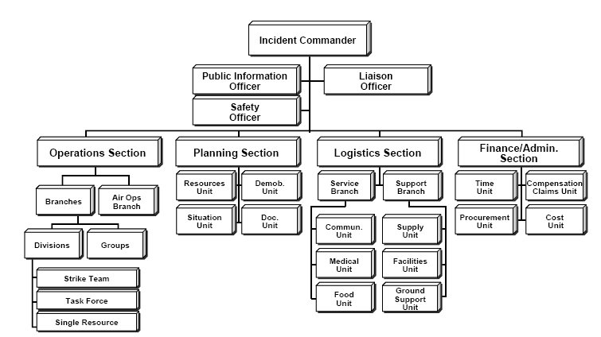
Sample IMS Structure
Emergency Measures Radio Group (EMRG) - Ottawa ARES

Slide 50
Smallest IMS Structure
The smallest IMS implementation for Amateur Radio is the same as for all IMS structures, one person, Command.
Command is the top position in IMS and the title Incident Commander, is only used at an incident site. In IMS for Amateur Radio, Command is the Director Amateur Radio Emergency Operations.
In the beginning hours of an incident, where Amateur radio has not been activated, there may only be one person from Amateur radio involved. The Director fills all positions that are required at that time, the Director may also be the NCS, if there is a net active.
DIRECTOR
Amateur Radio
Emergency Operations
Emergency Measures Radio Group (EMRG) - Ottawa ARES

Slide 51
Build From The Bottom UP
The IMS structure builds from the bottom up, so there is a director at the top and then there are Resources at the bottom. As the number of resources increases, other pieces of IMS structure are introduced to maintain span of control and provide logical management of the response.
  Recommended span of control is from 3 to 7, with 5 as the optimal. Span of control can exceed 7, based on experience. For example, in a situation where there are multiple stations activated, but in a backup capacity with minimal traffic, the Director may decide to increase the span of control.
DIRECTOR
Amateur Radio
Emergency Operations
EOC
Emergency Operations Centre
ESS Emergency Social Services
Red Cross
Shelter A
Shelter B
Emergency Measures Radio Group (EMRG) - Ottawa ARES

Slide 52

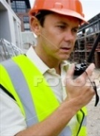


Amateur Radio IMS – Single Resource
The Single Resource is the smallest unit within the IMS structure and is the base unit on which the Amateur Radio IMS structure is built.
The Single Resource can be an EOC, Shelter, SCC, Neighbourhood Patrol in car or on foot, etc.
Each resource will have a name, such as EOC, Patrol 1, Orleans Shelter, Red Cross, etc.
EMO IMS Doctrine, Page 20, Item 42:
Single Resource: May be an individual, a piece of equipment and its personnel complement, or a crew or team of individuals with an identified supervisor.
3 People
Radio Operator
Logger
Runner/Assistant
1 Person
Radio Operator
1 Person
Radio Operator
1 Person
Radio Operator
Emergency Measures Radio Group (EMRG) - Ottawa ARES

Slide 53
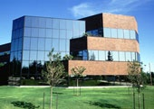

Net Control Station (NCS) - Dispatch
The NCS (Net Control Station) is the Amateur Radio equivalent of a Radio Dispatcher, and controls communications between stations on the radio network.
The NCS is at the same level in the IMS structure as the other stations. This allows the NCS to control more than 7 stations and allows the individual stations to be grouped in various arrangements to maintain the IMS span of control.
Net #1
3 People
Radio Operator
Logger
Runner/Assistant
1 Person
Radio Operator
5 People
Resource Leader
Net Control Station #1
Net Control Station #2
Logger #1
Runner/Assistant
1 Person
Radio Operator
1 Person
Radio Operator
Emergency Measures Radio Group (EMRG) - Ottawa ARES

Slide 54
Basic Amateur Radio IMS Structure
Client IMS
Amateur Radio (AR) Mutual Aid
Support from local AR clubs
DIRECTOR
Amateur Radio
Emergency Operations
Point to Clients Information Officer
Safety Officer
Liaison Officer
Operations Group Coordinator
Planning Group Coordinator
Logistics Group Coordinator
Admin/Finance Group Coordinator
Emergency Measures Radio Group (EMRG) - Ottawa ARES

Slide 55
Expanded Amateur Radio IMS Structure
Client IMS Command & Staff Positions
Amateur Radio (AR) Mutual Aid
Support from local AR clubs
Amateur Radio Service Command Centre
(AR SCC)
Director AR Emergency Operations
Point to Clients Information Officer
Safety Officer
Liaison Officer
Operations Group Coordinator
Planning Group Coordinator
Logistics Group Coordinator
Admin/Finance Group Coordinator
EOC Site Prime
ESS Site Prime
RC Site Prime
ESS Site Prime
ESS Site Prime
ESS Site Prime
Leader
NCS + Logger
NCS
Leader/OP + Logger
Operator
Leader/OP + Logger
Operator
Leader/OP + Logger
Operator
Leader/OP + Logger
Leader/OP + Logger
Leader/OP
Tactical Net
Command Net
AR SCC
EOC
ESS SCC
Red Cross
Shelter A
Shelter B
Shelter C
NCS = Net Control Station (Dispatch) EOC = Emergency Operations Centre OP = Radio Operator
AR = Amateur Radio (EMRG – ARES) ESS = Emergency Social Services Logger = Records Keeper/Alternate OP
Site Prime = Person AR reports to on site SCC = Service Command Centre Leader = Designated AR Team Leader
Emergency Measures Radio Group (EMRG) - Ottawa ARES

Slide 56
Amateur Radio IMS Structure –EOC & ESS
Solid red lines indicate Primary Accountability for Amateur Radio (AR) in a site. AR places radio operators in a client managed site, so the AR operators answer to the clients designated site prime.
Dashed red lines indicate Amateur Radio Secondary Accountability. The AR IMS manages AR resources and would resolve any issues for AR operators.
Solid blue lines indicate command level reporting
The AR Net Control Station (NCS) controls communications across the sites that participate in the radio network (Net), but has no authority beyond managing communications flow.
AR IMS Command
& Staff Positions
EOC IMS Command
& Staff Positions
ESS IMS Command & Staff Positions
EOC Site Prime
ESS Site Prime
ESS Site Prime
Leader
NCS + Logger
NCS
Leader/OP + Logger
Operator
Leader/OP + Logger
Operator
Leader/OP + Logger
Tactical Net
Management Net
AR SCC
EOC
ESS SCC
Shelter
NCS = Net Control Station (Dispatch) EOC = Emergency Operations Centre OP = Radio Operator
AR = Amateur Radio (EMRG – ARES) ESS = Emergency Social Services Logger = Records Keeper/Alternate OP
Site Prime = Person AR reports to on site SCC = Service Command Centre Leader = Designated AR Team Leader
Emergency Measures Radio Group (EMRG) - Ottawa ARES

Slide 57
Amateur Radio IMS Structure Used In Ottawa During 2003 Power Outage
Director EOC Emergency Operations
Director ESS Emergency Operations
Director AR Emergency Operations
ESS Site Prime
NCS + Logger
Leader/OP + Logger
Tactical Net
EOC
Shelter
NCS = Net Control Station (Dispatch) EOC = Emergency Operations Centre OP = Radio Operator
AR = Amateur Radio (EMRG – ARES) Logger = Records Keeper/Alternate OP
Client IMS = Person AR reports to on site Leader = Designated AR Team Leader
Emergency Measures Radio Group (EMRG) - Ottawa ARES

Slide 58
Example Using Groups To Maintain Span of Control
Director AR Emergency Operations
Safety Officer
Liaison Officer
Operations
Group Coordinator
Planning
Group Coordinator
Logistics
Group Coordinator
Staging
Management
Group
Hospital
Group
Shelter
Group
ARES SCC
QCH
Shelter 1
Mun EOC
Civic
Shelter 2
ESS SCC
General
Shelter 3
RC SCC
Montfort
Shelter 4
Airport EOC
Emergency Measures Radio Group (EMRG) - Ottawa ARES

Slide 59
Example Using Groups and Divisions To Maintain Span of Control
Director AR Emergency Operations
Safety Officer
Liaison Officer
Operations
Group Coordinator
Planning
Group Coordinator
Logistics
Group Coordinator
Staging
Resource Unit
Management
Group
Hospital
Group
East Shelter
Division
West Shelter
Division
ARES SCC
QCH
Shelter 1
Shelter 1
Mun EOC
Civic
Shelter 2
Shelter 2
ESS SCC
General
Shelter 3
Shelter 3
Red Cross
Montfort
Shelter 4
Shelter 4
Sally Ann
Neighbourhood Patrol Task Force
Emergency Measures Radio Group (EMRG) - Ottawa ARES

Slide 60
Example Using Groups, Sectors and Divisions To Maintain Span of Control
Director AR Emergency Operations
Safety Officer
Liaison Officer
Mutual Aid
Local AR Clubs
Volunteers
Operations
Group Coordinator
Planning
Group Coordinator
Logistics
Group Coordinator
Staging
Resource Unit
Management
Group
Hospital
Group
East Shelter
Division
West Shelter
Division
AR SCC
Critical Care Sector
Shelter 1
Shelter A
Mun EOC
QCH
Shelter 2
Shelter B
ESS SCC
Civic
Shelter 3
Shelter C
Red Cross
General
Shelter 4
Shelter D
Salvation Army
Montfort
Neighbourhood Patrol Task Force
Long Term Care Sector
St Vinc
E Bryere
Emergency Measures Radio Group (EMRG) - Ottawa ARES

Slide 61
Summary of AR Fit in IMS
Clients will provide objectives to Amateur Radio, such as “we need to speak from shelter A to the Red Cross office”.
The client objectives will most likely come from someone within the clients organization who is responsible for support services, not from the Incident Commander, or an EOC director.
Clients will not provide the strategy for Amateur Radio communications, such as “use VHF repeater ABC for wide area shelter net”.
Clients will not provide tactical deployment plans, such as “send 2 people to shelter A with a UHF to VHF cross band repeater and 3 UHF portables”.
Amateur radio IMS must take the objectives and develop a strategy and deployment plan.
Emergency Measures Radio Group (EMRG) - Ottawa ARES

Slide 62
Summary AR IMS Structure -1
Each site (building location, vehicle, or portable) that requires Amateur Radio, is a resource. This is the smallest unit in the Amateur Radio IMS structure.
A resource may be one radio operator, or several radio operators and loggers.
One person will be designated as the Amateur Radio Leader for a site. This may be a radio operator, or a separate dedicated position as Leader.
Radio communications is managed by the Net Control Station (NCS), who acts as the Amateur Radio version of a dispatcher. NCS is a resource, equal to other resources such as a shelter site.
Emergency Measures Radio Group (EMRG) - Ottawa ARES

Slide 63
Summary AR IMS Structure -2
The Amateur Radio leader at a site reports to the person designated under the clients IMS structure. The Amateur Radio team is in the Clients managed site, so the Amateur radio volunteers primary accountability is to the client.
The Amateur Radio leader at a site also answers to the next level in the Amateur Radio IMS structure. This is the secondary accountability.
If there is a conflict between the direction given by the Clients IMS contact and the Amateur Radio contact, the clients contact direction will be followed, while a request is sent up in the Amateur Radio IMS structure to request clarification.
Emergency Measures Radio Group (EMRG) - Ottawa ARES

Slide 64
Summary AR IMS Structure -3
Amateur Radio is an External Service Provider to the clients. The location where Amateur Radio manages it’s implementation will be called a Service Command Centre (SCC).
Amateur Radio does not have an Information Officer. All Information Officer duties are performed by the Clients Information Officer. Amateur Radio is just a Service Provider to the client.
The Amateur Radio Liaison Officer is the interface to outside resources through Mutual Aid, Local Amateur Radio Clubs and AR volunteers.
The Safety Officer visits the sites to ensure AR volunteers are safe and that AR equipment is not endangering site. The Safety Officer also acts as a liaison to the clients local contact, to ensure the Amateur Radio team members are behaving appropriately.
Emergency Measures Radio Group (EMRG) - Ottawa ARES

Slide 65
Summary AR IMS Structure -4
The Admin & Finance Group Coordinator will bring the reports and forms together on a daily basis, compile them into a package that can be handed to the client when the incident is over. They also track resources (who was where and for how long) and where required, track expenses.
Emergency Measures Radio Group (EMRG) - Ottawa ARES

Slide 66
Client Objectives Example
City hall is attached to a sports complex, and the EOC has asked Amateur radio to provide communications from the EOC in City Hall, to the shelter in the attached sports complex.
  Amateur Radio has decided to use portable radios on simplex.
A second shelter is opened, and the EOC has asked Amateur Radio to provide communications between the EOC, Shelter 1 and Shelter 2.
  Amateur Radio has decided that simplex is no longer a suitable solution, so a local repeater is used to link the 3 sites.
  The EOC has a permanent radio, but shelter 1 does not, and a portable radio cannot reach the repeater, so a cross band repeater is deployed at shelter 1.
  Shelter 2 is located near the repeater, so a portable radio works fine from inside the shelter.
The EOC is not involved in the decision to use simplex, repeaters, cross band repeaters, etc. This is the responsibility of the service provider, Amateur Radio.
Emergency Measures Radio Group (EMRG) - Ottawa ARES

Slide 67
Review
To be added
Emergency Measures Radio Group (EMRG) - Ottawa ARES

Slide 68
5: IDENTIFICATION
THIS SECTION IS A ROUGH DRAFT – MORE DETAIL TO BE ADDED
Emergency Measures Radio Group (EMRG) - Ottawa ARES

Slide 69
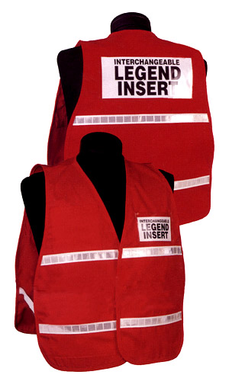
IMS Identification
There are designated colours for Command, Operations, etc under ICS/IMS.
The EOC and Incident site teams may wear coloured vests with large text on the front and back to show their role in the IMS structure.
Using coloured vests for Amateur radio IMS has a couple challenges.
  The cost of vests, since most groups have little or no money.
  Avoiding confusion with the people holding the official positions. Having two people standing in the EOC in green vests would be confusing, if the only differentiator is the text on the vest.
Emergency Measures Radio Group (EMRG) - Ottawa ARES

Slide 70
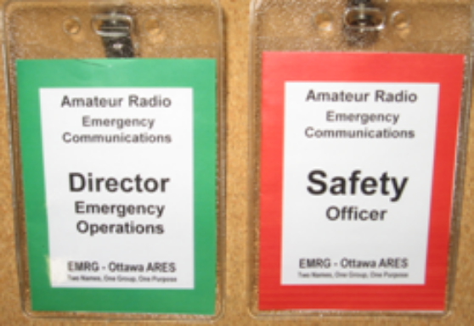
IMS Identification
For Amateur Radio
To keep cost low and avoid confusion, it is recommended that Amateur radio use coloured tags, similar to ID tags, to indentify the positions.
The tags can be printed on the appropriate coloured paper, or the tag can be printed on white paper, cut out, then placed on a larger piece of coloured paper, creating a coloured border. (See next few pages for samples)
Emergency Measures Radio Group (EMRG) - Ottawa ARES

Slide 71
IMS Identification
For Amateur Radio
The Amateur radio IMS tags can be worn with a safety vest, or with a client vest. The client vest indicates their organization, or your role within their IMS structure, while the tag identifies the role within the Amateur radio IMS structure.
There are several options for tags from most office supply stores. The tags on the next few pages are designed to be printed, folded over and slid into plastic pouches available from Staples (add model number).
Another options is at some of the maibox/UPS type stores, they have hot laminating for about $2 per card.
Emergency Measures Radio Group (EMRG) - Ottawa ARES

Slide 72
Amateur Radio
Emergency Communications
Amateur Radio
Emergency Communications
Director
Emergency Operations
Director
Emergency Operations
EMRG - Ottawa ARES
Two Names, One Group, One Purpose
EMRG - Ottawa ARES
Two Names, One Group, One Purpose
The tags shown have the local ARES group name on the bottom. Leaving this out would allow standard tags to be made in bulk which would reduce costs and make a standard look at feel.
Emergency Measures Radio Group (EMRG) - Ottawa ARES

Slide 73
Amateur Radio
Emergency Communications
Amateur Radio
Emergency Communications
Operations
Group Coordinator
Operations
Group Coordinator
EMRG - Ottawa ARES
Two Names, One Group, One Purpose
EMRG - Ottawa ARES
Two Names, One Group, One Purpose
Emergency Measures Radio Group (EMRG) - Ottawa ARES

Slide 74
Amateur Radio
Emergency Communications
Amateur Radio
Emergency Communications
Planning
Group Coordinator
Planning
Group Coordinator
EMRG - Ottawa ARES
Two Names, One Group, One Purpose
EMRG - Ottawa ARES
Two Names, One Group, One Purpose
Emergency Measures Radio Group (EMRG) - Ottawa ARES

Slide 75
Amateur Radio
Emergency Communications
Amateur Radio
Emergency Communications
Logistics
Group Coordinator
Logistics
Group Coordinator
EMRG - Ottawa ARES
Two Names, One Group, One Purpose
EMRG - Ottawa ARES
Two Names, One Group, One Purpose
Emergency Measures Radio Group (EMRG) - Ottawa ARES

Slide 76
Amateur Radio
Emergency Communications
Amateur Radio
Emergency Communications
Finance/Admin
Group Coordinator
Finance/Admin
Group Coordinator
EMRG - Ottawa ARES
Two Names, One Group, One Purpose
EMRG - Ottawa ARES
Two Names, One Group, One Purpose
Emergency Measures Radio Group (EMRG) - Ottawa ARES

Slide 77
Amateur Radio
Emergency Communications
Amateur Radio
Emergency Communications
Safety
Officer
Safety
Officer
EMRG - Ottawa ARES
Two Names, One Group, One Purpose
EMRG - Ottawa ARES
Two Names, One Group, One Purpose
Safety Officer is a critical position. This person would visit each radio operator location and do an evaluation to ensure that the radio operators are working in safe conditions AND ensure that the radio operators are not creating hazards. Radio operator created hazards include batteries without fuses, loose cords on the floor, or cables stretched in the air where people could run into them.
More to come on this role.
Emergency Measures Radio Group (EMRG) - Ottawa ARES

Slide 78
Review
To be added
Emergency Measures Radio Group (EMRG) - Ottawa ARES

Slide 79
6: RESOURCES
THIS SECTION IS ROUGH DRAFT – MORE DETAILS TO BE ADDED
Emergency Measures Radio Group (EMRG) - Ottawa ARES

Slide 80
Resource Kind & Type
  Listing resources by Kind and Type is an important step in IMS, in order to provide effective management of resources.
  Standard resource definitions must be developed first, which are then compiled into a common list of resource Kinds and Types, so anyone can identify all the resources
  Resource Kind and Type define the minimum that will be provided.
    For example, a base station could be defined as a 25 watt radio, 6 amp continuous duty power supply, 15 feet of mast, ¼ wave antenna and 100 feet of RG8 coax.
    Anyone who requests a base station, for example through mutual aid, can expect to meet the minimum capabilities.
    The actual capability delivered may exceed the standard.
Emergency Measures Radio Group (EMRG) - Ottawa ARES

Slide 81
NIMS Resource Management
From IS703.A - August 2010
The development of typed resources supports the establishment of:
  Comprehensive, national mutual aid and assistance agreements.
  Resource management and tracking systems.
To ensure that responders get the right personnel and equipment, ICS resources are categorized by:
  Kind: Describe what the resource is (e.g., medic, firefighter, Planning Section Chief, helicopter, ambulance, combustible gas indicator, bulldozer).
  Type: Describe the size, capability, and staffing qualifications of a specific kind of resource.
Emergency Measures Radio Group (EMRG) - Ottawa ARES

Slide 82
Wikipedia – ICS Type & Kind
The "type" of resource describes the size or capability of a resource.
  For instance, a 50 kW (for a generator) or a 3-ton (for a truck). Types are designed to be categorized as "Type 1" through "Type 5" formally, but in live incidents more specific information may be used.
The "kind" of resource describes what the resource is.
  For instance, generator or a truck. The "type" of resource describes a performance capability for a kind of resource for instance,
In both type and kind, the objective must be included in the resource request. This is done to widen the potential resource response.
  As an example, a resource request for a small aircraft for aerial reconnaissance of a search and rescue scene may be satisfied by a National Guard OH-58 Kiowa helicopter (Type & Kind: Rotary-wing aircraft, Type II/III) or by a Civil Air Patrol Cessna 182 (Type & Kind: Fixed-wing aircraft, Type I). In this example, requesting only a fixed-wing or a rotary-wing, or requesting by type may prevent the other resource's availability from being known.
Emergency Measures Radio Group (EMRG) - Ottawa ARES

Slide 83
Kind & Type Needs Skilled Users
  Using resources effectively requires someone with detailed knowledge to use those resources. Determining which resources to request comes from the experts in each agency or organization that is part of the Incident Management team.
  In other words, assignment of resources based on Kind and Type must be done by a competent person. From the Occupational Health and Safety Act for Ontario;
    “competent person: means a person who,
    (a) is qualified because of knowledge, training and experience to organize the work and its performance,
    (b) is familiar with the Act and the regulations that apply to the work, and
    (c) has knowledge of any potential or actual danger to health or safety in the workplace
Emergency Measures Radio Group (EMRG) - Ottawa ARES

Slide 84
Kind & Type – Amateur Radio
  Amateur Radio is no different than other organizations. Resources can be catalogued by kind and type, but assignment of resources requires someone with expertise in Amateur radio communications solutions.
  Clients will not have the knowledge and understanding to define which resources to request. Clients will define objectives, which Amateur radio will use to develop a strategy and tactical deployment plan.
  The use of resource Kind and Type is critical for Amateur radio to implement tactical plan and to request and deploy resources. Mutual Aid requests should be based on resource type and kind, so the requester and the supplier are referring to the same thing.
Emergency Measures Radio Group (EMRG) - Ottawa ARES

Slide 85
Incident Resource List
The Amateur Radio Resource list is designed to be used by Amateurs who are managing an Amateur radio response.
The requirements are the absolute minimum required. If you have less than the minimum, you will be sent home. There can be recommended equipment accessory lists with items like headphone splitter, but no one would be sent home for not having the splitter.
There is a requirement to show an availability component for people and equipment. How long are you needed, in reverse, how long can you stay? (See sample next page)
This is the basic Amateur radio functions. Local groups may have other agreements in place for volunteer duties.
Emergency Measures Radio Group (EMRG) - Ottawa ARES

Slide 86
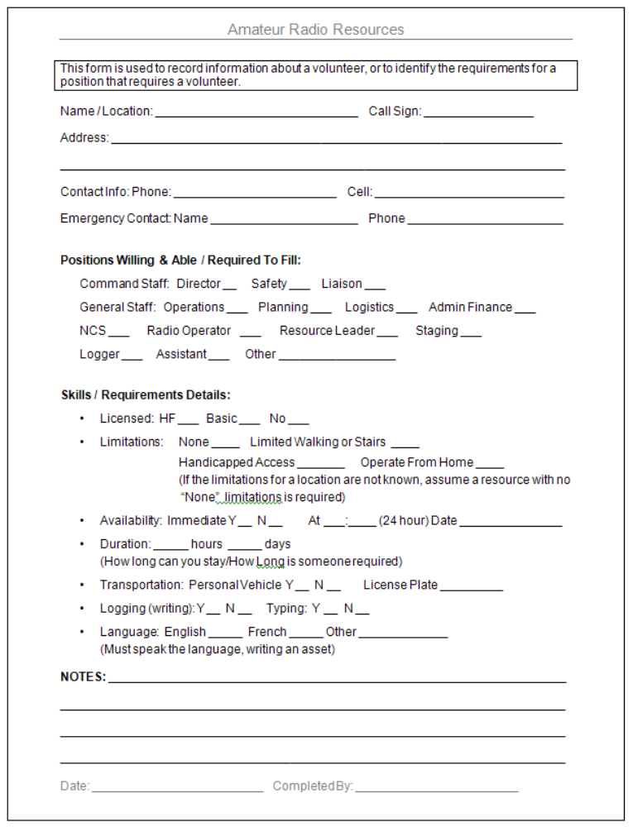
People List
Most Amateurs will have little or no training, so forms must be easily understood. This is not the military where everyone has drilled many times to develop the required skills.
There are many variables in a volunteer based organizations. Volunteers are not all equal in their skills, dedication and available time.
The Amateur Radio Resource form is a simple way to collect information for each individual, regarding their availability, capability and limitations.
Emergency Measures Radio Group (EMRG) - Ottawa ARES

Slide 87
Equipment List
In the same way that information is collected about a volunteer, information must be collected about the equipment that volunteer can provide.
Rather than list everything they have, the equipment can be referenced to the Kinds and Types they can meet with what they have.
Like the availability of the volunteer, equipment availability will vary. Some people will only allow their equipment to be used while they are there and expect to pack it up when the they leave. Others are willing to leave their equipment in place for subsequent shifts, and retrieve it later.
Emergency Measures Radio Group (EMRG) - Ottawa ARES

Slide 88
Review
To be added
Emergency Measures Radio Group (EMRG) - Ottawa ARES

Slide 89
7: FORMS
THIS SECTION IS JUST A FEW NOTES ON THOUGHTS. THE GOAL IS TO LIST SPECIFIC FORMS RECOMMENDED FOR USE BY AMATEUR RADIO, WITH NOTES ON HOW TO USE EACH ONE.
Emergency Measures Radio Group (EMRG) - Ottawa ARES

Slide 90
Overview
Use the IMS forms as they are written. Do not create a set of Amateur Radio only forms. It wastes time, and diminishes the goal of standardization.
Use only the forms that add value. Amateurs are volunteers and only work with the forms in exercises and a hand full of real events. (Keep It Simple Stupid – KISS).
Create Amateur Radio specific notes for using the forms. This would include Amateur Radio information like where to enter your call sign, where to enter your ARES group name, or where to enter the call sign for a repeater (see next two pages)
Emergency Measures Radio Group (EMRG) - Ottawa ARES

Slide 91
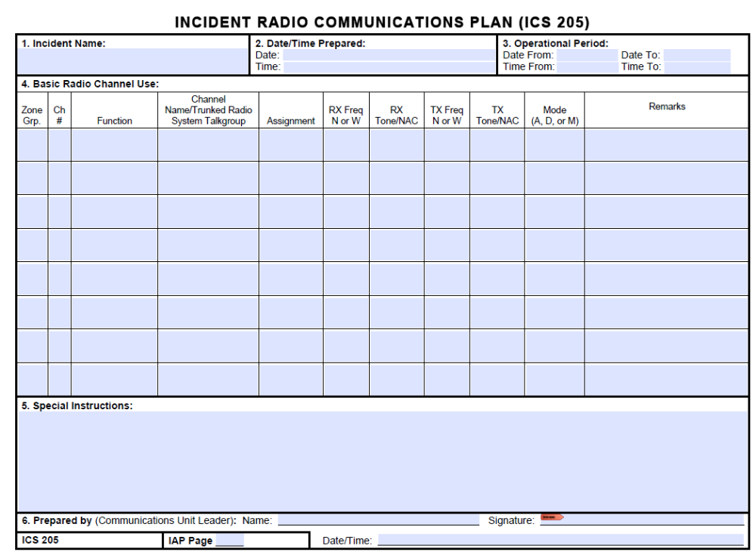
Emergency Measures Radio Group (EMRG) - Ottawa ARES

Slide 92
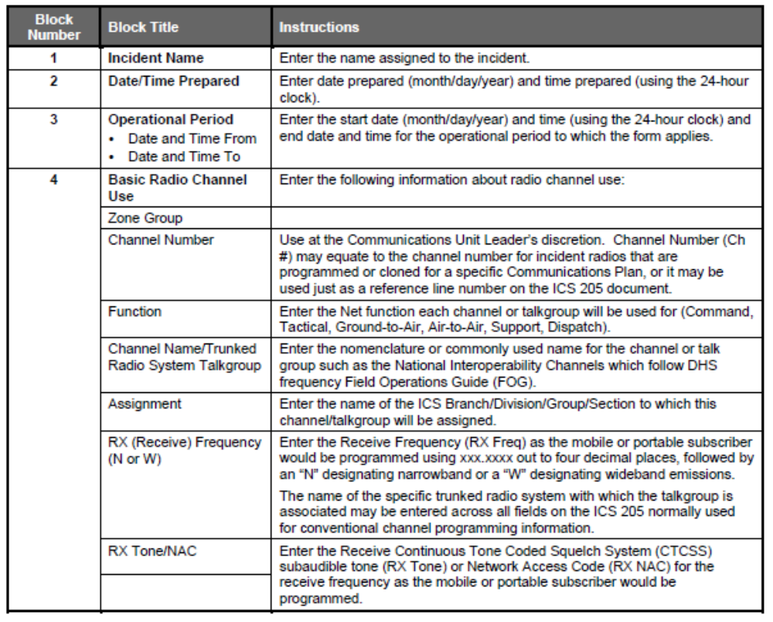
The notes shown on the right, are written for the FEMA ICS205 form shown on the previous page.
These notes can be modified to explain Amateur radio related information such as where to enter a repeater call sign.
There are plenty of columns and the information is quite generic, so there is no value in creating an Amateur modified version of the form.
Emergency Measures Radio Group (EMRG) - Ottawa ARES

Slide 93
Review
To be added
Emergency Measures Radio Group (EMRG) - Ottawa ARES

Slide 94
8: SUPPORTING INFORMATION
Emergency Measures Radio Group (EMRG) - Ottawa ARES

Slide 95
Acronyms & Definitions
ESS – Emergency Social Services
SCC – Service Command Centre
Internal Service Provider
External Service Provider
EOC – Emergency Operations Centre
EMO – Emergency Management Ontario
IMS – Incident Management System
ICS – Incident Command System
NIMS – National Incident Management System
Emergency Measures Radio Group (EMRG) - Ottawa ARES

Slide 96
9: WHY NOT ARCT?
Emergency Measures Radio Group (EMRG) - Ottawa ARES

Slide 97
FEMA Definitions
Kinds of Resources: Describe what the resource is (e.g., medic, firefighter, Planning Section Chief, helicopters, ambulances, combustible gas indicators, bulldozers).
Type: A classification of resources in the ICS that refers to capability. Type 1 is generally considered to be more capable than Types 2, 3, or 4, respectively, because of size, power, capacity, or, in the case of Incident Management Teams, experience and qualifications.
Emergency Measures Radio Group (EMRG) - Ottawa ARES

Slide 98
Assumptions For ARCT
Expectation that the “Incident” is major, with EOC activated, full IMS, communications failures, amateur radio long distance communications and mostly mobile operators.
Emergency Measures Radio Group (EMRG) - Ottawa ARES

Slide 99
What Is ARCT
  ARCT (Amateur Radio Communications Team) is a proposed system for classifying the capabilities of teams of volunteer amateur radio operators based on a set of four ICS-IMS resource types.
  The ARCT solution was developed by US Amateurs as a proposal for the Department of Homeland Security (DHS), in response to Amateurs interpretation of the DHS National Incident Management System (NIMS) requirements. The two key requirements focused on are;
    All resources must be catalogued by type, so a manager can pick resources from the catalogue.
    All volunteers must have all levels of NIMS training.
Emergency Measures Radio Group (EMRG) - Ottawa ARES

Slide 100
Four Resource Types
  ARCT (Amateur Radio Communications Team) is a proposed system for classifying the capabilities of teams of volunteer amateur radio operators based on a set of four ICS-IMS resource types.
TYPE FOUR: The foundation, a federally licensed amateur radio operator and a vehicle with a vehicle-mounted, or a handheld transceiver, almost always on VHF or UHF frequencies.
TYPE THREE: Two licensed operators, with one or two vehicles. High frequency, shortwave and longwave capabilities are desirable.
TYPE TWO: Field or base station with both short range (VHF/UHF) and long range (HF, shortwave and longwave) voice and digital communications It has its own generator, so it is not dependent on outside power or infrastructure. It requires four (or more) licensed and registered operators with one or two vehicles.
TYPE ONE: Full field station (Type Two) with four of the Type Four mobile/portable stations. It is intended to serve one or more agencies, and requires 12 persons including one supervisor and one assistant supervisor. As with the Type Two unit, it is self-sufficient, without requiring outside power or other support.
Emergency Measures Radio Group (EMRG) - Ottawa ARES

Slide 101



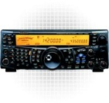






Type 4
US ARCT Proposal Resource Types
or
Type 3
or
Clients Select From List of 4 Resource Types.
There is no resource type for a single radio operator without equipment.
There is no resource type for infrastructure equipment such as a portable repeater.
1 or 2
Cars
HF = Maybe
Type 2
or
HF Voice & Data
1 or 2
Cars
May have more than 4
Generator
Type 1
Fixed & Portable Infrastructure
1 Type 2 + 4 Type 4 +
1 Supervisor + 1 Assistant
Total of 12 People
Emergency Measures Radio Group (EMRG) - Ottawa ARES

Slide 102
Amateur Radio As A
Resource Type – P1
  The ARCT (Amateur Radio Communications Team) proposal is based on a large set of assumptions on skills, equipment, availability and physical health, with gaps in how long term service delivery is maintained.
Assumes radio operators using Amateur radio equipment and regulations, can be assigned by clients to meet their needs.
  Clients may not understand the differences in radio bands, and infrastructure, as it relates to solving their current problems.
  Assumes a National structure with training and operations standards and a near endless supply of teams.
Assumes there is no infrastructure so communications is all simplex (direct station to station).
  Direct communications has limited distance for local use and may not meet client needs. Portable infrastructure may be required.
Emergency Measures Radio Group (EMRG) - Ottawa ARES

Slide 103
Amateur Radio As A Resource Type - P2
Vague on how resources are assigned across multiple agencies at different levels, such as National, Provincial, Municipal, NGO, and how shift changes are managed.
  Typical descriptions address the highest level of Gov assigning resources for their needs, then no description of what other agencies or NGOs do.
Assumes Amateurs have specific training, skill sets and physical capabilities, so they can be deployed interchangeably.
    Amateurs are volunteers and come in all age groups, with varying levels of commitment, equipment and physical capability.
  Does not address radio equipment.
    Equipment varies across amateurs from one old portable, to multiple multiband portables, vehicle radios, and vehicle repeater capability.
    Some Amateurs will leave their equipment in a site when they change shift. Others expect to remove their equipment when they leave.
Emergency Measures Radio Group (EMRG) - Ottawa ARES

Slide 104
Amateur Radio As A Resource Type – P3
Promotes the importance of understanding ICS-IMS to fit into the clients command structure and use their forms. Typically assumes Amateur radio under Logistics Section.
  ICS-IMS structure easily maps to Amateur radio as a managed service and comes complete with the forms Amateur radio requires, such as communications logs, resource sign in and planning forms. The value of ICS-IMS for Amateur radio is in using it.
ARCT Resource types contain options in their description which allow for wide variation in capability. For example;
  ARCT Type 4 allows “vehicle-mounted, or a handheld transceiver”. The capabilities are significantly different with much greater distance for the vehicle radio, but the portable radio is easier to carry, especially inside a building.
  ARCT Type 3 lists “High frequency, shortwave and longwave capabilities are desirable”, so a Type 3 may or may not have these capabilities.
Emergency Measures Radio Group (EMRG) - Ottawa ARES

Slide 105
Kind & Type – Agency Specific
When we call the fire department, we explain our situation and they send the resources appropriate (heavy rescue, water rescue, pump, tanker, ladder), based on our explanation.
  We do not specify the quantity, kind and type of resources required. They are the experts.
The highest ranking firefighter that is first on scene assumes command and begins an assessment of the situation.
  What is the situation? What needs to be done first? Are the resources (equipment and people) enroute sufficient?
  Are services from other agencies such as Police and Paramedics required?
From this point, the fire department will ramp up their response. Additional resources may be brought in either to bring specialized equipment, teams, or more people.
  Within the fire department, they do specify the kind and type of resources required.
  If Paramedics are required, command requests their services and provides a summary of the situation which may include an estimated number of patients to transport.
Paramedic services deploys resources to the scene and does an assessment from their point of view.
    What is the situation? What needs to be done first? Are the resources (equipment and people) enroute sufficient?
    Within the Paramedic service, they do specify the kind and type of resources required.
Emergency Measures Radio Group (EMRG) - Ottawa ARES

Slide 106
Kind & Type – Summary
  Standardizing resources by Kind and Type is an important step in IMS and the US NIMS to provide common management of resources.
  Resources are be compiled into a common list, so anyone can identify all possible resources.
  Using resources effectively still requires someone with detailed knowledge to use those resources. Determining which resources to request, comes from the experts in each agency or organization that is part of the Incident Management team.
  Amateur Radio is no different than other organizations. Resources can be catalogued by kind and type, but assignment of resources requires someone with expertise in Amateur radio communications solutions.
Emergency Measures Radio Group (EMRG) - Ottawa ARES

