Slide 1
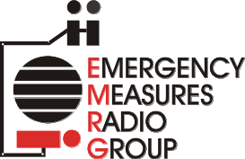
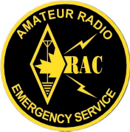
EMRG-803
Self Study Training Course
EMERGENCY MEASURES RADIO GROUP
OTTAWA ARES
Two Names - One Group - One Purpose
IMS For Amateur Radio
Why Not Use ARCT
Amateur Radio Communications Team
Prepared By: Peter Gamble – VE3BQP
Date Of Last Change: 2011-04-02
Version: 0.1

Slide 2
What Is ARCT
  ARCT (Amateur Radio Communications Team) is a proposed system for classifying the capabilities of teams of volunteer amateur radio operators based on a set of four ICS-IMS resource types.
  The ARCT solution was developed by US Amateurs as a proposal for the Department of Homeland Security (DHS), in response to Amateurs interpretation of the DHS National Incident Management System (NIMS) requirements. The two key requirements focused on are;
  All resources must be catalogued by type, so a manager can pick resources from the catalogue.
  All volunteers must have as much NIMS training as possible.
There are several versions of ARCT documented on the Internet, with minor variances in the proposal.
Emergency Measures Radio Group (EMRG) - Ottawa ARES

Slide 3
Purpose of Resource Typing
From the FEMA Website;
Q: What is the purpose of resource typing?
A: Resource typing enhances emergency readiness and response at all levels of government through a system that allows an already overwhelmed jurisdiction to augment its response resources during an incident. Standard resource typing definitions help responders request and deploy the resources they need through the use of common terminology. They allow emergency management personnel to identify, locate, request, order, and track outside resources quickly and effectively and facilitate the movement of these resources to the jurisdiction that needs them.
“…help responders request and deploy the resources they need.”
Emergency Measures Radio Group (EMRG) - Ottawa ARES

Slide 4
FEMA Definitions
Kinds of Resources
Describe what the resource is (e.g., medic, firefighter, Planning Section Chief, helicopters, ambulances, combustible gas indicators, bulldozers).
Type
A classification of resources in the ICS that refers to capability. Type 1 is generally considered to be more capable than Types 2, 3, or 4, respectively, because of size, power, capacity, or, in the case of Incident Management Teams, experience and qualifications.
Emergency Measures Radio Group (EMRG) - Ottawa ARES

Slide 5
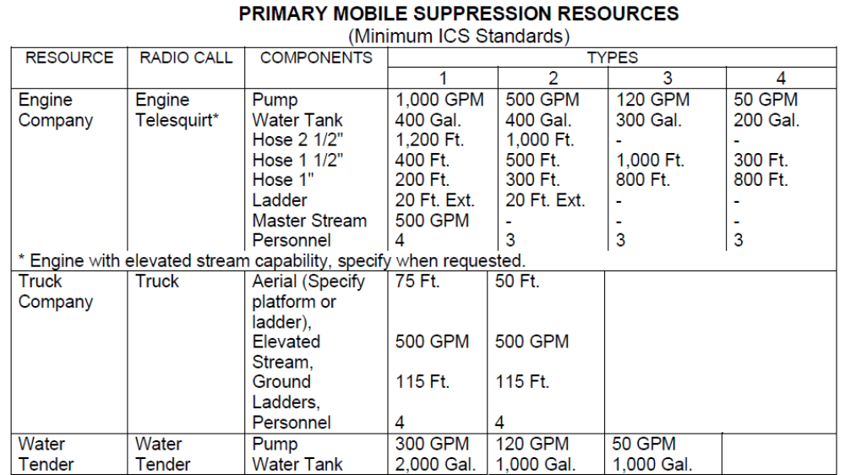
Example Resource List
Emergency Measures Radio Group (EMRG) - Ottawa ARES

Slide 6
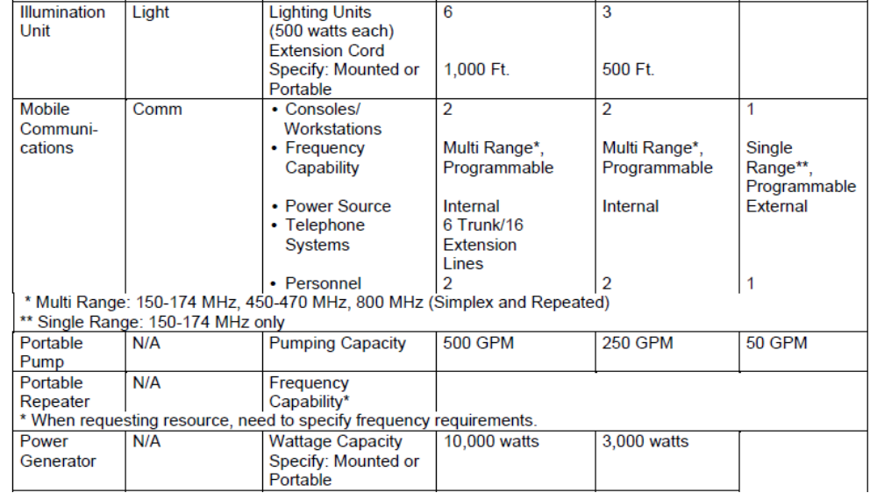
Other Kinds Of Resources
Emergency Measures Radio Group (EMRG) - Ottawa ARES

Slide 7
ARCT Resource Types
ARCT is based on a set of four ICS-IMS resource types;
TYPE FOUR: The foundation, a federally licensed amateur radio operator and a vehicle with a vehicle-mounted, or a handheld transceiver, almost always on VHF or UHF frequencies.
TYPE THREE: Two licensed operators, with one or two vehicles. High frequency, shortwave and longwave capabilities are desirable.
TYPE TWO: Field or base station with both short range (VHF/UHF) and long range (HF, shortwave and longwave) voice and digital communications It has its own generator, so it is not dependent on outside power or infrastructure. requires four (or more) licensed operators with one or two vehicles.
TYPE ONE: Full field station (Type Two) with four of the Type Four mobile/portable stations. It is intended to serve one or more agencies, and requires 12 persons including one supervisor and one assistant supervisor. As with the Type Two unit, it is self-sufficient, without requiring outside power or other support.
Emergency Measures Radio Group (EMRG) - Ottawa ARES

Slide 8



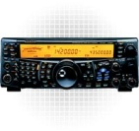
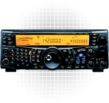


Type 4
Pictorial View of ARCT Resource Types
or
Type 3
or
“Officials” Select From List of 4 Resource Types.
There is no resource type for a single radio operator without equipment.
There is no resource type for infrastructure equipment such as a portable repeater.
1 or 2
Cars
HF = Maybe
Type 2
or
HF Voice & Data
1 or 2
Cars
May have more than 4
Generator
Type 1
Fixed & Portable Infrastructure
1 Type 2 + 4 Type 4 +
1 Supervisor + 1 Assistant
Total of 12 People
Emergency Measures Radio Group (EMRG) - Ottawa ARES

Slide 9
ARCT Is Incomplete
The ARCT concept is not a solution to the challenge of managing Amateur radio response to an emergency. ARCT is not wrong, it is incomplete.
ARCT is defined as 4 resource types, which is an incomplete list of the Amateur radio resource Kinds required, which is only part of one piece of ICS/IMS, resource management.
The 4 ARCT Resource Types describes only one kind of resource, Amateur Teams. There are additional Kinds of resources, including individual Amateurs, repeaters, base stations, portables, cross band repeaters, battery backup, data communications stations, etc.
  For each Kind of resource, there will be different Types, which define the capabilities for that Kind of resource.
Emergency Measures Radio Group (EMRG) - Ottawa ARES

Slide 10
ARCT Assumptions
The ARCT proposal is based on a large set of assumptions on skills, equipment, availability and physical health, with gaps in how long term service delivery is maintained.
Assumes radio operators, using Amateur radio equipment and regulations, can be assigned by clients to meet their needs.
  Clients typically do not understand the differences in radio bands, and infrastructure, as it relates to solving their current problems.
  Assumes a National structure with training and operations standards and a near endless supply of teams.
Assumes there is no infrastructure so communications is all simplex (direct station to station).
  Direct communications has limited distance for local use and may not meet client needs. Portable infrastructure may be required.
Emergency Measures Radio Group (EMRG) - Ottawa ARES

Slide 11
ARCT Deficiencies
Vague on how resources are assigned across multiple agencies at different levels, such as National, Provincial, Municipal, NGO, and how shift changes are managed.
  Typical descriptions address the highest level of Gov assigning resources for their needs, then no description of what other agencies or NGOs do.
Assumes Amateurs have specific training, skill sets and physical capabilities, so they can be deployed interchangeably.
  Amateurs are volunteers and come in all age groups, with varying levels of commitment, equipment and physical capability.
  Does not address radio equipment.
  Equipment varies across amateurs from one old portable, to multiple multiband portables, vehicle radios, and vehicle repeater capability.
  Some Amateurs will leave their equipment in a site when they change shift. Others expect to remove their equipment when they leave.
Emergency Measures Radio Group (EMRG) - Ottawa ARES

Slide 12
ARCT Differences
Promotes the importance of understanding ICS-IMS to fit into the clients command structure and use their forms. Typically assumes Amateur radio under Logistics Section.
  ICS-IMS structure easily maps to Amateur radio as a managed service and comes complete with the forms Amateur radio requires, such as communications logs, resource sign in and planning forms. The value of ICS-IMS for Amateur radio is in using it.
ARCT Resource types contain options in their description which allow for wide variation in capability. For example;
  ARCT Type 4 allows “vehicle-mounted, or a handheld transceiver”. The capabilities are significantly different with much greater distance for the vehicle radio, but the portable radio is easier to carry, especially inside a building.
  ARCT Type 3 lists “High frequency, shortwave and longwave capabilities are desirable”, so a Type 3 may or may not have these capabilities.
Emergency Measures Radio Group (EMRG) - Ottawa ARES

Slide 13
1st Responder Resource Use
When we call the fire department, we explain our situation and they send the resources appropriate (heavy rescue, water rescue, pump, tanker, ladder), based on our explanation.
  We do not specify the quantity, kind and type of resources required. They are the experts.
The highest ranking firefighter that is first on scene assumes command and begins an assessment of the situation.
  What is the situation? What needs to be done first? Are the resources (equipment and people) en-route sufficient?
  Are services from other agencies such as Police and Paramedics required?
Emergency Measures Radio Group (EMRG) - Ottawa ARES

Slide 14
1st Responder Resource Use continued
From this point, the fire department will ramp up their response. Additional resources may be brought in, either to bring specialized equipment, teams, or more people.
  Within the fire department, they do specify the kind and type of resources required.
  If Paramedics are required, command requests their services and provides a summary of the situation including an estimated number of people needing help.
Paramedic services deploys resources to the scene, and does an assessment from their point of view.
  What is the situation? What needs to be done first? Are the resources (equipment and people) en-route sufficient?
  Within the Paramedic service, they do specify the kind and type of resources required.
Emergency Measures Radio Group (EMRG) - Ottawa ARES

Slide 15
Amateur Resource Use
An incident will be managed by a single Incident Commander and all the agencies are working as a single large team, however, within that large team, are smaller teams which are managed using the expertise of each agency.
Amateur radio, when requested, would also assess the situation from an Amateur radio communications point of view. Based on that assessment, resources would be requested.
  If the objective is to activate permanent stations at the EOC and Red Cross, then the only resource required is radio operators.
  If communications is required within a small area, radio operators with portable radios may be all that is required.
  If it is a rural area and house to house checks are being supported, then radio operators with mobiles may be required.
  If it is a large incident, all of the above may be required, along with the use of multiple repeaters, cross band repeaters and many amateurs.
Emergency Measures Radio Group (EMRG) - Ottawa ARES

Slide 16
Resource Kind & Type Is Important
  Standardizing resources by Kind and Type is an important step in IMS and the US NIMS to provide standardization of resources.
  Everyone agrees on the size and voltage of an AA battery, so batteries from different sources can be used interchangeably = Standardization
  Resources are compiled into a common list, so anyone can identify all possible resources, to ensure they can deliver or receive these resource Kinds and Types.
  Using resources effectively still requires someone with detailed knowledge to use those resources. Determining which resources to request, comes from the experts in each agency or organization that is part of the Incident Management team.
  Paramedics typically do not call up Fire or Police kinds and types from a list, because they lack the expertise in these areas. Likewise, Fire and Police would not call up EMS resources.
Emergency Measures Radio Group (EMRG) - Ottawa ARES

Slide 17
Summary
Clients will provide objectives to Amateur Radio, such as “we need to speak from shelter A to the Red Cross office”.
The client objectives will most likely come from someone within the clients organization who is responsible for support services, not from the Incident Commander, or an EOC director.
Clients will not provide the strategy for Amateur Radio communications, such as “use VHF repeater ABC for wide area shelter net”.
Clients will not provide tactical deployment plans, such as “send 2 people to shelter A with a UHF to VHF cross band repeater and 3 UHF portables”.
Amateur radio IMS must take the objectives and develop a strategy and deployment plan.
Emergency Measures Radio Group (EMRG) - Ottawa ARES

Slide 18
Summary continued
  Amateur Radio is no different than other organizations. Resources can be catalogued by kind and type, but assignment of resources requires someone with expertise in Amateur radio communications solutions.
  ARCT has become the holy grail for reaching acceptance of Amateur radio. There is a misdirected belief that being documented in a ICS/IMS/NIMS list of resource Types and Kinds, will ensure that Amateur radio is called on for assistance. Much like some believe being written into an emergency plan will “force officials” to call.
  It is ongoing relationships with end users of Amateur radio services that leads to acceptance, and use of Amateur radio in an emergency. These relationships are developed over time, nurtured and maintained, along with working operations plans, on both sides that identify the use of Amateur radio.
Emergency Measures Radio Group (EMRG) - Ottawa ARES

Slide 19
Review
To be added
Emergency Measures Radio Group (EMRG) - Ottawa ARES

Slide 20
Answers
To be added
Emergency Measures Radio Group (EMRG) - Ottawa ARES

Slide 21

www.emrg.ca
The EMRG web site provides information related to Amateur radio emergency communications, specifically as it relates to the City of Ottawa.
  Project Information
  Newsletters
  Upcoming Events
  Documentation
  Links to related information
Information:
Emergency Measures Radio Group (EMRG) - Ottawa ARES

