Slide 1

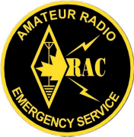
EMRG-315
Repeater Requirements
EMERGENCY MEASURES RADIO GROUP
OTTAWA ARES
Two Names - One Group - One Purpose
Building Robust Repeaters for Amateur Radio Emergency Communications
Date Of Last Change: 2008-10-24
Version: 1.0

Slide 2
All Amateur Repeaters are Emergency Repeaters, aren’t they?

Slide 3
EXPECTATIONS
Emergency Management is mostly about planning; what could happen, what could be needed and what resources are available.
Includes communications, & backup communications.
When Amateurs say “our repeater is available for use in an emergency”, there is an expectation that basic emergency requirements have been considered and are in place.

Slide 4
CLIENT REQUIREMENTS
Clients are the groups who use EMRG communications services in an emergency.
EMRG clients are;
  Community Services (City of Ottawa)
  Ottawa Red Cross
  Ottawa Salvation Army
  Hospitals
All EMRG strategy, planning, development and training is based on client requirements.

Slide 5
THERE IS A PLAN
In theory, every Amateur radio repeater is available to assist in an emergency.
Not all repeaters in Ottawa are included in the EMRG plan.
Repeaters not in the EMRG plan may still be used in an emergency, however they may not meet the criteria for an emergency repeater.

Slide 6
PLANNING CONSIDERATIONS
RELIABILITY
  Repeaters must be dependable and withstand continuous use for days in an emergency
DIVERSITY
  Some repeaters may not work in an emergency, so enough capacity is required to maintain effective coverage with some infrastructure loss.
CHANNEL CAPACITY
  User requirements and message volumes will vary, so more than one repeater and coverage area is required to effectively meet client needs.

Slide 7
COVERAGE AREA
Emergency communications for Ottawa cannot be done using a single wide area repeater.
There is a requirement for multiple channels, serving different groups, requiring different coverage areas, operating on different bands.
EMRG has 3 categories for repeater coverage;
  Wide Area - Reaches across the City
  Regional - Covers a unique portion of the City,
  including the core
  Community – Covers a specific local community

Slide 8
POWER
Repeaters must be able to operate when AC power fails, so they must be located in a critical site with generator power and battery backup.
  Generator backup is required for extended operation if the AC power fails.
  Critical Sites have an importance which means they are likely to be refuelled in an emergency.
  Battery backup is required in case the generator does not start.
Notes:
While many sites have a generator to ensure basic operation if the power fails, they are not critical sites for their owners, so in the event of a long term emergency, these sites would not be refuelled.

Slide 9
SUPPORT & ACCESS
If the repeater fails during an emergency, there must be a high probability that someone will be available, have the skills required and be able to get access for repairs.
There must be more than 1 person who can gain access to the repeater site, and more than 1 person capable of working on the equipment.

Slide 10
ANTENNAS
There must be a high probability that a repeater will remain operational, which includes good antennas that can survive heavy wind and ice.
Unfortunately, many groups are turning to Amateur fibreglass antennas for repeater service due to the low cost.
If a club is claiming their repeater is available for an emergency, they must invest in antennas.
Notes:
For anyone who has seen a solid commercial antenna, such as a Sinclair 210C-4, whip in the wind like a long stick of rubber, realizes that the fibreglass antennas built for Amateur radio will not survive a significant wind or ice build up.

Slide 11
REPEATER EQUIPMENT
In an emergency, a repeater may operate non stop for hours, even days.
This type of operation requires repeaters to be built from suitable equipment that can withstand continuous duty.
While a pair of mobiles may work for normal use, especially with a fan, there is a high risk that the system will fail under continuous use.

Slide 12
COMPATABILTY
Long tails make it difficult to use cross band repeaters because the end user cannot break in.
CTCSS helps reduce noise from intermod and ensures cross-band repeaters are not adding to the problem. CTCSS IS IMPORTANT.
In an emergency, the controller should meet license requirements and no more.
  The long winded announcements just make it more difficult to move messages.

Slide 13
CTCSS TONES
Many people believe repeaters should not use CTCSS because there are amateurs who have radios that cannot support CTCSS tone encode.
In reality this is not an issue for three reasons;
  Most amateur radios can encode a CTCSS tone
  Many people will be partnered with someone and will be using the other persons equipment.
  Some locations have permanent radios, plus EMRG is has a supply of radios.

Slide 14
ALTERNATE REPEATERS
In some cases, there are multiple repeaters that provide coverage in the same area.
Based on the emergency plan, there needs to be a reasonable number of repeaters with overlapping coverage, in case of failure, but not all repeaters may be required.

Slide 15
REPEATERS IN
THE EMRG PLAN

Slide 16
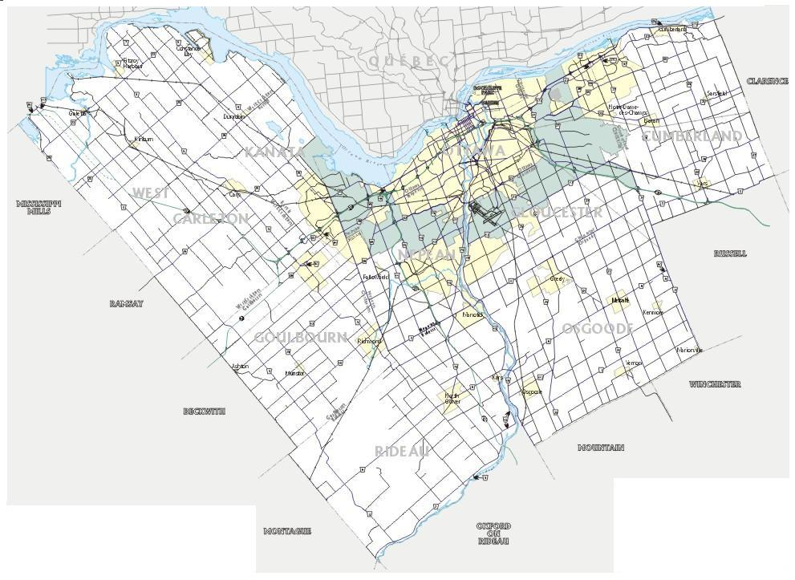
CITY WIDE REPEATERS
Camp Fortune
VE2CRA
VHF/UHF
Randall
VE3OCE
VHF/UHF
Barrhaven
VA3OFS
VHF/UHF
VE2CRA is a club repeater that provides City wide coverage and is diverse in location and power grid.
There is no single repeater that can cover the full City of Ottawa. By using several repeaters, most areas are covered and are accessible from key locations.

Slide 17
COMMUNITY REPEATERS
E
NW
Carp
VA3EMV/E
VHF Community Repeater, providing coverage in the East End.
W
S
VA3EMV/W
VHF Community Repeater, providing coverage in the West End.
SW
Community Repeaters provide a voice channel serving a community of interest, for communications within the local area.
(The actual repeater coverage will overlap in some areas and fall short in others.)
Boundary for area with repeater installed or under construction
Boundary for area proposed for a Community Repeater

Slide 18
USE OF EMRG REPEATERS
EMRG repeaters are open for use by anyone in the Amateur community under the following understanding;
  The purpose of the repeaters is for emergency communications, so EMRG has priority.
  Conversations should be useful, Amateur radio related and free from personal opinions.
  If the repeater is not working, tell someone. Notify any member of the EMRG management team, or send an email to ve3oce@rac.ca
Notes:
The repeaters are on City of Ottawa property and are occasionally monitored by City staff who have scanners.

Slide 19

www.emrg.ca
The EMRG web site provides information related to Amateur radio emergency communications, specifically as it relates to the City of Ottawa.
  Project Information
  Newsletters
  Upcoming Events
  Documentation
  Links to related information
Information:

