Slide 1
EMRG-407
Logging
EMERGENCY MEASURES RADIO GROUP
OTTAWA ARES
Two Names - One Group - One Purpose
Logging
Date Of Last Change: 2008-01-20
Version: 1.2

Slide 2
Course Introduction
Course Number: EMRG-407
Course Name: LOGGING
Self Study: YES
Instructor Led: YES
Prerequisites:
  Student must be able to hear and (write/print legibly or type)
What You Should Learn From This Course:
  Logging is easy, just write stuff down – but what is important, and how do you get it all down so fast?
  Why couldn’t we do this with an MP3 recorder?
Notes:
Course developed for the January 2008

Slide 3
Why?
Before looking at what or how to log, why bother logging?
The log is your memory. You don’t have to remember all the minutia that comes out your ‘phones. Your boss at the site wants that one piece of information of all you hear in a day. – The one that you logged two hours ago.
Logging provides continuity over operator changes.
It also lets you keep straight the sequence of events, and the times. If you can’t remember when you last checked the progress of the food truck, check your log.
It may be needed to replace lost parts of someone else’s log that got soaked or blew away.
In some cases the info may be required for future reference, whether in a legal proceeding, or just a debrief session after the event.
Notes:
Don’t worry about the legal stuff, just do your best and don’t erase things.

Slide 4
Why not just use a recorder?
Recorders are OK for recording, but not for accessing a part of the event log quickly.
Suppose you have 36 hours of MP3 file from an event. It’s been a while since you heard from VE3XYZ.
When did you last hear them? Where were they?
How do you find that information in an audio recording?
AN AUDIO RECORDING IS AN EXCELLENT SUPPLIMENT TO A LOG, BUT DOESN’T REPLACE IT

Slide 5

Logging(not the knocking down trees kind)
If you are really lucky, there will be two people at a station, one logging and one operating the radio.
Maybe you will also have a runner, to get messages to their intended recipient at your location.
Notes:
Things work so well when there are enough people for all the work that needs doing.

Slide 6

Logging
Unfortunately, at events and even some exercises, you are by yourself.
When that happens you run the radio, log and pass traffic to the person that needs the info in the first place.
In the real world, you are all by your self, and you feel like that circus guy who keeps the plates spinning.
YOU: OPERATOR, LOGGER AND MESSAGE RUNNER
Notes:
As with the circus act, it gets easier with practice. Try copying a yak net, or the swap net on Mondays.

Slide 7
If you can do it all by yourself, it will be a breeze if you get some help.
All you have to do is write down the important stuff.
-Easier said than done...
Notes:
Training is supposed to be harder than the real thing, so train without a second operator.

Slide 8
FACTS FIRST
A LOG IS ALL ABOUT FACTS
-The trouble is.. What’s a fact?
Dictionary definition:
Something known to be done or have existed.
-Known by whom?
If you saw it, it’s a fact. Log it.
If the person you work for says it, it’s a fact as far as the log is concerned. Log it.
If it sounds like a fact on the radio, it probably is,
- so log it.
Most questions are facts in disguise, or need the question to make sense of the answer. – Log them too.
Notes:
A fact is ..You know, a fact. Something that is .. Something. Like Alice and the words (which mean whatever I mean them to mean)

Slide 9
EXAMPLES -
Sally Shelter says she needs 500 blankets by 17:30 (from Sally)
George at the generator needs 50 litres of fuel by 21:00 (From George’s radio operator)
Weather network says 50 cm of snow to fall in next 24h
VE3ABC from VE3XYZ (no answer)
Has anybody seen Captain Majors recently?
What is the supply truck route?
Notes:
Why do you log ABC from XYZ? So you know how long it has been since ABC was last heard.

Slide 10
Non Facts – don’t bother logging:
“Looks like it’ll rain here soon”
(“It’s raining”, or “It’s not raining” are facts)
“Two guys walk into a bar. Third guy says I bet that hurt”
(A non loggable exchange, and a waste of net time too.)
Notes:
There are a surprising number of non loggable exchanges even in a formal net.

Slide 11
Gray Areas
– Log if there is time
“When does shelter 1 close?”
“I don’t know, I’ll check”
You might log the question just to ensure it gets answered eventually.
(When they get a time, you get a fact you can log)
There will always be lots of gray. There is no such thing as logging too much. There practical limit is the amount of time you can devote to the process.
Notes:
Log as much as you can. Make sure you get your own stuff logged. Let the other station’s stuff fall away if you have to.

Slide 12
What to Ditch – Assuming you aren’t at Net Control
Anything that does not involve your location
– George needs 50 litres of fuel by 21:00
What to Keep – Assuming you aren’t at Net Control
Things that your boss at the location might want to know later – “What is the supply truck route?”
Notes:
You may be asked to take on the net control task for a short while. If you have a good log you won’t have any trouble doing so.

Slide 13
HOW TO LOG – If it’s worth logging, it’s worth doing right
Log the TIME of the exchange, in LOCAL, 24 hour time,
Log WHO said it. and WHO they said it to.
Make sure you can tell which of the two was sending. Use “traffic for net control” as your default, as you will usually find that is the case for more traffic than anywhere else.
Log WHAT they said, not word-for-word, just what the facts were.
Log WHETHER an item is “open” or resolved. a check mark will do.
By coincidence, we happen to have a form for all that stuff.

Slide 14
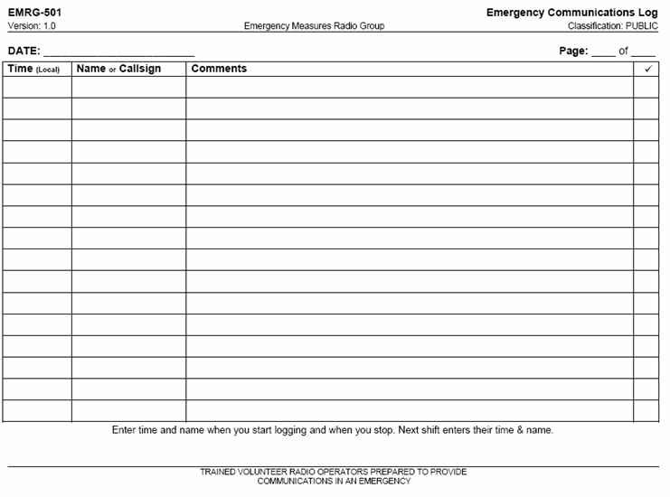

Slide 15
KEEP IT READABLE
If you can type, and have the means to do so, great. Just remember that you need a hard copy on site, so you need a printer as well as a computer before you are ready to type your log. A manual typewriter is fine.
Don’t erase. Cross things out if you have to make corrections. Just put a line through the junk. Use a pen rather than a pencil if you can.
If you can’t write legibly, then print. If you can’t print legibly, then trade jobs with someone who can.
Notes:
0 with a slash is zero. I prefer capital letters so there is less confusion between 1, I and L. I still have trouble with 5 and S.

Slide 16
KEEP IT READABLE
On one page print the alphabet and numbers 0-9 so we can tell “Ss” from your “5s” and your “Is” from your “ls” (and don’t use Arial (this font) if you are typing your log)
0123456789 abcdefghijklmnopqrstuvwxyz ABCDEFGHIJKLMNOPQRSTUVWXYZ
If you can’t tell one character from another except for context, consider practicing the way you write certain characters.
If you can’t write fast enough to keep up, use abbreviations and work on your short term memory. Fill in the details after. Leave a space below each line to put in the final version. Don’t be afraid to use up the paper.
Notes:
The text in the first part is “Lucida Handwriting”

Slide 17

A little practical example..
The following is a weather bulletin. See how much of the information you can get down on paper...
Just to make it easy, assume you are only interested in Alexandria.
Notes:
I’m thinking of adding another question – after the recording is played

Slide 18
So...
What is the low tonight?
How much snow is Alexandria expected to get?
Notes:
How about Bancroft?

Slide 19
Text:
Environment Canada has updated a severe weather bulletin for Southern Ontario at 6:37 PM Eastern standard time Sunday December 16 2007.
A winter storm warning is continued for Westport, Charleston Lake, Merrickville Wolford, Kemptville, Ottawa North Kanata, Orleans, Ottawa South Richmond Metcalfe, Gatineau, Prescott and Russell, Morrisburg, Long Sault, Cornwall, Lancaster, Winchester, Newington, Maxville, Alexandria, Plevna, Sharbot Lake, Western Lanark County and Smiths Falls, Perth, Eastern Lanark County.
A winter storm warning is continued for Bancroft, Hastings Highlands, Denbigh, Barry's Bay, Kilaloe, Renfrew, Arnprior, Calabogie, Petawawa, Pembroke, Cobden, and Deep River, Whitney, Eastern Algonquin Park.
Weather Conditions at 8 P.M.
Ottawa Temperature -12. Relative humidity 94% Wind NNW 15 km/h Wind-chill -19 Barometric pressure 99.31 kPa and falling.
Gatineau Temperature -12. Relative humidity 91% Wind North 17 km/h Wind-chill -19 Barometric pressure 99.33 KPa and falling.
Kemptville -12 Wind N 15 KM/h Bancroft -13 Wind N 17 gusting to 31 km/h.
The environment Canada Forecast for City of Ottawa, Gatineau, Prescott and Russell, Morrisburg, Long Sault, Cornwall, Lancaster, Winchester, Newington, Maxville, Alexandria, Merrickville Wolford, Kemptville, Westport, Charleston Lake, Smiths Falls, Perth, Eastern Lanark County, Plevna, Sharbot Lake, Western Lanark County.
Winter storm warning in effect. For tonight snow at times heavy ending overnight then cloudy with 60% chance of flurries. Amounts 10 to 15 CM. Blowing snow. Wind NE 40km/h gusting to 60 becoming NW 20 this evening then becoming light overnight. Temperature steady near -12
For Monday cloudy with 60% chance of flurries early in the morning. Clearing in the morning. Local blowing snow in the morning. High -10. For Monday night a few clouds. Low -17.
Extended forecast:
Tuesday a mix of sun and cloud. High -10. For Wednesday periods of snow. Low -10 high 0.
For Thursday a mix of sun and cloud. Low -8 high 0. Normals for the period Low -12 high -3.

Slide 20
308 words in 3:24 = Just over 90 WPM
This is SLOW compared to normal speech. .
Trained communicators
(That’s supposed to be you) SLOW DOWN when someone is trying to write.
Notes:
This is SLOW. People speak at hundreds of words per minute in conversation (The record is in high five hundreds). Trained communicators slow down when someone is trying to write things down.

Slide 21
Sunday December 16 2007.
A winter storm warning is continued for... ...Alexandria...
Winter storm warning in effect.
Tonight snow at times heavy ending overnight then cloudy 60% chance of flurries.
Amounts 10 to 15 CM.
Blowing snow.
Wind NE 40km/h gusting to 60.
Becoming NW 20 this evening then becoming light overnight.
Temperature steady near -12
--------------------------------------------------------------------
Monday cloudy 60% chance of flurries early morning. Clearing in morning. Local blowing snow in morning. High -10.
For Monday night a few clouds. Low -17.
Extended forecast:
Tuesday sun and cloud. High -10.
Wednesday periods of snow. Low -10 high 0.
Thursday sun and cloud. Low -8 high 0.
This is a lot fewer than 308 words
Notes:
If you are able, write more. There might be questions later.

Slide 22
Practice:
Try to write down the weather report.
Listen to a “Yak” net
    Start by just copying names and callsigns
    Then try writing down any “facts” that go by
Listen to the Swap net, part of the Capital City net on Mondays, 20:00L on VE2CRA, 146.940-
    Try copying every item listed.
    If you can’t keep up, try every second one.

Slide 23
A short Pause..
The fun part follows...
Notes:
If you are able, write more. There might be questions later.

Slide 24
Questions so far?
Notes:
This is just about everything in the net. –Or at least it seems that way.

Slide 25
AN EVENT
The next audio is 15 minutes from an event (Tour Nortel)
The audio is time compressed, meaning that things happen faster than in real time.
Log it.
(There is a quiz at the end)
(4)
Notes:
Some sidetracks, noises etc. removed. SOME of the “This is A calling B” has been re-arranged to protect the guilty.

Slide 26
NC:RADIO CHECK VA3UNK OK
NC:RADIO CHECK VE3ANO OK
VA3UNK: SUPPLY TRUCK UNLOADING
CP1: NORTEL CREW WITH THE BUS SETTING UP
VA3UNK: RADIO CHECK OK
VE3BSM: RADIO CHECK OK, RUNNING ON LOCAL REPEATER
CP2: NORTEL ERT RADIO WORKING OK @ CP2
BASKINS BEACH: ERT HERE
BASKINS BEACH: WHEN DOES 60K START? ADVISE WHEN THEY GO THROUGH
NC: 60K STARTS 09:00 30 k STARTS 09:30
CP2: SOME CYCLISTS HAVE LEFT CARLING, 1ST 2 ARRIVED @ BASKINS BEACH
VA3DB: CONFIRMS SEEING CYCLISTS ON CARLING
CP1: WHICH WAY SHOULD TRAFFIC BE TRAVELLING ON HERZBERG?
VA3DB: HERZBERG TRAFFIC GOING WRONG WAY, DIRECTED SOUTHBOUND, NOT NORTHBOUND
CP1: NORTEL IS HAVING POLICE CHANGE TRAFFIC NORTHBOUND
VE3URL: TRAFFIC DIRECTION CHANGED. 1ST CYCLISTS LEAVING NOW
NC: TIME 09:02
CP1: 1ST CYCLIST THROUGH
CP2: AMBULANCE ARRIVED, HAVE NORTEL RADIOS,MAY USE THEM INSTEAD OF US, WILL BE GOING OUT ON COURSE PERIODICALLY, WILL INFORM US WHEN THEY LEAVE
VA3DB: 2 CYCLISTS ON 6TH LINGE NEARING VANCES ROAD NOW
CP1: ADVISE CP3 FIRST CYCLISTS THROUGH (ALREADY HEARD)
VA3DB: RADIO CHECK (NO COPY) ,IMPROVED, NOW OK
CP1: FIRST BUNCH OF CYCLISTS THRU CP1
CP3: REMINDER, LOOK FOR CYCLISTS WITH NUMBERS
VE3URL: REMINDER, BIBS MAY BE UNDER JACKETS, BRING ANY INCIDENTS TO ATTENTION OF NET
NCS: 30K CYCLISTS STARTED
VA3DB: FIRST TWO THRU VANCES SIDE ROAD
CP3: 2 CYCLISTS AT CP3, STOPPING FOR A FEW MIN.
BASKINS BEACH: SPECIAL EVENT SECURITY VEHICLE ARRIVED @ CP3
VA3DB: SECURITY VEHICLE LEFT VANCES, WANTED TO ENSURE CYCLISTS WERE STOPPED FOR TRAFFIC
NC: CP3, MAKE CONTACT WITH SECURITY, LET THEM KNOW WHO YOU ARE
CP3: FIRST 2 CYCLISTS OUT OF CP3, GOING TO VANCES
CP3: SECURITY VEHICLE HAS LEFT CP3
CP2: DO WE GET BBQ TICKETS AT FINISH, OR FEND FOR OURSELVES FOR LUNCH?
VE3URL: RETURN TO OARC BOOTH AT FINISH. VOLUNTEERS ARE ENTITLED TO FOOD AT FINISH.
Notes:
Do you want to hear it again, while looking at this text? Note mostly one station noted as traffic seems to go to NCS or ALL. One exception is NC:CP3, Make contact...

Slide 27
Quiz?
What callsigns and tactical callsigns were heard?
Where were they?
What is the last known position of ERT and security?
CALL TACTICAL CALL LOCATION
VE3RC Net Control Nortel
VA3UNK Baskin Beach, CP3 Baskins Beach
VE3ANO No tactical call given Behind tents
no call given CP1 Hertzberg Rd and Carling
VA3DB No tactical call given Vance's side road
VE3URL/ No tactical call given Nortel
VE3BSM CP2 No location given
ERT @CP2,3 Security OUT OF CP3 Going down the course
Notes:
Keeners do this on the fly, adding times, too.

Slide 28
Questions / Discussion
I can’t write that quickly, now what?
I try to write stuff down, but somebody is calling me. What do I do first?
I could read this an hour ago, but now I can’t make heads or tails of it.
Notes:
Abbreviate as much as you have to, but make sure the abbreviations will make sense in a year. Try to write stuff down before acknowledging or replying. It helps everybody if nobody rambles, but gets straight to the point. “Do you have...” is better than “You wouldn’t know where I can find...”

Slide 29
www.emrg.ca
The EMRG web site provides information related to Amateur radio emergency communications, specifically as it relates to the City of Ottawa.
  Project Information
  Newsletters
  Upcoming Events
  Documentation
  Links to related information
Information:
Notes:
Try to put email addresses into the form of images, rather than text if it is going on the internet.

Slide 30
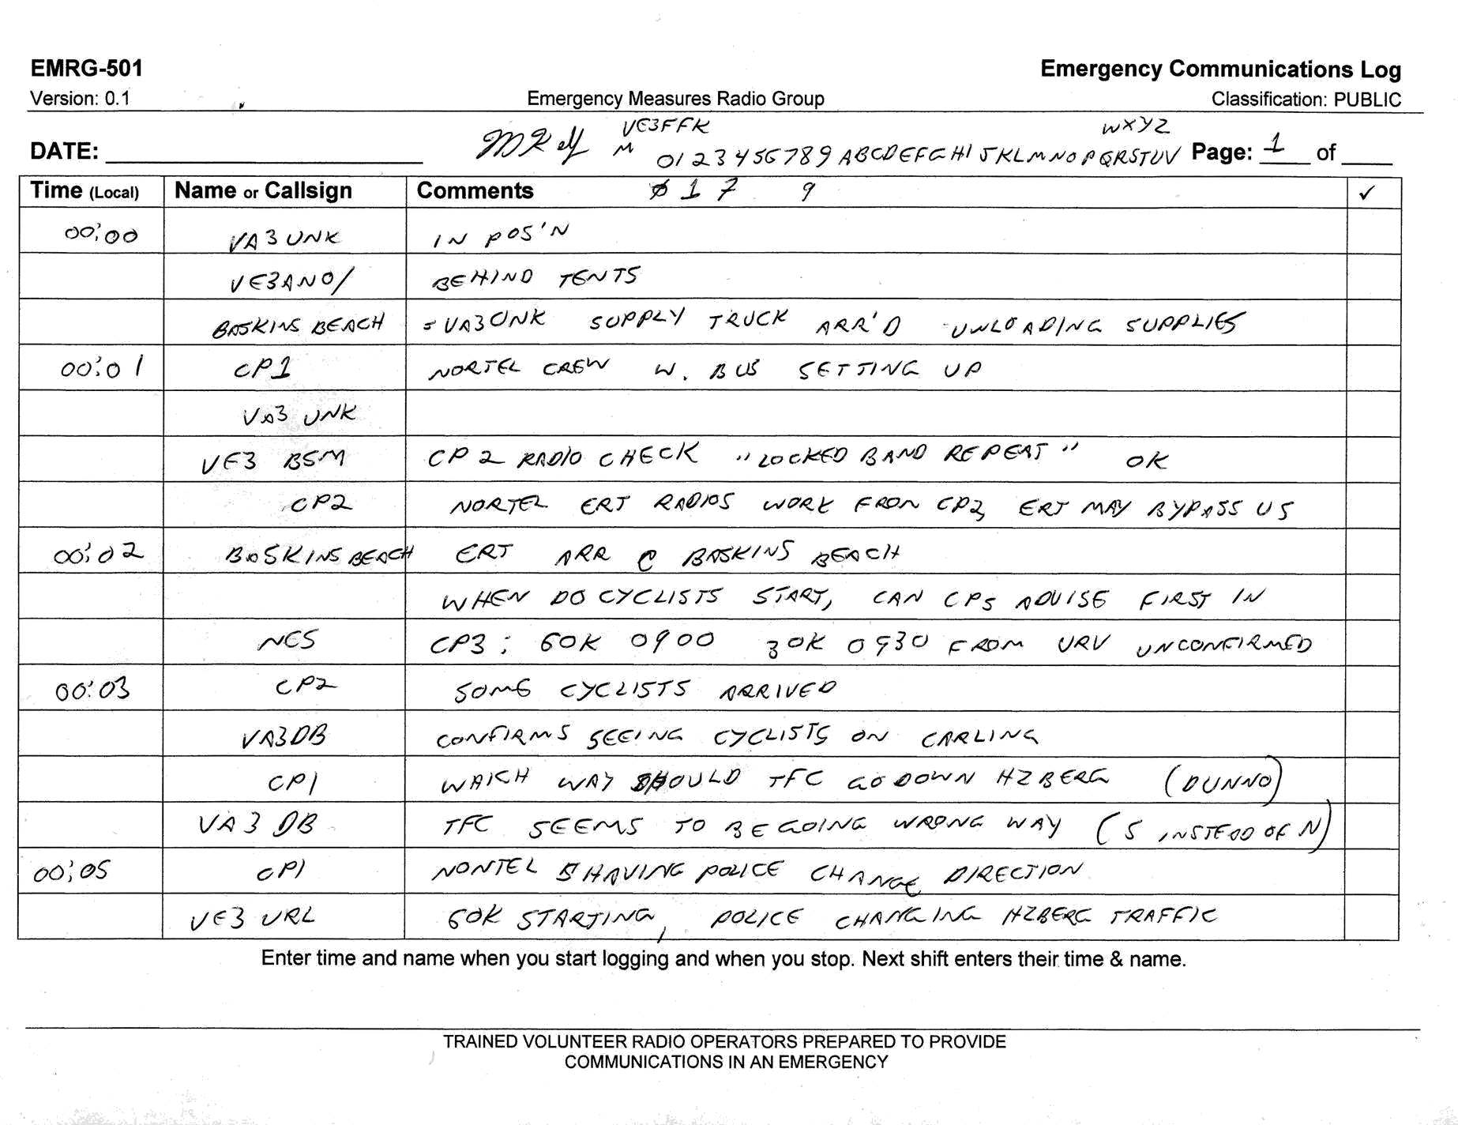

Slide 31
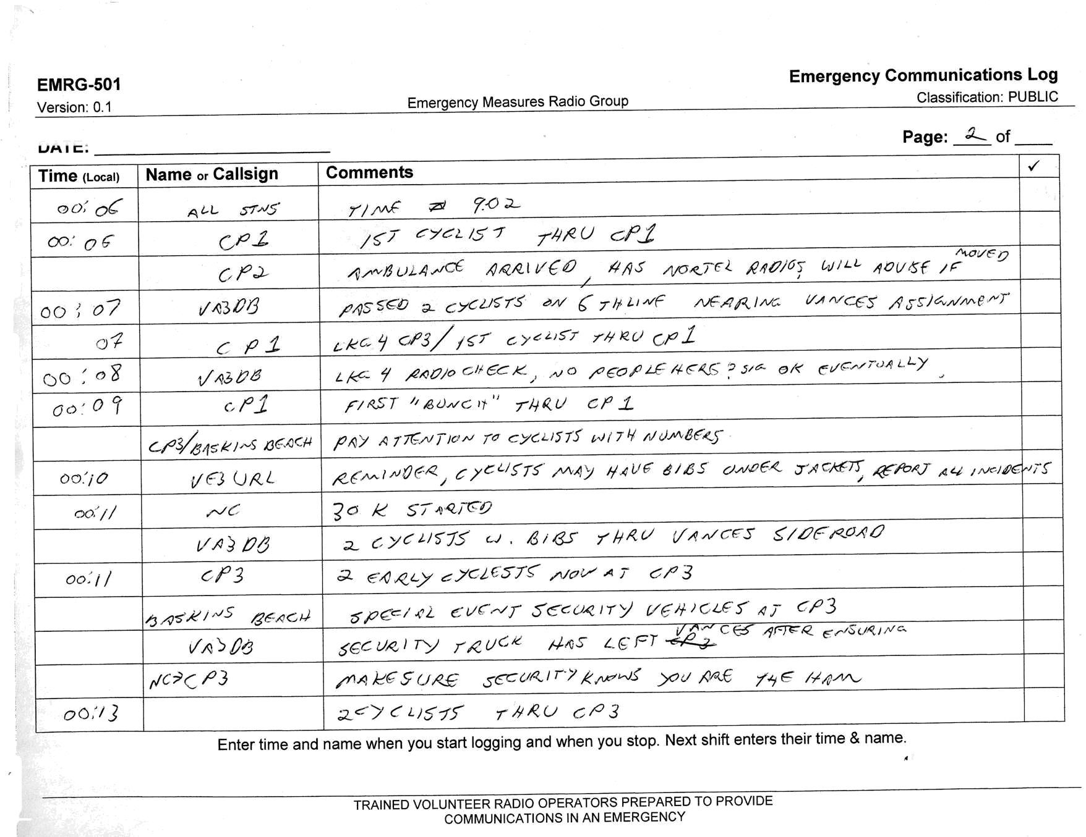

Slide 32
