Slide 1


EMRG-412
Training Course
EMERGENCY MEASURES RADIO GROUP
OTTAWA ARES
Two Names - One Group - One Purpose
EMRG-412
12VDC for the
RADIO AMATEUR
Date Of Last Change: 2010-05-30
Version: 1.1
Notes:
Prepared by M.Kelly VE3FFK for EMRG/Ottawa ARES

Slide 2
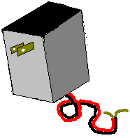
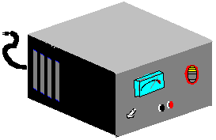

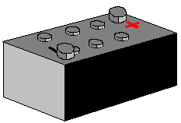
12V DC AND AMATEUR RADIO
A GUIDE TO EVERYTHING DC RELATED
SOURCES
POWER SUPPLIES, AUTOMOTIVE, OTHER BATTERIES, OTHER SOURCES, CHARGERS
CONNECTIONS
WIRES, CONNECTORS, FUSES, HOLDERS, INSULATION
LOADS
RADIOS, RATINGS, LAMPS,OTHER APPLIANCES, SAVING POWER, NOISE
Notes:
However your radio gets it, it needs power. Usually that means 12V DC.

Slide 3
SOURCES
MANY SOURCES OF DC:
Batteries –Rechargeable vs Primary: When?
Li-Ion, Ni-Cd ,“Gel Cell”, Ni-MH (Metal Hydride)‏
12v supplies running off of AC mains
Automotive Power- Lighter Sockets etc.
Others.. Gas powered Generators, Solar, Wind ..Can you use a battery charger as a supply?
Notes:
Many sources. Each has advantages and disadvantages. There is seldom just one “optimum” solution.

Slide 4
SOURCES -BATTERIES
Primary: The chemical reaction
only goes one way.
Most common these days is the
Non-Rechargeable Alkaline
ADVANTAGES: Relatively cheap and has a long storage life. Available anywhere.
DISADVANTAGE: High cost per use despite low initial cost.
Notes:
Alkaline, Zinc Carbon, Lithium batteries are all commonly available as primary. Zinc carbon cells may be the most cost effective choice for ultra low drain applications like clocks, but otherwise low priced-high cost.
Lithium primary batteries are useful at extreme low temperatures, or where weight is a paramount factor ( ie. mountaineering)‏

Slide 5
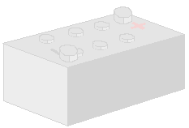
SOURCES- BATTERIES cont’d
Secondary, better known as rechargeable: The chemical reaction can be reversed by pushing current back through the battery.
ADVANTAGES: Cheap per use. Good if you use the radio all the time.
DISADVANTAGES: Charge decays with time. Requires periodic recharging. Some types drop off suddenly. Some (rechargeable alkaline) have low peak current capability.
Notes:
Ni Cd (Nickel Cadmium) Ni-MH (Nickel Metal Hydride) PB SO4 (Lead Acid) lead the pack in this category.
You don’t have to know the chemistry, just the characteristics.
Steep discharge curves make it difficult to predict remaining capacity, unless you predict that it is empty.
They will go “bad” and let you down in an emergency, if you ignore them for too long.
Usually you have to charge them before use. You can’t run into the store and run out again with working batteries.

Slide 6
SOURCES- BATTERIES cont’d
Note:, No Ni-Cd battery you will see today has any “memory”. What people perceive as memory is really burnout. People leave their batteries on charge wa-a-y too long . The batteries overheat. The electrolyte vents out, leaving behind a battery with less capacity.
A cheap charger is enemy #1 for a Ni-Cd or Ni-MH battery. If you have one of these, try using a timer with it.
Notes:
If you can set the timer to charge for 8 (or 12 or 16 hours, whatever the manufacturer recommends), then STOP, you have
much less chance of ruining the battery pack by forgetting it on the charger.
Yes, you can bring back a Ni-Cd that has shorted by blasting away the nickle dendrites that grow across the cell.
No, it isn’t reliable afterward. For the cost, why not just replace the cells and start over with a battery at 100%?

Slide 7
SOURCES- BATTERIES cont’d
How Much Battery Capacity?
What if you want to run your rig on a lead acid battery. What do you need to know before you get one?
Notes:
Any guesses from the audience?
Bigger is always better, until you have to carry it up the stairs...

Slide 8
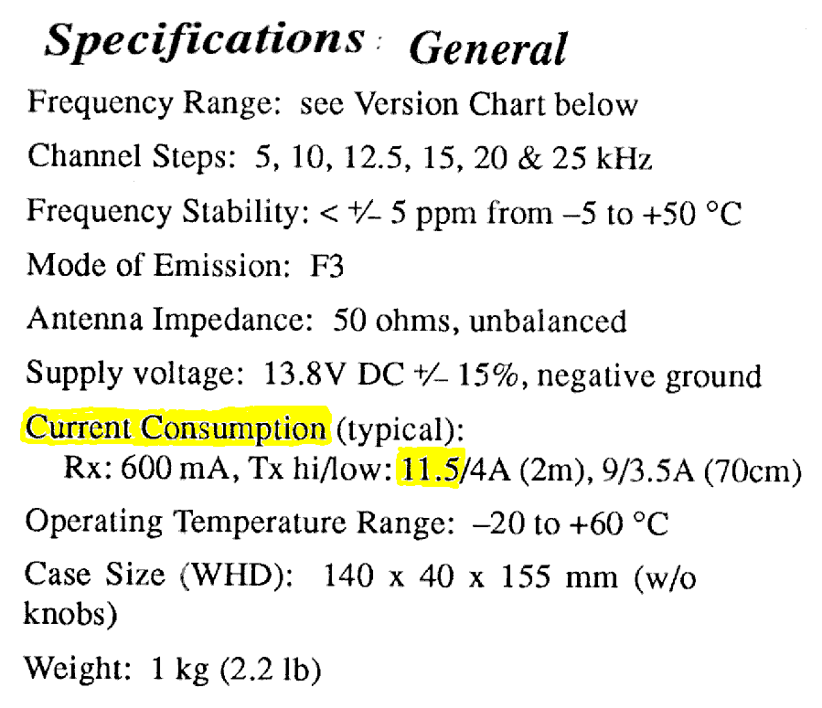
SOURCES- BATTERIES cont’d
How Much Battery Capacity?
RTFM: Find the transmit and receive current for your rig
(if multiple rigs, use the highest and sum receive currents.)‏
Notes:
You have to know how much :
(current the radio takes)
You have to know how long:
(you want to run before recharging)‏
You have to know how many :
(Volts it takes to run the rig in a satisfactory manner)‏
OR YOU GET THE BIGGEST ONE YOU CAN
NO PENALTY EXCEPT PRICE AND WEIGHT

Slide 9

SOURCES- BATTERIES cont’d
How Much Battery Capacity?
Example rig draws 11.5A on transmit, 0.6A on receive
If you are “Net Control”, assume a 50% duty cycle.
If you aren’t NCS, use a lower duty cycle.
(maybe 25% to start)‏
How long will you be on station before
you can recharge?
(assume 24 hours unless you know it will be longer.)‏
Notes:
Through the example I use worst case numbers.

Slide 10
SOURCES- BATTERIES cont’d
How Much Battery Capacity?
If you aren’t transmitting, you are listening
You need (11.5 X 50%) + (0.6 X 50%) X 24 hours = 145.2 Ampere Hours.
Since it isn’t a good idea to take more than 50% of the charge out of a lead acid battery, divide this by 0.5
= 290 AH ! This is a serious battery.
Notes:
This is what it takes to be net control for a 24 hour day. A lead acid battery this size is about 5 ½ x 7 x 18 inches or about 34 Kg / 75 Pounds.
Other rules of thumb from the sailing world (where they don’t always recharge every day) are 4x daily AH, and 4x highest current load.
While 50% is OK for occasional, emergency conditions, using 40% gives you room for unplanned accessories.
Some studies indicate that the way to get the maximum energy per dollar out of a set of batteries over their lifetime is to discharge them to 50%. Size, Life, Cost: Pick any ONE.

Slide 11
SOURCES- BATTERIES cont’d
How Much Battery Capacity?
Do you NEED that much capacity?
Maybe, if you make a habit of operating off the battery
often, for long periods of time.
If you are only going to run on the battery for a few days per year, you can likely get by with less.
The deeper a battery is discharged, the fewer cycles it will last.
Notes:
Take a 12V battery all the way down (leaving the lights on overnight), and you can expect to get about ten cycles out of it.
Take 10% of the rated ampre hours out of it and you can expect over 500 cycles.
If you absolutely HAVE to stay on the air, be prepared to sacrifice your battery’s future. It’s only money.

Slide 12
SOURCES- BATTERIES cont’d
How Much Battery Capacity? (What's an AH?)‏
“10AH”
Duration
20H
10H
5H
3H
1H
30m
20m
Current
.5 A
.9 A
1.5A
2.2A
5 A
7.5A
10 A
Capacity
10AH
9AH
7.5AH
6.6AH
5AH
3.7AH
3.3AH
How does this relate to the automotive “Cold Cranking Amps”, or Reserve Capacity?...
Notes:
Note that most Sealed Lead Acid batteries have their capacity rated at C/20, discharging over 20 hours, not one hour.
As a rule of thumb, assume you can get half of the c/20 capacity out at C/1 (You get 5 AH from a 10 AH battery if you take it all in 1 hour)‏
Note that the usable capacity drops off as the current increases.
Battery life also decreases if you try to extract the maximum capacity before recharging. – so recharge early and often.
Capacity decreases with temperature. As the temperature rises, so does the leakage, meaning you must recharge more often.

Slide 13

SOURCES- BATTERIES cont’d
AUTOMOTIVE BATTERY RATINGS:
Cold Cranking Amps: Current it can
provide for 30 seconds without
dropping below 7.2 V at -18˚C/0˚F
(not too useful a measure for us)‏
Marine Cranking Amps, Cranking amps same as cold cranking amps except at 0˚ C/32˚F (ditto)‏
Reserve Capacity: Time it can supply 25A while remaining above 10.5V@ 25.7˚C/80˚F
AH =approx. Reserve Capacity X 0.6
(This is a number we can work with)‏
Notes:
If you are stuck with buying an automotive battery for portable radio operations, look at its reserve capacity.
A battery with a 80 minute reserve capacity has a capacity of about 80 times 0.6 equals 48 AH.
Because automotive batteries are designed to put out an enormous amount of energy in a 5 second burst and then be immediately recharged, their ratings are only approximate guide to how long they will support radio operations.
You can do almost as well by judging their size or weight and comparing them to batteries of known Ampre-Hour capacity.

Slide 14
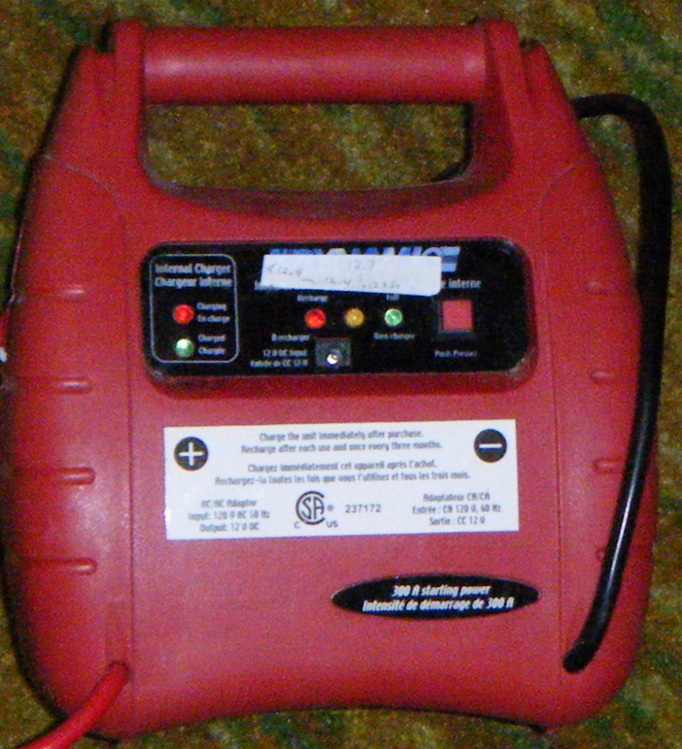
SOURCES- BATTERIES cont’d
OTHER BATTERIES
USED BATTERIES FROM ALARM SYSTEMS, UPS SYSTEMS
Maybe OK, maybe not depending on the charge system used before replacement.
Check the open circuit voltage before accepting/ buying
ALL IN ONE BATTERY BOOSTER PACKS/ INVERTERS/ POWER PACKS
May be OK, but I haven't had much luck with them.
Chargers seem mediocre, and the batteries seem to
be pretty old by the time they make it into the sales flyer.
Notes:
If you know how the batteries were maintained, pulls from alarm and emergency lighting systems MAY be a deal. Just remember there is a reason why companies replace them when they do. Expect reduced capacity or a shorter service life than new, but if the price is right, go for it.
The chargers in these booster packs aren't very sophisticated, although some are getting better. If you can, check the open circuit voltage before buying, and don't accept anything less than 12.0V no matter what the price.

Slide 15
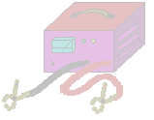
SOURCES- CHARGERS
Battery chargers:
Often put out really bad D.C.
Often can’t supply enough current to run the radio.
So...
Charge the battery, then remove the charger ... and run the radio.
Notes:
Chargers vary widely, from fully filtered, electronically controlled versions all the way down to el cheapo models with
leaky selenium rectifiers and absolutely no filtering. These often have the prettiest cabinet and lots of meters and LEDs.

Slide 16

SOURCES- CHARGERS
When float charging: Consider setting the maximum voltage below the limit You will never fully charge the battery that way, but you will never kill it, either.
Which is more useful to you, a battery well charged to 80% of its capacity, or one that has 5% capacity because the electrolyte has been driven off by overcharging?
Notes:
Float charging means connecting a constant voltage supply across the battery terminals and leaving them there approximately forever.
Periodic or cyclic charging means charging the battery periodically, as required, then removing the charger once the battery is charged.
If you are lucky, you will have a set of tables that tell you what the float voltage should be, and how it varies with temperature.
If you are really lucky, you will have a temperature compensating charger. We can all dream.

Slide 17
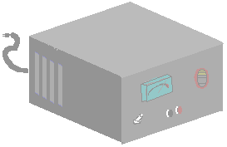
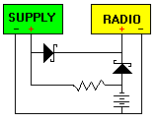
SOURCES- AC SUPPLIES
Regulated Power Supplies:
An excellent way to get DC, IF you have AC.
Can be used to float charge a battery.
Can be wired so the battery
takes over “if” AC fails.
D1
D2
Notes:
The supply runs the radio via D1 most of the time. A tiny amount of current is allowed to flow into the battery. When the power fails, the battery runs the radio through D2. It takes a long time to recharge the battery this way, but it isn’t harmed by the small amount of current that flows through the resistor. After a power failure, you can parallel a smaller resistor for a while to speed things up. Just don’t leave it in the circuit. The power supply isn’t in any danger from the battery current when the AC is off.

Slide 18
SOURCES- AUTOMOTIVE
Direct to battery, or through “Lighter socket”? (is it your vehicle or someone else’s?)‏
Either way, Ensure it is fused correctly
Try to have extra noise filtering on hand.
Remember the cable run is always longer than you think it is. (See “connections”.. later)‏
Notes:
Direct to battery is sometimes difficult to manage, especially in somebody else’s car (either mom or the fire chief). Lighter sockets are often electrically noisy, mechanically loose and sometimes have cigarette ash in them.

Slide 19
SOURCES- AUTOMOTIVE
Try to route the wiring directly from
battery + and – to the rig.
Keep wires away from:
.Motors, the ignition system, other noise makers
.Computers, Airbags or other susceptible systems.
.Moving or Hot parts
.Antenna cables – Your own or the broadcast set.
Notes:
You don’t want to put RF into the airbag controller. You don’t want noise from the ignition system computer in your receiver. No matter how convenient it looks, don’t run the cables through the fan blades. Don’t let them get chopped short by the door hinges either.

Slide 20
SOURCES- AUTOMOTIVE
Finding a place to run the cable isn’t always really easy. My preferred route in vehicles I don’t own is through the door edge. If you own the vehicle, look for an existing opening in the firewall. If none are available, look carefully AT BOTH SIDES before drilling through it. Make the hole big enough for your DC cable as well as a grommet or other protection
Speaking of protection.. Fuse at the battery
To protect against shorts along the cable run.
Notes:
Often the hardest part of drilling through the firewall is getting the drill into the right place. In the movies they shoot holes in them.

Slide 21

SOURCES- AUTOMOTIVE
No matter where you get your DC from in a car, expect it to be noisy. Record your audio as received and listen for alternator or other noise.
Lighter sockets aren’t built with any means of retaining the plug. Therefore it WILL vibrate out over time. This is more of a problem with higher power systems where the wire is heavier.
Notes:
The IRLP echo reflector is a good way to listen to your ignition and other noise.
Shims, duct tape and smaller diameter wires all help to keep the lighter plug in the socket, but they all fail sooner or later.

Slide 22
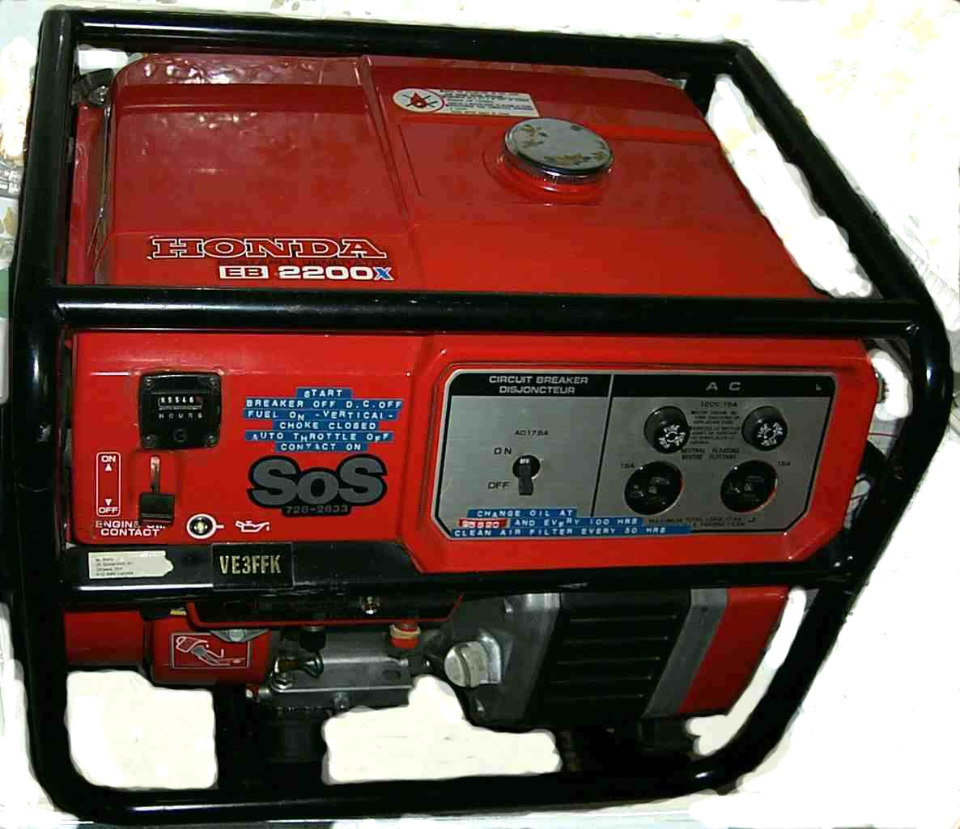
SOURCES- OTHER
Generators, either purpose built engine plus alternator combinations or AC generators with a DC battery charging outlet are usually too big for typical amateur stations, but come in handy if you want to run a 1500W coffee pot, or power amplifier.
Not really the topic of this piece, since we are concentrating on low voltage DC here.
Notes:
You really don’t need a 2KW generator to run a couple of 50 Watt radios.
Yes, generators are nice to have, if you don’t have to do the maintenance.
Newer, smaller generators are a better match, but still need maintenance.
I'm waiting for a 200W propane powered genset to arrive on the market.

Slide 23



SOURCES- OTHER
Solar panels, wind and manually cranked generators are an OK, if expensive source of DC to recharge your batteries -- if you plan on being away from commercial mains for a month or more.
Give it a lot of thought before
going that route.
Notes:
Most of these things are cool ideas. They are fun to play with – but...
Watch out for cost, size and complexity before deciding to rely on them.
Still waiting for a real fuel cell..
If you are getting fresh supplies of food and water, can’t you get fresh electricity sent in also?

Slide 24
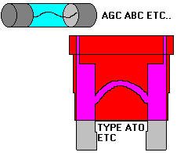
CONNECTIONS -FUSING
Pick a fuse appropriate
for the wire size and current you are running.
.Fuse at about 150% of the maximum current you will use.
.Use a LOW VOLTAGE Fuse.
I now prefer ATO because they are easier
to identify and test, and are more vibration resistant than glass types. Use which ever you like, but bring spares.
Notes:
Low voltage means rated at 50 volts or less. Higher voltage fuses (120V /250V tend to have higher internal resistance. (A two volt drop at 120V isn’t much of a problem, but it can be the end of a 12V system. A higher voltage fuse has to be able to quench an arc better than an automotive fuse.
Fuses are a topic all in themselves.
A typical fast blow fuse will carry a 100% overload (20A through a 10A fuse) for 60 sec, and a 35% overload (13.5A through a 10A fuse) for an hour at 20˚C.
The fuse rating will drop to 75% of its marked value at 50˚C.

Slide 25

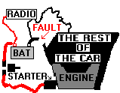
CONNECTIONS -FUSING
WHEN AND WHY YOU FUSE A RADIO NEGATIVE LEAD
It does no harm.
If your radio is connected directly to the battery AND
the vehicle’s ground system fails, the starter return current may travel through your
radio negative lead.
CONNECTION THROUGH CHASSIS OR ANTENNA
Notes:
Thanks to EMRG website http://www.emrg.ca for the clearest explanation of this problem that I have read.

Slide 26
CONNECTIONS- Wires
Wire size required to keep voltage drop below 3% in a 12V system
Power
Current
Distance- Battery to Radio (Feet)‏
(Watts)‏
(Amps)‏
10 Ft.
15 Ft.
20 Ft.
30 Ft
40 Ft.
50 Ft.
60
5
14 Ga
12 Ga
10 Ga
10 Ga
8 Ga
6 Ga
120
10
10 Ga
10 Ga
8 Ga
6 Ga
6 Ga
4 Ga
180
15
10 Ga
8 Ga
6 Ga
6 Ga
4 Ga
2 Ga
240
20
8 Ga
6 Ga
6 Ga
4 Ga
2 Ga
2 Ga
300
25
6 Ga
6 Ga
4 Ga
2 Ga
2 Ga
1 Ga
Notes:
Remember your 50 Watt radio probably takes about 100 W in. That’s over 8 Amperes.
If the wire is smaller than specified in the table, the voltage will be less than it should be. Three things save people :
There is usually another path to ground, so the voltage dropped in the ground line is less than shown here.
The “12V” electrical system is only as low as 12 V at the worst of times. Usually it is around 13 to 14 VDC.
Rigs will (Sometimes) run on voltages less than 12V, although they won’t put out anything near their rated power at lower input voltages. Some rigs have really nasty failure modes if the voltage is too low when transmitting. Better safe than sorry.
Note the distance is from battery to radio, and includes one (red) wire out and one (black) for the return.

Slide 27
CONNECTIONS -Wires
I use speaker wire for a lot of my DC wiring because it:
--is big enough (10-12Ga)
--has thick insulation
--is relatively cheap, compared to red/black zip cord.
I can tell the difference between the + and – conductors.
In any case, always use stranded (not solid) wire for mobile installations. 12 Ga House wire may be OK for wiring the home station with DC, but the vibration in a car or truck will kill it in short order.
Notes:
There is stranded wire available for marine and automotive use, but I am happy with speaker wire for now. Its only drawback is that it isn’t designed to withstand very high temperatures, so be careful not to over tighten when strapping it down in hot locations. Don’t rely just on the wire insulation when you run through the firewall.
A little red paint or permanent marker will distinguish the conductors if you can’t see any other difference between the two.

Slide 28
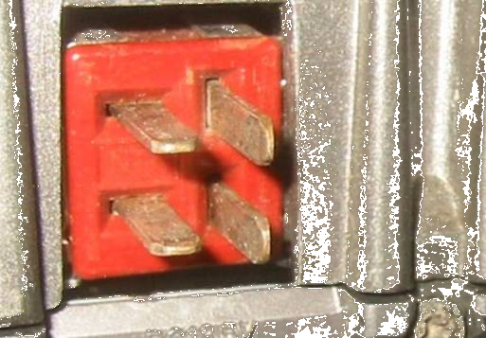
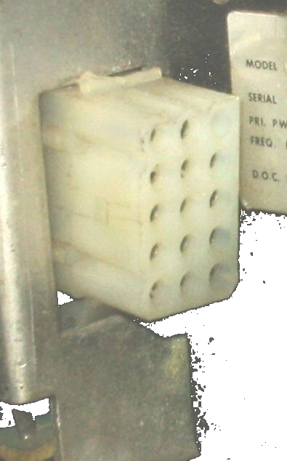
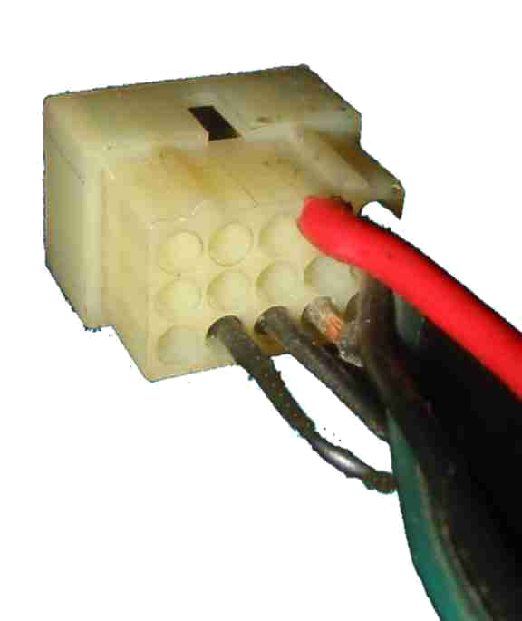
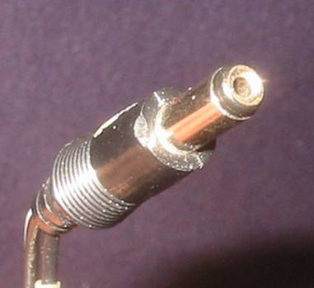

CONNECTIONS -Connectors
We mentioned lighter plugs earlier. What does your rig need?
JONES?
COAXIAL?
POWER POLE?
If you want to be able to interchange rigs and power supplies in an emergency, find out what everyone else is using and make an adaptor from yours to theirs...
Around here the standard is the Anderson Power Pole
MOLEX?
Notes:
Everyone has their favorite connector. Don’t try to convert them, just try to adapt. If they use trailer connectors, try to have an adaptor from trailer connector to your favorite, and from your favorite to a trailer connector. At least have one of each sex of your connectors with wire leads on it, so you can get connected.

Slide 29


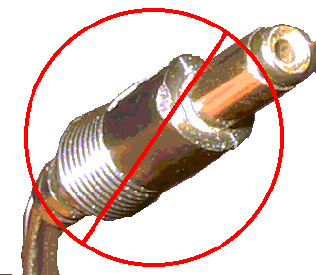
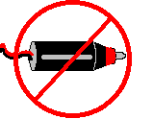
CONNECTIONS -Connectors
If no local common connector, look for one that:
Can’t be confused with something else.
Can’t be connected backwards
Handles all the current you might want
Can be locked together
Cheap, available and water proof (can’t have everything)‏
Notes:
The Power Pole stacks up pretty well against these criteria. It isn’t waterproof, but neither is a PL259.
For short durations, (days, not months) the 12V DC connectors don't have to be waterproof. If the connectors are soldered, rather than crimped, there will be no issues with water wicking back up the conductor.
Trailer connectors usually aren't built heavy enough to take the current.

Slide 30
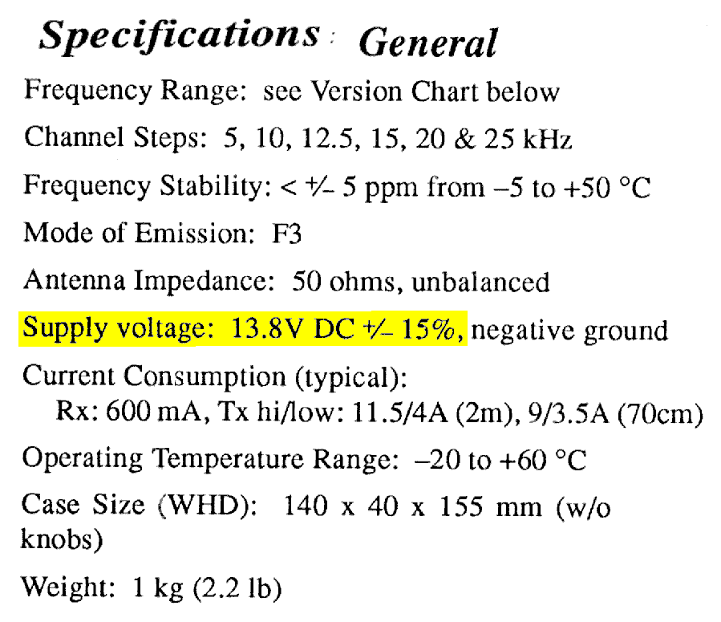
LOADS
WHAT 12V DC REALLY MEANS check your specs.
This rig will work on 15.87 to 11.73 V
but the power out is specified at 13.8 V
Notes:
This rig puts out 50W if there is 13.8V at it’s input connector. At 12V, it is down to 38W, at 11V it is down to 32W.
If you add an extra ohm (total) of resistance in the power line the story gets really bad really fast.

Slide 31
LOADS
The power output of the rig in this example is 50W.
It’s input current is 11.5 A and the supply is 13.8 V
This means the input power is 158.7 W, which means the rig itself must get shed over 100W worth of heat.
The fan on the back doesn’t look big enough all of a sudden.
Now stuff the rig into a dash board, right in front of the heater. Better yet, put it on top of the dash, in the sun. They make heatsinks black so they radiate better, but a good radiator is also a good absorber of heat.
Notes:
Keep it cool. You wouldn’t think this would be a problem during the Ski Marathon, but it gets that way sometimes.

Slide 32
LOADS
Depending on the situation, you may also be running a fan, or a lamp. Look for an LED lamp, rather than a regular incandescent.
In some situations, I use a "seat heater" designed for automotive use. It costs me another 3 amperes.
In some (car rally) situations you may also have to power a light bar or siren.
Use a good antenna and low power, rather than high power and a crappy antenna. It has other dividends too.
Notes:
One place where "Larry Lightbar" would feel right at home is in CAR 0 of a car rally.
Keep in mind that some accessories will generate electrical noise - you may want to put them on a different circuit than your radio gear.

Slide 33
SAFETY
Although it is theoretically possible to electrocute yourself with 12V DC, I've never met anyone who has killed themself this way.
Your biggest hazard will be heat, from conductors (rings or wrenches) getting across an unfused source. (ie battery terminals)‏
Related to this is the fire hazard. Imagine a short in a Gell Cell pack in your vest pocket (been there, done that) or on your belt.
There are a few ways to make a battery explode in your face.
-Avoid them.* Keep the acid out of your eyes too.
Lead is heavy, don’t drop it on your toes, even if you are wearing safety boots. Orange crates are light duty shelving.
*Over charge a battery in a confined space, and create a spark while doing so.
Short the battery, and leave it shorted. For an extra kick, seal the vents.
Notes:
Over charge a battery in a confined space, and create a spark while doing so.
Short the battery, and leave it shorted. For an extra kick, seal the vents.

Slide 34
SAFETY
YOUR BEST BETS for an unexciting installation:
FUSE EARLY AND OFTEN -Put a big fuse at the battery (it only has to protect against a "dead short"). Use another one near the rig, sized to the radio manufacturers recommendations.
USE INSULATED TOOLS when hooking up the battery. Wrap a few layers of tape around the handle of the wrenches you use.
LOSE THE BLING. Rings, metal watchbands, bracelets and neclaces are a bad idea when working around automotive batteries. If the ring won't come off, cover it with a layer of tape.
WATCH THE ROUTING. Make sure the wire won't be crushed or grounded when you close the hood, door or window.
Notes:
Some suggest safety glasses and gloves. Not a bad idea if you can.

Slide 35


– Wrap Up
Use big wire and a big battery
Fuse early and often
Standardize your power connectors
Charge early and often
Keep cool
..ZZZ?
QUESTIONS?
..zzzz
Can we go home now? What’s for lunch? What’s on TV?
Notes:
Can we go home now? What’s for lunch? What’s on TV?

Slide 36
CHARGERS and TEMPERATURE
Temp ˚ C
Voltage
When float charging *: The charger should be set 0.6V lower than the table at left.
50
13.80
40
13.98
30
14.19
25
14.34
20
14.49
10
14.82
0
15.24
*FLOAT CHARGING = Leaving the battery and charger connected for a long time.
-10
15.90
-20
17.82
(BELOW -20c NOT MUCH HAPPENS)‏
Notes:
Float charging means connecting a constant voltage supply across the battery terminals and leaving them there approximately forever.
Periodic or cyclic charging means charging the battery periodically, as required, then removing the charger once the battery is charged.If you are lucky, you will have a set of tables that tell you what the float voltage should be, and how it varies with temperature.
If you are really lucky, you will have a temperature compensating charger. We can all dream.

Slide 37
www.emrg.ca
The EMRG web site provides information related to Amateur radio emergency communications, specifically as it relates to the City of Ottawa.
  Project Information
  Newsletters
  Upcoming Events
  Documentation
  Links to related information
Information: training@emrg.ca
Notes:
73 from VE3FFK

