Slide 1

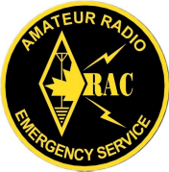
EMERGENCY MEASURES RADIO GROUP
OTTAWA ARES
Two Names - One Group - One Purpose
General Meeting
2006-09-30
Notes:
This training course provides an overview introduction for anyone wanting to know more about EMRG. The course is intended to be reviewed individually, or presented to a group.

Slide 2
KATRINA - RITA
1 Year Later
What Can We Learn About Providing Emergency Radio Communications?
Notes:
It is as important to understand what EMRG does as it is to know what it does not do. Effective emergency communications requires planning, which starts with knowing what is required and who requires it.

Slide 3
BETTER THAN NOTHING
Some Amateurs believe that whatever we provide is better than nothing.
In an emergency/disaster people have expectations for communications, based on their normal world experiences.
They don’t expect to have their “normal” communications, but they want as close to normal as possible.
Sometimes providing something “better than nothing” is viewed as nothing, so people look for something better!
We need to provide effective communications that meets user needs. We need to do the best that we can!

Slide 4
DEPLOY IN TEAMS
X Amateurs = Communications Team
End user groups are not looking for radios or radio operators, they want effective communications!
Effective communications typically requires some infrastructure
Implementing an effective communications solution requires a team approach, not a random group of individuals.
We cannot assume that if a random group of Amateurs comes together, they can provide effective communications!

Slide 5
WE ARE REGULAR VOLUNTEERS
Amateur radio volunteers are volunteers with a radio.
Public Safety (Police, Fire, EMS) do not let volunteers into an area until it is considered reasonably safe.
Public Safety does not look to Amateur radio to provide interoperability.
  They can hold 2 radios themselves
  There are numerous commercial interoperability solutions available
  Many of the interoperability issues are not radio related
We need to be clear on our role and be dedicated to it!

Slide 6
“EVERTYTHING FAILED”
In our world today with multiple types of communications, redundant networks and multiple service providers, having “Everything Fail” is unlikely to occur.
Some things will fail, some things will work, but lose connectivity to the rest of their network.
Some things can be fixed temporarily or portable equipment can be brought in to fill some gaps.
We need to understand and be truthful about what really happened!

Slide 7
Amateur Radio =
Tip Of The Iceberg
Amateur Radio HF Communications
Amateur Radio HF Communications
Amateur Radio HF Communications
Amateur Radio VHF/UHF Communications
Amateur Radio VHF/UHF Communications
Growing Segment
Of Commercial Solutions
= Lost / Abandoned Opportunity For
Amateur Radio
Non Amateur Communications
- Satellite
- Commercial Mobile Radio
- WiFi, VoIP
Military, NGO
Private Companies, Satellite Companies
Radio Manufacturers, Service Providers
Still Lots Of Opportunities For Amateur Radio To HELP. Requires Solutions That Match User Requirements
For many Amateurs, Emergency Communications means Amateur Radio HF.
Many Amateurs Also Recognize Amateur Radio VHF/UHF Local Communications.
NOT TO SCALE
Communications Required, but no viable communications solution available to deploy.
What most Amateurs do not see is the massive amount of commercial communications and the requirements for communications that are not filled.
NOT TO SCALE

Slide 8
SATELLITES PROVIDE LONG HAUL SOLUTION
Harris has reconfigured and diverted 12 C-band satcom terminals originally destined for Africa to provide vital communications lifelines throughout Mississippi and Louisiana. These satcom terminals will provide vital voice, data, Internet, and fax capabilities - and telemedicine video.
http://www.harris.com/katrina/
Satellite telephone provider Globalstar and its dealers deployed over 10,000 phones to the region in the first five days after Katrina struck. Globalstar rival Iridium has delivered a similar number, is shipping another 6,000 and expects orders for thousands more in the coming days and weeks.
http://www.space.com/spacenews/businessmonday_050912.html
Communications between Red Cross aid stations and back to their national headquarters continues to be an enormous challenge as they face an ongoing, long term aid situation in Louisiana, Mississippi, and Alabama. In light of this the American Red Cross chose Telex/Vega IP-223 Dual IP-Adaptor Panels and C-Soft Software Based Dispatch Consoles to create a flexible, reliable emergency communications system. High power, low-band VHF radios, located at tower sites across the affected area have been bridged onto an IP-based network, which is then connected directly to satellite uplink devices. The satellite broadcasts are then being transmitted to 3 regional emergency dispatch centers. The solution allows all relief centers to communicate with central dispatch, and with each other, using simple portable two-way radios.
http://www.policeone.com/police-products/communications/dispatch/press-releases/119206/

Slide 9
PORTABLE INFRASTRUCTURE
The radio operator needs to be co-located with the people who need communications.
The radio antenna should be located as high as possible.
The distance between the user and the best antenna location is usually too far to run coax.
Running between the users and the radio is not acceptable.
A portable repeater can help solve this problem. The user can co-locate with the people needing support and the repeater antenna can be located in the best available location.

Slide 10
EXTEND REACH
EXPAND COVERAGE
SIMPLEX
Portable
Repeater
SIMPLEX
Portable
Repeater
SIMPLEX
Portable
Linking
Repeater
Portable
Repeater

Slide 11
TRAINING

Slide 12
GROUP THINK
Time To Stretch Your Brain
Remember - There are no wrong answers, just different ideas!

Slide 13
GROUP THINK
It is Tuesday morning. The power has been out since Sunday night, due to a combination of transmission line and generation failures. It looks like power will be out for an indefinite term.
Telephone service is intermittent, due to the loss of some cell sites and overhead telephone wiring.
The city is advising those who are able, to shelter in place, and offering to shelter others in one of four shelters being opened up in various parts of the city. They estimate that if conditions remain unchanged they will have about 10,000 residents in shelters by Thursday.

Slide 14
GROUP THINK
You have been asked to report to a city works yard on Industrial Avenue to provide communications, either at a shelter, for a street patrol, or for some other fixed site.
Weather forecast is as follows:
  Wednesday -Freezing rain continuing, then colder, high minus five, low minus 15.
1) What do you need to do BEFORE you head out
the door?
2) What else would you ask?

Slide 15
EMRG PROJECTS
Looking For Volunteers

Slide 16
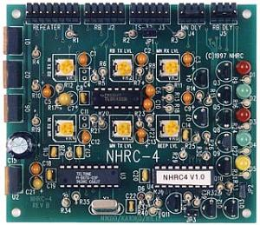
REPEATER CONTROLLER
EMRG bought the controller kits, Mike Kelly put them together. Now we need to get the controllers installed into metal boxes.

Slide 17
KENWOOD REMOTE CONTROL HEAD
Neutrik Connector
Kenwood TH742A TriBand Radio
Front view with the control head removed.
F18
.
.
.
.
.
.
.
.
.
.
.
.
White
Blue
Black
Red
.
.
.
3
5
1
7
12in Cable
Front View
Female
Terminals
Rear View
Looking At Terminal
Solder Cups
Cut the original 4 wire cable in half and solder the new cable to the wires on the connector
Connector is behind small plastic plate
Microphone Jack
Neutrik Connector
Kenwood TH742A TriBand Radio Control Head
Back view with the control head removed from the radio
Front View
Male Terminals
Rear View
Looking At Terminal
Solder Cups
.
.
.
.
.
.
.
.
.
.
.
.
.
.
3
48 inch cable
1
5
7
M18
.
Cut the original 4 wire cable in half and solder the new cable to the wires on the connector
The control head can be split into two parts. Do not split, keep the two parts together
.
.
.
.
.
.
3
1
5
7
Red
Black
Blue
White
Connector is behind small plastic plate

Slide 18
REPEATER CONTROLLER CABLES
EXISTING
REPEATER
DA15M
Round DIN Jack
Round DIN Plugs
DA15F
EXISTING
REPEATER
CONTROLLER
DA15M
Header Plug
Parts being ordered this week. Should arrive by mid next week.
All drawings and parts provided.
ANOTHER
REPEATER
CONTROLLER

Slide 19
DTMF KEYPAD
EMRG needs a source for DTMF keypads. These would be installed into all permanent radio locations, as well as into the Standard User Interfaces.
1
2
3
A
4
5
6
B
7
8
9
C
*
0
#
D
We need someone to look for options, try some things out and deliver a proposal with a source for keypads and any optional wiring required to make it work on a standard radio microphone input.

Slide 20
REPEATERS
Strategy
&
Current Activity
Notes:
EMRG can provide radio communications, but what does that mean?
Radios can be used to provide many different types of communications solutions.

Slide 21
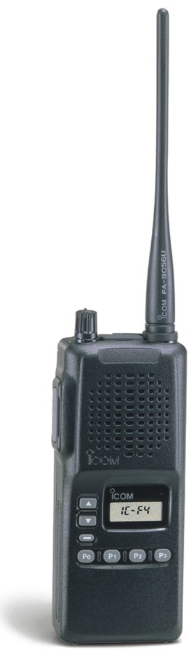



RADIO REPEATERS
Repeaters link users within an area who cannot otherwise communicate directly, radio to radio. The coverage area could be City wide, within a local community or between a few buildings.
Repeater
Telephone
Repeaters can be for voice or data communications and can interface to the telephone network and the Internet.
Internet
Notes:
Repeaters are an important part of EMRG communications. While Amateurs can provide some communications simplex, without repeaters, it is not as effective.
Repeaters can provide and interface to the telephone network or the Internet.

Slide 22
REPEATER STRATEGY
RELIABILITY
Repeaters must be dependable
  Withstand continuous use for days in an emergency
  Generator backup, with battery backup in case of generator failure
  Quality parts and workmanship
  Regular testing and maintenance
DIVERSITY
Some repeaters may not be functional in an emergency, so sufficient capacity is required to maintain effective coverage with some infrastructure loss.
  More than one site that can cover an area
  Sites independent of other radio systems
CHANNEL CAPACITY
User requirements and message volumes will vary, so more than one repeater and coverage area is required to effectively meet user needs.
  Multiple repeaters on different bands
  Channels should meet user through put volume and speed. Some groups may need a dedicated repeater so messages never wait.
Notes:
Creating an effective repeater network requires some work. Repeaters used for emergency communications must be reliable.

Slide 23
EMRG REPEATERS
VE3OCE VHF - 146.880 (-)
  CSQ In & 136 Hz Tone Out
  Wide Area VHF Repeater
  Provides coverage across most of the City Extended range with cross band repeaters
VE3OCE UHF - 443.800 (+)
  CSQ In & 136 Hz Tone Out
  Regional UHF Repeater
  Provides coverage in Central core of the City.
  Deployment This Fall
VE3OCE Packet - 145.030
  Provides good coverage in the Urban areas
  Partial coverage City wide.
VA3OFS VHF - 146.670 (-)
  136 Hz Tone In & Out + CSQ In
  South/Regional VHF Repeater
  Provides coverage in the Southern portion of the City and Central core.
VA3EMV/E VHF - 146.985 (-)
  100 Hz Tone In & Out
  East End Community VHF Repeater
  Provides local coverage from Blackburn Hamlet to the Eastern edge of Ottawa..
VA3EMV/W VHF - 146.985 (-)
  123 Hz Tone In & Out
  West End Community VHF Repeater
  UNDER CONSTRUCTION : Provides local coverage for most of West Carleton and Stittsville area.
VA3EMV/P VHF - 145.110 (-)
  136 Hz or CSQ In & 136.5 Hz Tone out
  Portable VHF Repeater
  Provides coverage in local area if required.

Slide 24
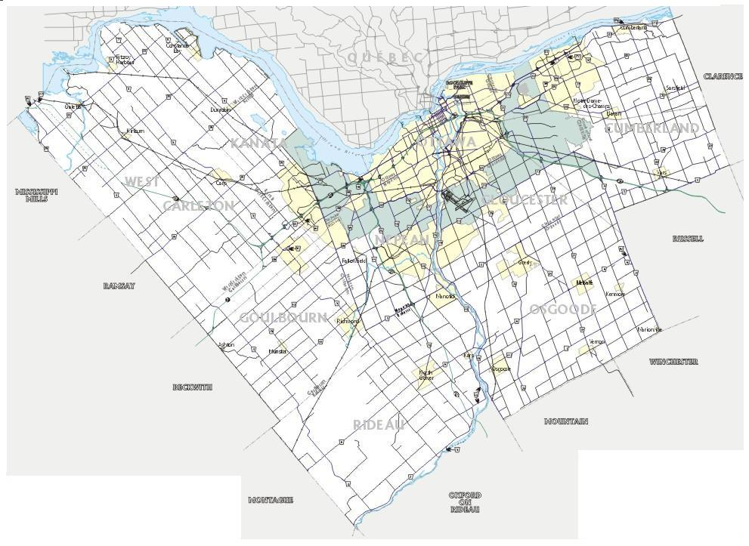
CITY WIDE
REPEATERS
VE2CRA is a club repeater that provides City wide coverage and is diverse in location and power grid.
Camp Fortune
VE2CRA
VHF
Randall
VE3OCE
VHF
Barrhaven
VA3OFS
VHF
Repeater signal decreases over distance and depending on terrain. At the edge of the coverage area, portable radios and mobile radios typically will not provide reliable operation.
There is no single repeater that can cover the full City of Ottawa. By using several repeaters, most areas are covered and are accessible from key locations.
Notes:
EMRG operates two wide area repeaters that can be accessed from the City core and from most other areas in the City. These repeaters are important for sharing information across the City, and provide diversity in case one should fail.
The Ottawa Amateur Radio Club (OARC) operates a repeater on Camp Fortune in Quebec, which is available for use in an emergency. This provides another radio channel and increased diversity.
It is possible that more than one wide area repeater could be required in an emergency.

Slide 25
COMMUNITY
REPEATERS
E
NW
W
S
SW
Boundary for area with repeater installed or under construction
Community Repeaters provide a voice channel serving a community of interest, for communications within the local area.
(The actual repeater coverage will overlap in some areas and fall short in others.)
Boundary for area proposed for a Community Repeater
Notes:
Not all information needs to be shared City wide. Community repeaters focus on specific areas of the City. This could be to share information between several local sites, or to support a local citizen patrol.
The objective is to implement a series of community repeaters to cover all areas of the City. The locations are based on regional areas and where there is a suitable antenna available.

Slide 26
SPECIALITY
REPEATERS
Baseline/Woodroffe
VE3xxx UHF With VHF Linking
Randall
VE3OCE
UHF
The Randall UHF repeater covers the Urban core and can be used to link dispatch centres, hospitals or other central locations.
(Proposal - Equipment acquisition underway)
Notes:
Repeaters can be used for special applications to provide a specific function.

Slide 27
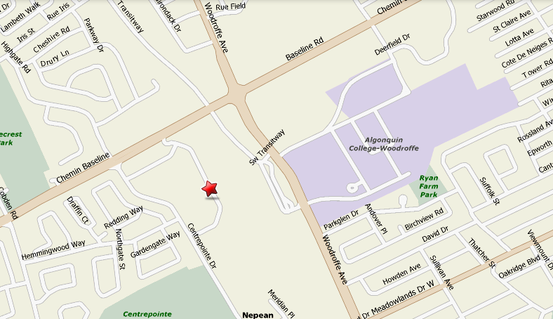
UHF Repeater
With VHF Link
Repeater
VHF
UHF
UHF
Repeater
VHF
Link Radio
Stn 21
100 Constellation Cr.
BF

Slide 28
BACKUP POWER
Generators
&
Batteries
They Are Not All Equal!

Slide 29
BACKUP POWER?
Many Amateur groups state that there repeater is ready and available for emergency use;
  It is in a site with Generator Backup
  It has battery backup
These statements can be misleading;
  Generators
  Is your repeater plugged into an AC outlet connected to the generator?
  How long does it take for the generator to start?
  What is the designed run time for the generator? (How much fuel is stored on site?) Environmental rules may limit on site storage.
  What happens if the generator does not start? - Generators do fail sometimes!
  Batteries
  What is the current draw of the repeater?
  What is the AH rating of the battery?
  How old is the battery?
  How is the battery charged?
    How fast can the battery recover once discharged?
    Is the battery overcharged, causing heating and water evaporation?

Slide 30

OUR BATTERIES

Slide 31
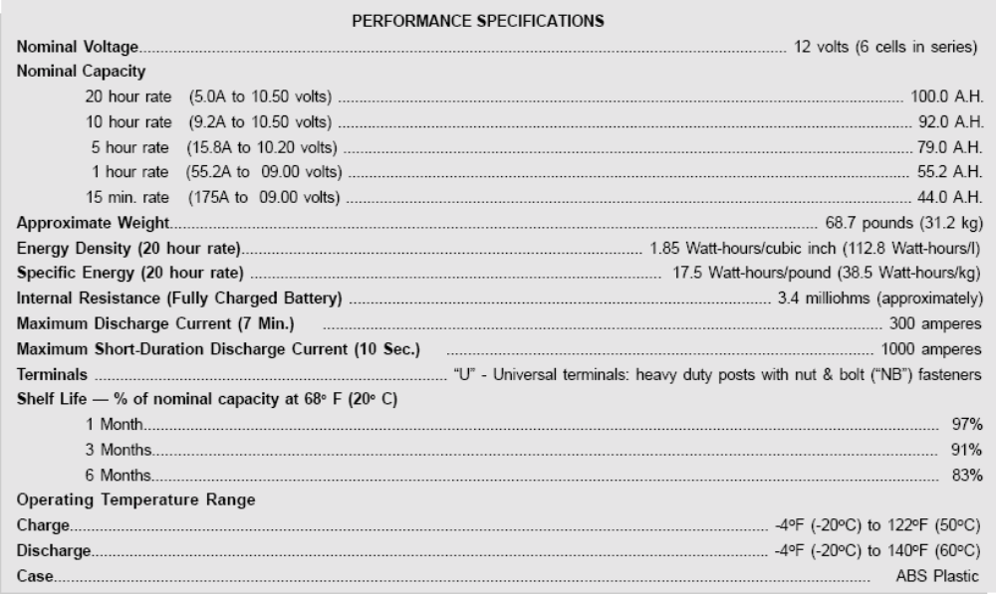
BATTERY SPECS

Slide 32
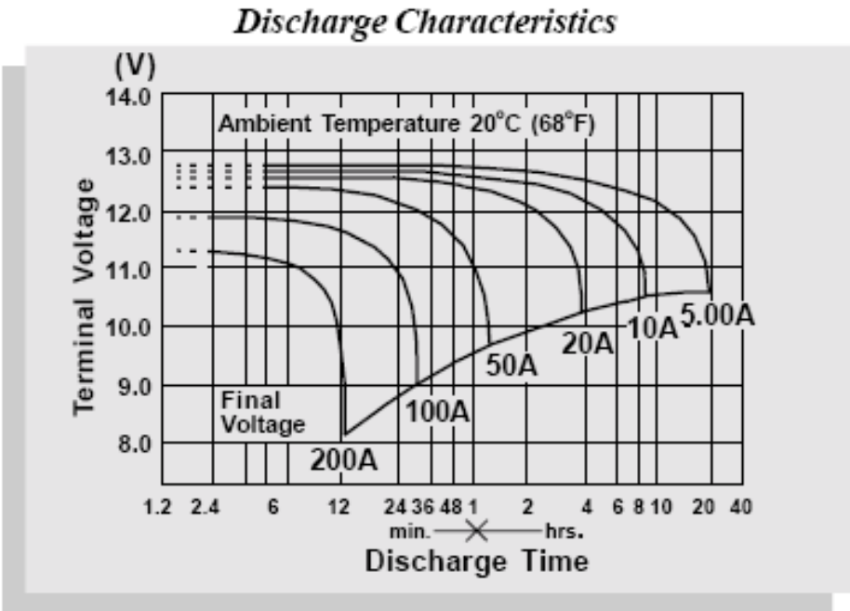
DISCHARGE
NOTE: Due to the self-discharge characteristics of this type of battery, it is imperative that they be charged after 6-9 months of storage, otherwise permanent loss of capacity might occur as a result of sulfation.

Slide 33
BATTERY CAPACITY
A 30 watt repeater has roughly the same power consumption as a mobile when transmitting (appx 10 Amps)
Starting with a 100AH battery
  Standard Discharge Time called C20 = 20 hours
  100 AH / 20H = 5 Amps
Battery 10 hour rating = 92AH = 9.2 Amps
  For easy math we will assume 90AH = 10 Amps for 9 hours
Battery never really at peak
  Assume battery at 80% due to age age and current charge state
  80% of 90 AH = 72AH
  72AH / 10A = 7.2 Hours
The single battery provides enough time to make a plan to get more batteries, abandon the repeater, or replace a generator that failed!

Slide 34
EMRG RESPONSE
City Of Ottawa Antenna Bylaw

Slide 35
EMRG RESPONSE
Our concern with the bylaw as written, specifically section 120, is that it would inhibit a viable Amateur radio community in Ottawa, by limiting the number and location of Amateur antennas. This will cause a drastic decline in the number of Amateur radio operators in Ottawa over the next few years.
The EMRG membership and skill sets are drawn from the local Amateur community, so if there are less Amateurs in Ottawa, there are less people to participate in EMRG. Installing antennas at home, and operating from home, is a critical component of the hobby. Therefore having a viable Amateur radio community in Ottawa requires the ability to install suitable antennas.

Slide 36
EMRG RESPONSE
Not all Amateur radio operators participate in Emergency Communications. There is a pool of about 10% of the Amateur community who share an interest in Amateur radio and public service. This pool of people changes over time as personal circumstances change. There are numerous people who develop new solutions, design and test antennas or otherwise develop infrastructure that is used or adapted by EMRG for use as part of our Emergency Communications solutions.

Slide 37
EMRG RESPONSE
We understand that with the ability to enjoy our hobby comes a responsibility to be good neighbours. The National Amateur radio organization, the Federal Government dept regulating Amateur radio, and most radio amateurs, agree that dialogue with neighbours is the first step in establishing any new significant radio antenna or supporting structure.
We also understand that guidelines and recommendations are required to help establish what our community feels is acceptable. For this reason, we support development of a set of guidelines for Amateur radio antennas and supporting structures. The City of Calgary Policy Guidelines provide an example of such a solution. (See Document Attached)

Slide 38
www.emrg.ca
The EMRG web site provides information related to Amateur radio emergency communications, specifically as it relates to the City of Ottawa.
Team Leader: Peter Gamble - VE3BQP
(VE3BQP@RAC.CA)

