Slide 1

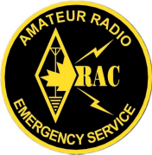
EMRG
General Meeting
EMERGENCY MEASURES RADIO GROUP
OTTAWA ARES
Two Names - One Group - One Purpose
General Meeting
Date Of Last Change: 2010-02-27
Version: 1.1

Slide 2
WELCOME
Coffee in the end room, help yourself
Washrooms in the hall, through the door
Fire exits at each end of the room. USE THE MAIN ENTRACE unless it is blocked
Sign In sheet by the door – Please sign in
Listen and Participate, respect those around you
Emergency Measures Radio Group (EMRG) - Ottawa ARES

Slide 3
Agenda
Introduction
New Team Leader
Haiti – What can we learn
Quiz
Break
Training – Message Handling
OEM – Jim Mongomery
ARES District & Mutual Aid
Pizza Lunch – Optional (Cost appx $8)
Emergency Measures Radio Group (EMRG) - Ottawa ARES

Slide 4
Canadian Ski Marathon
Harold Hamilton – VE3UNK
Emergency Measures Radio Group (EMRG) - Ottawa ARES

Slide 5
UPCOMING RADIO EVENTS
Collegeville
  Contact Mike Kelly VE3FFK
CN Cycle For CHEO (May 2 ?)
Emergency Measures Radio Group (EMRG) - Ottawa ARES

Slide 6
Team Leader Change
As most of you know, I am stepping down as Team Leader and Richard Hagemeyer is taking over.
The transition is nearly complete with this meeting.
The City is aware of the change (I will arrange a meeting to introduce Richard)
I started as Team Leader in late 1995, so this is my 15th year, a good time for change.
Emergency Measures Radio Group (EMRG) - Ottawa ARES

Slide 7
Team Leader Change
I will remain active in EMRG with 3 responsibilities;
  Partner Liaison – OEM, OFS
  Technical Coordinator – Repeaters, Projects, Comm Centre, work sessions
  Treasurer – Maintain financial records
My focus will be to complete the technical requirements for EMRG to support the operational requirements like exercises and practice drills.
Emergency Measures Radio Group (EMRG) - Ottawa ARES

Slide 8
Lots of things Accomplished & Lots of things still to do
I am pleased with my results as Team Leader, happy to step down and equally happy that Richard is taking over.
We accomplished a lot. Many of you have been helping me for the past 15 years.
EMRG recognizes it’s role and clients and those clients recognize and support EMRG.
EMRG has an extensive capability established, with many more opportunities still available.
Emergency Measures Radio Group (EMRG) - Ottawa ARES

Slide 9
Some History
Fall 1995 – My first meetings with RMOC
Sept 1996 – Signed agreement with RMOC
1998 Ice Storm
2001 – EMRG New Approach, Slow but Steady
2003 Power Outage
2005 was year 1 of the 5 year plan
2010 we are still working on year 1 of 5 yr plan
Emergency Measures Radio Group (EMRG) - Ottawa ARES

Slide 10
Contacting Richard
teamleader@emrg.ca
Emergency Measures Radio Group (EMRG) - Ottawa ARES

Slide 11
HAITI EARTHQUAKE
What can Amateur Radio Learn From This?
Emergency Measures Radio Group (EMRG) - Ottawa ARES

Slide 12
Initial Hours After
Not all communications infrastructure was destroyed, so messages were coming out of the country.
  There was no information collection and distribution organized at this time.
Military and Relief agencies responded
Satellite companies responded by delivering terminals to Haiti and adjusting signal strength and capacity to support Haiti.
Emergency Measures Radio Group (EMRG) - Ottawa ARES

Slide 13
Things We Learned
Amateur HF is not the solution of choice for long distance communications.
  Satellite systems are easier to use, and provide greater capacity and minimal propagation issues.
People want real time message delivery. “Internet Speed”.
  Amateur radio NTS is too slow to be useful.
Local communications is more difficult to resolve and where Amateur radio can provide real value.
Emergency Measures Radio Group (EMRG) - Ottawa ARES

Slide 14
Things We Learned
Partnerships must be created, nurtured and practiced before there is an emergency.
  Amateur radio serves relieve agencies, we do not operate in parallel.
Emergency communications is a team event. Amateurs must focus on service delivery to clients, which means being able to deliver consistent quality and capacity.
  Brining a handful of Amateurs together does not equal a successful communications capability.
  Infrastructure equipment must be owned by a group and deployed for the duration.
  Service capability can’t change when shifts change.
Emergency Measures Radio Group (EMRG) - Ottawa ARES

Slide 15
We already knew these things.
This is just another example to show EMRG is on the right path!
Emergency Measures Radio Group (EMRG) - Ottawa ARES

Slide 16
EMRG Quiz
How Are You Doing With Your EMRG Homework?
Emergency Measures Radio Group (EMRG) - Ottawa ARES

Slide 17
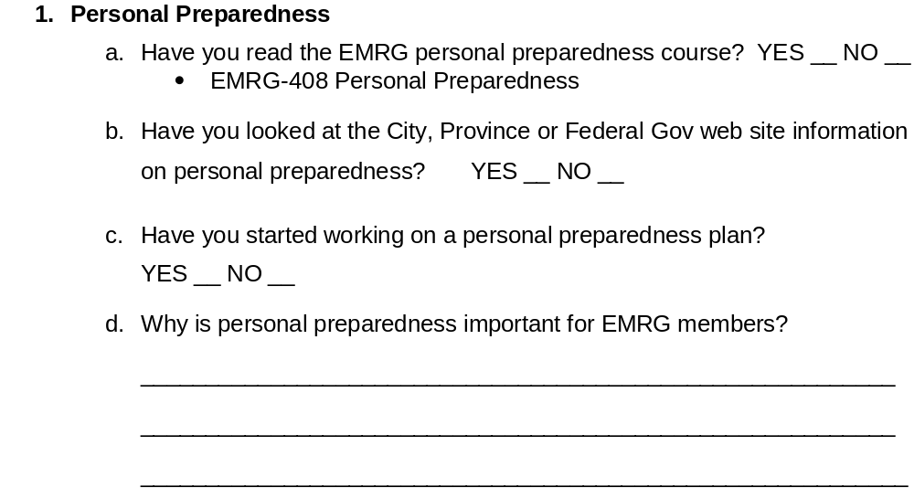
Quiz Questions
Emergency Measures Radio Group (EMRG) - Ottawa ARES

Slide 18
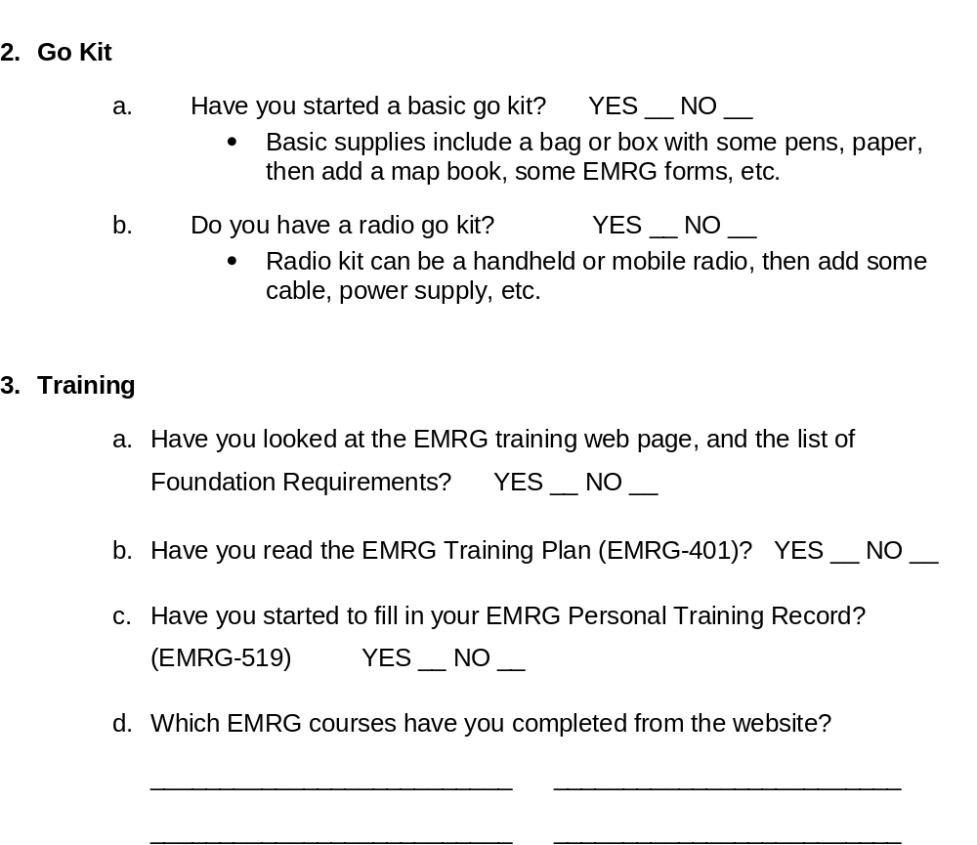
Emergency Measures Radio Group (EMRG) - Ottawa ARES

Slide 19
BREAK TIME
Emergency Measures Radio Group (EMRG) - Ottawa ARES

Slide 20
Message Handling
Check out EMRG-411 Message Handling on the web site, in the training section.
Emergency Measures Radio Group (EMRG) - Ottawa ARES

Slide 21
Office of Emergency Management (OEM)
Jim Montgomery – Manager of the Office of Emergency Management (OEM) for the City of Ottawa
Formerly with Ottawa Police
Emergency Measures Radio Group (EMRG) - Ottawa ARES

Slide 22
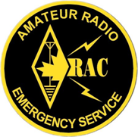
ARES
Amateur Radio Emergency Service
Ottawa is part of ARES (Amateur Radio Emergency Service) which is a program administered in Canada by RAC (Radio Amateurs of Canada)
The EMRG Team Leader is also the ARES EC (Emergency Coordinator) for Ottawa.
EMRG – Ottawa ARES
Two Names – One Group – One Purpose
Emergency Measures Radio Group (EMRG) - Ottawa ARES

Slide 23
ARES Structure
VP Field Services
Administration & Organization Support
SM (Section Manager) Ontario
SEC (Section Emergency Coordinator) Ontario
DEC (District Emergency Coordinator) Eastern Ontario
EC - Local ARES Group
Deployment & Decision Making
Emergency Measures Radio Group (EMRG) - Ottawa ARES

Slide 24
ARES CAPITAL & SEAWAY DISTRICTS
Providing Amateur Radio Emergency Communications across Eastern Ontario
ACTIVE GROUPS
Renfrew County West ARES
Ottawa ARES – City of Ottawa
Prescott Russell ARES – United Counties of Prescott Russell
Cornwall ARES – City of Cornwall
Lanark North Leeds ARES – North East Lanark, Lanark & North Leeds
Iroquois Amateur Radio Club - North & South Dundas
INACTIVE (Less Active) GROUPS
Renfrew County East ARES (New Group)
United Counties of Leeds & Grenville ARES
SD&G ARES – Stormont & Glengarry
Emergency Measures Radio Group (EMRG) - Ottawa ARES

Slide 25
Mutual Aid
Eastern Ontario has excellent ARES Mutual Aid program, which started 6 years ago.
Now have a shared callout list for the District, updated yearly.
District Mutual Aid Plan
Working on minimum go kit requirements.
Looking at common operations and training.
Emergency Measures Radio Group (EMRG) - Ottawa ARES

Slide 26
Former Radio Groups
The area now called the City of Ottawa, had two other radios groups in the 90s.
  Cumberland Emergency Radio Group (CERG)
  Osgoode-Rideau ARES
By the time amalgamation was completed in 2001, both groups had faded out of existence.
With amalgamation, there was one City, with one Amateur radio emergency communications group.
Emergency Measures Radio Group (EMRG) - Ottawa ARES

Slide 27

www.emrg.ca
The EMRG web site provides information related to Amateur radio emergency communications, specifically as it relates to the City of Ottawa.
  Project Information
  Newsletters
  Upcoming Events
  Documentation
  Links to related information
Information:
Emergency Measures Radio Group (EMRG) - Ottawa ARES

