Slide 1


EMRG-601
Red Cross (RC) Radio Cabinet
EMERGENCY MEASURES RADIO GROUP
OTTAWA ARES
Two Names - One Group - One Purpose
Revision Summary
2009-07-02 V1.3 Paste drawings from original MS Visio to Powerpoint
Purpose Of This Document
This document is a copy and paste of the drawings from the MS Visio version. The drawings are pasted in this document for those who do not have the Visio software.

Slide 2
QTY Description
1 4' x 8' x ½" - Plywood (Good Both Sides)
[For easier transport, the plywood can be cut into two pieces 4' x 5' & 4' x 3']
1 4' x 4' x 1/8" - Hardboard (Masonite)
1 2' x 4' x 1/8" - Whiteboard
1 2' x 4' x ¾" - Plywood (Good One Side)
2 Swivel Caster 2" to 3"
2 Fixed Caster 2" to 3"
1 5' Piano Hinge
1 2' Piano Hinge
1 Cabinet lock + 3 extra keys
1 Small can Stain & Varnish wood finish
Materials List
Emergency Measures Radio Group Ottawa ARES
Page: <number>

Slide 3
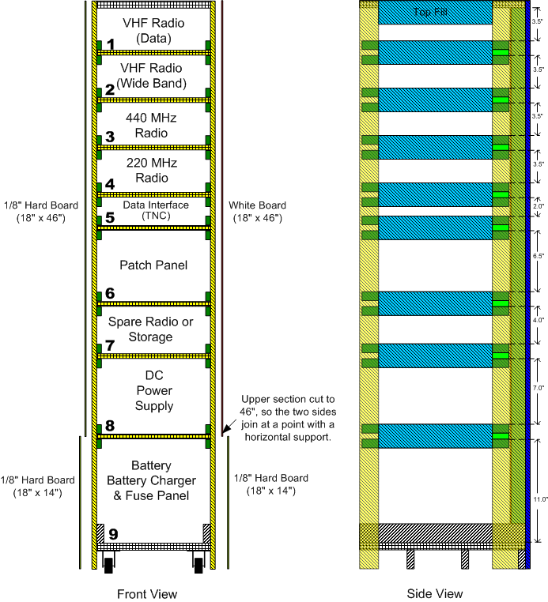
Glue side panels onto interior frame structure.
Front & Side Detail View
Emergency Measures Radio Group Ottawa ARES
Page: <number>

Slide 4
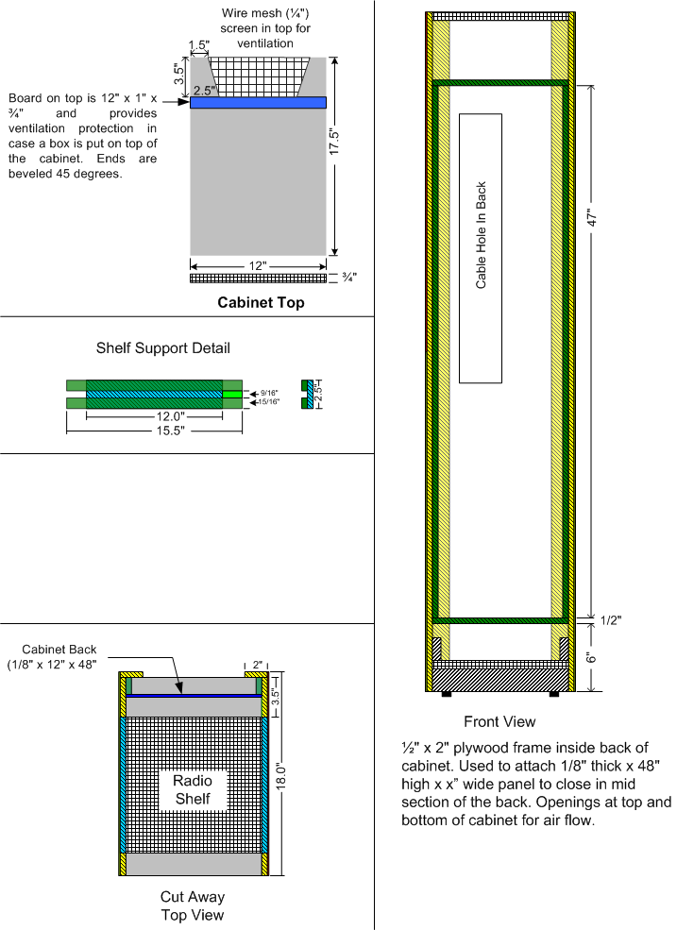
Components Detail View
Emergency Measures Radio Group Ottawa ARES
Page: <number>

Slide 5
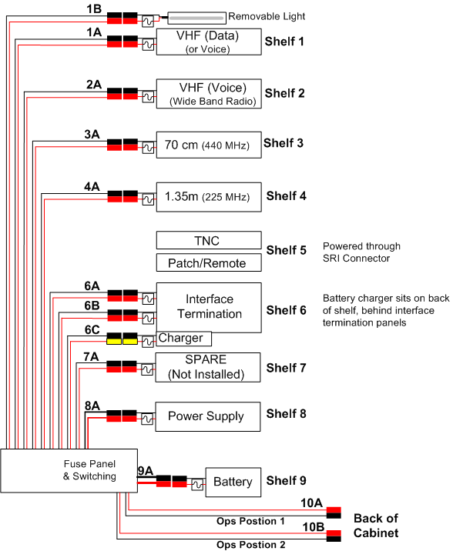
DC Wiring -LOADS
Emergency Measures Radio Group Ottawa ARES
Page: <number>

Slide 6
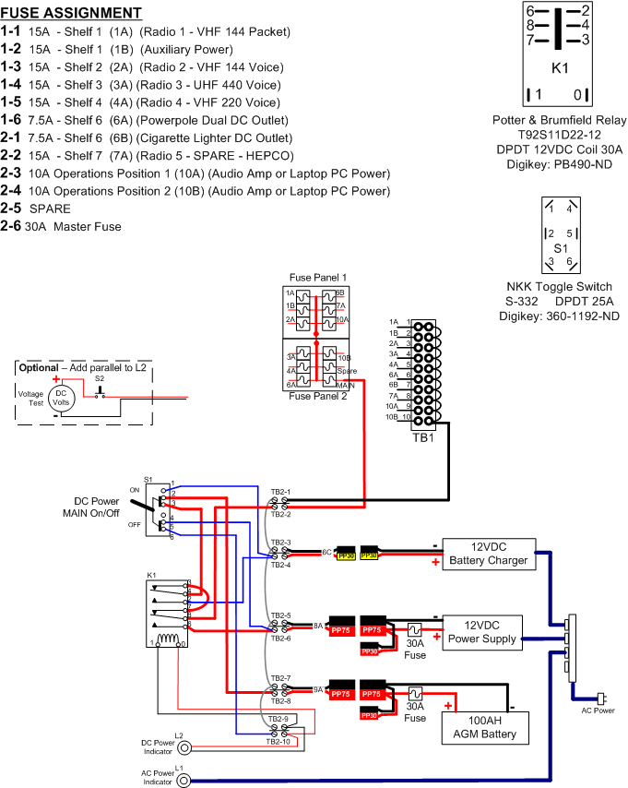
DC Wiring - Detailed Control Wiring
Emergency Measures Radio Group Ottawa ARES
Page: <number>

Slide 7
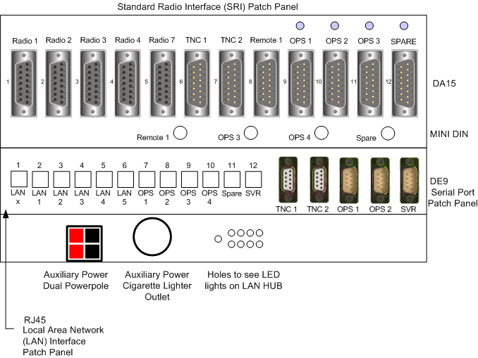
Patch Panel Layout
Emergency Measures Radio Group Ottawa ARES
Page: <number>

Slide 8
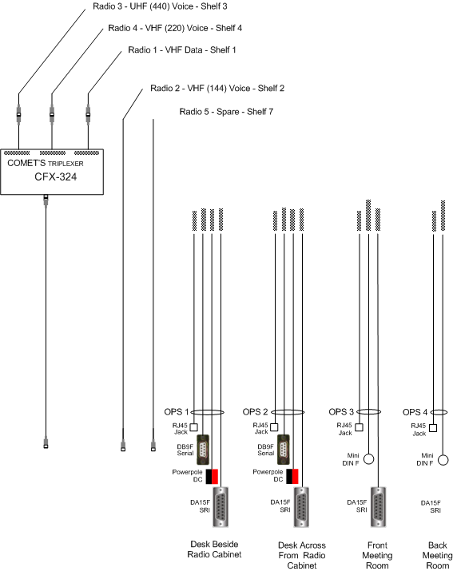
Back Cable Layout
Emergency Measures Radio Group Ottawa ARES
Page: <number>

Slide 9
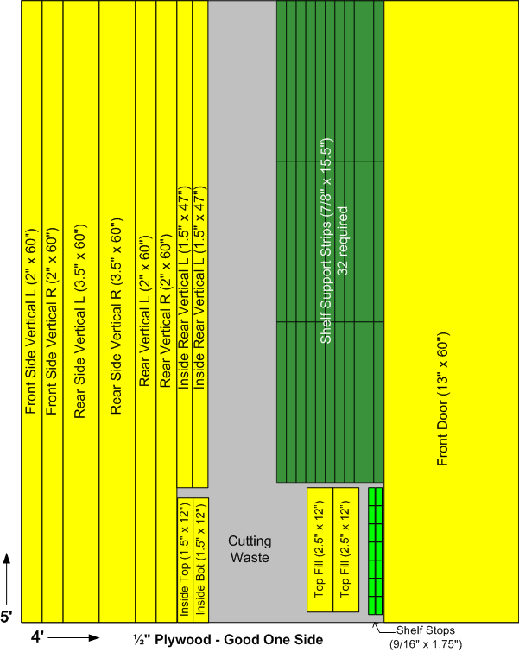
NOTE:
4' x 8' sheet of plywood can be cut at the store into two pieces; 4' x 5' + 4' x 3' for easier transport.
Cutting Layout -1
Emergency Measures Radio Group Ottawa ARES
Page: <number>

Slide 10
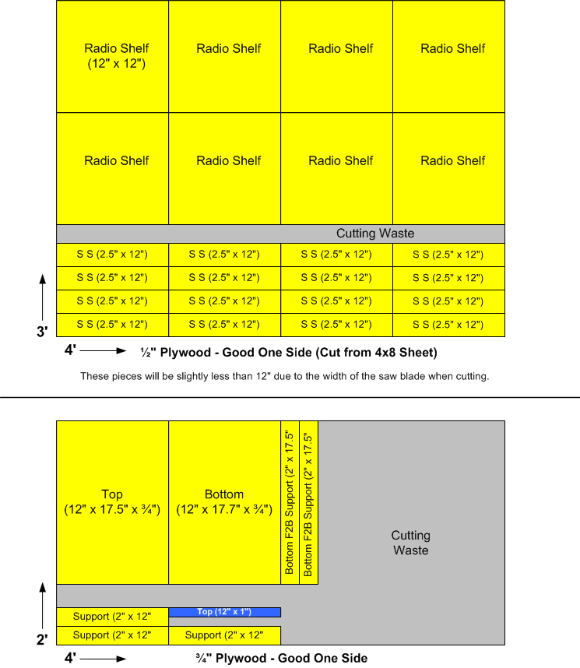
Cutting Layout -2
Emergency Measures Radio Group Ottawa ARES
Page: <number>

Slide 11
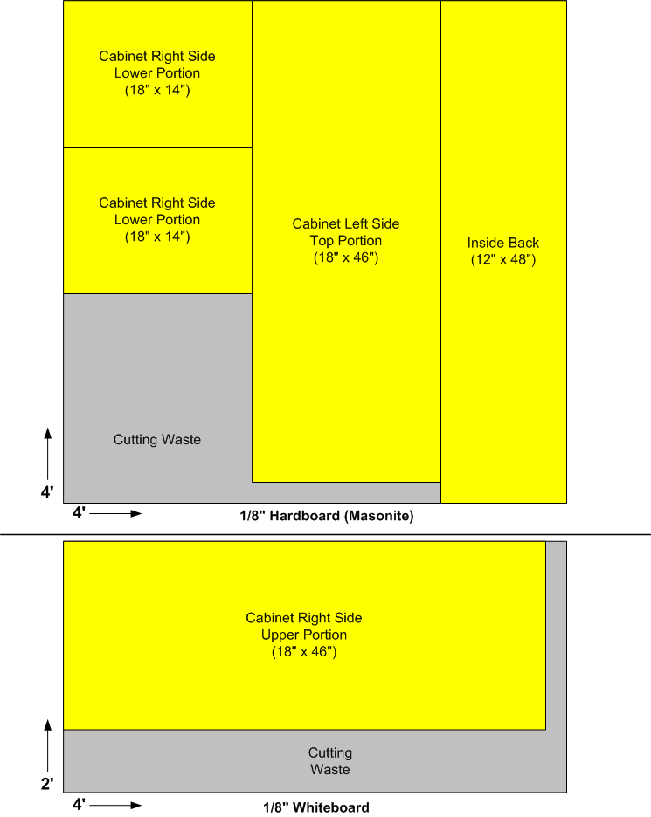
Cutting Layout -3
Emergency Measures Radio Group Ottawa ARES
Page: <number>

