Slide 1

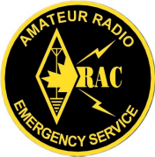
EMRG-613
Red Cross Radio System
EMERGENCY MEASURES RADIO GROUP
OTTAWA ARES
Two Names - One Group - One Purpose
Revision Summary
V1.0 xxxx-xx-xx Create initial document
V1.1 2009-07-02 Quick review and update, but still draft in progress
Purpose Of This Document
Defines the Red Cross radio requirements and the solution implemented by EMRG, including detailed drawings for all wiring.
Front Page
Emergency Measures Radio Group Ottawa ARES
Page: <number>

Slide 2
INTRODUCTION
Through numerous steps over several years, the Ottawa branch of the Red Cross moved into a new location in 2003, with no Amateur radios and no antennas. In 2004, with money from the Red Cross and the RAC ARES fund, as well as some donated supplies, EMRG set about designing and implementing a radio communications solution.
This document describes the EMRG Red Cross Radio Communications System Project. It starts with the requirements, describes the design and provides detailed drawings for all aspects of the project.
The purpose of this document is to provide a detailed reference for ongoing operation and maintenance of the Red Cross radio communications solution. It also provides a reference document for anyone who has a requirement and wants to learn from the work EMRG has done. The information in this document is available for any Amateur radio group or individual to use. EMRG would appreciate if you identify the original source of the information.
Emergency Measures Radio Group Ottawa ARES
Page: <number>

Slide 3
REQUIREMENTS
Must support Amateur radio on 144 MHz, 220 MHz and 440 MHz, and each radio must be able to support voice or data (1200 baud packet).
Must be easy to use, with any special functions such as battery backup being transparent to the user.
  The system can not be dependant on the operator to remember to do something, such as switch back to AC power. This should be done automatically.
The space available for installing the radios is 14 inches wide, situated between a filing cabinet and a desk.
  The radios will be installed in an office which is used for normal daily operations, but would be dedicated to radio communications in an emergency.
Heavy duty (100AH) battery backup capability is required.
  There was no generator in the building at the time.
Must allow use of the radio from 2 operator desk positions in the same office as the radio equipment, or from more distant locations such as one of two conference rooms on the main floor or even from the second floor.
Implement the EMRG Standard Radio Interface (SRI) for all radio, TNC and operator wiring.
  EMRG SRI (Standard Radio Interface) Specification: EMRG-210
  EMRG SUI (Standard User Interface) Specification: EMRG-214
Must be able to provide radio communications capability between the National Red Cross office on Metcalf Street and the Ottawa Branch, if required in an emergency (in addition to local branch requirements).
The radio system must be easily removable, so it could be disconnected and moved to a different location if the Red Cross building had to be abandoned in an emergency.
Emergency Measures Radio Group Ottawa ARES
Page: <number>

Slide 4
DESIGN CONSIDERATIONS
The Red Cross branch office is located on Catherine Street in Ottawa, in an area, backed by the Queensway (Just West of the Voyageur bus station). This is not a premium radio operating location, in terms of HF or long range VHF/UHF communications.
  There will not be any HF radio communications at the Ottawa branch office.
  For HF communications, an HF relay station in an EMRG members home would be used, with VHF or UHF radio for the local link from the Red Cross offices.
The Red Cross branch office is centrally located allowing low power operation into voice and data repeaters, as well as for simplex communications with key sites such as the EOC.
The design selected, has all the radios in narrow vertical cabinet, supported by a single DC power supply and battery backup. This design is possible for the following reasons;
  The decision was made not to operate HF from the Red Cross branch office
  The proximity to repeaters and simplex access, allows the use low power for voice and data.
  Not all radios will be transmitting all the time. The main nets will be VHF voice and data, while 220 MHz and 440 MHz will be used for command and control with much lower duty cycles.
Emergency Measures Radio Group Ottawa ARES
Page: <number>

Slide 5
SYSTEM OVERVIEW
To maximize flexibility, all equipment and operator positions wire to jacks on a patch panel inside the equipment cabinet. This allows any related equipment to be connected together.
All cables that exit the back of the radio cabinet, have a connectorized interface point on the back of the cabinet. This allows the cabinet to be disconnected from all exterior wiring, without impacting wiring inside the cabinet. This is important in the event that the cabinet must be re-located to another room, or in an emergency, the whole cabinet can be removed as a functional unit.
The system overview shows the cables for each type of equipment connectivity. Later drawings show the bundles of cables for each operator position and still other drawings show wiring details such as cable type and connector pinouts.
Emergency Measures Radio Group Ottawa ARES
Page: <number>

Slide 6
OPERATOR POSITIONS
OPS1 & OPS2: The radio equipment is housed in a cabinet, which is located in an office that has 2 built in desks. The office is normally used for other activities, but in an emergency, it becomes the radio room.
Radio Cabinet
Shelving
OPS 1
WINDOWS
Door
OPS 2
OPS3 : The main conference room on the front, West side of the building. This is where most activity would take place in a large event.
OPS4: The small meeting room near the back of the building. This might be used for special coordination, or to manage a smaller event.
OPS5: Optional location that can be wired at a later date, if required.
Emergency Measures Radio Group Ottawa ARES
Page: <number>

Slide 7
CONNECTIVTY OPTIONS
The objective is to support Voice or Data, from any Operator Position, using any radio. There are different connectivity options, depending on the distance from the radio cabinet to the operator position.
OPS1, OPS2 & OPS3 use the EMRG Standard Radio Interface (SRI), which extends the speaker and microphone connections of the radio, as well as providing the option for Auxiliary audio.
  Auxiliary audio allows a second audio source such as an FM radio or scanner to be monitored at the operator position.
ALL positions are wired with a computer network connection.
OPS1 & OPS2 have 12 VDC power as well as a computer serial connection. The DC power can be used to run a laptop, or charge a cell phone, while the computer serial connection allows a laptop at the operator position to connect to a TNC to provide data communications.
OPS3 & OPS4 are wired with the DC Remote interface connection. This provides radio connectivity over greater distance, but requires the use of a DC Remote interface at the radio end and a Desk Console at the operator position.
The use of the EMRG Standard Radio Interface allows other options such as adding a repeater controller to create a cross band repeater.
  This would allow a VHF and UHF radio to be linked, so a UHF portable radio can be used anywhere inside the Red Cross, to communicate with VHF repeaters.
Emergency Measures Radio Group Ottawa ARES
Page: <number>

Slide 8
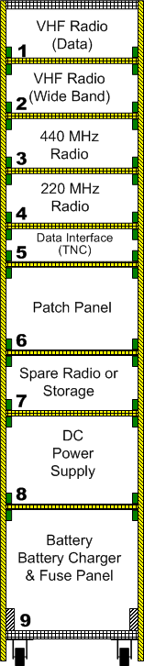
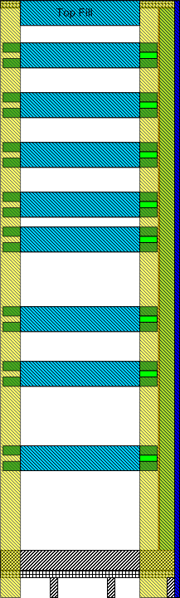
FRONT VIEW
SIDE VIEW
The Ottawa Red Cross radio cabinet is divided into 9 sections, starting with section 1 at the top and moving down to section 9 at the bottom. Each section from 1 to 8 has a 12” x 12” slide out shelf for installation of equipment. Section 9 is the base of the cabinet and does not slide.
There are 3 possible types of cable used for each section;
  Coax (RF) – PL259
  Red/Black zip cord (DC Power) –Powerpole
  15 pair cable (Standard Interface) –DA15
The cables are labelled based on section number, with a letter to designate cables that are used for a common purpose, such as connecting to a radio.
  Example, Section 1:
  The radio in section 1 is connected to three cables/ connectors, Coax/PL259, zip cord/Powerpole, 15 pair/DA15. Each cable is labelled 1A and they are differentiated by the type of connector. There is a second DC power cable to section 1, to power an emergency light. This is a zip cord/powerpole, labelled 1B.
Not all sections have the same wiring requirements, so the cables required varies by section.
Emergency Measures Radio Group Ottawa ARES
Page: <number>

Slide 9
Emergency Measures Radio Group Ottawa ARES
Page: <number>

Slide 10
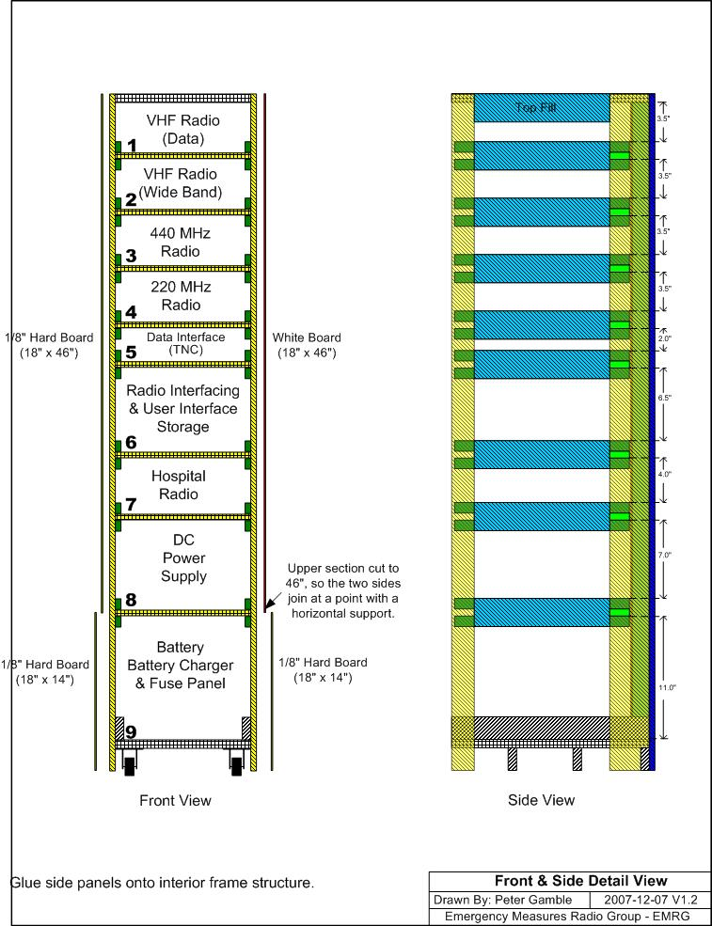
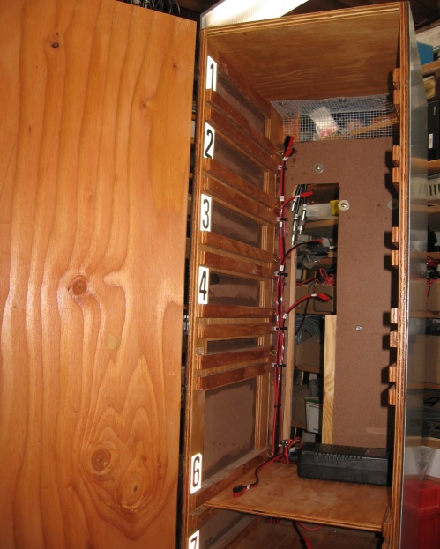
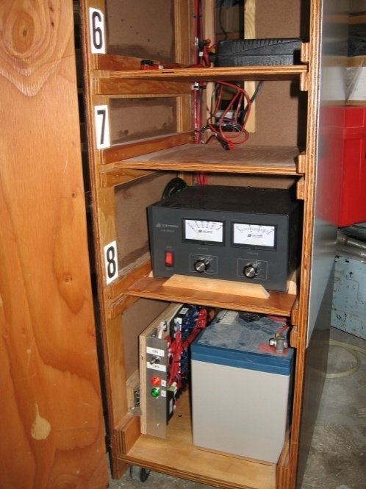
Upper part of cabinet, waiting for final cables and radio installation.
Lower part of cabinet showing completed DC installation of pull out fuse panel, batter, power supply and battery charger.
Emergency Measures Radio Group Ottawa ARES
Page: <number>

Slide 11




Standard Radio Interface (SRI)
Operator Position 1
Radio Room – Adjacent Desk
VHF (144)
Multi Channel Radio
F
M
F
M
OPS1
F
M
M
SUI
F
Operator Position 2
Radio Room –Opposite Corner Desk
VHF (144)
99 Channel Radio
OPS2
M
SUI
F
M
M
F
M
F
UHF (440)
Multi Channel Radio
F
M
OPS3
F
M
F
Operator Position 3
Conference Room - Front West Corner
VHF (220)
Multi Channel Radio
TNC 1
Back Of Radio Cabinet
Wall Mounted Connectors At Operator Positions
F
F
M
UHF (Low Band)
2 Channel Radio
F
M
TNC 2
The Standard Radio Interface (SRI) is an interface specification defined by EMRG, to allow radios and equipment to be easily connected together. For more information on the SRI, see the EMRG document EMRG-210 Standard Radio Interface.
SRI (DA15)
Patch Panel
M
DC Remote
M
SPARE
Radio 1
Radio 2
Radio 3
Radio 4
Radio 7
TNC 1
TNC 2
Remote 1
OPS 1
OPS 2
OPS 3
SPARE
SRI (DA15) Patch Panel Layout
1
2
3
4
5
6
7
8
9
10
11
12
Remote 1
OPS 3
OPS 4
OPS 5
Emergency Measures Radio Group Ottawa ARES
Page: <number>

Slide 12
Standard Radio Interface (SRI)
Description
There are two types of Standard Interface extension cables, one for connecting equipment to other equipment or a patch panel and one for connecting the user interface (radio operator connection) to a radio or patch panel.
The Standard Interface cables all go to section 6, where there will be a DA15 patch panel.
CABLE # | CABLE LENGTH | WIRING DIAGRAM | DESCRIPTION
1A | 50 in | EIE-15 | Radio 1 – 2 m data
2A | 46 in | EIE-15 | Radio 2 - 2 m Wideband Voice
3A | 40 in | EIE-15 | Radio 3 – 70 cm
4A | 36 in | EIE-15 | Radio 4 – 1.35 m
5A | 34 in | EIE-15 | TNC
5B | 34 in | EIE-15 | Phone patch or Desk Remote
7A | 30 in | EIE-15 | Radio 6 – Hospital UHF
21A | 36 in | UIE | Operator Position 1 Desk in Northeast corner
21B | 36 in | UIE | Operator Position 2 Desk in Northeast corner
22A | 30 ft | UIE | Operator Position 3 Desk in Southeast corner
ITEM | DESCRIPTION | QUANTITY
1 | DA15 M Connector & Hood | 10
2 | DA15 F Connector & Hood | 10
3 | 8 wire shielded cable (Belden 9538) | 30 ft
4 | 15 wire shielded cable (2464) | 30 ft
Emergency Measures Radio Group Ottawa ARES
Page: <number>

Slide 13
PIN | Signal | Description | Wire Colour
2 | Microphone Audio | Audio Input to TX -Before Pre-emphasis (Standard microphone connection on radio)
3 | PTT-Microphone | Microphone PTT
6 | SG & Ext Spk- | Signal Ground & External Speaker - | Shield
7 | COR/COS | Squelch Output
8 | +12 VDC | Auxiliary DC + (1.3 Amp for TNC or audio amp)
9 | DC GND | Auxiliary DC Ground
12 | Aux Input + | Auxiliary Audio Input (Second Radio)
13 | Int Spk + | Internal speaker
14 | Ext Spk + | External speaker
Standard Interface Wiring– Enhanced
Emergency Measures Radio Group Ottawa ARES
Page: <number>

Slide 14
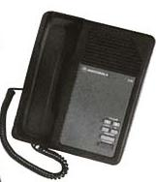
DC REMOTE INTERFACE
DC Remote
OPS3
M
SUI
M
F
Operator Position 3
Conference Room - Front West Corner
OPS4
Mini DIN
Patch Panel
SPARE
OPS5
Back Of Radio Cabinet
Operator Position 4
Conference Room – Back Hall
Wall Mounted Connectors At Operator Positions
The DC Remote is a commercial radio solution that uses telephone cables to connect a remote desk console (Telephone Desk Unit) to a remote interface unit that is connected to the radio. The telephone cable can be up to several kilometers long, allowing EMRG to provide an operator position in locations that are too far for the Standard Radio Interface.
The desk console can be used with the built in handset, as well as having a SRI wired by EMRG, to allow the multi-operator with headset configuration.
Emergency Measures Radio Group Ottawa ARES
Page: <number>

Slide 15
LOCAL AREA NETWORK
Wall Mounted Connectors At Operator Positions
OPS1
Operator Position 1
Radio Room – Adjacent Desk
OPS2
Operator Position 2
Radio Room –Opposite Corner Desk
OPS3
Operator Position 3
Conference Room - Front West Corner
OPS4
Operator Position 4
Conference Room – Back Hall
SPARE –OPS5
RJ45
Patch Panel
SERVER
Back Of Radio Cabinet
X
8
7
6
5
4
3
2
1
12 VDC 10 Mb HUB
1
2
3
4
5
6
7
8
9
10
11
12
LAN RJ45 Patch Panel Layout
LAN
LAN
LAN
LAN
LAN
LAN
OPS
OPS
OPS
OPS
OPS
SVR
x
1
2
3
4
5
1
2
3
4
5
Emergency Measures Radio Group Ottawa ARES
Page: <number>

Slide 16





COMPUTER SERIAL CABLES
TNC 1
F
M
F
OPS1
F
M
F
M
F
Operator Position 1
Radio Room – Adjacent Desk
M
M
TNC 2
F
OPS2
F
M
F
Operator Position 2
Radio Room –Opposite Corner Desk
M
M
Patch Panel
SERVER
Wall Mounted Connectors At Operator Positions
M
F
Back Of Radio Cabinet
Computer serial cables extend the serial interface from a laptop at the operator position, to the TNC for data communications. Serial cables support limited distance, so Operator position 2 may exceed the operating limits.
Server is an optional connection point for a future dedicated computer which would serve as a packet gateway and for information exchange between operator positions in the Red Cross building.
DE9 Serial Patch Panel Layout
TNC 1
TNC 2
OPS 1
OPS 2
SVR
Emergency Measures Radio Group Ottawa ARES
Page: <number>

Slide 17
Material List:
8 2 position jack boxes
6 Orange RJ 45 jacks (LAN)
2 Blue RJ 45 jacks (Microphone)
4 2.5 mm mono Jack
2 3.5 mm mono jack
4 Powerpole PP30
2 Speakers
2 PTT Foot switch with 3 meter cable and 2.5 mm mono plug
2 PTT Hand switch with 1 meter cable and 2.5 mm mono plug
2 Headsets (ex EOC units)
2 Headset-Speaker Control units
1 ½” Plywood for mounting ops 1 to 4 on back of cabinet
1 ¾” Plywood for mounting the speaker and volume control
7 DA15M connector & hood with mounting hardware
5 DA15F connector & hood
4 DB9M connector & hood
4 DB9F connector & hood
4 F 6 Position round “PC” type connector
{Title for drawing on this page}
Emergency Measures Radio Group Ottawa ARES
Page: <number>

Slide 18
Ops 4 Cabinet Interface: 1m (3’)
LAN RJ45
Punch Down
LAN Panel
OPS 4
LAN
Panel Mount
Mini DIN Jack
6 Pos F
Panel Mount
Mini DIN Jack 6 Pos F
OPS 4
DC Remote
Ops 3 Cabinet Interface: 1m (3’)
LAN RJ45
Punch Down
LAN Panel
OPS 3
LAN
Panel Mount
Mini DIN Jack
6 Pos F
OPS 4
Panel Mount
Mini DIN Jack 6 Pos F
OPS 3
DC Remote
Clips for cable ties
Panel Mount
SRI
DA15M
OPS 3
SRI-
SRI
DA15F
OPS 3
Ops 2 Cabinet Interface: 1m (3’)
SRI
Panel Mount
Serial
DB9M
OPS 2
PC Serial
Serial
DB9F
Serial
Punch Down
LAN Panel
OPS 2
LAN
LAN RJ45
OPS 2
Wired to fuse panel
OPS 2
2m (6’)
DC Power
SRI
Panel Mount
SRI
DA15M
OPS 2
SRI-
SRI
DA15F
Serial
Ops 1 Cabinet Interface: 1m (3’)
OPS 1
Panel Mount
Serial
DB9M
OPS 1
PC Serial
Serial
DB9F
LAN RJ45
SRI
Punch Down
LAN Panel
OPS 1
LAN
Wired to fuse panel
OPS 1
2m (6’)
DC Power
Panel Mount
SRI
DA15M
SRI-
SRI
DA15F
Jacks mounted on 11mm (½”) plywood
(Plywood 50 cm H x 15 cm W)
OPS 1
NOTES:
These cables run from inside the cabinet, to a panel on the back of the cabinet
Detailed cable wiring and part numbers are on the following pages.
Operations Positions 1 to 4 –Inside Cabinet to Rear Ops Position Interface
Emergency Measures Radio Group Ottawa ARES
Page: <number>

Slide 19
Ops 4 Operator Position: Length as required
RJ45 Jack
RJ45 Plug
OPS 4
LAN
Mini DIN Jack
6 Pos F
Mini DIN Plug
6 Pos M
OPS 4
DC Remote
Ops 3 Operator Position: Length as required
SRI
DA15M
OPS 3
SRI-
SRI
DA15F
RJ45 Jack
RJ45 Plug
OPS 3
LAN
Mini DIN Jack
6 Pos F
Mini DIN Plug
6 Pos M
OPS 3
DC Remote
Ops 2 Operator Position: xx cm
Serial
DB9M
OPS 2
Serial
DB9F
RJ45 Jack
RJ45 Plug
OPS 2
Powerpole PP30
Powerpole PP30
OPS 2
OPS 2
SRI
DA15M
OPS 2
SRI
DA15F
Ops 1 Operator Position: xx cm
Serial
DB9M
OPS 1
Serial
DB9F
RJ45 Jack
RJ45 Plug
OPS 1
Powerpole PP30
Powerpole PP30
OPS 1
OPS 1
SRI
DA15M
OPS 1
SRI
DA15F
OPS 1 to 4 –Cabinet to Operator Position Cables
Emergency Measures Radio Group Ottawa ARES
Page: <number>

Slide 20
EMRG Standard Interface Wiring Diagram
User Interface Extension Cable
The User Interface extension cable extends signals from a radio (SRI) to a user (radio operator) position. There are two types of SUI extensions; Regular and Long.
  Regular User Interface Extensions (R-UIE) support up to 30 m (100 ft) and are typically used to connect between fixed user positions and the radio equipment.
  Long User Interface Extensions (L-UIE) support up to 200 m (600 ft) [STILL TO BE VERIFIED] and would be used to extend the radio operators (users) over a long distance from the radio. The L-UIE supports only a minimum functionality.
Regular User Interface Extension (R-UIE)
SG Ground 1
SG Ground 1
Microphone Audio 2
PTT-Mic 3
+12 VDC 8
Aux GND 9
Aux Input + 12
External Speaker + 14
External Speaker - 15
1 SG Ground
2 Microphone Audio
3 PTT-Mic
8 +12 VDC
9 Aux GND
12 Aux Input +
14 External Speaker +
15 External Speaker -
EMRG Standard Interface Connector
EMRG Standard Interface Connector
R-UI E
8
1
R-UIE
1
8
15
9
9
15
DA15 Male Plug
Back View
(Looking At Solder Cups)
3.5
Optional Auxiliary Audio Input
3.5 mm (1/8 in)
Mono Audio Inline Jack
DA15 Female Plug
Back View
(Looking At Solder Cups)
Plugs into radio connector or patch panel
Plugs into User Interface
Emergency Measures Radio Group Ottawa ARES
Page: <number>

Slide 21

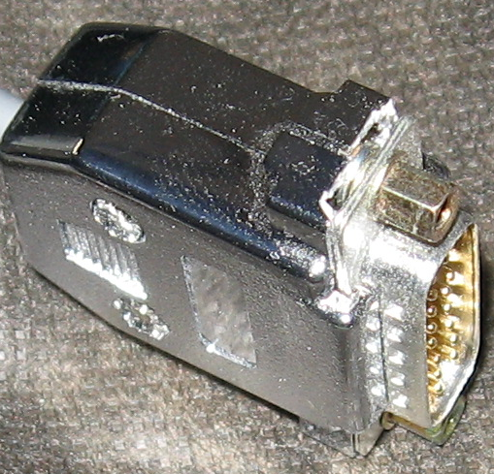

DA15 Male
Equipment such as Repeater Controllers, TNCs, Remote Interfaces, are wired with a DA15 Male connector. The Male connector is installed with internally threaded locking hardware, sometimes called a Jack Screw.
The plastic housing for the DA15 shell may need to have a bit nibbled away, so the shell will fit over the nut portion.
Install jack screws on the Male Plug, or use long nuts on the screw hardware, so the SRI plug from the radio can be secured to the TNC plug.
Emergency Measures Radio Group Ottawa ARES
Page: <number>

Slide 22
Local Area Network (LAN) WIRING
There are 2 standards for wiring LAN connections, T568A and T568B. The difference is the Orange and Green wires are reversed. EMRG uses the T568A wiring scheme to match the donated patch panels. Most new wiring hardware supports both T568A and T568B.
T568A
white/green
green
white/orange
blue
white/blue
orange
white/brown
brown
1 TX +
2 TX -
3 RX +
4
5
6 RX –
7
8
EMRG strategy is to create an independent overlay computer network to support data communications over radio. With this solution, EMRG retains control and is not impacted by failures of the partner network.
Emergency Measures Radio Group Ottawa ARES
Page: <number>

Slide 23
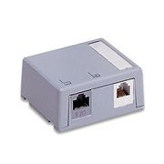
RJ45 Plug
RJ45 Jack
1 8
1
8
RJ45 Plug (T568A Wiring)
green
white/green
white/orange
white/blue
white/green
green
white/orange
blue
white/blue
orange
white/brown
brown
1
5 3 1 2
Leviton 41089-2WP, “Quickport” 2 port surface mount jack box.
4 6 8 7
Tab is on back side of plug
8
blue
orange
brown
white/brown
Leviton CAT 5e Jack
5G108-OR (Orange)
NOTES:
EMRG uses orange RJ45 jacks for LAN and blue for microphone connections.
The Leviton jack was selected simply because it is available from Home Depot, so it is easy to get.
There are 2 color charts on the sides of the Leviton Jack, one with an A (T568A) and one with a B (T568B), to indicate the 2 wiring standards.
Emergency Measures Radio Group Ottawa ARES
Page: <number>

Slide 24
LAN Patch Panel – Jack Assignment and Numbering
1
2
3
4
5
6
7
8
9
10
11
12
1
LAN
LAN
LAN
LAN
LAN
LAN
OPS
OPS
OPS
OPS
OPS
SVR
12
x
1
2
3
4
5
1
2
3
4
5
LAN Patch Panel – Front View
LAN X -Used to connect additional HUB/Switch
LAN 1 - HUB Port 1
LAN 2 - HUB Port 2
LAN 3 - HUB Port 3
LAN 4 - HUB Port 4
LAN 5 - HUB Port 5
OPS 1 - Operator Position 1
OPS 2 - Operator Position 2
OPS 3 - Operator Position 3
OPS 4 - Operator Position 4
OPS 5 - Spare (Operator Position 5)
SVR - Future dedicated computer server/gateway
orange
white/orange
Blue
white/blue
white/green
green
white/brown
brown
12
10
08
06
04
02
11
09
07
05
03
01
Jacks wired for T568A
LAN Patch Panel – Back View
Emergency Measures Radio Group Ottawa ARES
Page: <number>

Slide 25
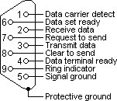
SERIAL COMPUTER INTERFACE WIRING
RS-232 Serial Cable (PC Serial)
Emergency Measures Radio Group Ottawa ARES
Page: <number>

Slide 26
USER INTERFACE WIRING
Emergency Measures Radio Group Ottawa ARES
Page: <number>

Slide 27
Mic Plug
Mic Jack
8
1
1
8
12 VDC
Microphone
8
RJ45 Plug Connections
1
2
3 - 12 VDC Output
4 - Ground
5 - Microphone
6 - PTT
7
8
Red
Black
Green
Blue
5 3 1 2
4 6 8 7
1
Ground
PTT
Tab is on back side of plug
HP 1 Output From Control Box
3.5 mm (1/8) Mono Plug
8
6
5
4
3
1 SG Ground
2 Microphone Audio
3 PTT-Mic
Not Wired
8 Aux Power +
9 Aux Power -
10 Receive Audio
14 External Speaker +
Aux Power (+12VDC)
Ground
TX Audio
PTT
Ext Speaker +
1
Shield
1m Shielded Cable
Belden 9536
EMRG Standard Interface Connector
PTT Foot Switch
2.5 mm (3/32) Mono Jack
PTT Hand Switch
2.5 mm (3/32) Mono Jack
8
1
Radio Speaker Output
3.5 mm (1/8) Mono Jack
15
9
Sleeve
Headphones (HP 1)
3.5 mm (1/8) Stereo Jack
Wired for universal Mono-Stereo
DA15 Male Plug
Back View
(Looking At Solder Cups)
Tip
3.5
Shield not connected
Emergency Measures Radio Group Ottawa ARES
Page: <number>

Slide 28
SRI
SRI
Serial
OPSX
Headphone Input (3.5 mm mono plug)
Mic (RJ45 – Vertex Wiring)
SRI Cable (DA15M)
Hand PTT (2.5mm mono)
Speaker Output (3.5 mm mono jack)
HP (3.5mm mono)
Foot PTT (2.5mm mono jack)
Headphone 1
Speaker
Headphone 2
Speaker
Headphone 1
Microphone
Hand PTT
PTT Foot Switch
DA15M SRI
Speaker
HP 1
HP 2
Speaker
PTT Hand Switch
OPS 1 & OPS 2 User Interface – Separate Speaker Option
Emergency Measures Radio Group Ottawa ARES
Page: <number>

Slide 29
SRI
SRI
Serial
OPSX
Headphone Input (3.5 mm mono plug)
Mic (RJ45 – Vertex Wiring)
SRI Cable (DA15M)
Hand PTT (2.5mm mono)
Speaker Output (3.5 mm mono jack)
HP (3.5mm mono)
Foot PTT (2.5mm mono jack)
Headphone 1
Speaker
Headphone 2
Speaker
Headphone 1
Microphone
Hand PTT
PTT Foot Switch
DA15M SRI
Speaker
HP 1
HP 2
Speaker
PTT Hand Switch
OPS 1 & OPS 2 User Interface - Integrated Speaker Option
Emergency Measures Radio Group Ottawa ARES
Page: <number>

Slide 30
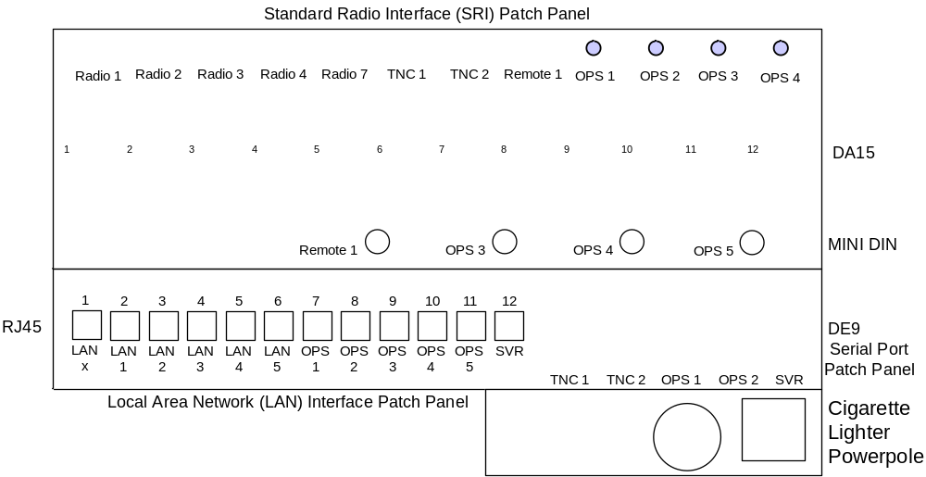
Emergency Measures Radio Group Ottawa ARES
Page: <number>

Slide 31
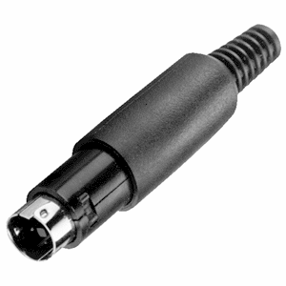
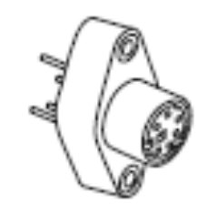
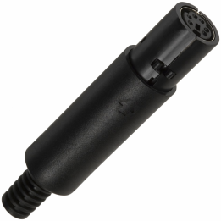
DC REMOTE WIRING
White/Blue
Blue
White/Orange
Orange
White/Green
Green
FEMALE CHASSIS MOUNT JACK
MALE INLINE PLUG
FEMALE INLINE PLUG
5
6
Solder Wires Here
3
4
1
2
Back View (Solder Cups)
6
5
4
3
2
1
6
5
4
2
1
3
Male Plug
Back View (Solder Cups)
Front View
NOTE:
Pins 1 & 2 are closer together than 5 & 6
The holes in the centre of the pins, for soldering, are very small. Using 26 gage solid copper ‘Telco’ cable, requires the wire to be soldered to the side of the pin. Use small pieces of heatshrint tubing on each pin, with a larger piece that covers all the pins and the end of the cable.
Emergency Measures Radio Group Ottawa ARES
Page: <number>

Slide 32
The coax cable runs from each radio position to the back of the cabinet, where they connect to the tri-plexer of directly to an antenna cable. Each Coax Cable has a PL-259 connector on both ends.
Radio 3 - UHF (440) Voice - Shelf 3
Radio 4 - VHF (220) Voice - Shelf 4
Radio 1 - VHF Data - Shelf 1
Radio 2 - VHF (144) Voice - Shelf 2
Radio 5 - Hospital Voice - Shelf 7
390-500 MHz
200-320 MHz
1.3-150 MHz
COMET’S
TRIPLEXER
CABLE LIST
CFX-324
CABLE # | CABLE LENGTH (IN) | DESCRIPTION
1A | 48 | Radio 1 – 2 m data
2A | 47 | Radio 2 - 2 m Wideband Voice
3A | 54 | Radio 3 – 70 cm
4A | 58 | Radio 4 – 1.35 m
7A | 76 | Radio 6 – Hospital UHF
10A | 40 | Tri-Plexer to antenna
MATERIAL LIST
ITEM | DESCRIPTION | QUANTITY
1 | UHF Connectors | 12
2 | UHF Connector Inserts For RG8X Coax | 12
3 | RG8X Coax | 27 ft
Comet Tri-band Antenna
Sinclair 210C (138-174 MHz)
Emergency Measures Radio Group Ottawa ARES
Page: <number>

Slide 33

DC POWER WIRING
The DC Power uses Red/Black zip cord, either #12 or #10. The equipment end of the cable has a powerpole connector and the other end is bare, so it can be wired up to a fuse panel in the bottom of the cabinet.
CABLE # | CABLE LENGTH (IN) | WIRE SIZE | DESCRIPTION
1A | 80 (#12) | #12 | Radio 1 – 2 m data
1B | 80 (#12) | #12 | 12 V Emergency Light
2A | 75 (#12) | #12 | Radio 2 - 2 m Wideband Voice
3A | 70 (#12) | #12 | Radio 3 – 70 cm
4A | 66 (#12) | #12 | Radio 4 – 1.35 m
6A | 54 (#12) | #12 | Interface Termination Panel
7A | 48 (#12) | #12 | Radio 6 – Hospital UHF
8A | 40 (#10) | #10 | DC Power Supply
9A | 24 (#10) | #10 | DC Fuse Panel & Battery
6
2
8
4
7
3
K1
1
0
Potter & Brumfield Relay
T92S11D22-12
DPDT 12VDC Coil 30A
Digikey: PB490-ND
ITEM | DESCRIPTION | QUANTITY
1 | #12 Red/Black DC zip cord | 40 ft
2 | #10 Red/Black DC zip cord | 64 in
3 | Powerpole connector (Red/Black) with 45 A terminals | 2
4 | Powerpole connector (Red/Black) with 30 A terminals | 7
1
4
2
5
S1
3
6
30A ATO Fuse
NKK Toggle Switch
S-332 DPDT 25A
Digikey: 360-1192-ND
PP75
PP30
Red Cross Power Supply
  Lugs are 1/4” hole, yellow insulator (12-10)
Emergency Measures Radio Group Ottawa ARES
Page: <number>

Slide 34
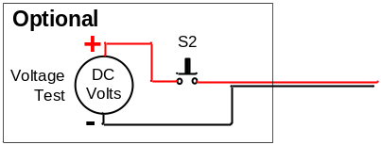
FUSE ASSIGNMENT
1-1 15A - Shelf 1 (1A) (Radio 1 - VHF 144 Packet)
1-2 15A - Shelf 1 (1B) (Auxiliary Power)
1-3 15A - Shelf 2 (2A) (Radio 2 - VHF 144 Voice)
1-4 15A - Shelf 3 (3A) (Radio 3 - UHF 440 Voice
1-5 15A - Shelf 4 (4A) (Radio 4 - VHF 220 Voice)
1-6 7.5A - Shelf 6 (6A) (Powerpole Dual Outlet + Cigarette Lighter )
2-1 7.5A - Shelf 6 (6B) (LAN HUB)
2-2 15A - Shelf 7 (7A) (Radio 5 - SPARE
2-3 10A - OPS 1 (10A) (Audio Amp or Laptop PC Power
2-4 10A - OPS 2 (10B) (Audio Amp or Laptop PC Power)
2-5
2-6 30A - Master Fuse
Fuse Panel 1
1A 1-1
1-4 6B
1B 1-2
1-5 7A
2A 1-3
1-6 10A
1A 1
1B 2
3A 2-1
2-4 10B
2A 3
4A 2-2
Spare
3A 4
6A 2-3
MAIN
4A 5
6A 6
Fuse Panel 2
6B 7
7A 8
10A 9
10B 10
TB1
S1
1
TB2
ON
2
TB2-1
DC Power
MAIN On/Off
3
4
TB2-2
OFF
5
6
-
TB2-3
PP30
PP30
12VDC
Battery Charger
K1
TB2-4
Yellow
Yellow
+
3
4
2
7
-
8
TB2-5
PP75
PP75
12VDC
Power Supply
6
+
1
0
TB2-6
PP30
30A
FUSE
TB2-7
PP75
PP75
TB2-8
PP30
30A
FUSE
+
-
AC Power
TB2-9
100AH
AGM Battery
DC Power
Indicator
L2
TB2-10
AC Power
Indicator
L1
Emergency Measures Radio Group Ottawa ARES
Page: <number>

Slide 35
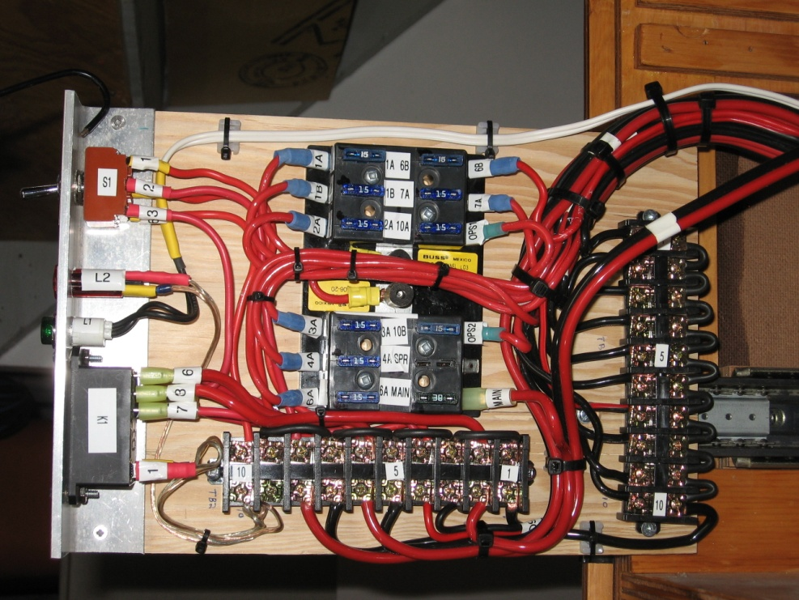
1B
Removable Light
1A
VHF (Data)
Shelf 1
2A
VHF (Voice)
Shelf 2
(Wide Band Radio)
3A
70 cm
(440 MHz)
Shelf 3
4A
1.35m
(225 MHz)
Shelf 4
TNC
Shelf 5
Patch/Remote
6A
6B
Interface
Shelf 6
Completed Fuse Panel
Termination
Battery charger sits on back of shelf, behind interface termination panels
6C
Charger
7A
SPAREl
Shelf 7
(Not Installed)
8A
Power Supply
Shelf 8
Fuse Panel
9A
& Switching
Battery
Shelf 9
10A
Ops Postion 1
10B
Back of
Cabinet
Ops Postion 2
Emergency Measures Radio Group Ottawa ARES
Page: <number>

Slide 36
Battery Wiring: 100 AH Battery for backup power.
NOTES:
Both PP30 and PP75 powerpole connectors installed. PP75 is preferred for use with #10 wire or above, plus it has a much stronger mating force. PP75 are used in all permanent installations, while PP30 are used for direct end user applications, such as a radio directly connected to the battery.
PP30 and PP75 Powerpole connectors are wired in series, so they share the same fuse. This prevents two loads being connected to a battery, where the sum of the loads exceeds the battery limit.
The wire from the battery to the PP75 connector is #10, while the wire from the PP75 connector to the PP30 connector is #12. Crimp and solder the wire at the PP75 terminal. Use the #8 wire terminal to install the two wires.
The black (negative) wire is about 30 cm long. The red (positive) wire is whatever length comes attached to the fuse.
Use ring lugs for connecting wire to the battery terminals. Yellow (12-10). Check bolt size for battery. Powersonic have 5/16 centre hole, while some others have 1/4” and still others have 3/8”.
Fuse should be 30A ATO type, preferably with the rubber cover on the fuse holder.
Battery 10.5” h x 12” d x 6.75” w (100AH)
30A ATO Fuse
PP75
PP30
Emergency Measures Radio Group Ottawa ARES
Page: <number>

Slide 37

 | Tri-band 146-220-446 MHz base antenna, 6.5-7.8-9.0 db, 10'4"
Comet CX333 Tri-band
(144/220/440)
20’ Mast
Custom UHF
Hospital Deskon
(Sitting On The Roof)
Sinclair 210-C
136-174 MHz
2 U-bolts anchored to wall (existing)
Wall over
stairwell
Ground
Treated board
to support mast
2 U-bolts anchored
to wall (existing)
Wall on roof,
enclosing stairwell
Measured Distances
14 ft - Main floor, front just inside the door, where cables go up to second floor (Above alarm control)
46 ft - Second floor, from front of building to where cable turns to go up to the roof
28 ft - Roof, from access hole to end of conduit by antennas
88 ft - Total [add appx 25 ft more to get to the room with the radios]
Total end to end length = 120 ft if buying cable to pull in
Emergency Measures Radio Group Ottawa ARES
Page: <number>

Slide 38
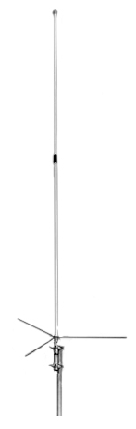
CX-333 Tri-Band 2m/220/440MHz Base Station Antenna
Specifications
Triband, simultaneous TX/RX possible
Gain:
  2M: 6.5dBi
  220: 7.8dBi
  440: 9.0dBi
Length: 10’4”
Weight:: 3lb 8ozs
Max Power: 120 watts
Max Wind Survival: 110MPH
Wind Load: 66 sq inches (.46sq ft)
Mast Required: 1.25-2.5 inches
Connector: Integral SO-239
Construction: Two piece white fiberglass radome, copper radiating element.
Mounting hardware included.
Emergency Measures Radio Group Ottawa ARES
Page: <number>

Slide 39
ROOF
CONDUIT FROM ROOF TO MAIN FLOOR
RADIO ROOM
Comet CX333 Tri-band
144/220/440 MHz
Amateur Band Only
U/M
RG8
N/M
N/M
N/M
N/M
U/M
U/M
U/M
1
1/2” Heliax
Ceiling Main Floor Front
Above Alarm Control
RG8
1
RG8X
PolyPhaser
IS-50NX-C1
Sinclair 210C
136-174 MHz
U/M)
U/M
U/M
U/M
U/M
U/M
RG8
2
RG8
2
RG8X
PolyPhaser
IS-50UX-C1
UHF 1/4 Wave
(413-418) MHz
U/M)
U/M
U/M
U/M
U/M
MiniU/M
RG58
3
RG8
3
RG58
PolyPhaser
IS-50UX-C1
Future Use
F/M
F/M
F/M
CATV
Ground
Block
4
RG6 [75 Ohm]
4
Coax Cable Connectors
F/M = Type F Male
N/M = Type N Male
U/M = UHF Male
MiniU/M = Mini UHF Male (Motorola )
#6 Standed Copper
(Green Cover)
Ground Rod
Two coax connectors with matching RF Adapter
Emergency Measures Radio Group Ottawa ARES
Page: <number>

