Slide 1

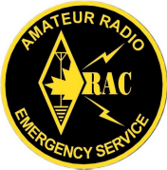
EMRG
OARC Meeting 2010-02-10
EMERGENCY MEASURES RADIO GROUP
OTTAWA ARES
Two Names - One Group - One Purpose
In Building Signal Reinforcement For Amateur Radio Emergency Communications
Date Of Last Change: 2010-01-30
Version: 1.0

Slide 2
Situation
In an emergency, EMRG Clients will be operating from multi-room, multi-level, commercial buildings.
  Examples: Nepean Sportsplex, City Hall
Most commercial buildings are constructed with concrete and steel, which acts as an RF shield.
Most amateur repeaters are designed for mobile or base station use, not portable or in building use.
  Using portables radios outside depends on location.
Emergency Measures Radio Group (EMRG) - Ottawa ARES

Slide 3
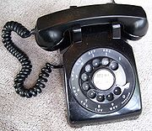
Communications Evolution
Black 500 set in the front hall has been replaced by phones in almost every room, cordless or mobile phones and more than 1 phone line.
Radio operator beside the main door with cable outside to an antenna has also been replaced.
  Clients want communications co-located so information can be exchanged quickly, in real time.
  May require 2 or more voice channels + data channel
Emergency Measures Radio Group (EMRG) - Ottawa ARES

Slide 4
Quality & Consistency
QUALITY: “Better Than Nothing” = Nothing
  If audio signal quality of 3 and above is considered usable, then providing an audio quality of 1 or 2 is viewed by clients as providing nothing.
CONSISTENCY: The capability and audio quality must be consistent through shift changes.
  Shift 1 has cross band repeater capability so they can communicate from anywhere inside the building.
  Shift 2 only has a portable radio so they can only communicate from outside the building.
Emergency Measures Radio Group (EMRG) - Ottawa ARES

Slide 5
Cross Band Repeaters
Cross band repeaters offer excellent solution to extend coverage to portable radios inside.
Can be deployed to any building
Problem with consistency if cross band mobile is in a vehicle and the person leaves.
Establishing multiple voice channels for a single building becomes more challenging due to the amount of equipment and interference between systems.
Emergency Measures Radio Group (EMRG) - Ottawa ARES

Slide 6
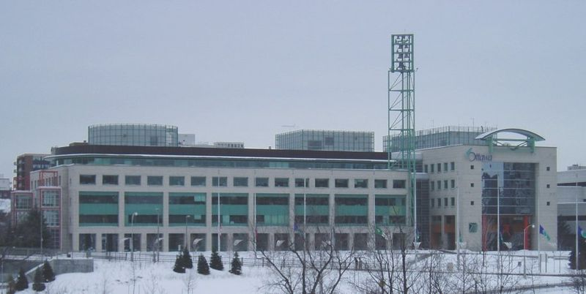
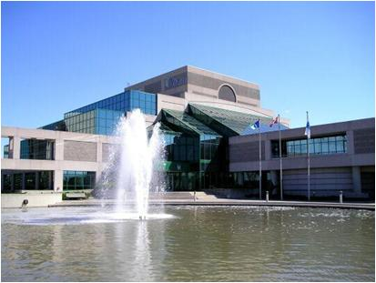
Two EMRG Challenges
Two Different Solutions
Ben Franklin Plan
Emergency Social Services (ESS) Command Centre
Ottawa City Hall
Emergency Operations Centre (EOC)
Emergency Measures Radio Group (EMRG) - Ottawa ARES

Slide 7


City Hall EOC
OBJECTIVE:
Provide up to 3 voice channels and 1 data channel in the EOC using portable radios, so the radio operator can sit at any position in the EOC.
Video Screens
Entrance
Supply Storage
RADIOS
Emergency
Exit
Emergency Measures Radio Group (EMRG) - Ottawa ARES

Slide 8
In Band & Cross Band Repeater Extension
VOICE CHANNELS
VHF – VHF
UHF – UHF
UHF – 220
Medium Power (10W)
Penthouse Roof
To/From EMRG Repeaters
Penthouse Mechanical Rooms
50 Ft Vertical separation from EOC to Roof = 50 db isolation + isolation from concrete and steel in 5 floors of building.
5
4
3
Floors…2
Antenna On EOC Ceiling
In-Band Repeater
Radio 1
Radio 2
Controller
Portable
Radio
Low Power
EOC - Main Floor City Hall
Not To Scale
Emergency Measures Radio Group (EMRG) - Ottawa ARES

Slide 9
Antenna on wire mesh for isolation from voice antenna
Tri-band (144/220/440)
PENTHOUSE ROOF
INSIDE EOC
CHANNEL 1
VHF
Controller
VHF
Multi Channel
Dual-band Mobile Antenna In Ceiling
Diplexer
CHANNEL 2
UHF
Controller
UHF
Multi Channel
Triplexer
Dual-band Mobile Antenna In Ceiling
CHANNEL 3
UHF
Controller
220 MHz
Multi Channel
WiFi 2.4 GHz on EOC Ceiling
DATA
W
1
2
3
4
Computer
TNC
VHF
Multi Channel
UPS
Emergency Measures Radio Group (EMRG) - Ottawa ARES

Slide 10
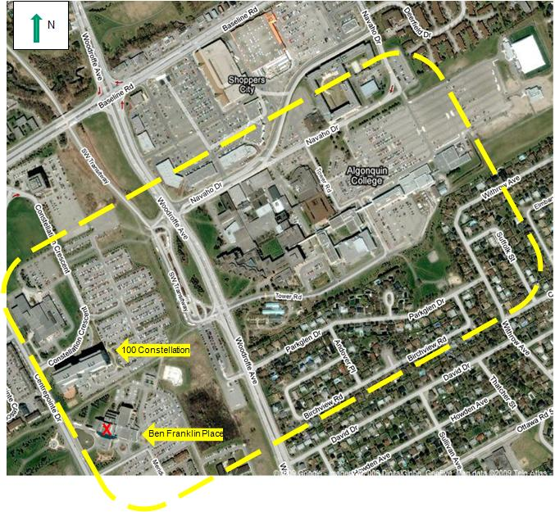
Ben Franklin Place (BFP)
OBJECTIVE:
Provide 3 voice channels and 1 data channel using portable radios in BFP, & 100 Constellation, and extending to Algonquin College.
Emergency Measures Radio Group (EMRG) - Ottawa ARES

Slide 11

Multi Coupling +
Cross Band Repeaters
Ben Franklin Place
Repeater Frequency
Repeater Frequency
UHF Repeater
UHF
NCS
Red Cross
City EOC.
Reception Centres would typically use VHF only
Cross Band
EMRG UHF Cross band Frequency #2
UHF
VHF
VHF Repeater
VHF
Repeater
Cross Band
EMRG UHF Cross band Frequency #3
Simplex
UHF
220
220
Repeater
VHF
VHF
UHF Packet Frequency
UHF
Digi
Simplex
UHF
Outpost & Winlink
Emergency Measures Radio Group (EMRG) - Ottawa ARES

Slide 12
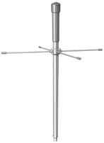
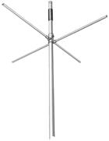

X
220 Omni
SG-301 (SRL-301)
UHF Omni
SG-201 (SRL 201)
VHF Omni
VHF
Multi-Channel
UHF
CH2
Controller
220
Controller
UHF
CH3
TNC
UHF
Data
CH1
Kenwood TKR-850
Emergency Measures Radio Group (EMRG) - Ottawa ARES

Slide 13
Remote Channel Control
Remote channel selection
Local Repeaters, or Simplex Frequency
Radio User inside the building
UHF Radio
DTMF
Control
VHF Radio
Controller
Diodes = 1N914 or equivalent
1
6
NHRC DTMF Remote
2
8
3
Motorola Radius GM300
16 pin accessory connector
4
9
5
6
7
8
No Connection
12
14
Emergency Measures Radio Group (EMRG) - Ottawa ARES

Slide 14
SUMMARY
The world’s expectation is crystal clear wireless communications any time, any place.
  In the Swiss Air crash, even amateurs would turn to cell phones if the radio link was noisy.
The technology exists and is available to Amateur radio to implement solutions that provide the coverage and audio quality required.
Emergency Measures Radio Group (EMRG) - Ottawa ARES

Slide 15

www.emrg.ca
The EMRG web site provides information related to Amateur radio emergency communications, specifically as it relates to the City of Ottawa.
  Project Information
  Newsletters
  Upcoming Events
  Documentation
  Links to related information
Information:
Emergency Measures Radio Group (EMRG) - Ottawa ARES

