Slide 1
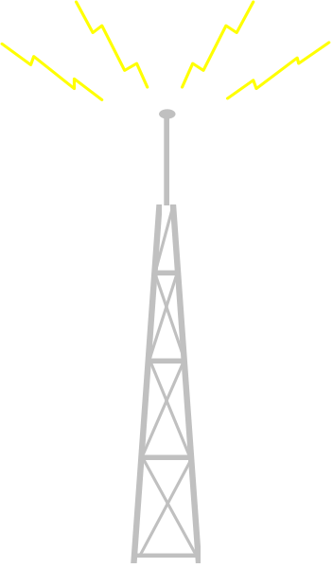
Emergency Measures Radio Group
Volunteer Disaster Communications

Slide 2
Guiding Principles
Major EMRG Role is communications support for humanitarian efforts in a disaster.
Disasters are unpredictable in duration, impact area and intensity. (Endurable infrastructure with a City wide reach)
Maximize ROI (Surplus Equipment + Minimal Investment $ + EMRG Skill & Effort = Solid communications infrastructure)

Slide 3
Communications
Objectives
Communications Across Ottawa
  Infrastructure to support “Anywhere to Anywhere” communications
Operations Control & Management Centres
  Permanent key radio operations locations
Speciality Radio Kits & Inventory
  Pre packaged equipment for common tasks (I.e. shelters)
Communications Outside Ottawa (Longer Term)
  Communicate across Ontario or Canada wide

Slide 4
Distributed Model
Distribution Of Resources
  Danger of all the eggs in one basket with central communications resources = single point of failure (e.g. New York City)
  Disaster response may require both local and City wide communications or communications with neighboring municipalities
  Physical impact of disaster &/or traffic congestion can make it difficult or impossible to reach a single central operating location.
Centralization reduces cost but increases risk
  Optimize cost and mitigate risk by using existing resources, but in a distributed and effective model
  Centralize where there is a clear benefit, but plan for alternate locations.

Slide 5
EMRG Value Add
EMRG members can and will provide effort to develop the equipment from the City into final solutions
Equipment that is not on a tower and that is not part of a shared system can be modified and repaired by qualified EMRG members.
EMRG can save money and gain even more useful parts, by helping with equipment removal. There are many small pieces, such as connectors, mobile antennas and cable, that would be thrown out by professionals. These components can easily be refurbished for use by EMRG volunteers.

Slide 6
City of Ottawa Benefits
Amateur radio communications support can be deployed quickly in a disaster because critical infrastructure is in place and EMRG members are trained on its operation
Amateur radio infrastructure, such as repeaters would be used on a daily basis by local amateurs, providing continuous testing and support for community events
If required in an emergency, EMRG communications infrastructure can be used in parallel to augment City communications
Communications infrastructure may be used in a disaster to support other organizations within the City of Ottawa

