Slide 1
EMRG
Emergency Measures Radio Group
and
Ottawa ARES
Two Names - One Group - One Purpose
EMRG has a long history in Ottawa since the 1950s.
EMRG became part of ARES in 1998.

Slide 2
OUR ROLE
Provide radio communications to support humanitarian response.
The three main humanitarian response groups in Ottawa;
  City of Ottawa Community Services, Ottawa Red Cross, Salvation Army
  These organizations do not have radio systems, lack capacity on their system or normally rely on phones and cell phones.
Secondary role to provide a back up radio communications solution, for the Hospitals existing emergency management radio system. (14 sites)
Not a back up for the City’s radio system used by Police, Fire and Paramedics.
  Will give everything available, if needed, but the capacity required is beyond the limits of what Amateur radio can supply.
  Can supply specialized solutions to assist and reduce non critical radio traffic.

Slide 3



PARTNERSHIPS
E M R G
Ottawa
ARES
Secondary
Partners
Primary
Partner
City of Ottawa
Emergency Measures Unit
H
Community
Services
Fire
Paramedics
Police
Individual Partnerships & Agreements
The City of Ottawa, Emergency Measures Unit is the primary partner. In the event that there are insufficient EMRG resources, EMU will assign priorities for EMRG.

Slide 4


SHELTER OPERATIONS
Shelter
Management
Community
Services
Communications
Food &
Clothing
Registration & Inquiry
First Aid
Shelters in Ottawa are managed by the City of Ottawa, Community Services.
The Ottawa Red Cross PDA (Personal Disaster Assistance) program is responsible for incidents with up to 50 people displaced, such as a large fire.

Slide 5
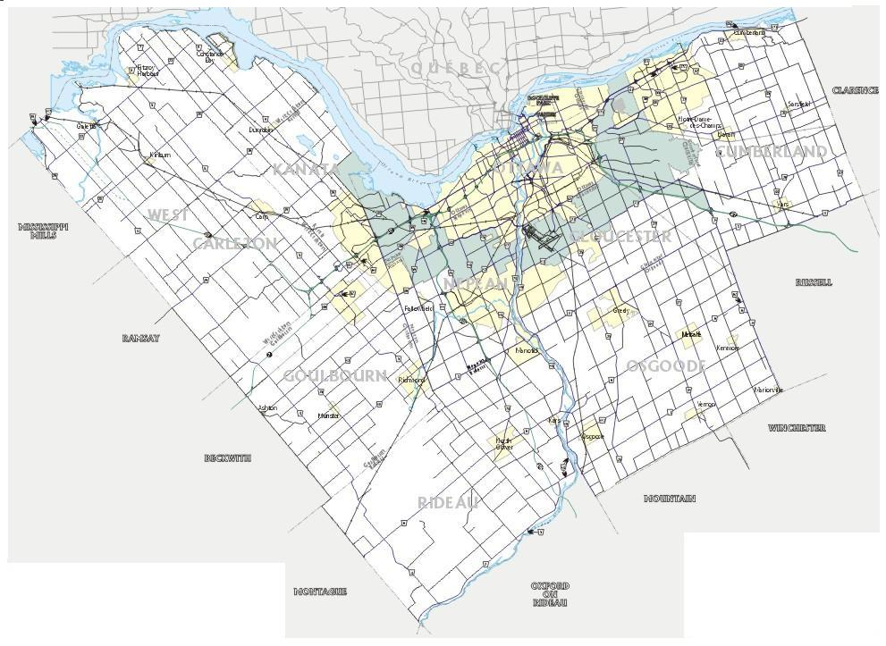
OUR AREA
Renfrew
Quebec
Prescott
Russell
A
C.
RC.
H
H
.R
B
A
OTTAWA
Lanark
North Leeds
Stormont
Dundas
Glengary
A
110 km by road
85 km by air
B
A
C
Leeds
Grenville
City
Hall
50 km by air
35 km by air
B
50 km by air
C

Slide 6
OUR PRIMARY FOCUS
PRIMARY FOCUS
Devastating Disaster
Earthquake
Emergency - Disaster
Tornado
People Impacted
“The
Big
One”
Red Cross PDA
Normal 1ST Response
Power Outage
ICE Storm
Fire
Accident
Theft
Plane Crash
Area Of
Impact
Amateur Radio
Involvement
NOT Involved
Best Effort With
What Is Left Available
Most Opportunities
To Help
&
Greatest Opportunity
To Preplan

Slide 7
OUR EMEGENCY
RESPONSE STRUCTURE
The EMRG Emergency Organization model is based on the Incident Management System (IMS)
Safety
Team Leader
(EMRG Incient Manager)
Liaison
Information
Planning
Resource/Logistics
Operations
Finance
Staging
Information & Finance are Partner Agency responsibilities
Net Control
(1 or more, people/nets)
EOC Radio Operator
Shelter Radio Operator
Relay Station Operator

Slide 8
EMERGENCY RESPONSE
DOCUMENT STRUCTURE
Notification Plan
EMRG-103
Used By Partner Agencies
To Contact Us
REFERENCE
Membership List
EMRG-104
Frequency List
EMRG-207
Activation Plan
EMRG-105
Technical Reference
EMRG-206
Ready To Deploy
SUB PLANS
Partner & Critical Site
Contacts EMRG-101
FORMS
Operations Plan
EMRG-106
Red Cross Plan
EMRG-107
Emergency Communications
Log EMRG-501
Equipment Operation
EMRG-205
Hospital Plan
EMRG-108
Resource Tracking
Log EMRG-501
Resource Assignment
Chart EMRG-501
Mutual Aid Plan
EMRG-109
Begin Shutdown
Termination Plan
EMRG-1xx
Dispatch Centre Personnel Report EMRG-501
Document
Management
Document List
EMRG-001
Debrief Plan
EMRG-1xx
Document Distribution
List EMRG-104
Most documents are posted on the web site: www.emrg.ca

Slide 9
SCHEDULES
General Meetings:
  3 to 4 per year
Management Team:
  Every third Wednesday of the month
Exercises:
  3 per year
Training:
  Varies

Slide 10

A MAJOR CHALLENGE
Window
Inside
Outside
Effective communications requires the radio operator to be co-located with the agency being supported!
  Installing antennas in 300 potential locations is not an option
  Smashing the window is not an option
  Running back and forth to a car is not an option

Slide 11


EMRG STANDARD RADIO INTERFACE
DA15 Female
DA15 Male
RADIO CONNECTOR
EQUIPMENT CONNECTOR
Microphone
& PTT
D
A
1
5
F
D
A
1
5
M
TNC
Basic Interface
Audio IN
DC Power
Antenna
Microphone
Amateur Radio
2A Aux Power
Speaker
Fuse Holder
Powerpole
DC Connectors
Fuse Holder

Slide 12
EMRG STANDARD USER INTERFACE
R OFF/AUX
EMRG
Radio
Interface
Unit
L OFF/AUX
Aux Volume
HP L&R
HP L&R
Aux Volume
POWER
PTT
Active
PTT
Active
HP Volume
HP Volume
Speaker
Volume
D
A
1
5
F
Mic / Headset
Headphone
PTT
PTT
Headphone
Mic / Headset
Antenna
Microphone
Amateur Radio
2A Aux Power
Speaker
Fuse Holder
Powerpole
DC Connectors
Fuse Holder

Slide 13
TECHNICAL PROJECTS
2005 is year 1 of the EMRG 5 year plan to improve communications capabilities.
The three key objectives for this year are;
  1: Maintain Existing Infrastructure
  2: Voice Communications City Wide
  3: Data Communications In Urban core

Slide 14
EQUIPMENT + PARTS
+ EFFORT
For several years, collecting surplus equipment such as radios, power supplies, phone patches and controllers.
The City of Ottawa has provided a one time grant of $5000 this year, plus $1000 each year after, to pay for material to make these projects happen
The projects also provide a unique opportunity for Ottawa amateurs to participate in various technical tasks, to learn new skills and help others learn
Some projects will focus on building basic skills, such as soldering, connector installation and parts recognition.

Slide 15
SUMMARY OF OBECTIVES
1) Maintain What We Have
  Exercise, Train & Test
2) Complete Operations Plans
  Document, Train & Test
3) Complete Year 1 Projects
  Document, Build, Train & Test
    Improve “In Building” Systems
    City wide voice coverage
    Urban Core Data communications:
4) Improve Quantity & Capability of Membership
  Motivate existing members and find ways to attract new members
    Look at making amateurs out of community minded people

Slide 16
EQUIPMENT AVAILABLE
Portable VHF Repeater - 145.110 - MHz
  Transceiver, duplexer, controller, power supply and antenna
Mobile Radios
  Appx 12 - 8 to 16 channel commercial VHF radios
12 VDC Power Supplies
  Appx 12 power supplies with various ratings
Coax Cable
  50 & 100 foot lengths of RG8
Cross Band Repeaters
  3 systems made from two commercial radios with controller
Equipment is being wired and packaged as part of the 2005 project plan.

Slide 17
www.emrg.ca
PURPOSE:
  Provide information related to Amateur radio emergency communications, specifically as it relates to the City of Ottawa.
OBJECTIVE:
  Only post information that has been verified.
SHARING:
  Information on the web site is there to be shared. If you use large portions of it, please note the source.

Slide 18
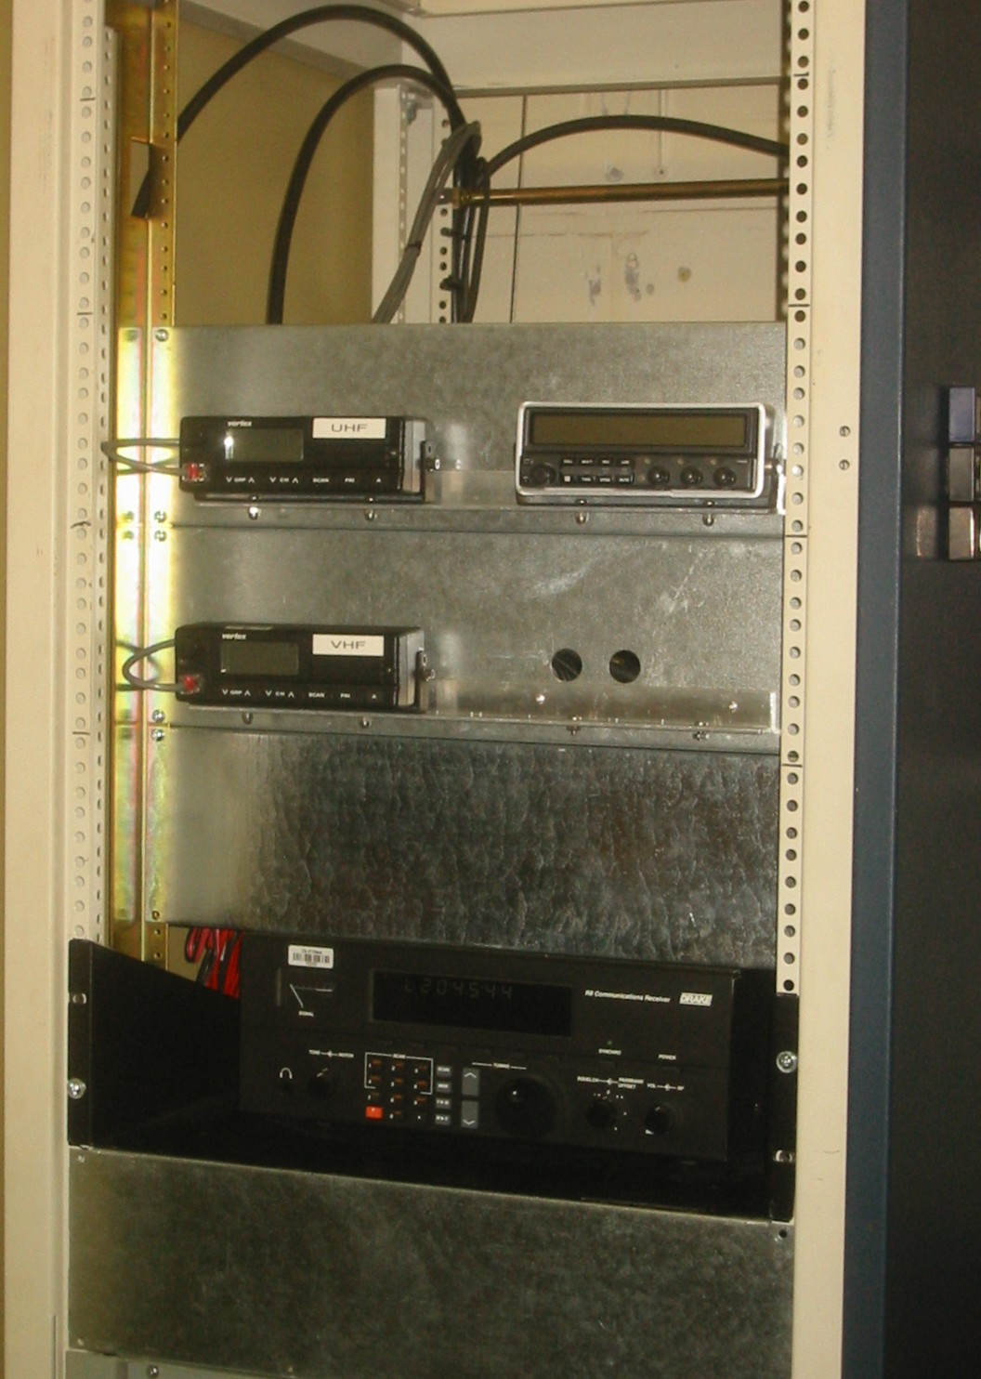
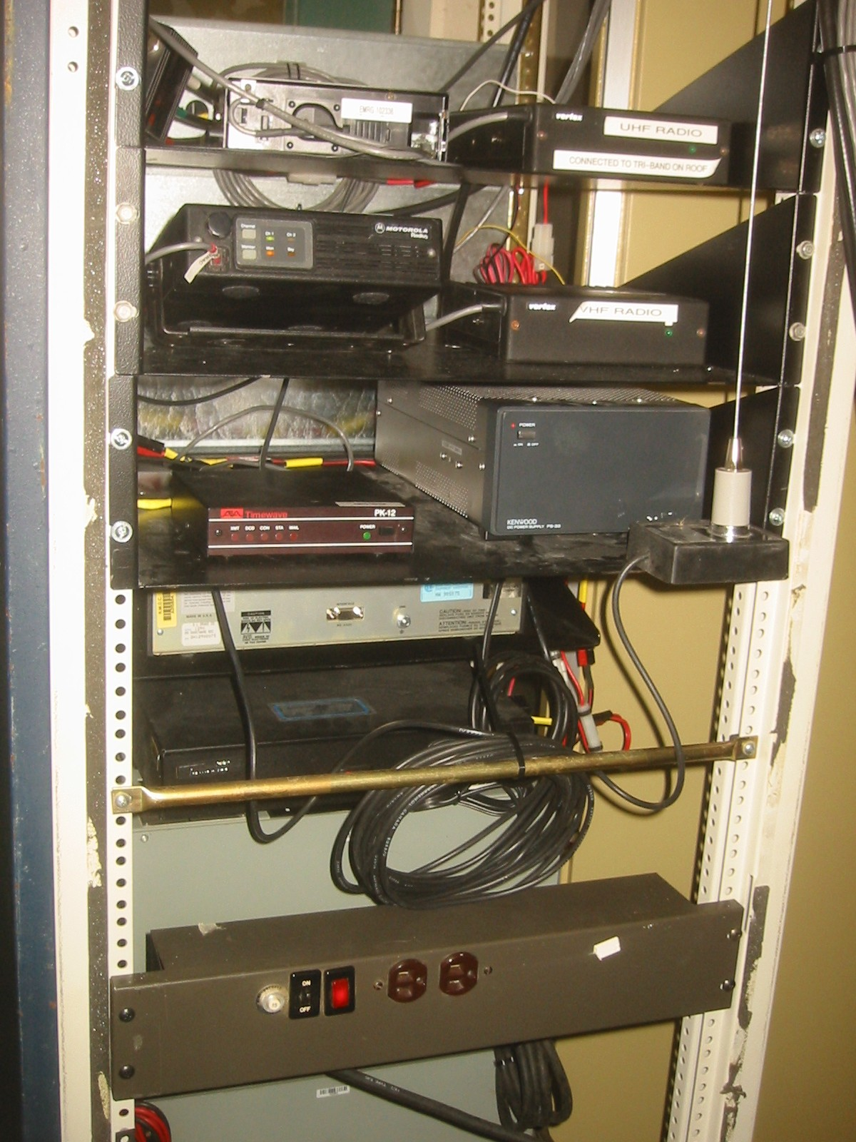
Front View: Radio Cabinet
Back View: Radio Cabinet
EMRG Communications Room at Ottawa Fire Dispatch Centre

Slide 19
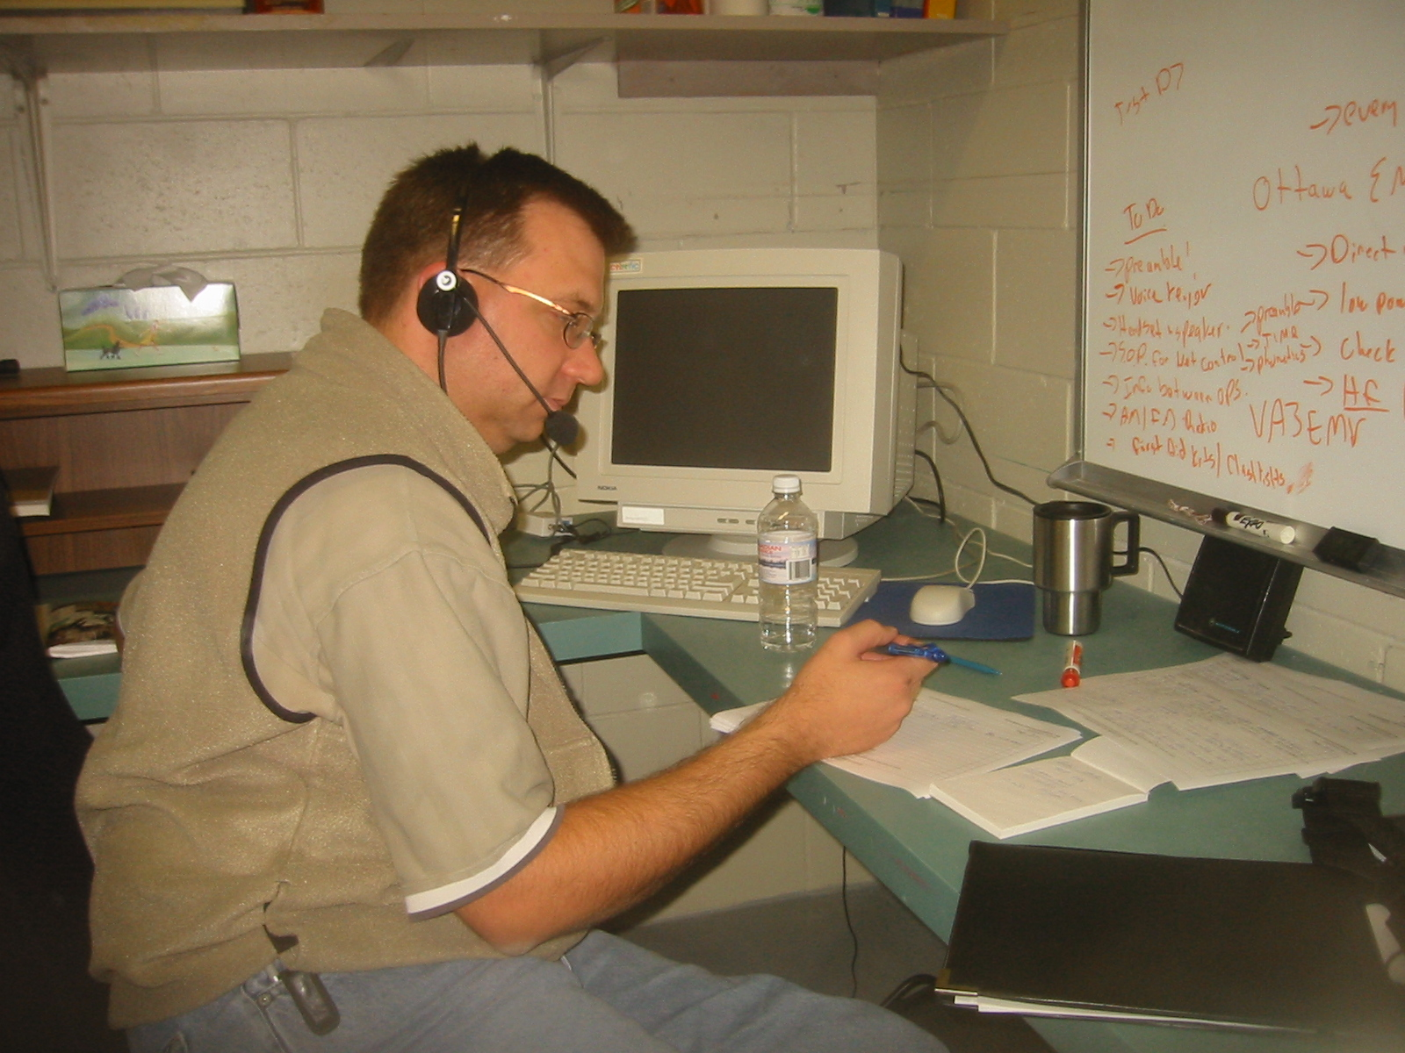
SET 2004: Net Control Station - VA3NFA

