Slide 1

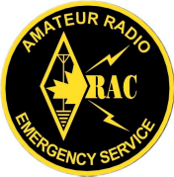
EMRG-411
Training Course
EMERGENCY MEASURES RADIO GROUP
OTTAWA ARES
Two Names - One Group - One Purpose
Message Handling
Date Of Last Change: 2009-11-13
Version: 0.1

Slide 2
Course Introduction
Course Number: EMRG-401
Course Name: Message Handling
Instructor Led: Optional
Prerequisites:
  EMRG-401 Introduction to EMRG
What You Should Learn From This Course:
  From this course you should understand the difference between tactical and formal messages, how to send and receive tactical messages and how to treat the privacy of information you may hear or read.
Recommended Reading:
  EMRG-407 Logging
  EMRG-520 Basic Message Form
  EMRG-521 ICS213 General Message Form
  EMRG-522 Formal Message Form (Includes instructions for filling in the form)
Emergency Measures Radio Group (EMRG) - Ottawa ARES

Slide 3
Information Management
Message handling is about more than just sending and receiving messages. It is also about;
  knowing what to say and what not to say
  who to share information with and who not to
  how to convey information effectively & efficiently
  logging the information exchange
Emergency Measures Radio Group (EMRG) - Ottawa ARES

Slide 4
Dealing With The Media
The media is looking for a story and to share information with the public. They are trying to do their job.
EMRG does not provide information to the media. If asked for information, direct the media to the City of Ottawa or Red Cross information person, or to the person you report to in your location.
EMRG members can talk about EMRG, so a good knowledge of EMRG-401 Introduction to EMRG is helpful.
Emergency Measures Radio Group (EMRG) - Ottawa ARES

Slide 5
Requests For 911
If you are requested to contact 911, ask if there is a working telephone first. If there is a phone, it is best to talk directly to the dispatcher.
If there is no working telephone, call the EMRG net controller and ask them to call 911. They will phone 911 and relay the information.
Do not route requests for 911 through the EOC, unless the Net Controller decides there are no other options (no working phone at NCS)
Emergency Measures Radio Group (EMRG) - Ottawa ARES

Slide 6
Tactical Vs Formal Messages
Formal messages are not needed for most “Real-Time” Tactical Communications:
  Direct conversations between third parties
  Life-safety matters when timing is critical
  Most routine task assignments
  Most routine task completions
  Most routine resource coordination
  Record routine exchanges as line-items in your Communications Log
    EMRG-501 ICS 309 Communications Log
Emergency Measures Radio Group (EMRG) - Ottawa ARES

Slide 7
Use Of Message Forms
In an emergency or disaster, most of the support roles will be performed by staff who normally have other jobs, or by volunteers such as Red Cross or Salvation Army.
Most information is local and will be handled on FM voice or data
Messages will be tactical, usually short, making requests for more water, blankets, an ambulance or replying to a request for information.
  Clients will not be familiar with formal message forms such as the ARRL/RAC Radiogram. Formal message forms will only be used when interfacing with the National Traffic System (NTS).
The City of Ottawa does not use an official message form.
Emergency Measures Radio Group (EMRG) - Ottawa ARES

Slide 8
Message Form Options
Messages do need to be written down, in order to hand them off to the recipient.
Using full sheets of paper is wasteful and ripping paper into pieces means a message may get treated as scrap.
EMRG has 4 options for writing messages;
EMRG-520 Basic Message Form
EMRG-521 ICS 213 General Message Form
EMRG-522 Formal Message From
Standard Office Memo Forms
Emergency Measures Radio Group (EMRG) - Ottawa ARES

Slide 9
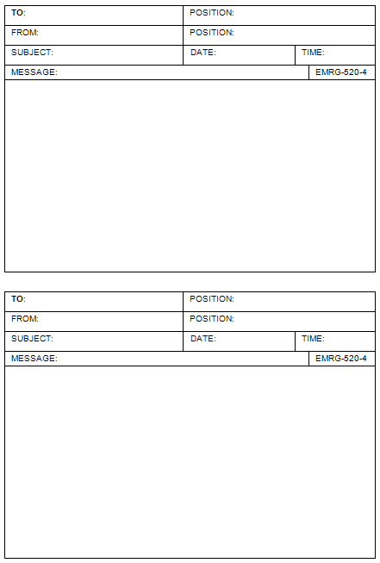
EMRG-520
Basic Message Form
EMRG Basic Message Form provides a simple form that is intuitive for the client and EMRG members.
Based on the ICS 213 General Message form, with the signature and reply sections removed.
Two versions of Basic Message Form;
EMRG-520-2 Two message forms per sheet
EMRG-520-4 Four message forms per sheet
Print out as many pages of either form as required and cut out the individual message forms on each page.
Emergency Measures Radio Group (EMRG) - Ottawa ARES

Slide 10
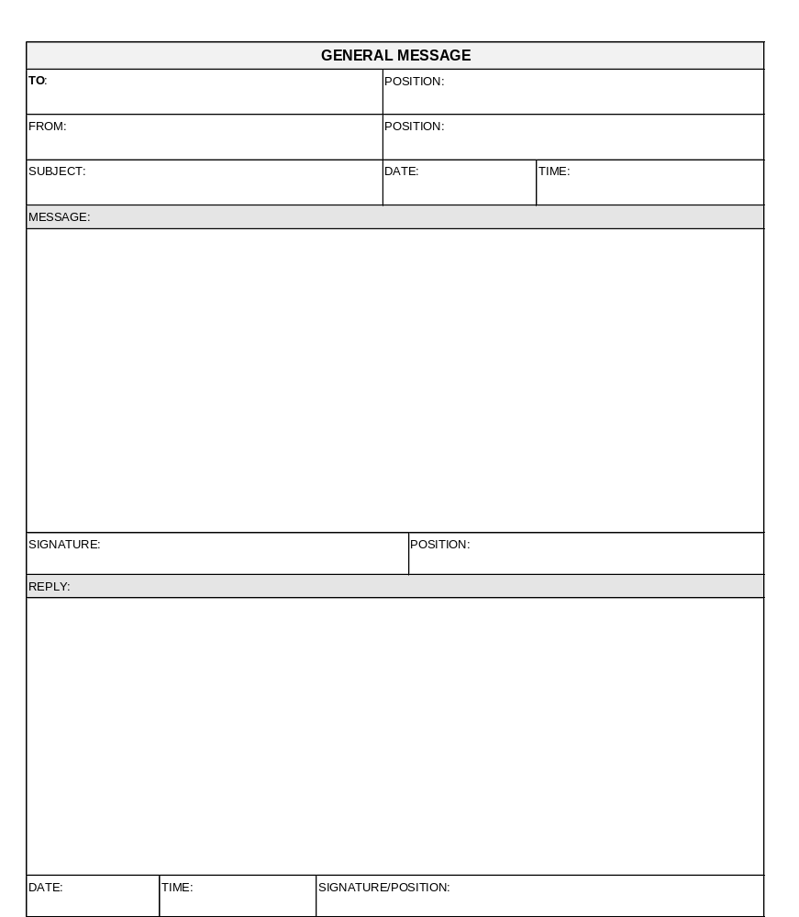
EMRG-521
ICS 213
General Message Form
The Incident Management System (IMS) includes a set of standard forms.
One of these forms is ICS 213, the General Message Form.
As IMS is integrated into client operations, the use of these forms will become more common place.
Emergency Measures Radio Group (EMRG) - Ottawa ARES

Slide 11
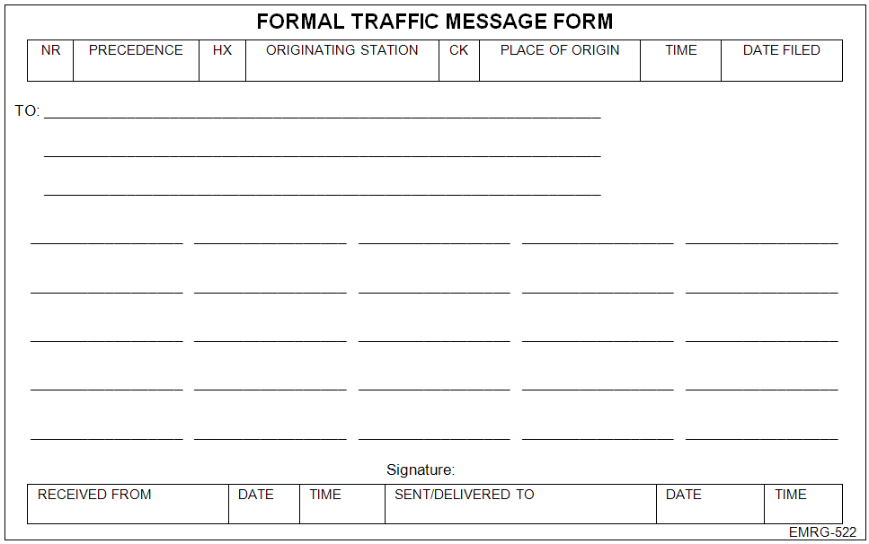
EMRG-522 Formal Message Form
The Formal Message Form is not typically used, but will be required for any messages that pass through the National Traffic System (NTS). Instructions are included with EMRG-522.
Emergency Measures Radio Group (EMRG) - Ottawa ARES

Slide 12
Standard Office Forms
Logging incoming and outgoing radio traffic with a time stamp is key to keeping a record of the information. EMRG Log Sheet
For incoming messages that require hand off to the recipient, a phone message pad provides a good solution. The duplicate version allows a record to be kept by the radio operator.
For short incoming or outgoing messages, a standard telephone single sheet message pad provides space for tactical messages and includes space for date, time, and TO/FROM information.
Another option for incoming or outgoing messages, where a duplicate is required and lots of writing space, is an Inter Office Memo pad. These are available with a printed sequential number as well.
Emergency Measures Radio Group (EMRG) - Ottawa ARES

Slide 13
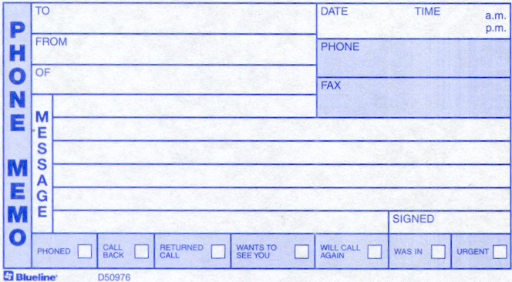
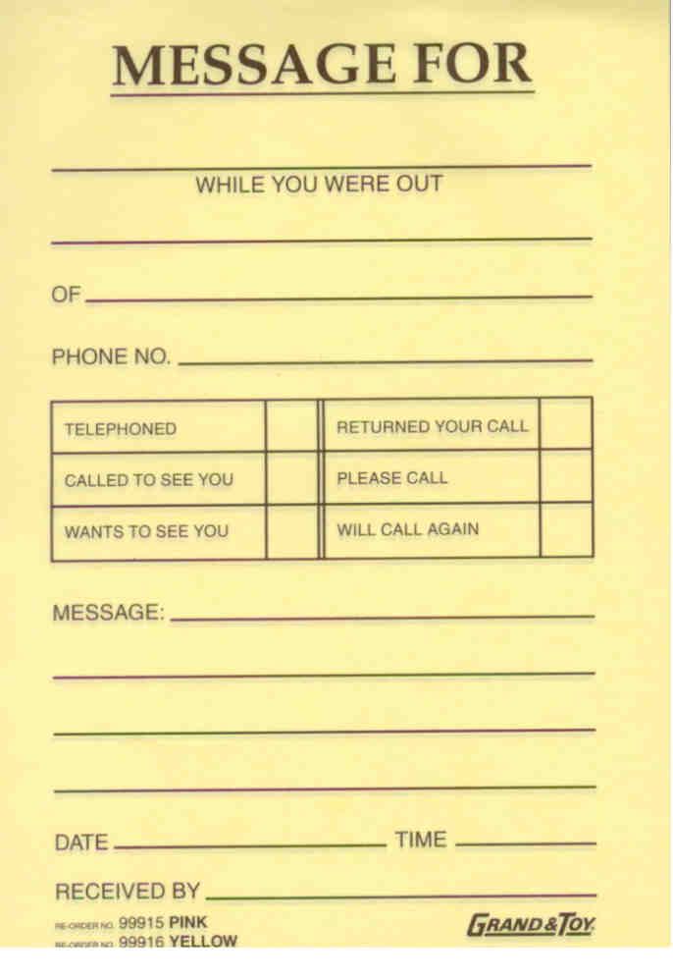
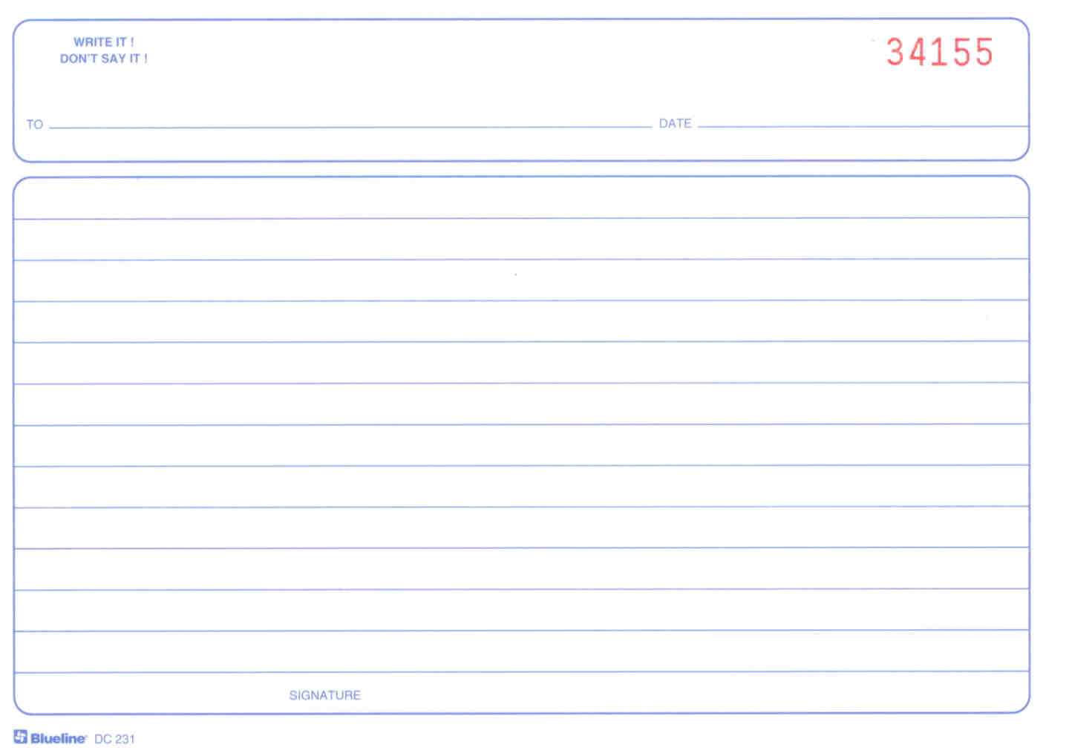
Sample Message Forms
Available in a spiral book with 400 duplicate messages, 4 per page. (Blueline D50976)
Available in pink or yellow and with different formats, but similar information.
Inter Office Memo pads have lots of writing space and they are available with a printed sequential number as well.
Emergency Measures Radio Group (EMRG) - Ottawa ARES

Slide 14
Numbering Messages
Emergency Measures Radio Group (EMRG) - Ottawa ARES

Slide 15
Message Basics
Do NOT reformat incoming messages; handle all incoming messages as received
Accurate, Brief, Clear messages in plain language, provide efficient emergency communications
If someone else has written the message, read it through before they leave to make sure you can read it, you understand it and there is no information missing, such as proper destination.
Emergency Measures Radio Group (EMRG) - Ottawa ARES

Slide 16
Your Have Rights
As the Sender
  say as little as possible, yet convey all of the meaning
  Send only as fast as you could write
  Insert Breaks to confirm the message is getting through
As the Receiver
  It’s OK to ask for a “repeat” if you miss any part of a message
  It’s OK to ask the sender to slow down
Emergency Measures Radio Group (EMRG) - Ottawa ARES

Slide 17
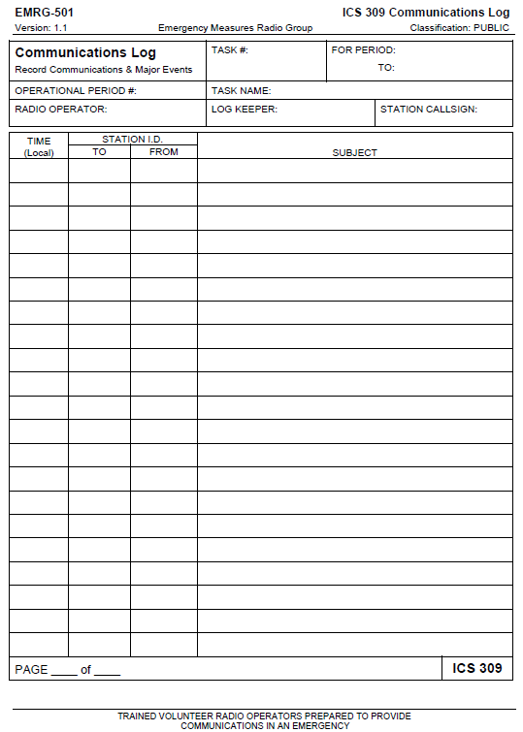
EMRG-501
LOG SHEETS
Logging is an important part of message handling. For more information on logging, see EMRG training course; EMRG-407 Logging.
Where possible, EMRG uses the standard Incident Management System forms. For logging, EMRG uses the ICS 309 Communications Log.
Each EMRG member should keep several copies of this form in their go-kits.
Instructions for filling in the form are included with EMRG-501.
Emergency Measures Radio Group (EMRG) - Ottawa ARES

Slide 18

Self Test
Emergency Measures Radio Group (EMRG) - Ottawa ARES

Slide 19
Answers
Emergency Measures Radio Group (EMRG) - Ottawa ARES

Slide 20
www.emrg.ca
The EMRG web site provides information related to Amateur radio emergency communications, specifically as it relates to the City of Ottawa.
  Project Information
  Newsletters
  Upcoming Events
  Documentation
  Links to related information
Information: training@emrg.ca
Emergency Measures Radio Group (EMRG) - Ottawa ARES

