Slide 1
Stacker Game Project Emrecan YİĞİT

Slide 2
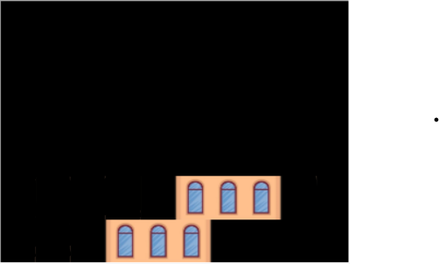
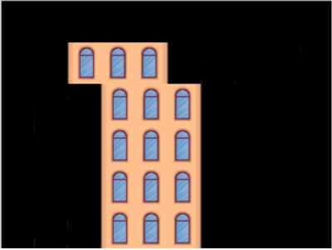
Introduction
The game is a basic block stacking game. The player stacks the building blocks on top of each other. Every new set of blocks appears on the left hand side of the screen and moves horizontally with constant speed. When any button is pressed, the blocks stop. If the blocks are exactly on top of the previous blocks, a new set of blocks appears on the upper floor and starts moving. If the block positions don’t match, the game ends. The player wins the game if the building reaches the top side of the screen.

Slide 3
Implementation
There are three main functions, which are basically for printing and sliding the images.
There are subroutines for handling side tasks such as rearranging color values, refreshing the screen and ending the game.
There is a delay function so that there is a pause between every movement of the images; otherwise, the game would be too difficult to play.

Slide 4
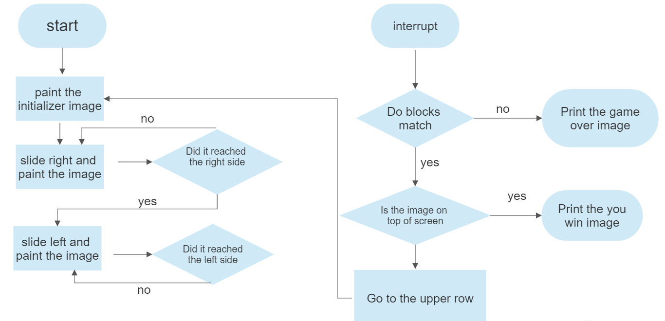


Flow chart of the algorithm
yes
no

Slide 5
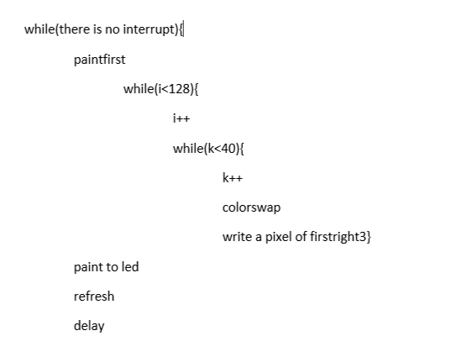
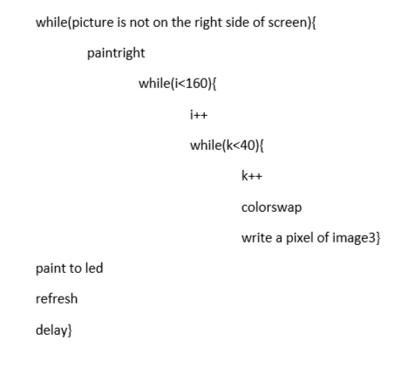
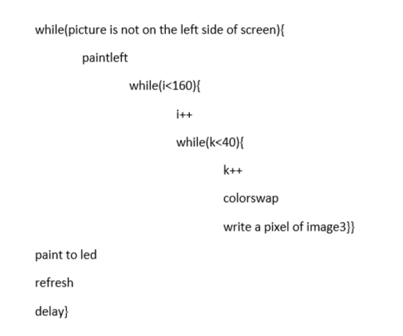
Pseudo c code about how cycle works
Blocks are moving right and left until a button is pressed.
If a button is pressed, the program checks if the blocks match.
Same cycle starts working on the floor above if the blocks match.
If the blocks match up until the top row of the screen, the player wins.
The game ends if the blocks do not match.

Slide 6

Discussion How i handled the problems
The first major problem we faced was deleting the places where the block pass. Resetting the whole screen was not a solution because i had to keep the lower rows. Instead, i used a different image which has 2 black rectangulars on its right and left sides. With this method, the black rectangulares replace the previous colored images.

Slide 7

How i handled the problems
Another problem was printing the first image on the left hand side. I was unable to use the same image directly because of the black rectangular on the left side of the image. In solution, i used a different image which does not have the black part on the left for only the first step of the cycle.

Slide 8
Ideas on improving the code
i tried to make our code improvable so we avoided the temporary solutions.
The first improvement would be decreasing the block count if the player misses one or two blocks. The player keeps playing with the remaining blocks.
The second improvement would be a score table on the screen.
Another improvement we thought was carrying on after the screen is filled by resetting the screen apart from the first row below. The player could continue the game and the game would be endless.

Slide 9
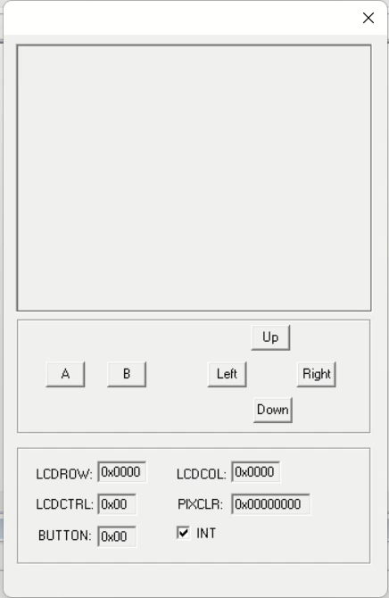
Demonstration

