Slide 1
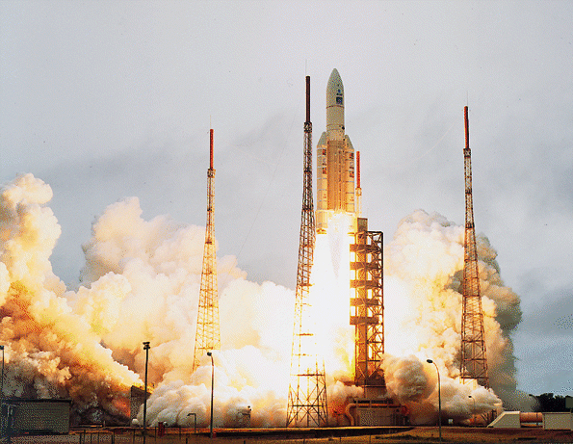
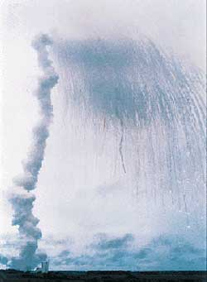
Notes:
Brief history - brady
How it failed - will
Why it failed, root causes - will
Significance of the failure - nick
Lessons learned - nick

Slide 2
Ariane 5 - Flight 501
Nick Nelson, Brady Field, William Montesdeoca

Slide 3
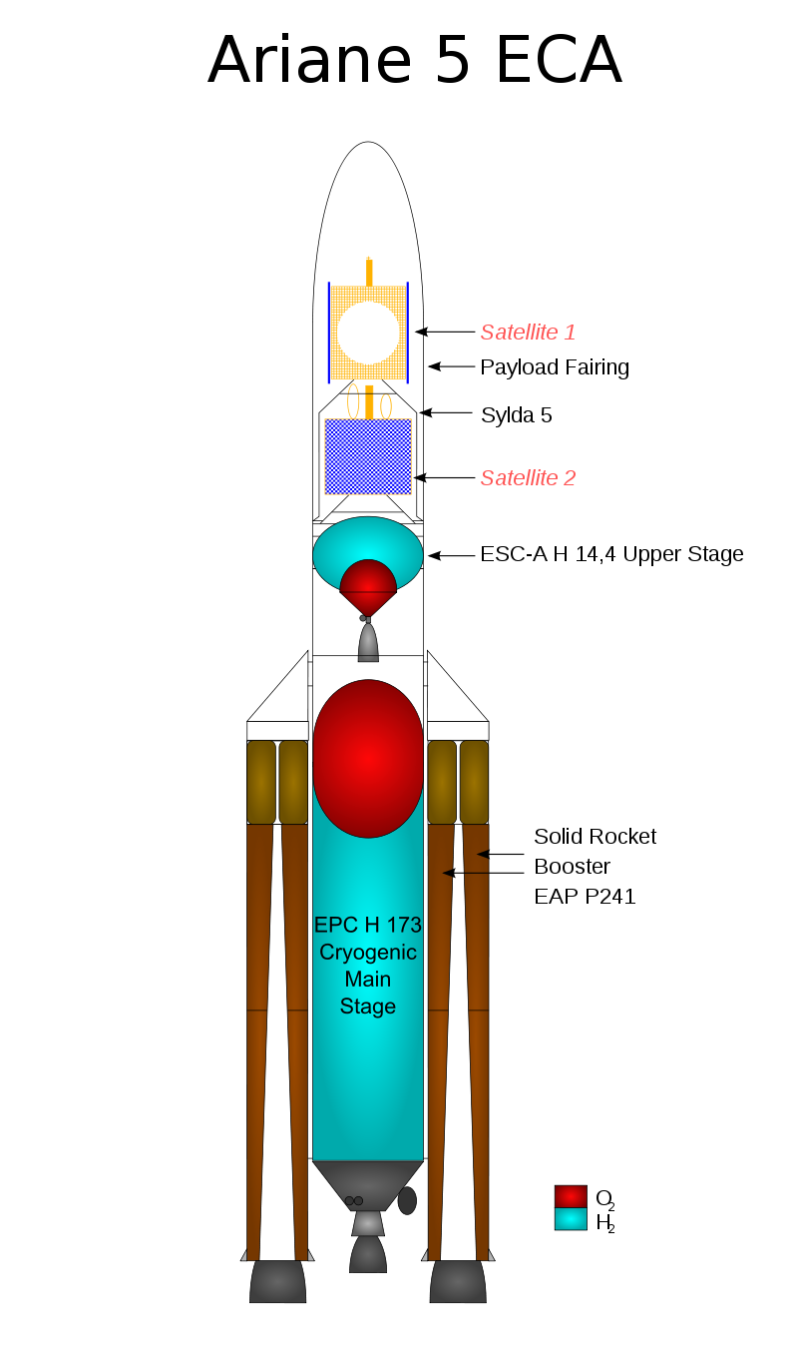
Brief History
Decade in development
$7 billion cost in development
European Ariane rocket design
Launch heavy objects into orbit
Reused software module from Ariane 4

Slide 4

How it Failed
Improper attempt to convert data types
SRI (inertial reference system) failure:
Backup SRI
Active SRI
Engine nozzles veered to extreme position

Slide 5
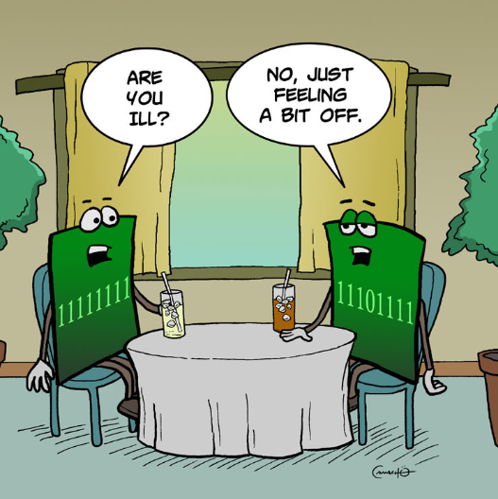
Why it Failed - Root Causes
Convert 64 bit float to 16 bit single integer
Data conversion was not protected
Exception handling failure

Slide 6
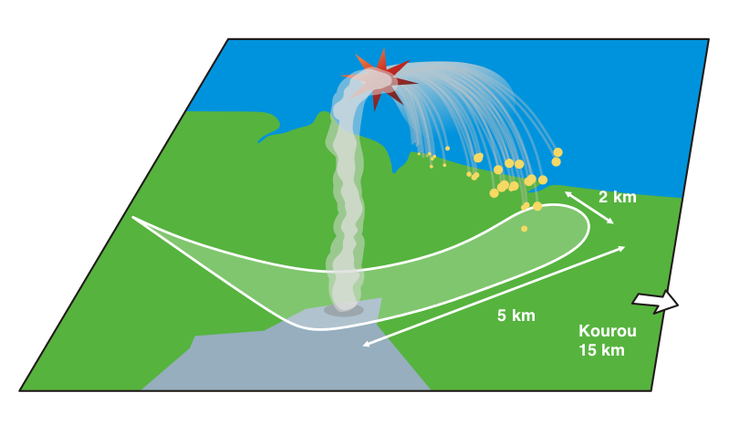
Significance of the Failure
$500 million loss
Caused by a single line of code
Specification and design allowed for the error
Software was believed to be correct until proven faulty
Notes:
Bullet 3: everything was made in compliance to requirements.

Slide 7
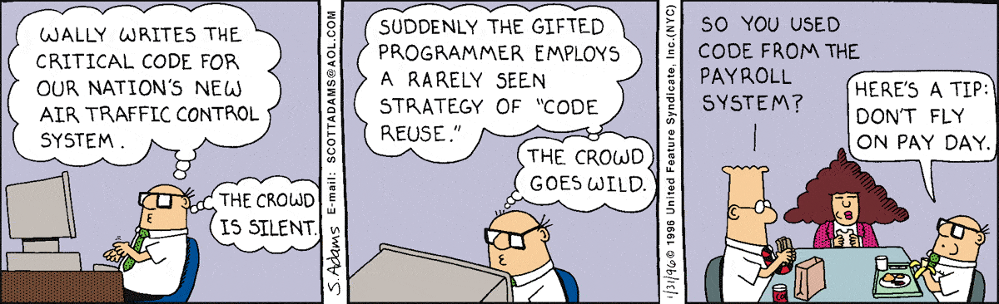
Lessons Learned

Slide 8

Lessons Learned
A simulation/test could have caught the error
When reusing code, look at the requirements
Reused code still needs to be tested
Make sure documentation links design to requirements
Identify implicit functionality and check requirements
Notes:
Bullet 1:
Bullet 2:
Bullet 3:
Bullet 4: when requirements change you should be able to track down which parts of the design needs to change, and vice-versa.
Bullet 5: code tends to make implicit assumptions. Make sure those assumptions comply with the requirements

Slide 9
Sources
Slide 3 information: https://en.wikipedia.org/wiki/Ariane_5, https://en.wikipedia.org/wiki/Cluster_%28spacecraft%29#Launch_failure
Slide 3 image: https://upload.wikimedia.org/wikipedia/commons/thumb/b/b9/Cut_drawing_of_an_Ariane_5_ECA_EN.svg/800px-Cut_drawing_of_an_Ariane_5_ECA_EN.svg.png
Slide 4 and 5 infomation: http://www.savive.com/casestudy/ariane5.html http://www.esa.int/For_Media/Press_Releases/Ariane_501_-_Presentation_of_Inquiry_Board_report
Slide 4 image: https://pbs.twimg.com/profile_images/456473652515463169/xXR95uqW_400x400.png
Slide 5 image: http://www.infragistics.com/community/cfs-filesystemfile.ashx/__key/CommunityServer.Blogs.Components.WeblogFiles/d-coding/4150.quick_5F00_byte_5F00_comic_5F00_a.jpg
Slide 6 and 8 information: http://personal.victoria.ac.nz/stephen_marshall/SE/Failures/SE_Ariane.html, https://msquair.files.wordpress.com/2013/07/ariane-501-report-white-paper.pdf
Slide 6 image: https://en.wikipedia.org/wiki/Cluster_(spacecraft)#Launch_failure
Slide 7 image: http://dilbert.com/strip/1996-01-31
Slide 8 image: https://www.parksmoving.com/about-us/quality-assurance

