Slide 1
Programming基礎篇4

Slide 2
Special operator
While loop
For loop
Do…while loop

Slide 3
Special operators

Slide 4
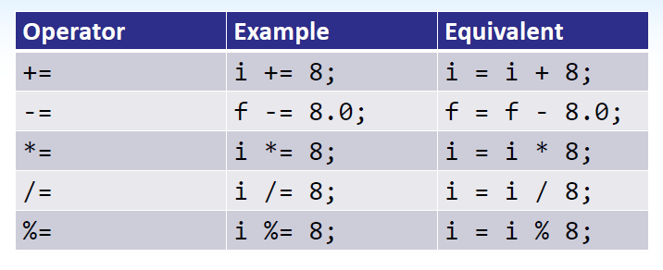
咁呢一章就係講一啲特別既運符號，學左既可以忽略，唔太記得既最好睇睇

Slide 5
咁++ 同 -- 係好特別既運算符號
基本上可以獨立運用。
Int x = 0;
X++; // x = 1
--x; // x = 0
Int y = 1;
Y--; //y = 0
++y; // y = 1

Slide 6
你會發現
X++;
++x;
出黎個答案會一樣，咁兩個野又有咩分別呢?

Slide 7
講不如試
Int j = 10;
Printf(“%d”, j); printf(“%d”, j++); printf(“%d”, j);
Int j = 10;
Printf(“%d”, j); printf(“%d”, ++j); printf(“%d”, j);

Slide 8
咁我諗你行完之後都會明個++ 同 -- 放係前同後係有咩分別了
咁我再問一問
int j = 10;
int newValue = 10 * j++; // j = ?
int j = 10;
int newValue = 10 * ++j; // j = ?

Slide 9
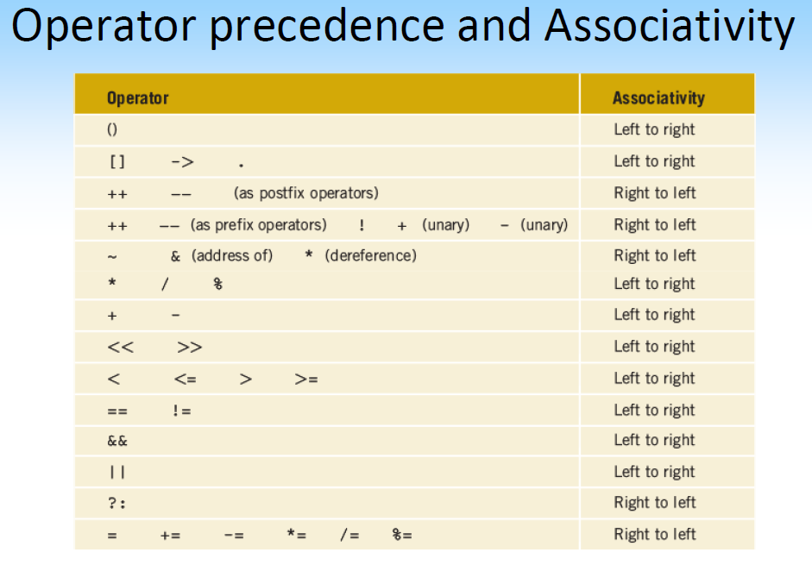

Slide 10
While loop

Slide 11
咩係LOOP?
啫係重複咁去做某啲事就係Loop

Slide 12
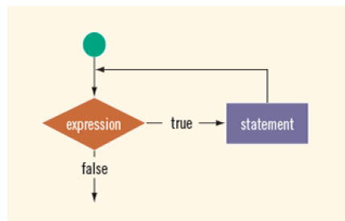
第一個介紹既係while loop，係好常用既一個looping
While(loop-continuation-condition) {
Statement
}

Slide 13
基本上都冇咩野好講，學過既可以自己複習番

Slide 14
For loop

Slide 15
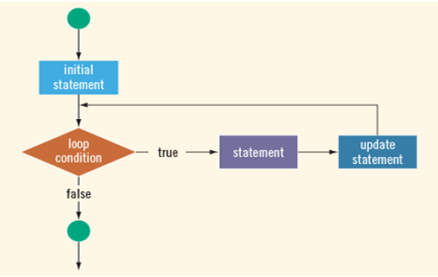
第二個係for loop
For (initial-action; loop-continuation-condition; action-after-each-iteration) { …; }

Slide 16
咁佢個運作法原理係
for ( int counter = 1; counter <= 10; count++) { printf(“%d”, counter); }

Slide 17
Action | Counter | Remark
Int counter = 1; | 1 | Declare & initialize counter (do once only)
Counter < 10 | 1 | Condition is true – enter the loop
Printf(“%d”, counter); | 1 | Print 1
Counter++ | 1 -> 2 | Update counter (increment)
Counter <= 10 | 2 | Condition is true – enter the loop
Printf(“%d”, counter); | 2 | Print 2
Counter++ | 2->3 | Update counter (increment)
…
Counter <= 10 | 10 | Condition is true – enter the loop
Printf(“%d”, counter); | 10 | Print 10
Counter ++ | 10 -> 11 | Update counter (increment)
counter <= 10 | 11 | Condition is false – loop ends

Slide 18
不過，其實for loop都幾大彈性既
正常
for (int i = 0; i < 10; i++)
{
…
}
可以改做
Int I = 0;
for (; i<10; )
{
…
i++;
}

Slide 19
咁係講下一個loop之前呢，有件事一定要知既，或者你都發現左，就係for同while loop好似
//for loop
For (int I = 0; I < 100; i++) { printf(“Hello”);}
//while loop
Int I = 0;
While (I < 100) {
Printf(“Hello”);
i++;
}

Slide 20
所以其實用邊一個loop都冇所謂既，主要係睇你自己鐘意用邊一個啫

Slide 21
Do…while loop

Slide 22
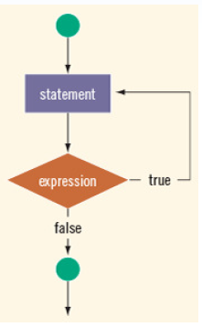
Do while loop呢就同while loop好似，不過都仲係有少少地方唔同。
Do { // loop body statement(s); } while (loop-continuation-condition);
第一，個；一定要加。

Slide 23
第二，同while loop唔同既地方係，while loop會先check左個條件先，而do while loop係後check左個條件，所以do while loop會先行左一次個loop body先，即使你知個條件一定唔會符合都好。

Slide 24
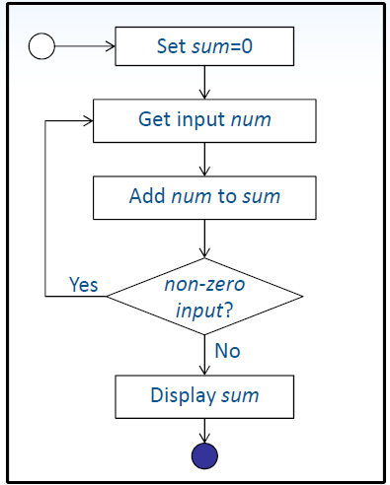
題目
Q1你可以試下將右圖轉成program
Q2 rewrite in for loop and while loop

