Slide 1
Concurrent Prime Number Generation
David Casente, Ellis Saupe

Slide 2
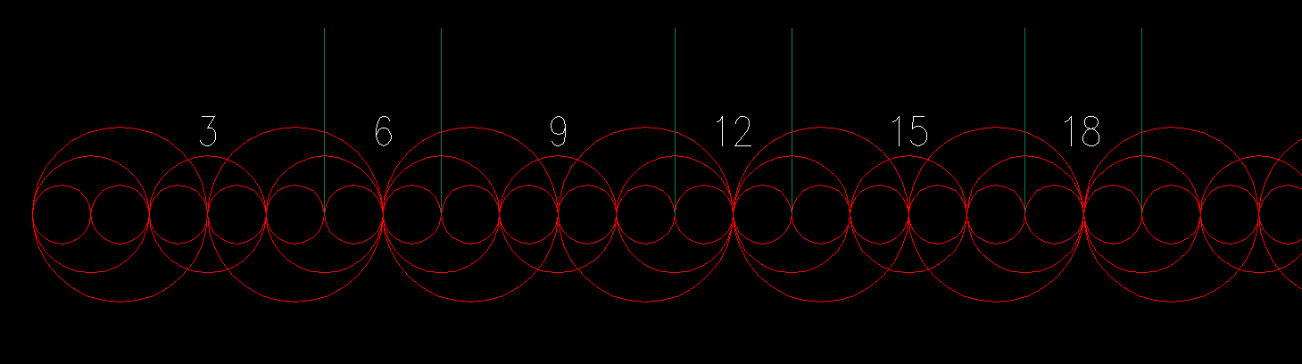
Sieve of Eratosthenes

Slide 3
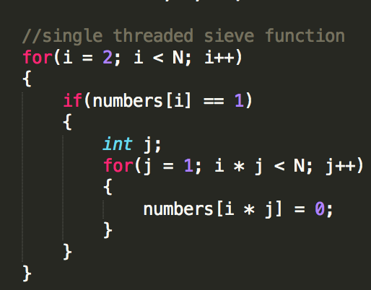
Single threaded
Advantages
Simple
Testing if integer x is prime is O(1) after generation
Disadvantages
Memory intensive
Generation could be faster

Slide 4
Using a Bounded Buffer
Advantages
Uses less memory
Unlimited generation
Disadvantages
No O(1) isPrime testing
Needs concurrency, more complex

Slide 5
Multiple Threads / Processes to run sieve
Should generate faster
Multiple “Producers”
Evaluate multiples of primes
“Consumer”
Parses array for primes

Slide 6
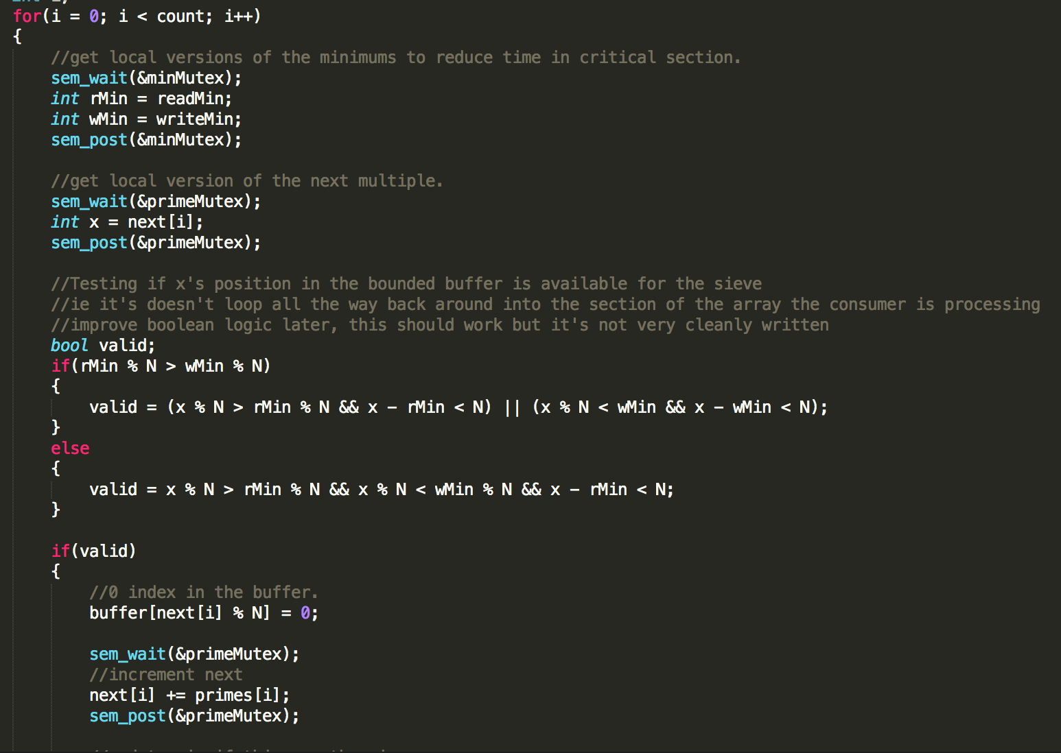
Current Sieve (Producer)

Slide 7
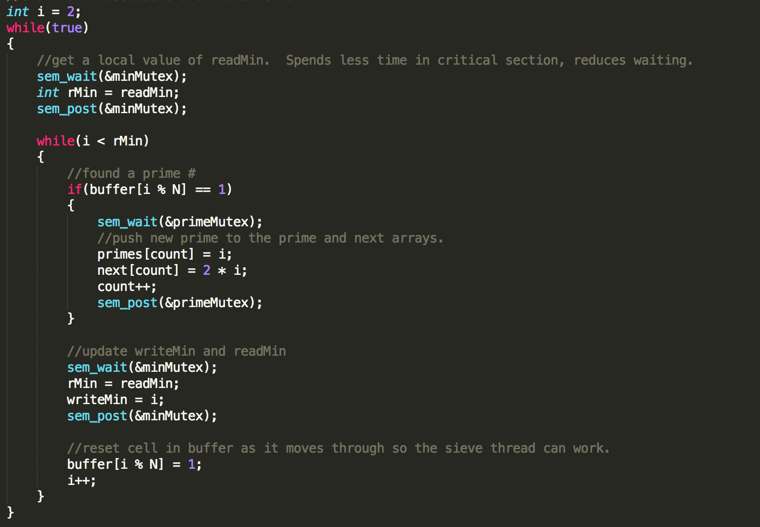
Current Consumer

