Slide 1
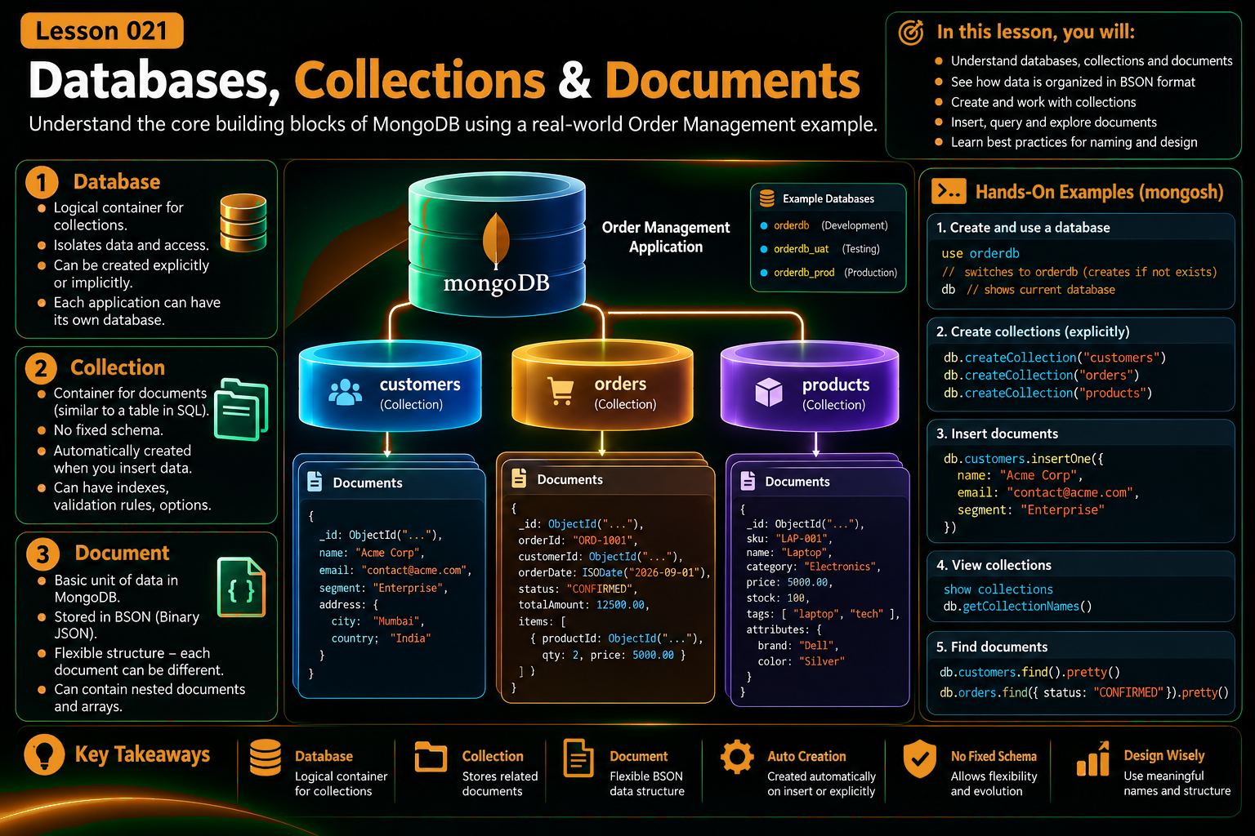

Slide 2
Learning Objectives
By the end of this lesson, learners should be comfortable with the three core building blocks.
1
2
3
4
Understand the hierarchy
Create a database
Work with collections
Read documents
Database → Collection → Document
Switch into an application database
Create, list and manage collections
Insert, inspect and query documents
One running example — Order Management
orders
customers
products
A practical order will carry us through the lesson so learners see where each MongoDB concept belongs in an application.
Build the mental model first; deeper CRUD, querying and data modeling come in later lessons.

Slide 3
MongoDB in One Picture
The developer mental model starts with a simple hierarchy.
Think: App data
DATABASE
A document is the actual data object your application reads and writes.
Logical container
customers
orders
products
collection
collection
collection
Customer
Order
Product
{
_id, fields, ...
}
{
_id, fields, ...
}
{
_id, fields, ...
}
Hierarchy: Database → Collection → Document

Slide 4
1 — Database
Use a database to group collections that belong to an application or domain.
mongosh
orderdb
// switch to the application database
use orderdb
[object Object]
// inspect the current database
db.getName()
[object Object]
// list databases (when permitted)
show dbs
A logical container for related collections.
✓
Name it for the application domain
✓
Switch into it with use orderdb
✓
MongoDB can create it when data is first written
Developer tip
Think of a database as the top-level boundary that gives your collections a shared home. It is not the same thing as a collection or a document.
✓
Keep permissions and operational boundaries clear
Database = the logical home for related collections.

Slide 5
2 — Collections
Collections group related documents and provide the working surface for queries and indexes.
Collections can also have:
customers
orders
products
+
Indexes
customer documents
order documents
product documents
+
Validation rules
doc
doc
doc
+
Collection options
{
...
}
{
...
}
{
...
}
+
Independent lifecycle
Similar idea: table
Collection = a named group of related documents.

Slide 6
3 — Documents
Documents hold the business data your application actually uses.
orders document
A document can contain
{
orderId: "ORD-1001",
orderDate: ISODate("2026-09-15"),
status: "CONFIRMED",
items: [
{ productId: "P100", qty: 2, price: 499.50 },
{ productId: "P200", qty: 1, price: 25.50 }
],
shippingAddress: { city: "Chennai", country: "India" },
payment: { method: "CARD", status: "AUTHORIZED" }
}
✓
scalars
Nested object
nested documents
✓
✓
arrays
Array of items
✓
typed values such as dates and ObjectId
Native Date
BSON on the wire / disk
Document = one application-oriented record; its shape can be hierarchical.

Slide 7
Order Management: Put the Three Pieces Together
Use one business object to see where each concept lives.
ORDER MANAGEMENT APP
orderdb
customers
orders
products
Customer
Order
Product
{
fields,
...
}
{
fields,
...
}
{
fields,
...
}
The point is not memorization — it is knowing which level you are working at.
Think top-down: application requirement → database → collection → document.

Slide 8
A Developer Workflow in mongosh
The shell is your fast feedback loop while learning and exploring.
mongosh
// 1. switch to the application database
use orderdb
[object Object]
// 2. create collections explicitly
db.createCollection("orders")
db.createCollection("products")
[object Object]
// 3. insert one document
db.orders.insertOne({
orderId: "ORD-1001",
status: "PLACED"
})
[object Object]
// 4. inspect the data
show collections
db.orders.find().pretty()
1
Choose database
2
Create or use collection
3
Write document
4
Read and inspect
Fast feedback, low ceremony
Use mongosh to build intuition; later, drivers will move the same operations into application code.

Slide 9
Reading the Document Back
A document is useful only when the application can find the data it needs.
mongosh
One document
// exact lookup
db.orders.findOne({
orderId: "ORD-1001"
})
[object Object]
// inspect matching orders
db.orders.find({ status: "PLACED" }).pretty()
ORD-1001
{
orderId: "ORD-1001",
status: "PLACED",
items: [ ... ],
shippingAddress: { ... }
}
Reading mindset
Start with the business question, identify the field, then write the filter. Keep the query aligned with the document structure you designed.
Business data, not rows
The document model and the query model should reinforce each other.

Slide 10
Practical Design Rules
Keep the first MongoDB model simple enough to understand and useful enough to evolve.
1
Name things by business meaning
orderdb, orders, products
2
Keep related data together when it is naturally read together
shippingAddress inside the order
3
Use collections as clear domain containers
orders, customers, products
4
Treat document shape as an application design decision
model for access patterns
5
Inspect what you actually store
mongosh + find() + explain() later
Good document design starts from requirements and access patterns, not from copying a table schema.

Slide 11
Key Takeaways
Remember the hierarchy, then use it in your next hands-on exercise.
DATABASE
COLLECTION
DOCUMENT
logical home
group of documents
business record
Remember
Application requirements → Database → Collection → Document → Query
Next: move from the structure to the data itself — JSON and BSON.
The goal is developer fluency: explain it, build it, inspect it.

