Slide 1
JSON vs BSON
JSON vs BSON
Two representations of MongoDB document data
JSON
BSON
Readable view
Typed binary representation
MongoDB
{
"orderId": "ORD-1001",
"status": "CONFIRMED",
"items": [ ... ]
}
ObjectId(...)
Date(...)
Decimal128(...)
Binary(...)
JSON-like syntax for developers • BSON for storage and wire representation

Slide 2
Learning Objectives
By the end, learners should be able to distinguish the readable JSON view from the BSON representation used by MongoDB.
Understand the distinction
Recognize what BSON adds
Apply it in development
• JSON is text-based and human-readable
• ObjectId and Date types
• Read JSON-like documents in tools
• BSON is a typed binary encoding
• Binary data and richer numeric types
• Understand what drivers send to MongoDB
• The two are related, but not interchangeable
• Type information with stored values
• Use Order Management examples to inspect types
Developer mental model
Application object → JSON for exchange/views → driver → BSON → MongoDB

Slide 3
JSON: The Readable Representation
JSON gives developers a simple way to describe structured data using objects, key/value pairs and arrays.
What JSON provides
Order Management example
Read it outside-in
• Text-based format
{
"orderId": "ORD-1001",
"orderDate": "2026-09-15",
"status": "CONFIRMED",
"items": [
{ "productId": "P100", "qty": 2, "price": 499.50 }
],
"shippingAddress": {
"city": "Chennai",
"country": "India"
}
}
1. Object
• Objects use { }
• Arrays use [ ]
2. Keys + values
• Values can be string, number, boolean, null, object or array
3. Nested object
4. Array
5. Scalar values

Slide 4
BSON: The MongoDB Data Representation
BSON is MongoDB's binary-encoded document format and includes explicit type information.
What BSON adds
ObjectId
Date
ObjectId(...)
ISODate(...)
Think:
• Binary encoding for documents
• Embedded type information
JSON
= readable
view
BSON
= typed
representation
• Additional types beyond standard JSON
Decimal128
Binary
NumberDecimal(...)
BinData(...)
• Designed for efficient encoding and decoding
Int32 / Int64
NumberInt / NumberLong

Slide 5
The Same Order, Two Representations
The business meaning stays the same; the representation changes depending on where the data is being viewed or transported.
JSON view
BSON-aware view
{
"orderId": "ORD-1001",
"orderDate": "2026-09-15",
"totalAmount": 1001.00,
"customerId": "CUST-001"
}
{
orderId: "ORD-1001",
orderDate: ISODate(...),
totalAmount: NumberDecimal("1001.00"),
customerId: ObjectId(...)
}
Same business data
different representation

Slide 6
Key Differences at a Glance
Focus on what changes for the developer and what MongoDB gains from BSON.
Aspect
JSON
BSON
Format
Text
Binary encoding
Types
Standard JSON types
Richer typed values
Dates
Usually represented as text
Native date type
Identifiers
Usually strings
ObjectId can preserve type
Numbers
Single JSON number category
Multiple numeric BSON types
Binary data
No native binary type
Binary BSON type

Slide 7
BSON Is More Than “Binary JSON”
The name is useful as a starting point, but BSON is its own encoded representation with type tags and database-oriented data types.
Not just smaller JSON
• Own binary encoding
JSON text
Driver
BSON
MongoDB
• Explicit type information
• Additional BSON types
Key idea
Developers often read JSON-like syntax, while MongoDB works with BSON internally.
• Built for document traversal

Slide 8
Where JSON and BSON Fit in an Application
The distinction becomes clearer when you follow data from application code to the database.
Application
API / Message
Driver
MongoDB
Object / model
JSON payload
Serialize / encode
BSON document
Practical rule
Use JSON when readability and interchange matter; understand BSON when type fidelity and MongoDB behavior matter.

Slide 9
Order Management: Why the Difference Matters
Use one business object to connect JSON readability with BSON type fidelity.
Business view
MongoDB-aware view
What changed?
{
orderId: "ORD-1001",
orderDate: "2026-09-15",
totalAmount: 1001.00,
customerId: "CUST-001",
notes: null
}
{
orderId: "ORD-1001",
orderDate: ISODate(...),
totalAmount: NumberDecimal("1001.00"),
customerId: ObjectId(...),
notes: null
}
• Date has a real BSON type
• Money can use Decimal128
• Identifier can use ObjectId
• Null stays explicitly represented

Slide 10
Developer Checklist
When a MongoDB document crosses application boundaries, ask what representation and types you actually need.
Readability
Can a developer understand the payload quickly?
Type fidelity
Do dates, identifiers, numbers or binary values need native BSON types?
Exchange
Will this data be sent over an API or message boundary as JSON?
Inspection
Can you inspect the stored type rather than guessing?
Consistency
Are application and database type expectations aligned?
The goal is not to pick a “winner” — it is to understand the role of each representation.

Slide 11
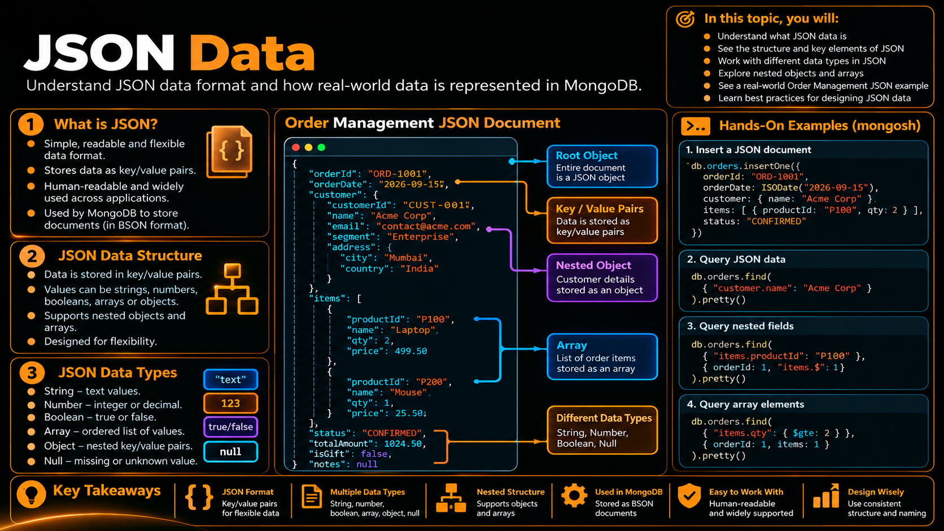
Key Takeaways

