Slide 1
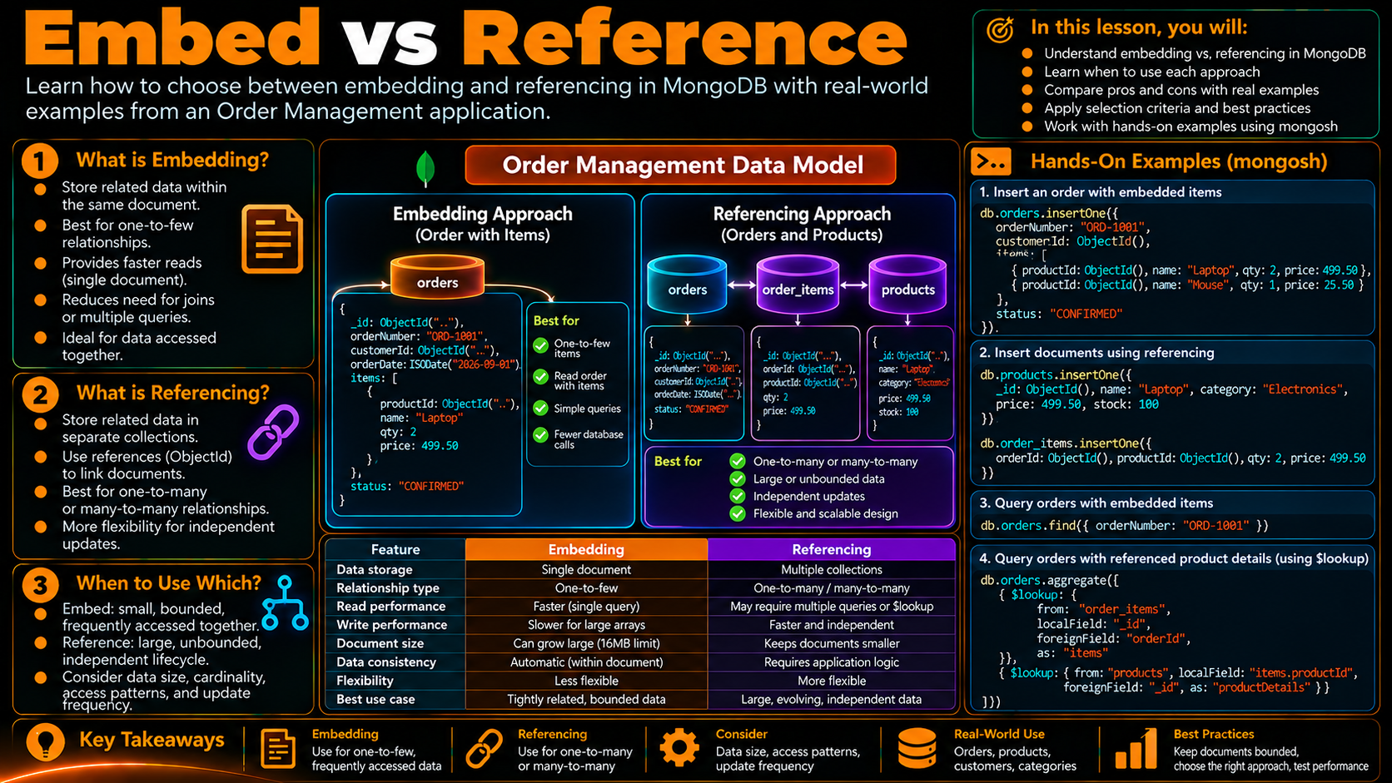

Slide 2
One-to-One
Embedded
In this topic, you will:
•
Recognize a one-to-one relationship
Keep one small, tightly related object inside its parent document.
•
Check ownership, access, size and lifecycle
Order Management example
•
Model the child as an embedded object
orders
shippingAddress
•
Read parent and child in one document
1:1
Mental model
one order
embedded object
PARENT
CHILD
Order
Address
{
orderId: "ORD-1001",
status: "CONFIRMED",
shippingAddress: {
city: "Chennai",
country: "India"
}
}
same business object • bounded • read together
One document
One read path
Small child

Slide 3
What “One-to-One” Means
One parent document contains one related child object.
Relationship anatomy
Example: one order → one shipping address
1 parent
1 related object
{
orderId: "ORD-1001",
status: "CONFIRMED",
shippingAddress: {
city: "Chennai",
country: "India"
}
}
One business object
retrieved as one document
Order
Address
The child object has a clear upper bound and is part of the parent business object.
Four signals that support embedding
OWNERSHIP
ACCESS
GROWTH
LIFECYCLE
The address belongs to the order
The application usually reads both
The child stays small and bounded
It changes with the parent order
owned by parent
read together

Slide 4
When Embedding Fits
Use the relationship characteristics to justify the document shape.
1
Ownership
The related object clearly belongs to the parent.
2
Access
Parent and child are commonly returned together.
3
Growth
The child is small, bounded and predictable.
4
Lifecycle
The child is maintained with the parent.
Embedding is a design decision — not a syntax shortcut.

Slide 5
One-to-One Embedded Document
The child object lives directly inside the parent document.
Order document
PARENT FIELD
{
_id: ObjectId("..."),
orderId: "ORD-1001",
orderDate: ISODate("2026-09-15"),
status: "CONFIRMED",
shippingAddress: {
street: "12 MG Road",
city: "Chennai",
state: "Tamil Nadu",
country: "India",
pinCode: "600001"
}
}
shippingAddress
object value
ACCESS PATH
order → shippingAddress → city
RESULT
One document read
returns parent + child

Slide 6
Read Parent and Embedded Data Together
The application can retrieve the order and its one-to-one child in one document read.
mongosh query
Application view
db.orders.findOne({
orderId: "ORD-1001"
})
Order
Address
City
Returned data
No separate address lookup is required for this embedded shape.
{
orderId: "ORD-1001",
status: "CONFIRMED",
shippingAddress: {
city: "Chennai",
country: "India"
}
}
Single read
Parent and child arrive together
Simple path
order → shippingAddress.city
Local context
The address remains part of the order

Slide 7
Why Not Split It Into Two Documents?
Compare the access paths, while keeping the modeling decision tied to the use case.
Split model
Embedded model
Order
Address
Order
Address
read #1
read #2
one read
•
An extra read path may be needed.
•
Parent and child stay together.
•
A small, tightly coupled object gains a separate lifecycle.
•
The access path is simple for common reads.
•
The application must join the information conceptually.
•
The shape is a good fit when the child is small and bounded.

Slide 8
Practical Design Checks
Ask these questions before choosing one-to-one embedding.
Always together?
Are the parent and child usually returned together?
Small enough?
Will the embedded object remain bounded and predictable?
Same lifecycle?
Does the child naturally change with the parent?
Clearly owned?
Does one parent clearly own the object?
Four “yes” answers strongly support a compact embedded child object.

Slide 9
Build It in mongosh
A focused demo: create the order with its embedded one-to-one address, then inspect the nested field.
Hands-on flow
What to observe
1
Use the demo database
•
One parent document
•
One embedded object
2
Insert one order with shippingAddress
•
Same read path
3
Read the parent document
•
No second collection
Design takeaway
4
use orderdb_one_to_one
db.orders.insertOne({
orderId: "ORD-1001",
status: "CONFIRMED",
shippingAddress: {
city: "Chennai",
country: "India"
}
})
db.orders.findOne({ orderId: "ORD-1001" })
db.orders.findOne(
{ orderId: "ORD-1001" },
{ _id: 0, orderId: 1, shippingAddress: 1 }
)
Project only shippingAddress
The command is simple because the model is simple.
Document shape follows the relationship and access pattern.

Slide 10
Embedding vs a Reference
Both are valid modeling tools; choose based on the relationship and application behavior.
EMBED
REFERENCE
•
Small and bounded
•
Can grow independently
•
Owned by the parent
•
Shared by multiple parents
•
Usually read together
•
Queried or updated separately
•
Same or tightly coupled lifecycle
•
Separate lifecycle
Order
shippingAddress
Order
addressId
same document
separate collection
For a small order shipping address, embedding keeps the business object compact and easy to read.

Slide 11
Key Takeaways
One parent + one bounded child can become one document and one simple access path.
01
Relationship
02
Signals
03
Shape
04
Result
One-to-one
Owned • together • bounded • aligned
Embed child object
One document • one read path
Order Management model
shippingAddress
ONE DOCUMENT
Order
ORD-1001
city: Chennai
parent + child returned together
country: India
Model around behavior
Keep the child bounded
Preserve clear ownership
Access patterns matter
Avoid unbounded growth
Embed when it belongs together

