Slide 1
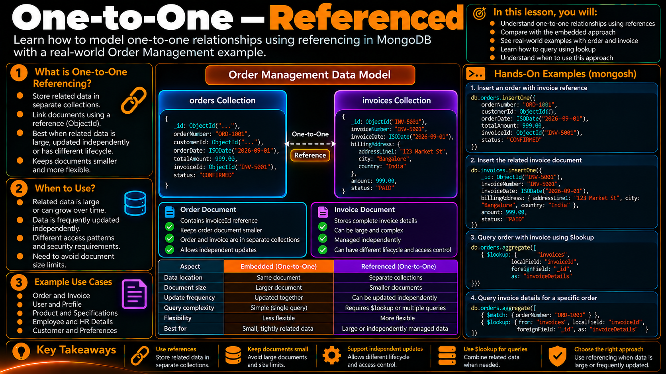
One-to-One — References
One-to-One —
References
Order Management: order → referenced document
Learn how MongoDB connects one related document through an explicit reference.
1

Slide 2
One-to-One — References
In this lesson, you will
• Model a one-to-one reference
• Store the related document separately
• Connect documents with ObjectId
• Query related data when needed
• Understand when references fit
Keep the related object in a separate collection and connect it with an identifier.
What is a one-to-one reference?
Order Management model
Why use a reference?
• One parent document points to one related document.
• The related object lives in its own collection.
• A reference such as ObjectId links the two documents.
• The application resolves the relationship when needed.
• Large or complex related object
• Frequently updated independently
• Different lifecycle or access pattern
• Avoid growing the parent document
• Separate security or ownership boundary
orders
invoices
orderId
invoiceId
one-to-one
reference
invoiceId
amount
{ orderId: "ORD-1001",
invoiceId: ObjectId("...") }
Core idea: the link is stored; the related data stays separate.
2

Slide 3
How the Reference Works
In this lesson, you will
• Model a one-to-one reference
• Store the related document separately
• Connect documents with ObjectId
• Query related data when needed
• Understand when references fit
The parent keeps an identifier; the related document keeps the full object.
1. Parent document
2. Related document
3. Application read path
{
orderNumber: "ORD-1001",
customerId: ObjectId("..."),
invoiceId: ObjectId("...")
}
{
_id: ObjectId("..."),
invoiceNumber: "INV-5001",
amount: 1299.00,
status: "PAID"
}
Order
↓ invoiceId
Query / $lookup
↓
stores the reference only
stores the full object
Invoice details
3

Slide 4
Choosing One-to-One Referencing
In this lesson, you will
• Model a one-to-one reference
• Store the related document separately
• Connect documents with ObjectId
• Query related data when needed
• Understand when references fit
Check independence, growth, access and lifecycle before separating the data.
INDEPENDENCE
Can the related object be updated by itself?
SIZE
Could the object become large or complex?
ACCESS
Is it often queried separately?
LIFECYCLE
Can it live longer or shorter than the parent?
A stronger reference signal appears when several answers point to independent management.
4

Slide 5
Reference vs Embedded
In this lesson, you will
• Model a one-to-one reference
• Store the related document separately
• Connect documents with ObjectId
• Query related data when needed
• Understand when references fit
The same business relationship can use different document shapes.
Referenced one-to-one
Embedded one-to-one
orders
{
orderNumber: "ORD-1001",
invoiceId: ObjectId("...")
}
invoices
{
_id: ObjectId("..."),
invoiceNumber: "INV-5001",
amount: 1299.00
}
orders
{
orderNumber: "ORD-1001",
shippingAddress: {
city: "Chennai",
country: "India"
}
}
• One document read
• Simple access path
• Best for small, bounded, co-owned data
• No separate relationship lookup
• Smaller parent document
• Independent invoice updates
• Separate lifecycle
• Extra query or $lookup when details are needed
Decision follows application behavior — not a universal rule.
5

Slide 6
Querying the Reference
In this lesson, you will
• Model a one-to-one reference
• Store the related document separately
• Connect documents with ObjectId
• Query related data when needed
• Understand when references fit
A reference is stored as data; the application chooses how to resolve it.
// Find the order
db.orders.findOne({ orderNumber: "ORD-1001" })
// Resolve invoice details with $lookup
db.orders.aggregate([
{ $lookup: {
from: "invoices",
localField: "invoiceId",
foreignField: "_id",
as: "invoice"
} }
])
What the learner should notice
• The order stores invoiceId, not the complete invoice.
• `$lookup` combines related data during a read.
• A separate query is another valid application pattern.
• The reference does not automatically create a join.
Reference = explicit link + explicit read strategy
6

Slide 7
Hands-On mongosh
In this lesson, you will
• Model a one-to-one reference
• Store the related document separately
• Connect documents with ObjectId
• Query related data when needed
• Understand when references fit
Build one order and one related invoice, then resolve the relationship.
use orderdb_references
db.invoices.insertOne({
_id: ObjectId(),
invoiceNumber: "INV-5001",
amount: 1299.00,
status: "PAID"
})
// capture the id
const invoiceId = db.invoices.findOne({ invoiceNumber: "INV-5001" })._id
db.orders.insertOne({
orderNumber: "ORD-1001",
invoiceId: invoiceId,
status: "CONFIRMED"
})
Observe the model
• Two collections
• One invoice document
• One order document
• ObjectId links them
• Parent remains compact
7

Slide 8
Independent Updates
In this lesson, you will
• Model a one-to-one reference
• Store the related document separately
• Connect documents with ObjectId
• Query related data when needed
• Understand when references fit
One benefit of references is that the related document can change independently.
Update the related document
When this pattern helps
db.invoices.updateOne(
{ invoiceNumber: "INV-5001" },
{ $set: { status: "PAID",
amount: 1349.00 } }
)
• Invoice changes without rewriting the order
• Invoice is queried independently
• Different lifecycle from the order
• Reference keeps the parent document smaller
The order keeps the same invoiceId.
8

Slide 9
Practical Design Checklist
In this lesson, you will
• Model a one-to-one reference
• Store the related document separately
• Connect documents with ObjectId
• Query related data when needed
• Understand when references fit
Use the relationship signals to justify the document shape.
1
Is the related object independently managed?
2
Can it grow or become complex?
3
Is it often accessed on its own?
4
Does it have a different lifecycle?
More “yes” answers → stronger case for a separate referenced document.
9

Slide 10
One-to-One — References
REFERENCE → SEPARATE DOCUMENT → RESOLVE WHEN NEEDED
RELATION
LINK
ACCESS
SIGNAL
1 parent → 1 related document
ObjectId / reference field
query or $lookup when needed
independent size, lifecycle, or access
Order Management mental model
orders ── invoiceId ──▶ invoices
Keep relationships explicit. Keep independently managed data separate. Resolve related data deliberately.
10

