Slide 1
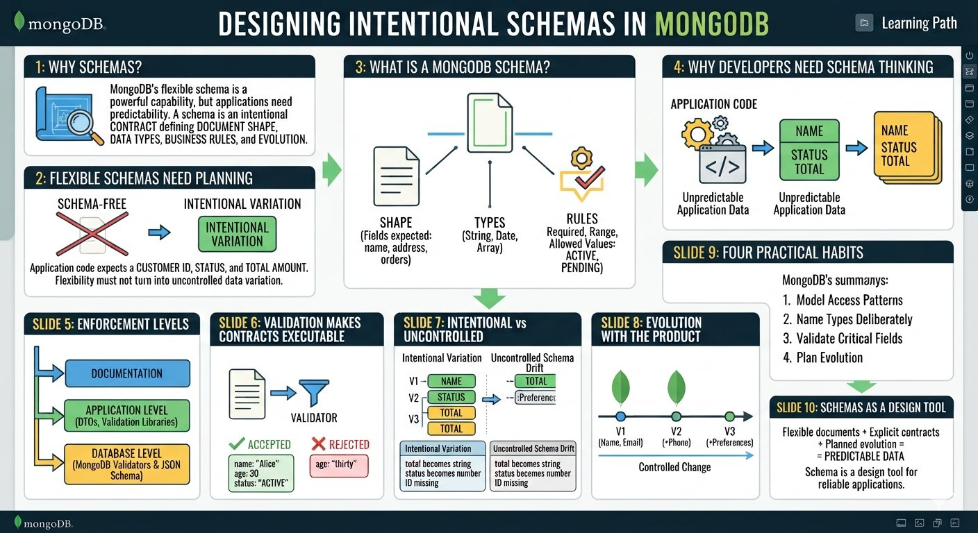

Slide 2
Why Schemas?
Why Schemas?
Flexible documents still need an intentional design.
FLEXIBLE
INTENTIONAL
The core idea
MongoDB lets documents evolve, but your application still needs a clear expectation of what data means, where it lives, and how it is accessed.
flexibility ≠ no design
{}
✓
→
Document
Contract
Query
can evolve
application expectation
access pattern
Running example: Order Management — one business object, intentionally shaped for how the application works.

Slide 3
What Does “Schema” Mean?
MongoDB
A schema is an expected shape — whether or not the database enforces it.
Think in three layers
Application contract
MongoDB flexibility
1
Meaning
Different documents can evolve without requiring every historical document to change at once.
Order shape
What does this field represent?
orderId: "ORD-1001"
status: "CONFIRMED"
items: [ ... ]
2
Shape
shippingAddress: { ... }
payment: { ... }
FIELD ADDED
Which fields should exist?
OPTIONAL FIELD
3
Access
Names have business meaning
How will the app read or change it?
VERSIONED CHANGE
Types have expected meaning
Common reads should be easy to express
The design still needs a reason.

Slide 4
Flexible Schema Does Not Mean “Schema-Free”
MongoDB
MongoDB may not enforce one fixed shape by default, but applications still need a model.
What “no fixed schema” really gives you
What the application still has to decide
Documents in one collection can have different fields.
Which fields are core to an order?
New fields can be introduced as the application evolves.
Which values should have consistent meaning and type?
Which data should be nested together?
Old and new document versions can coexist during a transition.
Which changes are backward compatible?
The database does not have to force every change through a table-style migration.
Which access patterns must remain predictable?
FLEXIBILITY + INTENTIONAL DESIGN

Slide 5
Why a Schema Still Matters
MongoDB
A model prevents “anything goes” from becoming inconsistent application data.
Inconsistent fields
Inconsistent types
Missing meaning
status, orderStatus, state
price: 499.50 vs "499.50"
shipping vs shippingAddress
Naming drift
Type drift
Semantic drift
Requirement
Document shape
Application access
Consistent data
A good schema is less about restriction and more about making data predictable enough for the application.

Slide 6
Same Collection, Evolving Documents
MongoDB
Flexibility is useful when changes are purposeful and understood.
orders
v1
v2
v3
orderId
orderId
orderId
status
status
status
items
items
items
shippingAddress
shippingAddress
payment
The important question is not “Can the next document look different?” — it is “Do we understand the change and its impact?”

Slide 7
Order Management: Define the Intended Shape
MongoDB
Start from the business object before thinking about storage enforcement.
Order document
What should be clear?
Intended shape
Core
orderId, status, orderDate
{
orderId: "ORD-1001",
orderDate: ISODate(...),
Nested
shippingAddress, payment
status: "CONFIRMED",
items: [ ... ],
shippingAddress: { ... },
payment: { ... }
Repeated
items[]
}
Evolution
new optional fields only when useful
This is the contract your application designs around — it can evolve later.
Next lesson: turn the shape into a deliberate document structure.

Slide 8
A Practical Schema Design Workflow
MongoDB
Use a repeatable sequence instead of designing by accident.
1
Requirements
What does the application need?
DO NOT
Document shape
Copy a table schema blindly and hope the document model works.
2
Which fields belong together?
3
Access patterns
How will reads and writes work?
Model around the business object and its access pattern.
4
Evolution plan
How might the shape change?
5
Guardrails later
Validation can enforce agreed rules when needed.

Slide 9
Flexibility Has Boundaries
MongoDB
Not every field should be equally flexible.
Keep consistent
Can evolve
Needs a decision
✓ orderId
→ giftMessage
? embedded vs reference
✓ status
→ deliveryNotes
? field optionality
✓ orderDate
→ marketingTag
✓ items[].qty
? array growth
✓ items[].price
Schema thinking is the discipline of knowing which variation is intentional and which variation is accidental.

Slide 10
Hands-On: Inspect Schema Drift
MongoDB
Use mongosh to see the difference between a flexible model and an inconsistent one.
Step 1 — create representative documents
Inspect the shapes
use orderdb
db.orders.drop()
Step 2 — inspect
db.orders.insertMany([
db.orders.find(
{ orderId: "ORD-1001", status: "CONFIRMED", totalAmount: 1250.00 },
{},
{ orderId: "ORD-1002", status: "PLACED", totalAmount: "980.00", priority: true },
{ _id: 0, orderId: 1, status: 1,
{ orderId: "ORD-1003", status: "SHIPPED", shippingAddress: { city: "Chennai" } }
totalAmount: 1, priority: 1,
])
shippingAddress: 1 }
).pretty()
Observation: one collection can hold different shapes, but unexpected variation can become application complexity.

Slide 11
Hands-On: Turn Observation Into a Design Decision
MongoDB
Fix meaning at the application level before adding enforcement.
Step 3 — inspect meaning and shape
Then decide
// Inspect the type of totalAmount
db.orders.aggregate([
Standardize totalAmount type
{ $project: { orderId: 1,
amountType: { $type: "$totalAmount" } } }
])
Define which fields are core
// Inspect which fields exist
db.orders.aggregate([
Allow optional fields deliberately
{ $project: { orderId: 1,
hasPriority: { $ne: ["$priority", null] },
hasShipping: { $ne: ["$shippingAddress", null] } } }
Document version changes
])
Add validation later when enforcement is needed
Flexible storage + clear contract = manageable evolution

Slide 12
Best Practices for Practical MongoDB Schemas
MongoDB
Keep flexibility useful, visible, and aligned with the application.
01
Meaningful names
02
Consistent semantics
orderId, shippingAddress, items
the same field should mean the same thing
03
Purposeful flexibility
04
Access-aware design
new fields solve a real requirement
model around common reads and writes
05
Explicit evolution
06
Use guardrails when needed
know what changed and why
validation can enforce agreed rules
Good schema design is a developer discipline — not simply a database setting.

