Slide 1
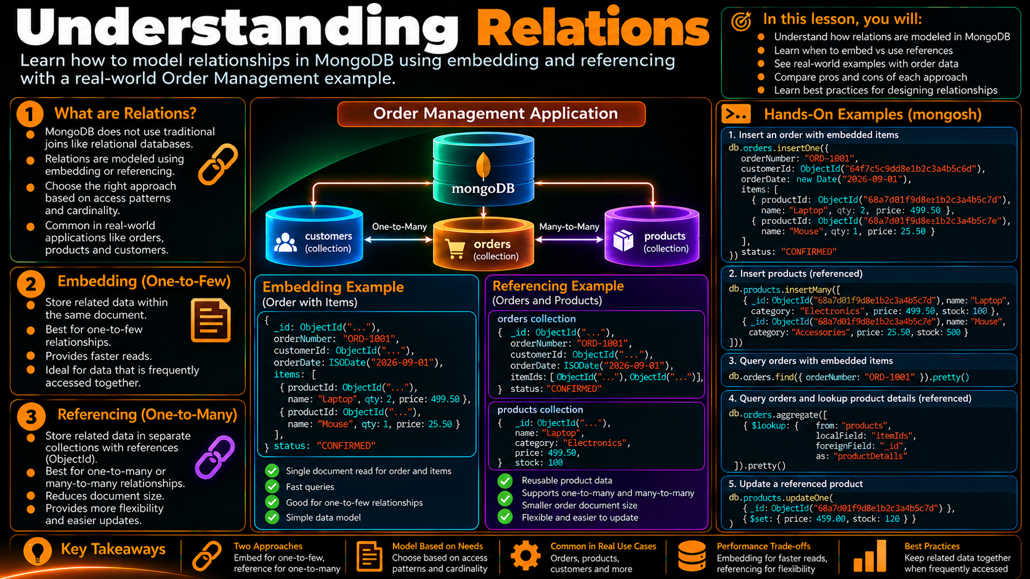

Slide 2
Understanding Relations
How MongoDB represents connections between real-world data.
Order Management
One application, many relationships
• Customer profile and address
• Orders and line items
• Products referenced by orders
• Relationships across collections
customers
1:N
orders
N:M
products
shippingAddress
Core question: keep related data together, or connect it by an id?
RELATION
CARDINALITY
OWNERSHIP
GROWTH
ACCESS
SHAPE
Logical connection
1:1 • 1:N • N:M
Who controls it?
How large can it get?
How is it read?
Embed or reference

Slide 3
What Is a Relation?
A relation is a logical connection between two pieces of application data.
1
.Start with the business meaning
Customer
Order
Product
Profile and contact data
Transaction and status
Reusable catalog data
Describe every relation with four questions
1
How many?
2
4
How big?
3
How shared?
How accessed?
Do not begin with table translation. Begin with the application relationship.
RELATION
CARDINALITY
GROWTH
SHARING
ACCESS
DESIGN
Business connection
How many?
Bounded or growing?
Owned or reused?
Read together?
Shape follows use

Slide 4
Cardinality: The Shape of the Relationship
The number of related records changes the modeling conversation.
1 : 1
1 : N
N : M
Customer → Primary Address
Customer → Orders
Orders ↔ Products
order 1
product
order
customer
address
customer
order 2
product
order 3
Often embedded
Often separate when orders grow
Represent with references / ids
1:1
1:N
N:M
KEY
NOT ENOUGH
NEXT
Usually small and owned
Check growth carefully
Shared relationship
Cardinality is a signal
Also inspect access
Choose a shape

Slide 5
One-to-One: Embed or Reference?
A primary shipping address is a useful example of a one-to-one relation.
EMBED
REFERENCE
• Small and bounded
• Read with the parent
• Owned by the parent
• Related data changes independently
• Shared across multiple parents
• Separate lifecycle
customers
customers
{
customerId: "CUST-1001",
shippingAddress: { city, country }
}
{
customerId: "CUST-1001",
shippingAddressId: "ADDR-44"
}
The relationship is the same; only the storage location changes.
EMBED
REFERENCE
DECIDE
CHECK
PATTERN
RESULT
Together
Separate
Ownership + access
Growth
Same relation
Different shape

Slide 6
One-to-Many: Customer → Orders
The common question is whether the child set is bounded and naturally read with the parent.
EMBEDDED ORDERS
SEPARATE COLLECTION
• Reasonable only for small, bounded sets
• Convenient when always read with customer
• Can create very large customer documents
• Orders can grow independently
• Orders have their own lifecycle
• Query by customerId when needed
customer
customers
orders: [
{ orderId: "ORD-1001" },
{ orderId: "ORD-1002" }
]
{ customerId: "CUST-1001" }
orders → customerId: "CUST-1001"
For growing order history, separate storage usually keeps the parent document bounded.
1:N
EMBED
REFERENCE
LIFECYCLE
QUERY
CHECK
Parent → many children
Bounded set
Growing set
Separate writes
Use customerId
Document size

Slide 7
Many-to-Many: Orders ↔ Products
One product can appear in many orders, and each order can contain many products.
ORDER ITEMS AS REFERENCES
Why not duplicate products?
• Product details change independently
• Catalog data is shared
• Avoid repeating large definitions
• Reference with stable ids
orders
products
P100
P200
P300
orders.items[]
productId → products._id
The order stores product identifiers; product definitions stay reusable.
N:M
ORDER
PRODUCT
LINK
REUSE
DESIGN
Shared relationship
Many products
Many orders
Use ids
Keep catalog separate
Avoid duplication

Slide 8
Embed or Reference?
Use the relationship and the way the application uses the data to choose a practical shape.
EMBED
REFERENCE
Read together?
Yes
Can it grow independently?
Yes
Small and bounded?
Yes
Shared by many parents?
Yes
Owned by parent?
Yes
Separate lifecycle?
Yes
Updated together?
Often
Often read separately?
Yes
Typical fit: address, small preferences, bounded child data.
Typical fit: growing orders, shared products, reusable entities.
ACCESS
GROWTH
OWNERSHIP
SHARING
LIFECYCLE
DECISION
Read together?
How large?
Who owns it?
Is it reused?
Change together?
Then choose shape

Slide 9
Order Management Relationship Map
Apply the rules to one realistic application model.
Customer
1:N
Order
N:M
Product
customers
orders
products
1:1 • embed
Order document
Address
customerId
items[].productId
embedded
One-to-one address is embedded; customer-to-orders is separate; product links are carried by item ids.
CUSTOMER
ADDRESS
ORDERS
PRODUCTS
ITEM IDS
MODEL
Profile owner
Small + together
Independent growth
Shared catalog
Reference link
Behavior first

Slide 10
Relation-Driven Design Decisions
Four quick checks keep the model grounded in application behavior.
How many?
1:1 • 1:N • N:M
How big?
Bounded • growing • unbounded
How shared?
Owned • reused • independent
How accessed?
Together • separately • mixed
Final question: will this document shape make the application's common reads and writes simpler?
CARDINALITY
SIZE
SHARING
ACCESS
LIFECYCLE
OUTCOME
Count related data
Watch growth
Control duplication
Model for reads
Model for changes
Practical document shape

Slide 11
Inspect Relations in mongosh
Use the shell to see the relationship represented directly in the stored documents.
1. Find a customer
2. Find that customer's orders
db.customers.findOne({ customerId: "CUST-1001" })
db.orders.find({ customerId: "CUST-1001" })
3. Find orders containing a product
4. Inspect the embedded address
db.orders.find({ "items.productId": "P100" })
db.customers.findOne(
{ customerId: "CUST-1001" },
{ shippingAddress: 1, _id: 0 }
)
Observe the storage decision: embedded data stays inside the document; references appear as ids.
SHELL
CUSTOMER
ORDERS
PRODUCT
ADDRESS
PRACTICE
Inspect directly
Parent document
Referenced children
Shared data
Embedded field
Trace the links

Slide 12
A Repeatable Relationship Design Workflow
Use this sequence before committing a MongoDB document shape.
1
Requirement
2
Cardinality
3
Access
4
Growth
5
Shape
How many related records?
Bounded or independently growing?
Embed, reference, or combine?
What does the application need?
Read together or separately?
Design around behavior — not around the source table.
A good relation model should make common application operations easy to reason about.
REQUIREMENTS
CARDINALITY
ACCESS
GROWTH
SHAPE
RESULT
Start with behavior
Count
Observe reads
Watch size
Embed / reference
Maintainable model

Slide 13
Key Takeaways
A visual checklist for modeling relationships in MongoDB.
1:1
N:M
Embed
Order Management Model
Reference ids
Small + owned
Shared data
RELATION → CARDINALITY → ACCESS → DOCUMENT SHAPE
1:N
Access
Reference
Design around reads
Grows independently
Behavior first
RELATION
CARDINALITY
EMBED
REFERENCE
ACCESS
GROWTH
Logical connection
1:1 • 1:N • N:M
Keep together
Separate + id
Model for use
Protect document size

