Slide 1
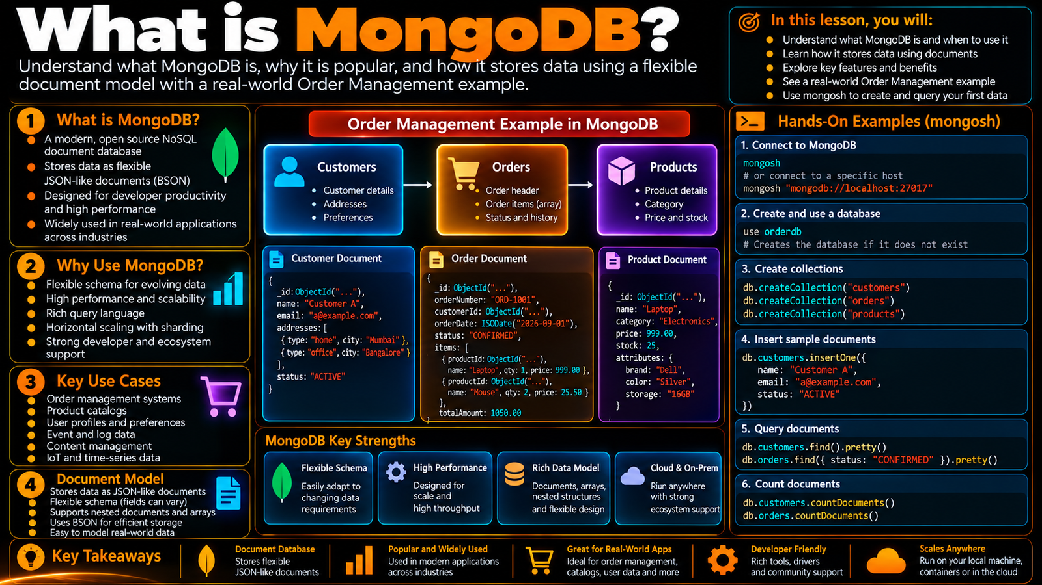

Slide 2
What Is MongoDB?
Understand MongoDB as a document database and see how it fits an application through a real Order Management example.
In this lesson, you will
Running example
Understand what MongoDB is and when to use it
See how data is stored as flexible documents
Connect the model to an Order Management application
Recognize core characteristics and common use cases
Run a small mongosh example
Order Management
Application
Application
MongoDB
Document
The lesson keeps the data shape connected to a real developer problem.

Slide 3
MongoDB in one picture
A document database centered on documents and collections.
Applications use MongoDB to store and work with application data.
Documents can hold nested structures and arrays.
The developer focus is on practical application data and access patterns.
Order Management
Order
Address
Payment
orderId
city
method
status
postalCode
status
items[]
Keep the lesson connected to a recognizable application object.

Slide 4
From application need to document
An order starts as application data.
The application needs to save it and read it back.
MongoDB can represent the order as one structured document.
Nested business information stays visible in the data shape.
Order Management
Order
Address
Payment
orderId
city
method
status
postalCode
status
items[]
Keep the lesson connected to a recognizable application object.

Slide 5
Order Management example
One order can carry orderId and status at the top level.
shippingAddress is a nested object.
items is an array of related order-item objects.
payment is another grouped object inside the order.
Order Management
Order
Address
Payment
orderId
city
method
status
postalCode
status
items[]
Keep the lesson connected to a recognizable application object.

Slide 6
Core characteristics
Document-oriented storage.
Flexible document structures for evolving requirements.
Rich query language and indexing.
Horizontal scalability and a broad developer ecosystem.
Order Management
Order
Address
Payment
orderId
city
method
status
postalCode
status
items[]
Keep the lesson connected to a recognizable application object.

Slide 7
Where MongoDB is used
Order management systems.
Product catalogs and user profiles.
Event and log data.
Content, IoT, analytics, and other data-centric workloads.
Order Management
Order
Address
Payment
orderId
city
method
status
postalCode
status
items[]
Keep the lesson connected to a recognizable application object.

Slide 8
A developer mental model
Think in documents before thinking in commands.
Start from the application data and access pattern.
Use mongosh to explore the same concepts the application will use.
Later lessons go deeper into modeling, CRUD, queries, and production topics.
Order Management
Order
Address
Payment
orderId
city
method
status
postalCode
status
items[]
Keep the lesson connected to a recognizable application object.

Slide 9
Hands-on: first document
Connect with mongosh.
Choose the application database.
Insert one order document.
Read the document back and inspect its shape.
mongosh
use orderdb
db.orders.insertOne({
orderId: "ORD-1001",
status: "CONFIRMED",
shippingAddress: { city: "Chennai" },
items: [{ sku: "KB-101", qty: 2, price: 1499.00 }]
})
db.orders.findOne({ orderId: "ORD-1001" })
Run the demo, then change one value and rerun it.

Slide 10
What to remember
MongoDB is a document-oriented database.
A document can model a useful business object directly.
Flexibility does not remove the need for design.
Keep the application problem at the center of the model.
Order Management
Order
Address
Payment
orderId
city
method
status
postalCode
status
items[]
Keep the lesson connected to a recognizable application object.

Slide 11
Next step
Move from “what is MongoDB?” into its document-oriented characteristics.
See how document structure differs from relational thinking.
Continue with the same Order Management example.
Order Management
Order
Address
Payment
orderId
city
method
status
postalCode
status
items[]
Keep the lesson connected to a recognizable application object.

Slide 12
Key Takeaways
Understand MongoDB as a document database and see how it fits an application through a real Order Management example.
01
02
03
04
05
Understand what MongoDB is and when to use it
See how data is stored as flexible documents
Connect the model to an Order Management application
Recognize core characteristics and common use cases
Run a small mongosh example
One concept at a time • one real example • repeat the practice loop

