Slide 1
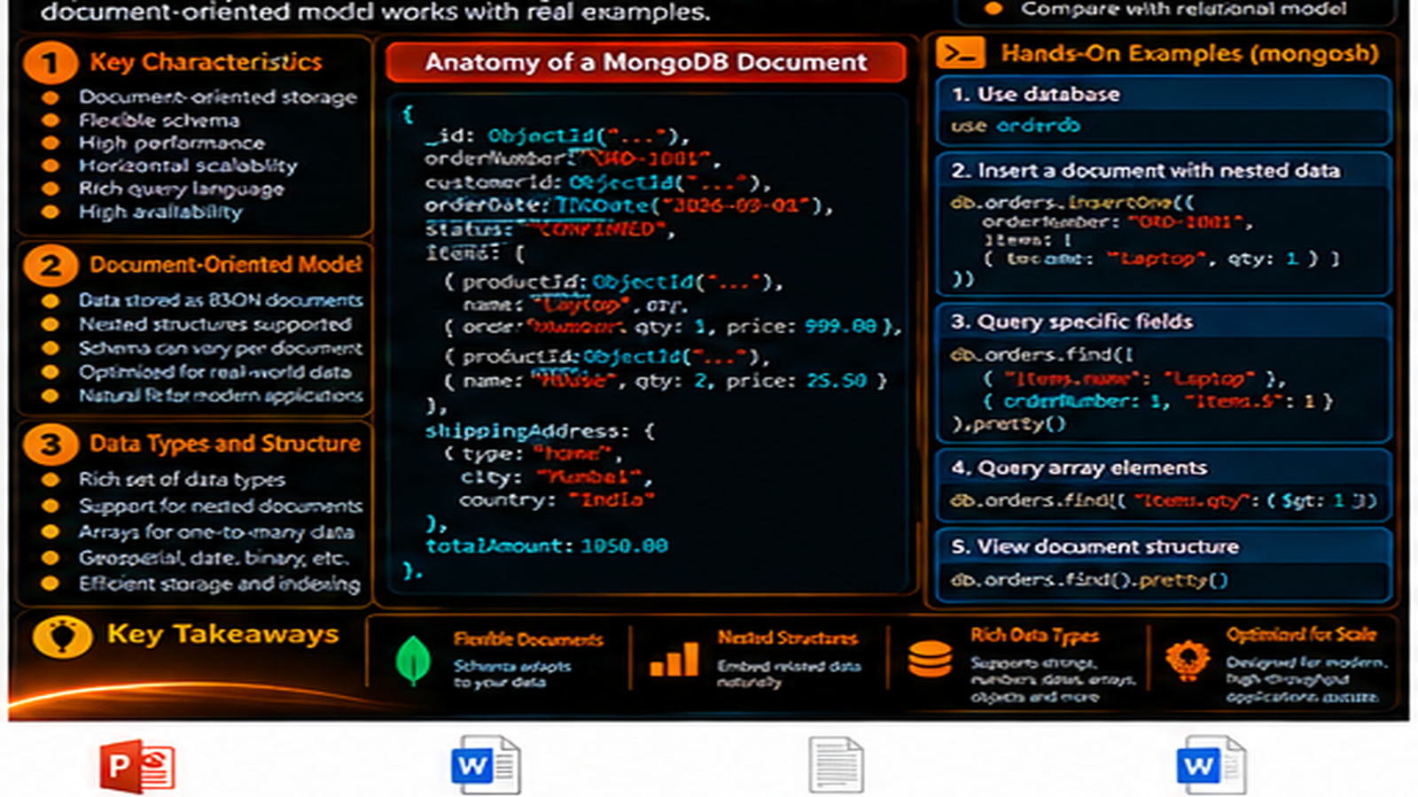

Slide 2
MongoDB Characteristics and Document-Oriented Model
Learn the characteristics that define MongoDB and how document-oriented thinking shapes application data.
In this lesson, you will
Running example
Recognize the core characteristics of MongoDB
Understand the document-oriented model
Compare relational and document thinking at a high level
See nested data and arrays in a document
Connect data shape to application access patterns
Order Management
Application
Application
MongoDB
Document
The lesson keeps the data shape connected to a real developer problem.

Slide 3
Document-oriented by design
MongoDB organizes data around documents inside collections.
A document represents related application data.
Documents can contain nested objects and arrays.
This structure can map naturally to application objects.
Order Management
Order
Address
Payment
orderId
city
method
status
postalCode
status
items[]
Keep the lesson connected to a recognizable application object.

Slide 4
A real Order document
The order is represented as one document with related business fields.
shippingAddress is nested inside the order.
items is an array of embedded item objects.
The structure follows the business object rather than a flat row.
Order Management
Order
Address
Payment
orderId
city
method
status
postalCode
status
items[]
Keep the lesson connected to a recognizable application object.

Slide 5
Relational thinking vs document thinking
Relational systems organize data primarily through tables, rows, and relationships.
MongoDB organizes data through documents and collections.
Related information can be represented together inside a document.
The important shift is how related data is modeled for application access.
TABLE / ROWS
DOCUMENTS
order header
One Order Document
orderId
items rows
shippingAddress
shipping row
items[]
payment
payment row
The modeling shift is about how related data is represented.

Slide 6
Flexible does not mean unplanned
Documents can contain different fields when application requirements evolve.
Nested structures and arrays support richer document shapes.
Schema design still matters.
Flexibility means the model can evolve; it does not mean “no design.”
Order Management
Order
Address
Payment
orderId
city
method
status
postalCode
status
items[]
Keep the lesson connected to a recognizable application object.

Slide 7
Why developers care
Model around how the application reads and writes data.
Keep information together when the application needs it together.
Avoid unnecessary complexity in common access paths.
Treat the document model as a foundation for later data modeling.
Order Management
Order
Address
Payment
orderId
city
method
status
postalCode
status
items[]
Keep the lesson connected to a recognizable application object.

Slide 8
Developer checklist
What is the business object?
Which fields belong together?
Which related values are naturally nested?
How will the application read and update the data?
Order Management
Order
Address
Payment
orderId
city
method
status
postalCode
status
items[]
Keep the lesson connected to a recognizable application object.

Slide 9
Hands-on: inspect the document
Use mongosh to create an order document.
Query the order document.
Read a nested shippingAddress field.
Query an embedded item field to connect structure with access.
mongosh
use orderdb
db.orders.insertOne({
orderId: "ORD-1001",
status: "CONFIRMED",
shippingAddress: { city: "Chennai" },
items: [{ sku: "KB-101", qty: 2, price: 1499.00 }]
})
db.orders.findOne({ orderId: "ORD-1001" })
Run the demo, then change one value and rerun it.

Slide 10
What to remember
MongoDB is document-oriented.
Nested data and arrays are first-class parts of the document model.
Flexibility and good design work together.
Application access patterns should guide document structure.
Order Management
Order
Address
Payment
orderId
city
method
status
postalCode
status
items[]
Keep the lesson connected to a recognizable application object.

Slide 11
Next step
Move from the document model to the MongoDB ecosystem.
See the server, shell, drivers, Compass, and import tooling together.
Order Management
Order
Address
Payment
orderId
city
method
status
postalCode
status
items[]
Keep the lesson connected to a recognizable application object.

Slide 12
Key Takeaways
Learn the characteristics that define MongoDB and how document-oriented thinking shapes application data.
01
02
03
04
05
Recognize the core characteristics of MongoDB
Understand the document-oriented model
Compare relational and document thinking at a high level
See nested data and arrays in a document
Connect data shape to application access patterns
One concept at a time • one real example • repeat the practice loop

