Slide 1
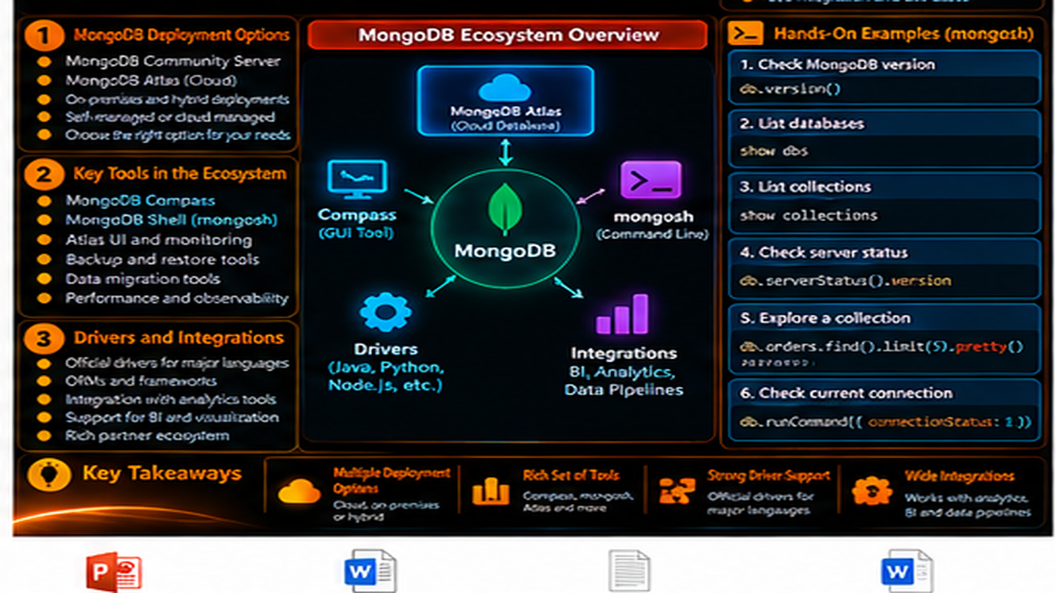

Slide 2
MongoDB Ecosystem
Understand the tools, clients, services, and integrations that surround MongoDB development.
In this lesson, you will
Running example
Identify the main MongoDB ecosystem components
Understand the role of the server, shell, drivers, and Compass
Recognize Atlas and import tooling in the workflow
See how the same data can be accessed through different tools
Connect the ecosystem to Order Management development
Order Management
Application
Application
MongoDB
Document
The lesson keeps the data shape connected to a real developer problem.

Slide 3
The ecosystem around MongoDB
MongoDB is more than the database server alone.
Developers use several tools and interfaces around the same data platform.
The core components serve different purposes.
Understanding those roles makes the architecture easier to reason about.
Server
mongosh
Drivers
Compass
Stores / processes data
Interactive access
Application connectivity
Visual exploration
Different tools, one MongoDB data platform.

Slide 4
MongoDB Server
The server is the database engine that stores and processes application data.
Clients and applications communicate with the server.
Server configuration and deployment choices come later in the learning path.
For now, treat the server as the central data service.
Server
mongosh
Drivers
Compass
Stores / processes data
Interactive access
Application connectivity
Visual exploration
Different tools, one MongoDB data platform.

Slide 5
Shell, drivers, and Compass
mongosh provides direct interactive database access.
Drivers connect application code to MongoDB.
Compass provides a visual way to explore and work with databases and collections.
Each tool addresses a different developer workflow.
Server
mongosh
Drivers
Compass
Stores / processes data
Interactive access
Application connectivity
Visual exploration
Different tools, one MongoDB data platform.

Slide 6
MongoDB Atlas and cloud access
Atlas is MongoDB’s managed cloud database service.
It provides a managed environment for MongoDB workloads.
The same application concepts still apply: databases, collections, documents, queries.
The learning path later uses deployment and production concepts in more depth.
Server
mongosh
Drivers
Compass
Stores / processes data
Interactive access
Application connectivity
Visual exploration
Different tools, one MongoDB data platform.

Slide 7
Data import and integrations
mongoimport supports repeatable ingestion of external data.
Drivers connect application services to MongoDB.
Additional integrations can connect MongoDB with analytics and other systems.
The ecosystem supports both development and broader data workflows.
Server
mongosh
Drivers
Compass
Stores / processes data
Interactive access
Application connectivity
Visual exploration
Different tools, one MongoDB data platform.

Slide 8
Order Management through the ecosystem
A developer can inspect an order with mongosh.
A developer can explore the collection visually with Compass.
Application code uses a language driver.
Atlas or another deployment hosts the MongoDB environment the tools connect to.
Server
mongosh
Drivers
Compass
Stores / processes data
Interactive access
Application connectivity
Visual exploration
Different tools, one MongoDB data platform.

Slide 9
Hands-on: identify the tool
Check the MongoDB version from mongosh.
List available databases and collections.
Insert and query an order document.
Use the same mental model when switching to Compass or a driver.
mongosh
use orderdb
db.orders.insertOne({
orderId: "ORD-1001",
status: "CONFIRMED",
shippingAddress: { city: "Chennai" },
items: [{ sku: "KB-101", qty: 2, price: 1499.00 }]
})
db.orders.findOne({ orderId: "ORD-1001" })
Run the demo, then change one value and rerun it.

Slide 10
What to remember
Server stores and processes data.
Shell supports interactive work.
Drivers connect applications.
Compass supports visual exploration.
Atlas and import tools extend the development workflow.
Server
mongosh
Drivers
Compass
Stores / processes data
Interactive access
Application connectivity
Visual exploration
Different tools, one MongoDB data platform.

Slide 11
Next step
Now compare two developer access paths directly: mongosh and language drivers.
Server
mongosh
Drivers
Compass
Stores / processes data
Interactive access
Application connectivity
Visual exploration
Different tools, one MongoDB data platform.

Slide 12
Key Takeaways
Understand the tools, clients, services, and integrations that surround MongoDB development.
01
02
03
04
05
Identify the main MongoDB ecosystem components
Understand the role of the server, shell, drivers, and Compass
Recognize Atlas and import tooling in the workflow
See how the same data can be accessed through different tools
Connect the ecosystem to Order Management development
One concept at a time • one real example • repeat the practice loop

