Slide 1
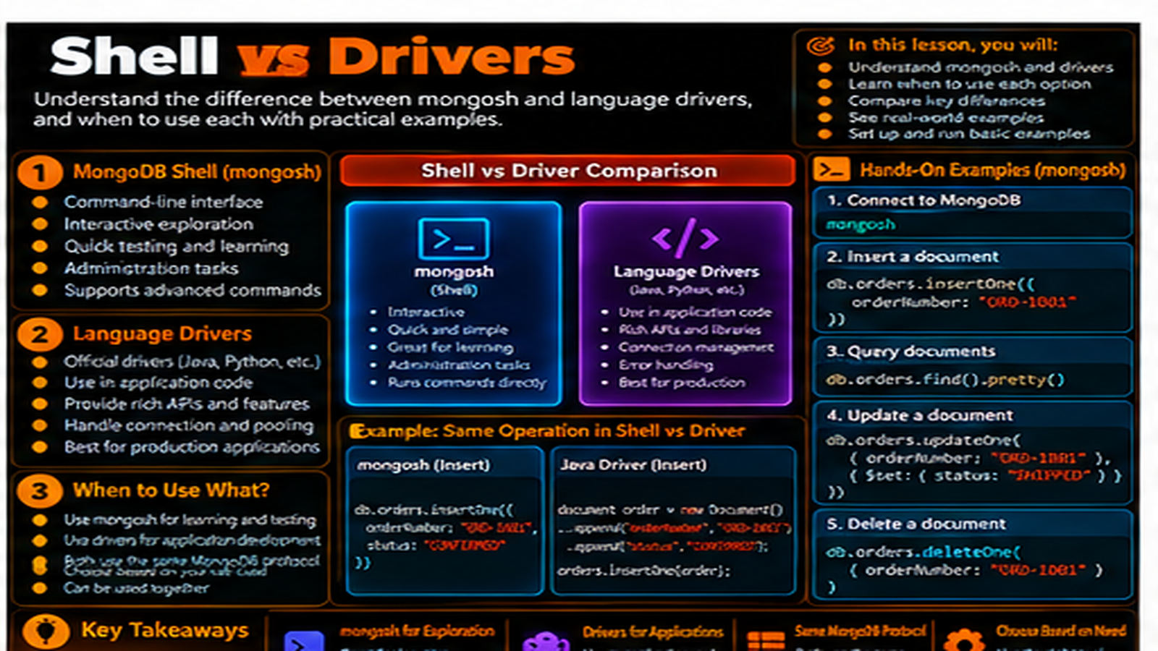

Slide 2
Shell vs Drivers
Understand the difference between interactive mongosh access and programmatic application access through drivers.
In this lesson, you will
Running example
Understand the role of mongosh
Understand the role of language drivers
See the same MongoDB operation expressed two ways
Know where each access path fits
Carry MongoDB concepts from shell to application code
Order Management
Application
Application
MongoDB
Document
The lesson keeps the data shape connected to a real developer problem.

Slide 3
mongosh: interactive access
mongosh is an interactive command-line environment.
Developers use it to connect, explore data, test queries, and troubleshoot.
It provides quick feedback while learning MongoDB.
It is a client, not the database server itself.
mongosh
use orderdb
db.orders.insertOne({
orderId: "ORD-1001",
status: "CONFIRMED",
shippingAddress: { city: "Chennai" },
items: [{ sku: "KB-101", qty: 2, price: 1499.00 }]
})
db.orders.findOne({ orderId: "ORD-1001" })
Run the demo, then change one value and rerun it.

Slide 4
Drivers: application access
Drivers provide language-specific APIs for MongoDB.
Application code uses drivers to create, read, update, and delete data.
The driver translates application operations into MongoDB requests.
The application owns the workflow; MongoDB remains the data service.
mongosh
Driver
mongosh
mongosh
db.orders.find({
status: "CONFIRMED"
})
const orders = await
collection.find({
status: "CONFIRMED"
}).toArray();
Same filter. Different client context.

Slide 5
Same operation, two expressions
The MongoDB concept stays the same.
mongosh expresses the operation interactively.
A driver expresses the same operation inside application code.
The data model does not change just because the client changes.
mongosh
Driver
mongosh
mongosh
db.orders.find({
status: "CONFIRMED"
})
const orders = await
collection.find({
status: "CONFIRMED"
}).toArray();
Same filter. Different client context.

Slide 6
Example: find an order
mongosh can run a direct find on the orders collection.
A driver can execute the same filter through application code.
Both use the same collection and business field.
The difference is the execution context and programming interface.
mongosh
Driver
mongosh
mongosh
db.orders.find({
status: "CONFIRMED"
})
const orders = await
collection.find({
status: "CONFIRMED"
}).toArray();
Same filter. Different client context.

Slide 7
When each path fits
Use mongosh for learning, exploration, testing, and troubleshooting.
Use drivers for application features and workflows.
Both can work with the same database and collections.
Choose the tool according to where the operation belongs.
mongosh
Driver
mongosh
mongosh
db.orders.find({
status: "CONFIRMED"
})
const orders = await
collection.find({
status: "CONFIRMED"
}).toArray();
Same filter. Different client context.

Slide 8
The developer bridge
Learn a MongoDB operation in mongosh first.
Understand what the operation does.
Translate that concept into the application driver.
Keep the database behavior separate from application orchestration.
mongosh
Driver
mongosh
mongosh
db.orders.find({
status: "CONFIRMED"
})
const orders = await
collection.find({
status: "CONFIRMED"
}).toArray();
Same filter. Different client context.

Slide 9
Hands-on: same order workflow
Insert an order with mongosh.
Read it back with a shell query.
Review the equivalent application-driver operation.
Compare syntax without changing the underlying MongoDB concept.
mongosh
use orderdb
db.orders.insertOne({
orderId: "ORD-1001",
status: "CONFIRMED",
shippingAddress: { city: "Chennai" },
items: [{ sku: "KB-101", qty: 2, price: 1499.00 }]
})
db.orders.findOne({ orderId: "ORD-1001" })
Run the demo, then change one value and rerun it.

Slide 10
What to remember
Shell and drivers are different clients.
Shell is interactive; drivers are programmatic.
The same MongoDB data model sits underneath both.
Move from shell understanding to application code with confidence.
mongosh
Driver
mongosh
mongosh
db.orders.find({
status: "CONFIRMED"
})
const orders = await
collection.find({
status: "CONFIRMED"
}).toArray();
Same filter. Different client context.

Slide 11
Next step
Bring shell, drivers, Compass, and other clients together into one architecture picture.
mongosh
Driver
mongosh
mongosh
db.orders.find({
status: "CONFIRMED"
})
const orders = await
collection.find({
status: "CONFIRMED"
}).toArray();
Same filter. Different client context.

Slide 12
Key Takeaways
Understand the difference between interactive mongosh access and programmatic application access through drivers.
01
02
03
04
05
Understand the role of mongosh
Understand the role of language drivers
See the same MongoDB operation expressed two ways
Know where each access path fits
Carry MongoDB concepts from shell to application code
One concept at a time • one real example • repeat the practice loop

