Slide 1
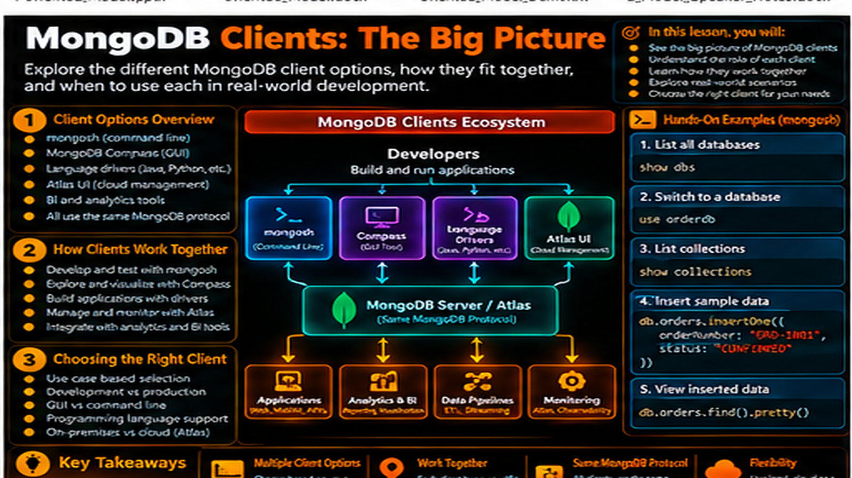

Slide 2
MongoDB + Clients: The Big Picture
See how applications, mongosh, Compass, drivers, and MongoDB fit together as one client-to-database flow.
In this lesson, you will
Running example
Identify different MongoDB clients
Understand the client-to-server communication path
See how the same data is accessed through different interfaces
Connect client choice to developer workflow
Build a clear MongoDB architecture mental model
Order Management
Application
Application
MongoDB
Document
The lesson keeps the data shape connected to a real developer problem.

Slide 3
Different clients, one data platform
Applications use drivers.
Developers can use mongosh.
Teams can inspect data with Compass.
Managed environments can be accessed through the same client concepts.
Application
mongosh
Compass
Driver
Tools
MongoDB
Clients connect to the same MongoDB data service.

Slide 4
The communication path
User interacts with an application.
The application uses a MongoDB driver.
The driver communicates with MongoDB.
MongoDB executes the operation and returns the result.
Application
mongosh
Compass
Driver
Tools
MongoDB
Clients connect to the same MongoDB data service.

Slide 5
The same data through different clients
A shell query can inspect an order.
Compass can visually inspect the same collection.
A language driver can read the same document for an application screen.
Different interfaces do not create different MongoDB data models.
Application
mongosh
Compass
Driver
Tools
MongoDB
Clients connect to the same MongoDB data service.

Slide 6
Choosing the right client
Use the shell for direct exploration.
Use Compass for visual inspection and management tasks.
Use drivers for application behavior.
Use import and integration tools when moving or connecting data.
Application
mongosh
Compass
Driver
Tools
MongoDB
Clients connect to the same MongoDB data service.

Slide 7
Order Management workflow
Application receives an order request.
Driver sends the operation to MongoDB.
MongoDB stores or retrieves the document.
The result returns to the application.
The developer can use mongosh or Compass to inspect the same data.
Application
mongosh
Compass
Driver
Tools
MongoDB
Clients connect to the same MongoDB data service.

Slide 8
Troubleshooting the path
Ask which client issued the operation.
Check the connection between client and MongoDB.
Separate application logic from database behavior.
Use the shell or Compass to inspect the data independently when useful.
Application
mongosh
Compass
Driver
Tools
MongoDB
Clients connect to the same MongoDB data service.

Slide 9
Hands-on: follow one request
Insert an order from mongosh.
Query the collection.
Trace where a driver would sit in an application.
Identify where MongoDB processes the operation.
mongosh
use orderdb
db.orders.insertOne({
orderId: "ORD-1001",
status: "CONFIRMED",
shippingAddress: { city: "Chennai" },
items: [{ sku: "KB-101", qty: 2, price: 1499.00 }]
})
db.orders.findOne({ orderId: "ORD-1001" })
Run the demo, then change one value and rerun it.

Slide 10
What to remember
Client is the access path; MongoDB is the data service.
Applications usually use drivers.
Developers often use shell and visual tools.
A clear client-to-server mental model helps development and troubleshooting.
Application
mongosh
Compass
Driver
Tools
MongoDB
Clients connect to the same MongoDB data service.

Slide 11
Next step
Finish the foundations with the complete developer learning path and expectations.
Application
mongosh
Compass
Driver
Tools
MongoDB
Clients connect to the same MongoDB data service.

Slide 12
Key Takeaways
See how applications, mongosh, Compass, drivers, and MongoDB fit together as one client-to-database flow.
01
02
03
04
05
Identify different MongoDB clients
Understand the client-to-server communication path
See how the same data is accessed through different interfaces
Connect client choice to developer workflow
Build a clear MongoDB architecture mental model
One concept at a time • one real example • repeat the practice loop

