Slide 1
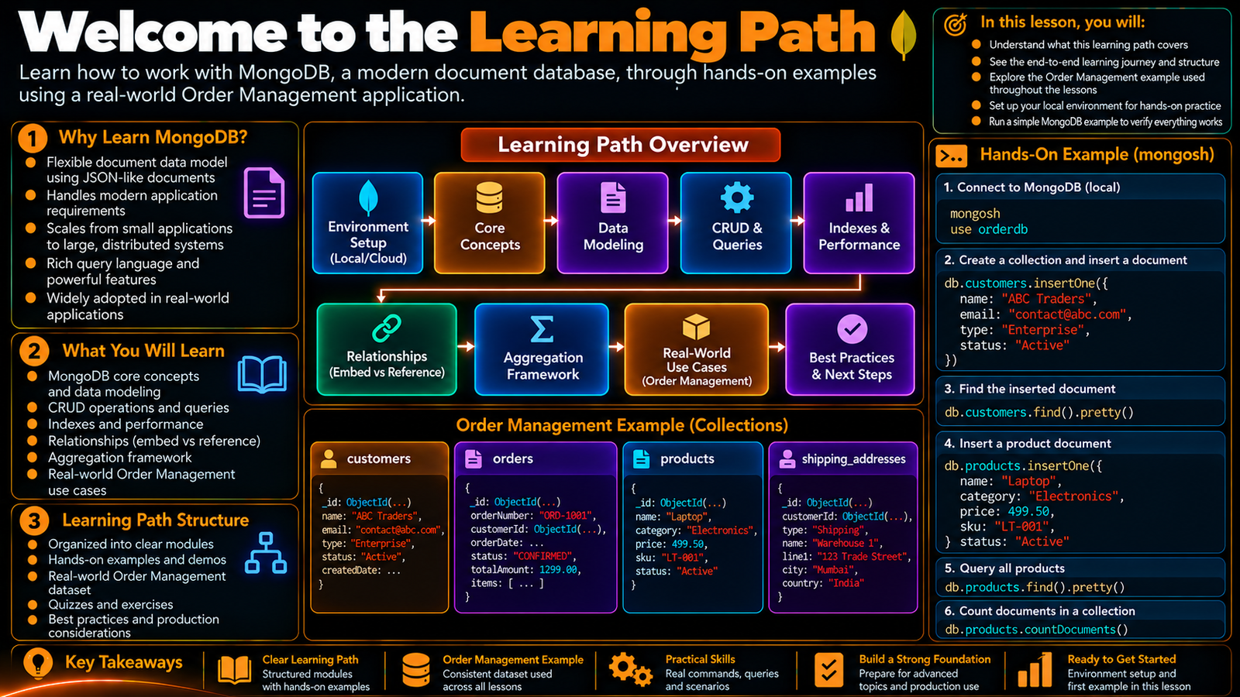

Slide 2
Developer Learning Path and Expectations
Understand how the learning path is organized, what to practice, and what to expect from the MongoDB Developer journey.
In this lesson, you will
Running example
Understand the structure of the learning path
Know how topics build progressively
Use active practice after each lesson
Understand the role of the recurring Order Management example
Know what successful practice looks like
Order Management
Application
Application
MongoDB
Document
The lesson keeps the data shape connected to a real developer problem.

Slide 3
How the learning path is structured
The journey moves from fundamentals to data modeling and developer skills.
Later lessons introduce querying, indexing, aggregation, application work, and production topics.
Each lesson adds one practical building block.
The same mental model should become stronger over time.
WATCH
PAUSE
CHANGE
CHECK
REPEAT
Understand the idea
Run the demo
Modify a value
Verify the result
Build fluency
Active practice is part of the learning design, not an optional extra.

Slide 4
What you will learn
MongoDB concepts and the document model.
Data modeling, relationships, and validation.
CRUD, querying, arrays, aggregation, and performance.
Application integration, testing, security, and production practices.
WATCH
PAUSE
CHANGE
CHECK
REPEAT
Understand the idea
Run the demo
Modify a value
Verify the result
Build fluency
Active practice is part of the learning design, not an optional extra.

Slide 5
The practice loop
Watch the explanation.
Pause and run the demo yourself.
Change a safe value and rerun it.
Check the result and explain what happened.
Repeat until the operation feels natural.
WATCH
PAUSE
CHANGE
CHECK
REPEAT
Understand the idea
Run the demo
Modify a value
Verify the result
Build fluency
Active practice is part of the learning design, not an optional extra.

Slide 6
What to expect from the lessons
Short, focused explanations.
Hands-on examples with real MongoDB commands.
A recurring Order Management scenario.
Progressive complexity rather than a jump straight to advanced topics.
WATCH
PAUSE
CHANGE
CHECK
REPEAT
Understand the idea
Run the demo
Modify a value
Verify the result
Build fluency
Active practice is part of the learning design, not an optional extra.

Slide 7
Developer habits to build
Read the data shape before writing the query.
Start from requirements and access patterns.
Use the shell to verify assumptions.
Keep examples reproducible and change small values deliberately.
WATCH
PAUSE
CHANGE
CHECK
REPEAT
Understand the idea
Run the demo
Modify a value
Verify the result
Build fluency
Active practice is part of the learning design, not an optional extra.

Slide 8
From concept to real application
Understand the MongoDB concept.
Shape the data.
Practice the operation.
Translate the idea into application code.
Connect the pieces into a real project workflow.
WATCH
PAUSE
CHANGE
CHECK
REPEAT
Understand the idea
Run the demo
Modify a value
Verify the result
Build fluency
Active practice is part of the learning design, not an optional extra.

Slide 9
Hands-on checkpoint
Open mongosh and connect to MongoDB.
Create or use the application database.
Insert a simple order document.
Explain the document shape and how the shell accessed it.
mongosh
use orderdb
db.orders.insertOne({
orderId: "ORD-1001",
status: "CONFIRMED",
shippingAddress: { city: "Chennai" },
items: [{ sku: "KB-101", qty: 2, price: 1499.00 }]
})
db.orders.findOne({ orderId: "ORD-1001" })
Run the demo, then change one value and rerun it.

Slide 10
What success looks like
You can explain MongoDB concepts in your own words.
You can reproduce and modify the demos.
You can connect a data-model decision to an application requirement.
You can move from interactive shell work toward application development.
WATCH
PAUSE
CHANGE
CHECK
REPEAT
Understand the idea
Run the demo
Modify a value
Verify the result
Build fluency
Active practice is part of the learning design, not an optional extra.

Slide 11
Ready for the next section
The foundation is now complete.
The next stage moves into the development environment and MongoDB tooling.
WATCH
PAUSE
CHANGE
CHECK
REPEAT
Understand the idea
Run the demo
Modify a value
Verify the result
Build fluency
Active practice is part of the learning design, not an optional extra.

Slide 12
Key Takeaways
Understand how the learning path is organized, what to practice, and what to expect from the MongoDB Developer journey.
01
02
03
04
05
Understand the structure of the learning path
Know how topics build progressively
Use active practice after each lesson
Understand the role of the recurring Order Management example
Know what successful practice looks like
One concept at a time • one real example • repeat the practice loop

