Slide 1
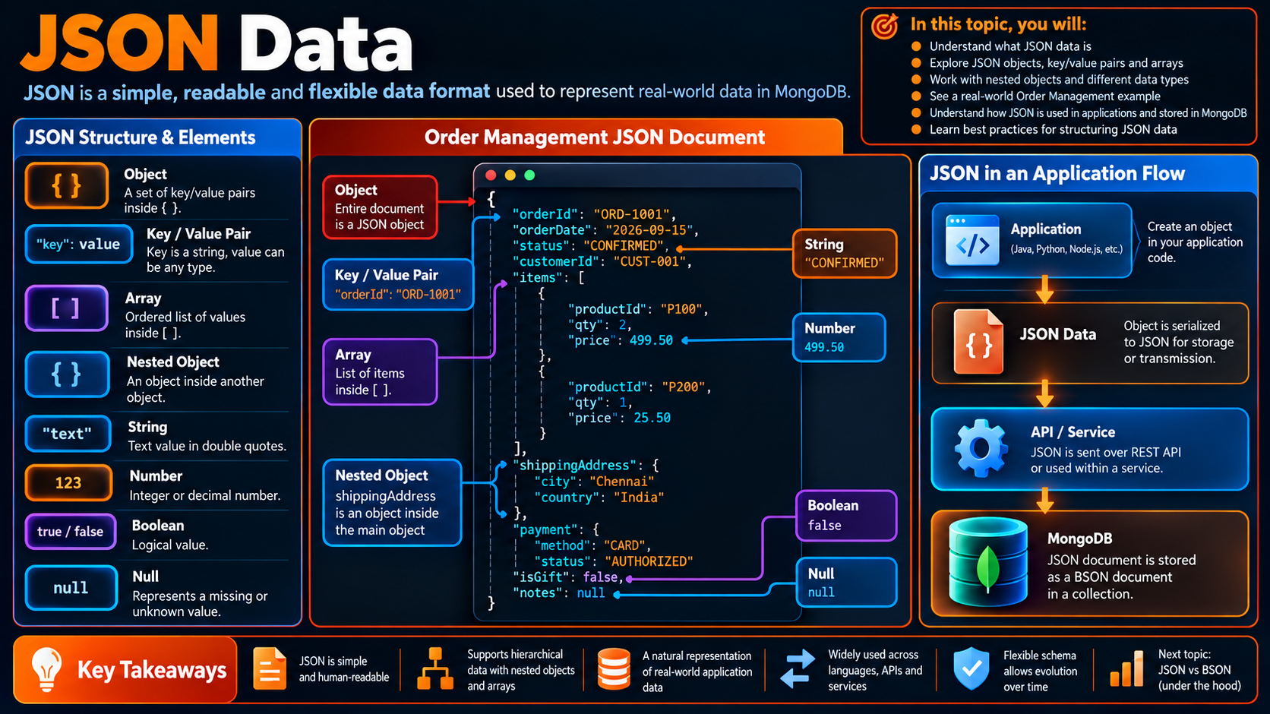

Slide 2
JSON
Data
In this lesson, you will:
A simple, readable structure for representing application data
• Understand what JSON is and why developers use it
• Recognize objects, key/value pairs and arrays
• Build nested JSON structures
• Read a real Order Management document
• Connect JSON with APIs and MongoDB
• Apply simple rules for readable structure
Running Example — Order Management
JSON object
JSON is built from
{
"orderId": "ORD-1001",
"status": "CONFIRMED",
"items": [
{ "productId": "P100", "qty": 2 },
{ "productId": "P200", "qty": 1 }
],
"shippingAddress": {
"city": "Chennai",
"country": "India"
}
}
Objects
Key / value pairs
Arrays
Nested objects
Foundation
Next: JSON → BSON

Slide 3
Why JSON Matters
Developers can understand structured data at a glance — without a table diagram.
1
Readable
2
Hierarchical
Human-friendly syntax makes the structure easy to inspect.
Objects and arrays can represent nested application data.
3
Portable
4
Natural for Apps
JSON is widely used between applications, APIs and services.
Many languages map JSON objects directly to application objects.

Slide 4
JSON Objects & Key / Value Pairs
The core building block is an object: a set of named properties inside { }.
Order object
Think in properties
JSON example
{
"orderId": "ORD-1001",
"status": "CONFIRMED",
"totalAmount": 1001.00
}
Key
orderId
Value
ORD-1001
Pair
"status": "CONFIRMED"
A key identifies the field; the value carries the data.

Slide 5
JSON Arrays
Arrays are ordered lists written with [ ], and they can hold values or objects.
Simple array
Where arrays appear
strings
[
"laptop",
"mouse",
"keyboard"
]
Tags
A short list of labels
Items
Repeated business objects
Array of objects
items[]
History
Ordered events or states
[
{ "productId": "P100", "qty": 2 },
{ "productId": "P200", "qty": 1 }
]
Options
Selectable values
Order matters when the application assigns meaning to position.

Slide 6
Nested Objects
One object can contain another object, creating a hierarchy that mirrors the application.
shippingAddress
Follow the path
Nested JSON
{
"orderId": "ORD-1001",
"shippingAddress": {
"city": "Chennai",
"country": "India"
}
}
order
shippingAddress
city
top level
nested object
target field
Field path: order → shippingAddress → city
Nested structures are useful when the data belongs naturally to the parent object.

Slide 7
Order Management as JSON
One business object can combine strings, numbers, arrays and nested objects in one readable structure.
Order document
orderId • status • orderDate
Top-level fields
{
"orderId": "ORD-1001",
"orderDate": "2026-09-15",
"status": "CONFIRMED",
"items": [
{ "productId": "P100", "qty": 2, "price": 499.50 },
{ "productId": "P200", "qty": 1, "price": 25.50 }
],
"shippingAddress": { "city": "Chennai", "country": "India" },
"payment": { "method": "CARD", "status": "AUTHORIZED" }
}
Array
items[] holds repeated objects
Nested object
shippingAddress and payment
Simple values
strings • numbers • booleans

Slide 8
Common JSON Value Types
Most JSON can be understood by recognizing a small set of value categories.
String
Number
Boolean
"CONFIRMED"
1499.00
true / false
Text
Numeric value
Logical value
Null
Object
Array
null
{ … }
[ … ]
No value
Nested structure
Ordered list

Slide 9
JSON Structure at a Glance
Read from the outside in: object → properties → nested objects → arrays → values.
ORDER OBJECT
orderId
status
items[]
shippingAddress
String
String
Array
Object
JSON is hierarchical: the structure tells you how the pieces belong together.

Slide 10
JSON in Application Development
JSON often sits between application objects, APIs, and database documents.
1
Application
2
Serialize
3
API / Service
4
MongoDB
</>
{}
⇄
MongoDB
Create an object
in Java, Python,
Node.js, etc.
Convert the object
to JSON text.
Send JSON through
REST or messaging.
Represent data as a
JSON-like BSON document.
Developer habit: keep the object shape readable before it crosses a service boundary.

Slide 11
Practical JSON Checklist
Use the checklist whenever you create or review structured application data.
1
Start with the business object
What real-world thing are you representing?
2
Name properties clearly
Can another developer understand the keys?
3
Choose the right structure
Should this be a scalar, object or array?
4
Group related data
Does the nesting reflect the relationship?
5
Keep the shape readable
Can someone understand the structure at a glance?
These habits make the next BSON, schema and data-modeling lessons easier to understand.

