Slide 1
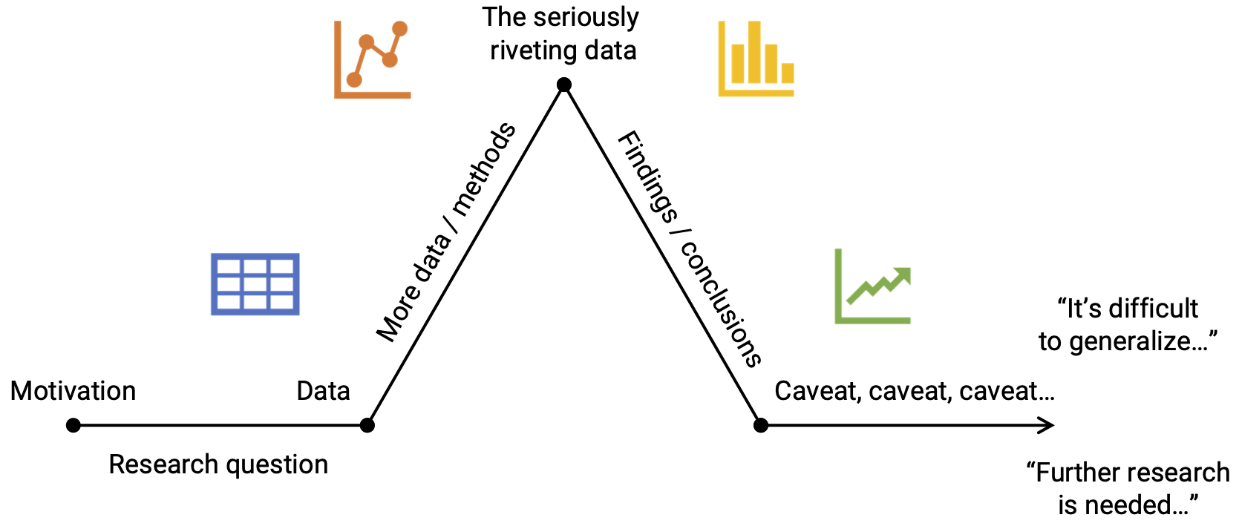
Telling a Story
Slide Design
“A single (static) visualization will rarely tell an entire story” – Clause O. Wilke (2019), Chp. 29.
Use layers or animation to build tension / provide context.
Make charts for the generals (i.e. keep it simple).
Build up towards complex figures.
Be consistent, but don't be repetitive.
Hitchcock’s rule: The size of any object on your slide should be proportional to its importance to the story at that moment.
Slide titles: A single statement about what slide means (in big font!).
Use large font sizes (>40 titles, >24 text).
Use fonts as pre-attentive attributes, e.g. san-serifs for slide text, italic serif for quotes.
Consider using a light-colored background (tan / gray)
Use high contrast between font and background color.
Don’t use silly fonts like Comic Sans, Papyrus, etc.
1 slide, 1 idea: Break up main points into multiple slides.
Slide numbers: bottom-left or bottom-right.
Remove “chart junk”: logos, etc. (exception: small footers).
Consider using handouts.
Starting a Speech
Tell a story, talk about people (“Imagine...”).
Use a shocking factoid (“There are more people alive today than have ever lived...”).
Ask a question that matters to the audience (“Have you ever...?”).

