Slide 1
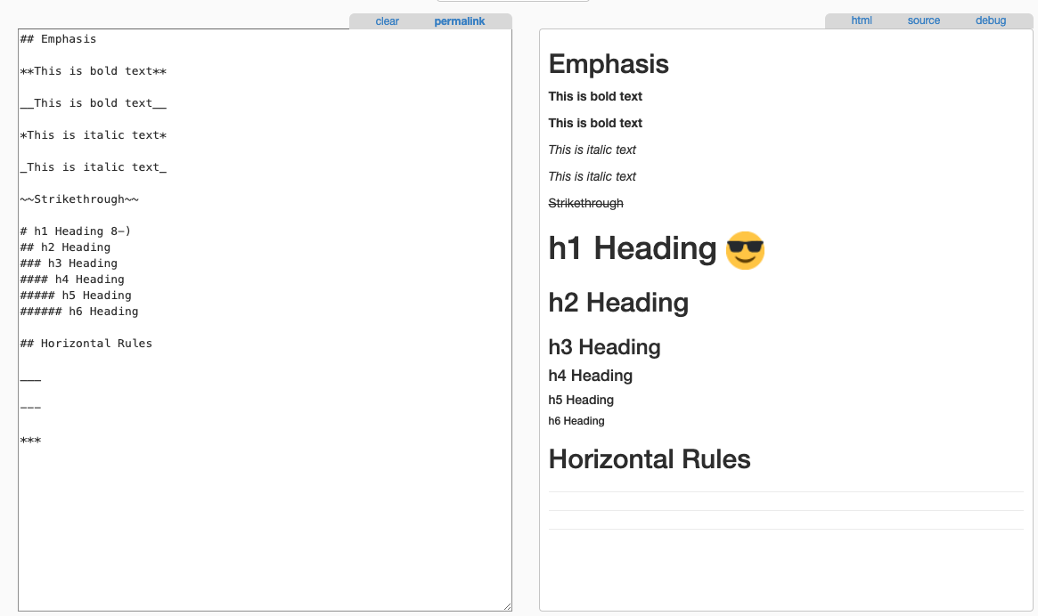
Plain Text | Rich Text

