Slide 1
Data-Driven Insights into Housing Trends: Forecasting Affordability Risks
Ethan ShElburne
BrainSTATION – The DIGITAL LEARNING COMPANY

Slide 2
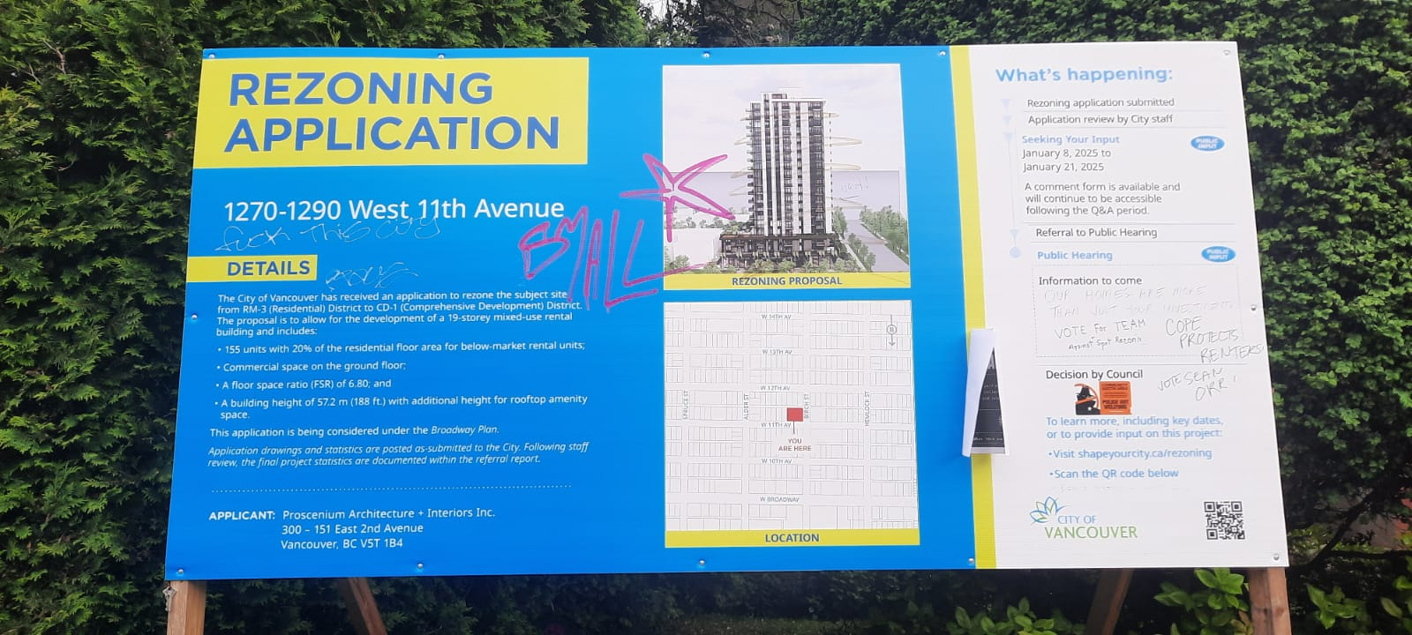
“our homes are more JUST than your investment”
The Broadway Plan is a 30-year redevelopment strategy for Vancouver’s Broadway Corridor, focused on building high-rise housing nearby new SkyTrain stations.
Critics fear it will lead to the displacement of renters and worsening affordability.
This project uses machine learning to model how new developments may impact local housing affordability.

Slide 3
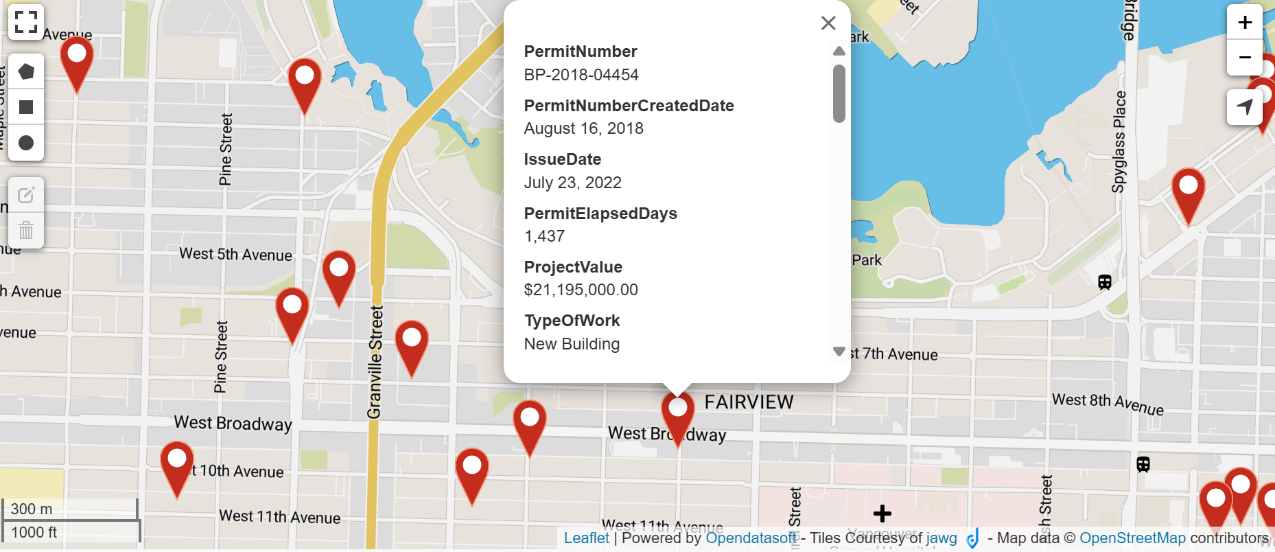
Predictive modeling with Machine learning
Goal: Build a predictive tool to estimate the effects of developments like those in the Broadway Plan.
Define affordability metrics at the neighborhood level.
Use supervised machine learning regression models (such as Linear Regression, Random Forest, and K-nearest neighbors) to uncover correlations between development types and shifts in affordability.

Slide 4

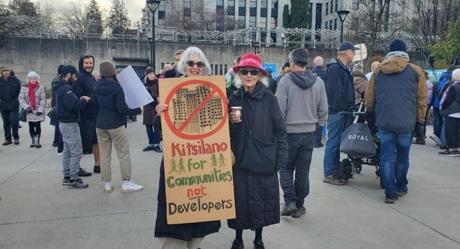
PURSUING HOUSING equity with data science
Activists have organized protests to challenge displacement linked to large-scale redevelopment plans.
My goal is to provide a data-driven tool to help assess how specific developments may impact neighborhood affordability.

Slide 5


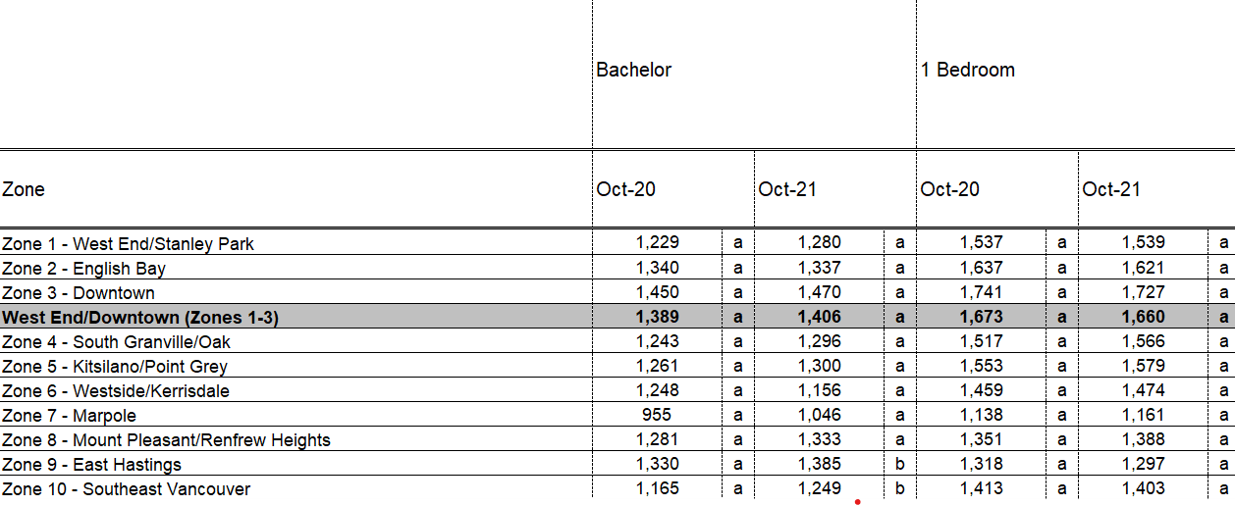
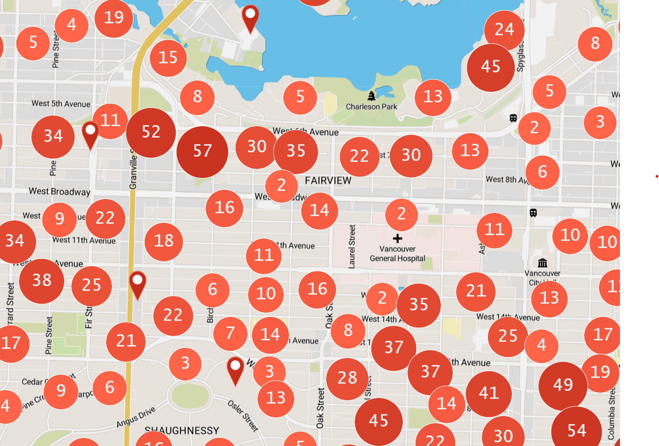
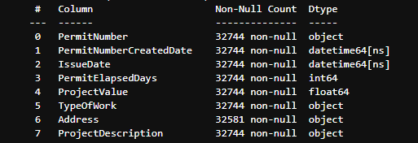
Introducing the data
The project combines housing construction data with neighborhood-level economic indicators.
Preliminary EDA shows the datasets are rich and detailed.
I anticipate challenges in merging datasets and handling inconsistent values.
Careful adjustments will also be needed to account for macroeconomic factors.

Slide 6
NEXT STEPS
Clean and organize datasets, building a cohesive database using SQL and Python.
Conduct feature engineering to align construction data with neighborhood-level economic indicators.
Research machine learning models used in housing analysis to identify suitable algorithms.
Begin baseline modeling!

Slide 7
Questions?

