Slide 1
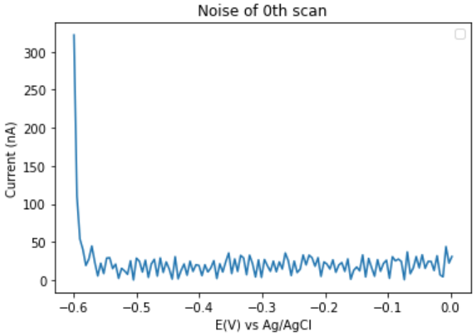
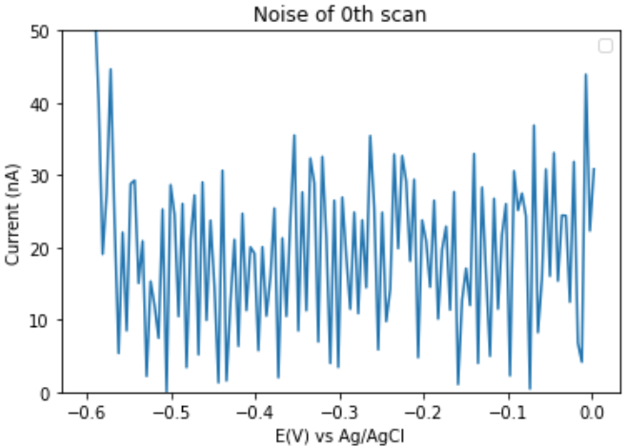
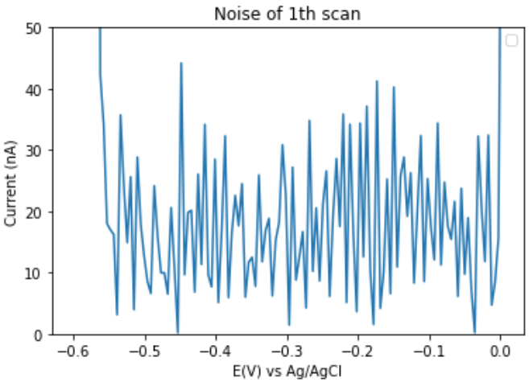
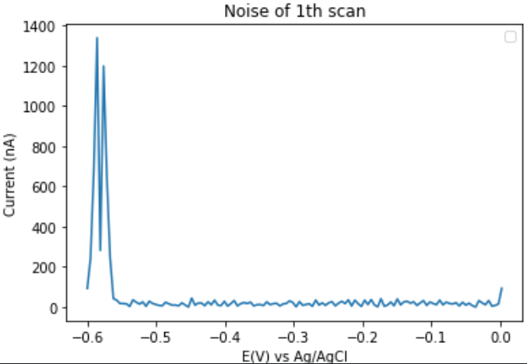
New algorithm:
Use the same voltage window of peak finding algorithm for noise level discovery
Currently the peak height threshold is around 100 nA (experiment output-dependent) at defined signal-to-noise ratio of 3.
Most of the bigger noise came from the edges of the scanning window, while the real noise envelope is in the range of 10 to 40 nA

