Slide 1
DBW301 Final Project

Slide 2




Member
AnhPN MienNTH PhongVH TrungĐQ

Slide 3
Table of content
1. Introduction
2. Project manager
3. Data warehouse requirement
4. Data warehouse Design
5. Demo

Slide 4
1. Introduction
This project is to design and implement a data warehouse for a customer order processing system in a company

Slide 5
2. Project manager
2.1 Team organization
2.2 Communication
2.3 Tools

Slide 6
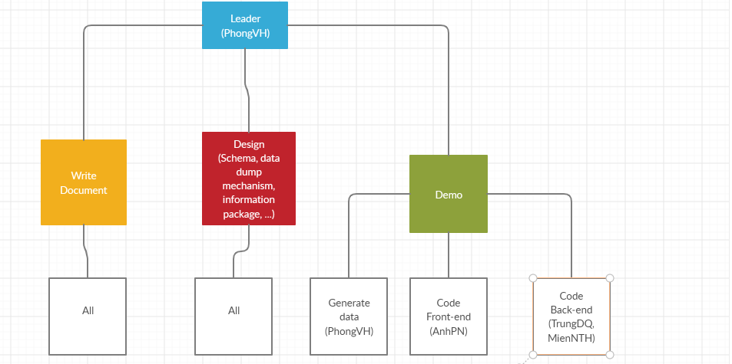
2.1 Team organization

Slide 7


2.2 Communication
- Time: Working together for at least 4 hours a day,
fourth time a week
- Location: School, home and

Slide 8

2.3 Tool
Visual studio 2017
DevExpress

Slide 9

2.3 Tool
SQL 17 – SSMS 2017
SQL Service Analysis Serviecs

Slide 10
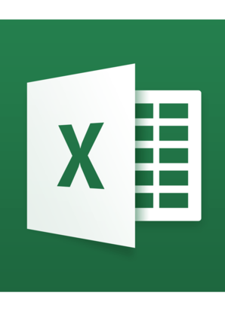
2.3 Tool
Excel
Date online generator

Slide 11
3. Data warehouse requirement
Find all the stores along with city, state, phone, description, size, weight and
unit price that hold a particular item of stock.
Find all the orders along with customer name and order date that can be
fulfilled by a given store.
Find all stores along with city name and phone that hold items ordered by
given customer.
Find the headquarter address along with city and state of all stores that hold
stocks of an item above a particular level.
For each customer order, show the items ordered along with description, store
id and city name and the stores that hold the items.
Find the city and the state in which a given customer lives.
Find the stock level of a particular item in all stores in a particular city.
Find the items, quantity ordered, customer, store and city of an order.
9. Find the walk in customers, mail order customers and dual customers (both
walk-in and mail order).

Slide 12
4. Data warehouse design
4.1 Convert 2 relational databases Headquarter and Sales into Extended Entity Relationship (EER) model.
4.2 Integrate two EERs into on Integrated ERR (IEER)
4.3 Convert IEER into Integrated Database (IDB)
4.4 Write information packages
4.5 Star schema for data warehouse
4.6 Mapping mechanism from IDB to Data warehouse
4.7 Generate data for data warehouse

Slide 13
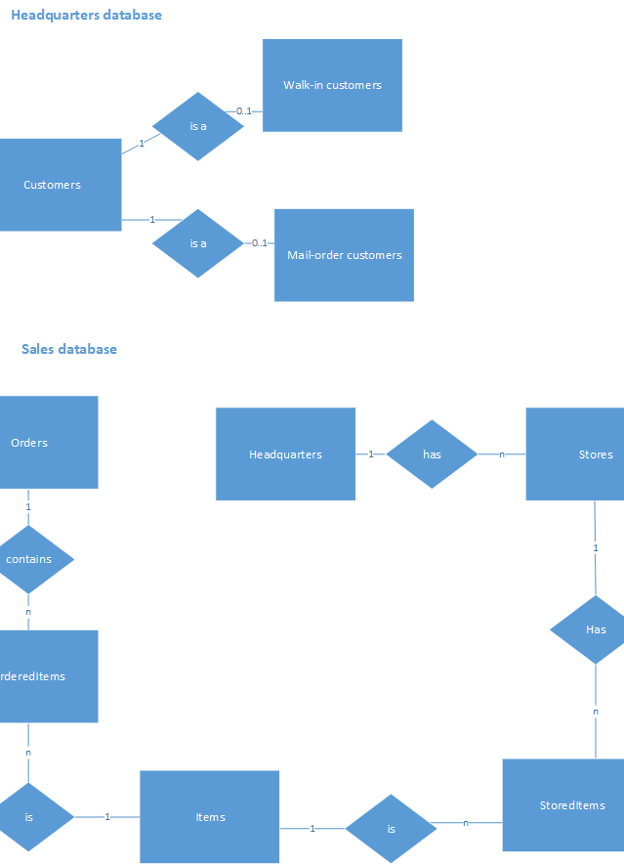
4.1 Data warehouse design Convert 2 relational databases Headquarter and Sales into Extended Entity Relationship (EER) model

Slide 14
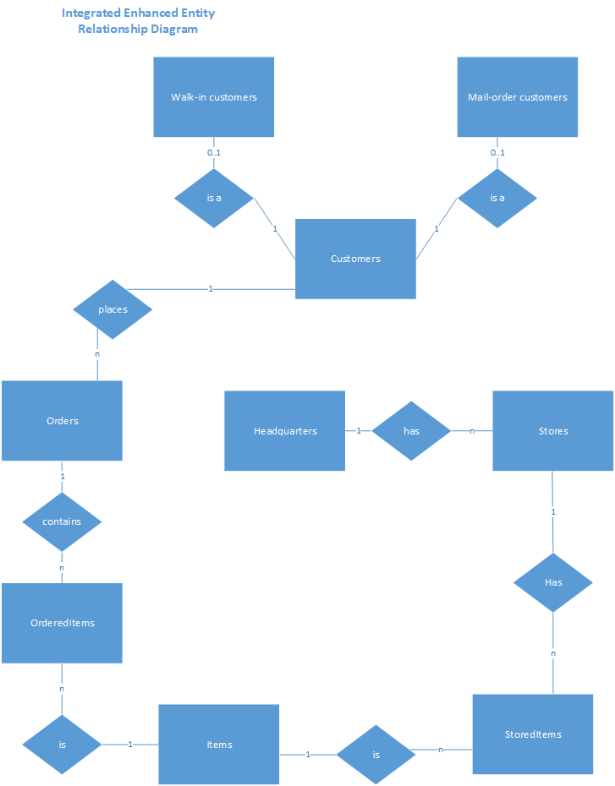
4.2 Data Integrate two EERs into on Integrated EER (IEER)

Slide 15
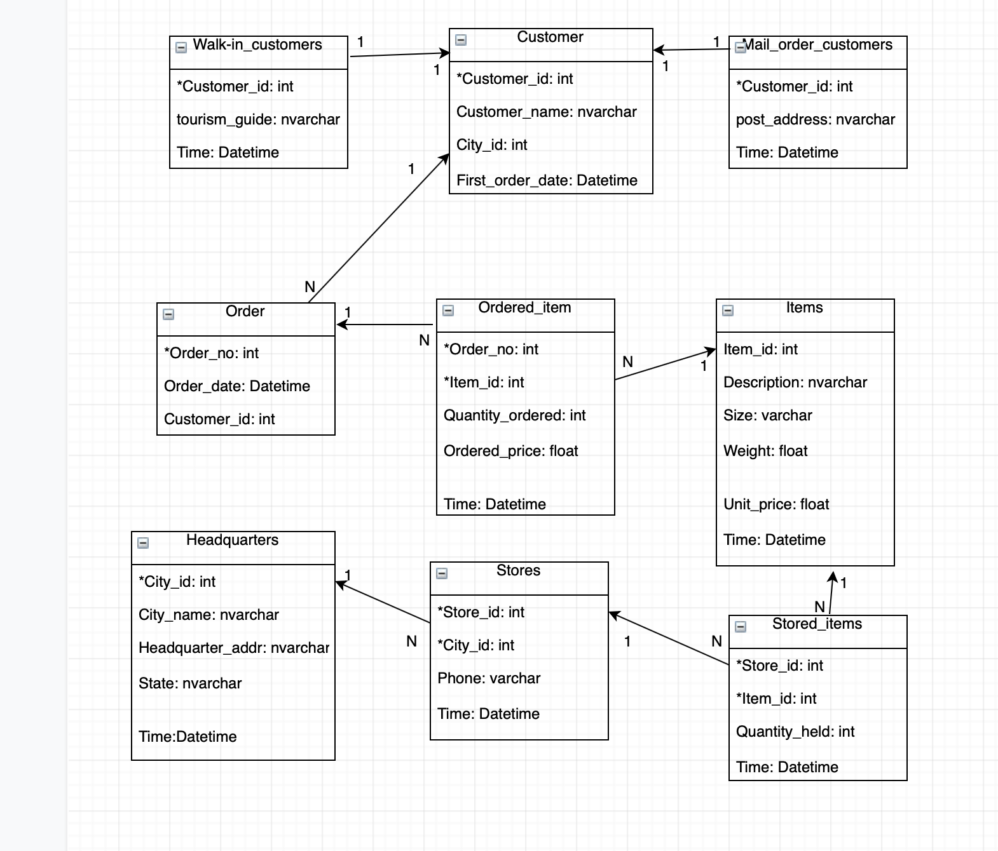
4.3 Convert IEER into Integrated Database (IDB)

Slide 16
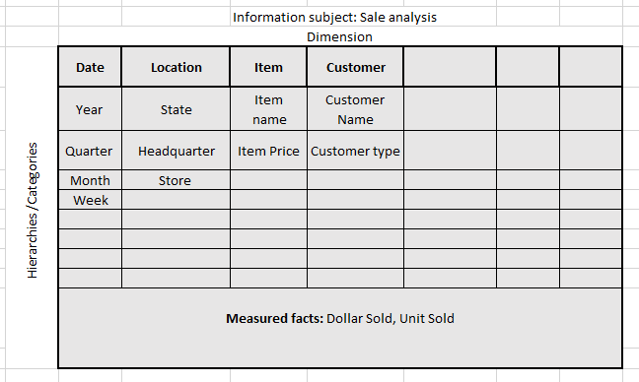
4.4 Write information package

Slide 17
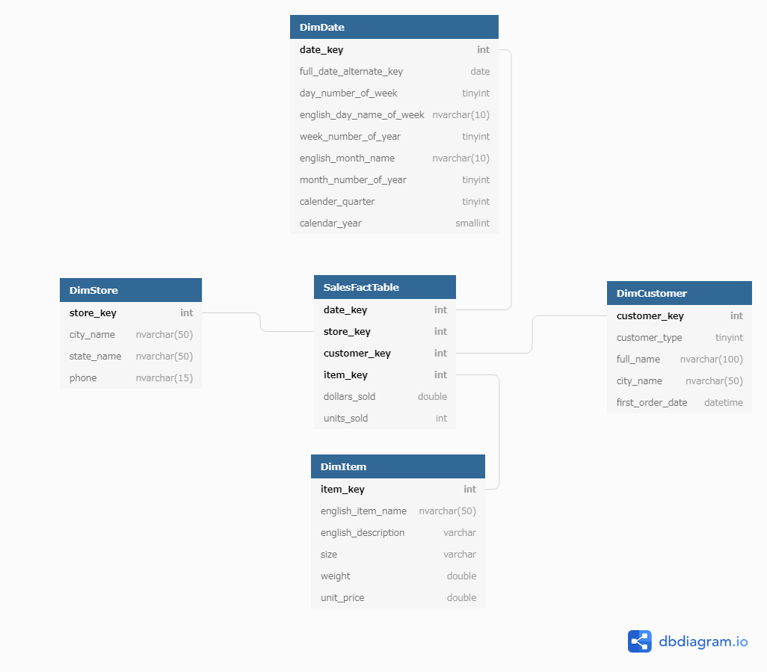
4.5 Start schema for data warehouse

Slide 18
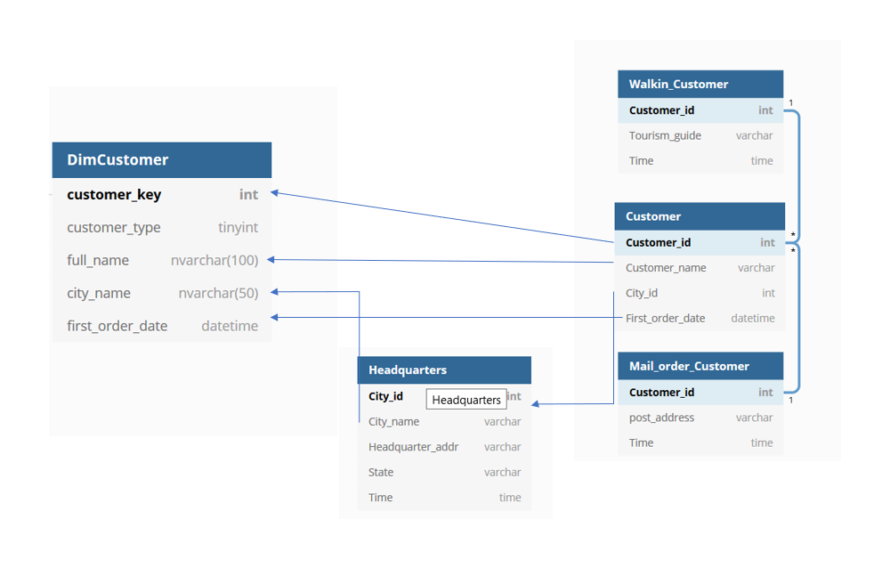
4.6 Mapping mechanism from IDB to Data warehouse

Slide 19
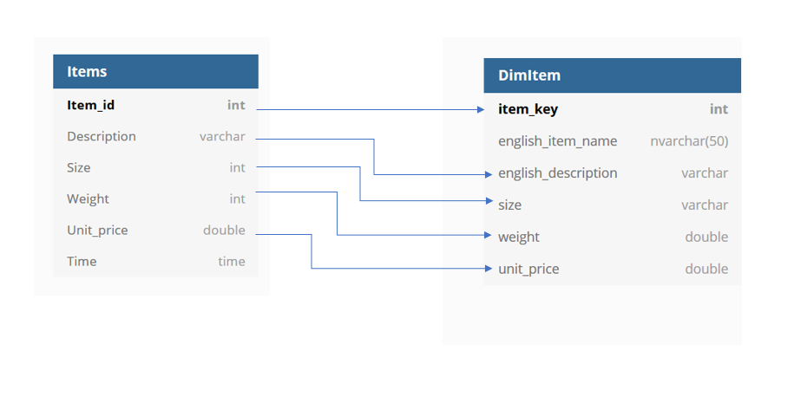
4.6 Mapping mechanism from IDB to Data warehouse

Slide 20
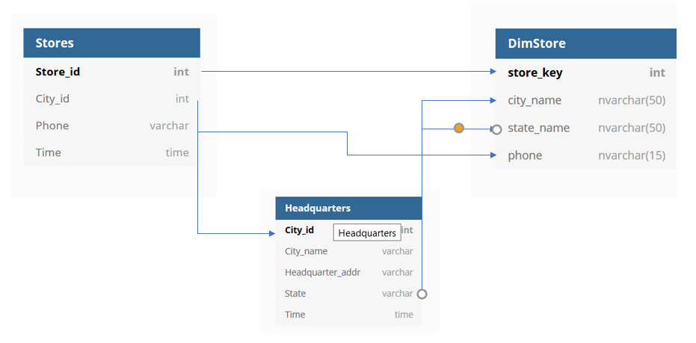
4.6 Mapping mechanism from IDB to Data warehouse

Slide 21
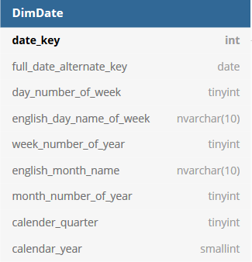
4.6 Mapping mechanism from IDB to Data warehouse

Slide 22
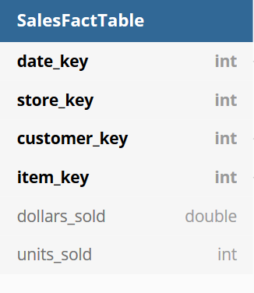
4.6 Mapping mechanism from IDB to Data warehouse

Slide 23
4.7 Generated data for data warehouse
We generated 10.000 records for each dimension table and nearly 40.000 records for SalesFact table.
Steps taken:
=> Generate data to for DBW_Final database
Tools used: Excel + data online generator
=> Import data into database using SQL Server Import and Export Data Wizard
=> Use Visual Studio 2017 Analysis Service Extension to import data from SQL Server to SQL Server analysis service

Slide 24

Thank you for your present

