Slide 1
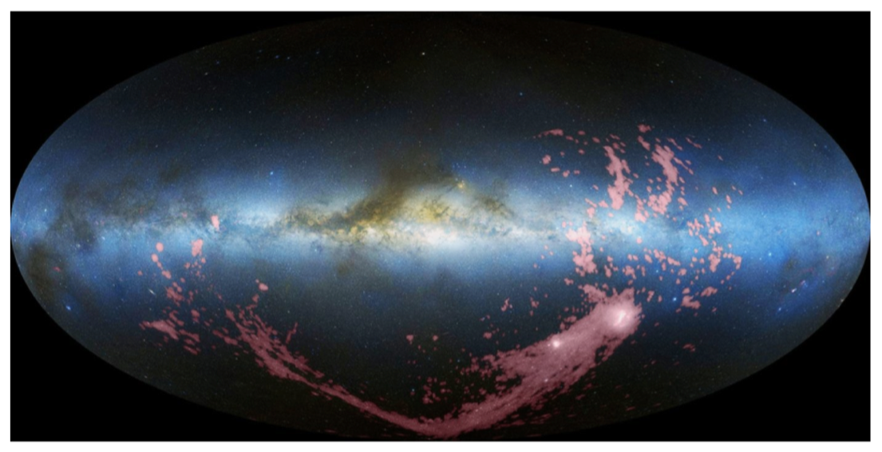
The Effects of the Galactic Center on the Ionization of the Magellanic Stream
Elaine M. Frazer¹, Andrew J. Fox¹, Joss Bland-Hawthorn², Kathleen A. Barger³ 1. Space Telescope Science Institute, Baltimore, MD, United States. 2. University of Sydney, Sydney, NSW, Australia. 3. Texas Christian University, Fort Worth, TX, United States
1. Introduction
The Magellanic System around our Milky Way (MW) galaxy consists of:
the Large and Small Magellanic Clouds (LMC and SMC)
the Magellanic Stream (“the Stream”): a filamentary system of multi-phase gas created primarily through tidal interactions between the LMC and SMC ~2Gyr ago
the Leading Arm (LA): a fragmented group of clouds that leads the LMC and SMC on their orbits around the galaxy
Fox et al. 2014 have observed
highly-ionized gas in the Stream and LA. There are two
competing models for how
this was created:
We use absorption spectra to look for (1) evidence of enhanced ionization of the Stream below the Galactic poles (see box 3), (2) differences between the low-ion and high-ion absorption components in the Stream and LA (see box 4), and (3) differences between the high-ion absorption in the Stream and LA (see boxes 5 and 6.)
4. Alignment of Different Stream and LA Sightline Components
The alignment of low- and high-ion components in different sightlines could lend evidence for the Seyfert model, while mis-alignment could point towards the two-phase model.
Above: The VoigtFit component fits to each LA sightline. Each figure shows the spectrum of a low ion and high ion plotted by relative velocity and offset flux, along with their best-fit lines. The dashed lines give the center redshift position of each component. The small number in the corner marks where each sightline lies on the map in box 3.
We see many examples of mis-aligned components: sightlines 1, 3, 4, 6.
Particularly interesting are the case where components appear at high-ion level, but not at the low-ion level, as in sightlines 1 and 3.
And vice-versa: sightlines 5 and 6.
Above: The VoigtFit component fits to each Stream sightline. The figures are as described above.
We see fewer examples of mis-aligned components: sightline 8 only.
There is 1 case where a component appears at high-ion level, but not at the low-ion level: sightline 9.
And vice-versa: sightlines 8 and 10.
5. Distribution of b-values
The figures to the right show the distribution of b-values of the low- and high-ion components of both the Stream and LA sightlines. High-ion components being wider in general than the low-ion components would lend evidence to the two-phase model.
We use the Kolmogorov–Smirnov (K-S) test to determine the probability that the two populations are drawn from different samples. The p-values are printed inside each plot. Within each direction, we see no significant difference between the low-ion and high-ion components.
Leading Arm Sightlines
Right: H I observations of the Magellanic System in Galactic coordinates, shown in pink (Nidever et al. 2010).
Galactic Center
Leading Arm
LMC
1
2
3
Magellanic Stream
SMC
the Seyfert flare model (Bland-Hawthorn et al. 2013): the Stream is photoionized by an energetic flash at the Galactic Center
the two-phase model: the high ions arise in mixing layers between the cool Stream/LA and the hot Galactic corona
Si IV
Si II
QSO
Si IV
Si IV
Si II
Si IV
QSO
Si IV
Si II
Si IV
Si II
Si II
T₁
T₂
T₂ > T₁
Si II
4
5
6
6. Distribution of Column Densities
We compare the distribution of the column densities of Si II, Si III, and Si IV components of the Stream and LA sightlines. The LA is much closer to the Milky Way disk, so one may expect to observe stronger high-ion absorption in those sightlines. The figures below show the opposite: stronger high-ion absorption in the Stream sightlines than in the LA.
As in box 5, we also test if there is a difference in the low- and high-ion populations in each direction. The p-values indicate that there’s no significant difference between the two populations.
Absorber
Observed Spectra
Si IV
Observed Spectra
Absorber
2. Data and Analysis
We study 6 sightlines through the Stream and 6 through the LA with far UV absorption spectra taken with the Cosmic Origins Spectrograph on Hubble from Fox et al. 2014 and 2018.
We use the Python package VoigtFit (Krogager 2018) to fit multi-component Voigt profiles to low and high ions for each sightline. We attempt to fit O I, C II, S II, Si II, Si III, Si IV, and C IV.
The VoigtFit module includes tasks to fit the continuum and mask unnecessary features while performing each fit. The outputs include a redshift, b-value (line width), and column density for each component fit. We compared the outputs of VoigtFit and VPFIT (Carswell & Webb 2014) for one LA sightline and found similar results.
Magellanic Stream Sightlines
7
8
9
7. Conclusions & Acknowledgements
There is evidence for slight high-ion enhancement in the Stream in the region below the Galactic Center.
Five out of 12 sightlines show evidence for mis-aligned low- and high-ion components.
We observe stronger high-ion absorption in the Stream than in the LA, but see no significant difference in the low-ion and high-ion populations with the Stream and LA themselves.
Future work includes expanding our sightline sample to include all 69 from Fox et al. 2014.
Sources:
Bland-Hawthorn, J., Maloney, P. R., et al. 2003, ApJ, 778, 1
Bland-Hawthorn, J., et al. 2018, submitted
Carswell R. F., Webb J. K., 2014, VPFIT, Astrophysics Source Code Library, 1408.015
D’Onghia, E. & Fox, A. J., 2016, ARA&A, 54, 363
Fox, A. J., Wakker, B. P., Barger, K. A., et al. 2014, ApJ, 787, 147
Fox, A. J., Barger, K. A., Wakker, B. P., et al. 2018, ApJ, 854, 142
Krogager, J. K., 2018, VoigtFit, https://arxiv.org/abs/1803.01187
Nidever, D. L., Majewski, S. R., & Burton, W. B. 2010, ApJ, 723, 1618
3. Effect of the GC on the Magellanic Stream
The plot below shows the ratio of total column density for a low/high ion pair for each sightline in our sample. The pairs will be either Si IV/Si II or C IV/ CII. Sightlines with white circles do not have measurements for those ions from VoigtFit. The Stream sightlines 8, 10, 11, and 12 (where we would expect the effects from the GC to be) all have elevated high-ion density.
10
11
12
2
1
4
3
5
6
12
8
11
7
9
10

