Slide 1
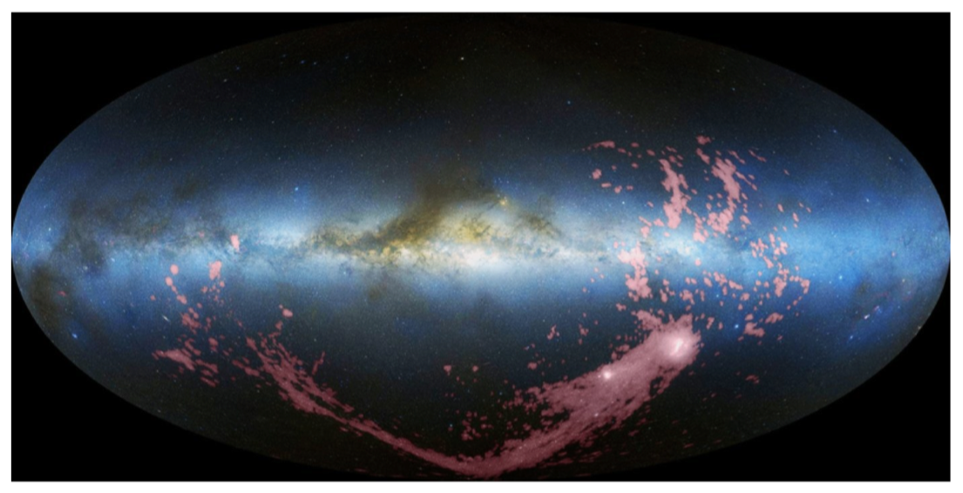

The Effects of the Galactic Center on the Ionization of the Magellanic Stream
Elaine M. Frazer¹, Andrew J. Fox¹, Joss Bland-Hawthorn², Kathleen A. Barger³ 1. Space Telescope Science Institute, Baltimore, MD, United States. 2. University of Sydney, Sydney, NSW, Australia. 3. Texas Christian University, Fort Worth, TX, United States
1. Introduction
The Magellanic System around our Milky Way (MW) galaxy consists of:
the Large and Small Magellanic Clouds (LMC and SMC)
the Magellanic Stream (“the Stream”): a filamentary system of multi-phase gas created primarily through tidal interactions between the LMC and SMC ~2Gyr ago
the Leading Arm (LA): a fragmented group of clouds that leads the LMC and SMC on their orbits around the galaxy
Fox et al. 2014 have observed
highly-ionized gas in the Stream
and LA. There are at least two
models for how this was created:
We use HST/COS absorption spectra to look for (1) evidence of enhanced ionization in the Stream below the Galactic pole (see box 3), (2) differences between the profiles of low-ion and high-ion absorption components in the Stream and LA (see box 4), and (3) differences between the distribution of absorption strengths in the Stream and LA (see boxes 5 and 6.)
4. Alignment of Different Stream and LA Sightline Components
The alignment of low- and high-ion components in different sightlines could lend evidence for the Seyfert model, while mis-alignment could point towards the two-phase model.
Above: The VoigtFit profiles for each LA sightline. Each figure shows the spectrum of a low ion and high ion plotted by relative velocity and offset flux, along with their best-fit lines. The dashed lines give the center redshift position of each component. The small number in the corner marks where each sightline lies on the map in box 3.
We see many examples of mis-aligned components: sightlines 1, 3, 4, 6.
Components seen in high ions, but not low ions: sightlines 1 and 3.
Components seen in low ions, but not high ions: sightlines 5 and 6.
Above: The VoigtFit component fits to each Stream sightline. The figures are as described above.
We see fewer examples of mis-aligned components: sightline 8 only.
Components seen in high ions, but not low ions: sightline 9.
Components seen in low ions, but not high ions: sightlines 8 and 10.
5. Distribution of b-values
The figures to the right show the distribution of b-values of the low- and high-ion components of both the Stream and LA sightlines. In the two-phase model, the low- and high-ion distributions are expected to differ. In the GC flare model, they are expected to match.
We use the Kolmogorov–Smirnov (K-S) test to determine the probability that the high- and low- ion populations are statistically distinct. The p-values are printed inside each plot. In the LA, there is 93% confidence that the high-ion components are distinctly broader than the low-ion components. In the Stream, there is no statistically significant evidence for a difference.
Leading Arm Sightlines
Right: H I observations of the Magellanic System in Galactic coordinates, shown in pink (Nidever et al. 2010).
Galactic Center
Leading Arm
LMC
3
Magellanic Stream
SMC
1
2
The Seyfert flare model (Bland-Hawthorn et al. 2013): the Stream (but not the LA) is photoionized by an energetic flash at the Galactic Center (GC)
The two-phase model: the high ions arise in turbulent or conductive mixing layers between the cool Stream/LA and the hot Galactic corona
Si IV
Si II
QSO
Si IV
Si II
Si IV
QSO
Si IV
4
5
6
6. Distribution of Column Densities
We compare the distribution of the column densities of Si II, Si III, and Si IV components of the Stream and LA sightlines. The LA is much closer to the Milky Way disk where the density of the ambient gas is higher, so one may expect to observe stronger high-ion absorption in those sightlines. The figures below show the opposite: stronger high-ion absorption in the Stream sightlines than in the LA. This could potentially be related to the GC flare elevating the high-ion column densities below the south Galactic pole.
Si II
flux
Si IV
Si II
T₁
flux
Si IV
velocity
Si II
Si IV
T₂
T₂ > T₁
velocity
Si II
Absorber
Observed Spectra
Absorber
Observed Spectra
2. Data and Analysis
We study 6 sightlines through the Stream and 6 through the LA with far UV absorption spectra taken with the Cosmic Origins Spectrograph on Hubble from Fox et al. 2014 and 2018.
We use the Python package VoigtFit (Krogager 2018) to fit multi-component Voigt profiles to low and high ions for each sightline. We fit O I, C II, S II, Si II, Si III, Si IV, and C IV, where detected.
The VoigtFit module outputs the redshift, b-value (line width), and column density for each component fit.
Magellanic Stream Sightlines
7
8
9
7. Conclusions & Acknowledgements
There is evidence for slight high-ion enhancement in the Stream in the region below the Galactic Center, as seen in the map of high/low ion ratios in box 3.
Five of 12 sightlines exhibit mis-aligned low- and high-ion components (box 4). Four of these are in the LA, while only one is in the Stream.
In the LA, we find the high-ion components are distinctly broader than the low-ion ones, whereas in the Stream, no difference is found (box 5).
We observe stronger high-ion absorption in the Stream than in the LA (box 6).
Future work includes expanding our sightline sample to include all 69 from Fox et al. 2014.
References:
Bland-Hawthorn, J., Maloney, P. R., et al. 2003, ApJ, 778, 1
Bland-Hawthorn, J., et al. 2018, ApJ submitted
D’Onghia, E. & Fox, A. J., 2016, ARA&A, 54, 363
Fox, A. J., Wakker, B. P., Barger, K. A., et al. 2014, ApJ, 787, 147
Fox, A. J., Barger, K. A., Wakker, B. P., et al. 2018, ApJ, 854, 142
Krogager, J. K., 2018, VoigtFit, https://arxiv.org/abs/1803.01187
Nidever, D. L., Majewski, S. R., & Burton, W. B. 2010, ApJ, 723, 1618
Richter, P., Fox, A. J., Wakker, B. P., et al. 2018, ApJ, 865, 145
3. Ion Ratio vs. Location
The plot below shows the ratio of total column density for a low/high ion pair for each sightline in our sample. The pairs will be either Si IV/Si II or C IV/ C II. Sightlines with white circles do not have measurements for those ions from VoigtFit. The Stream sightlines 8, 10, 11, and 12 (where we would expect the effects from the GC to be) all have elevated high-ion density.
10
11
12
2
1
4
3
5
6
12
8
11
7
9
Questions?
Email efrazer@stsci.edu or scan the QR code above for author info.
10

