Slide 1
HW-Topic-7 Data Acquisition, Modeling and Analysis: Big Data Analytics Submitted By – Sudhanshu Kakkar CWID – 20036779

Slide 2
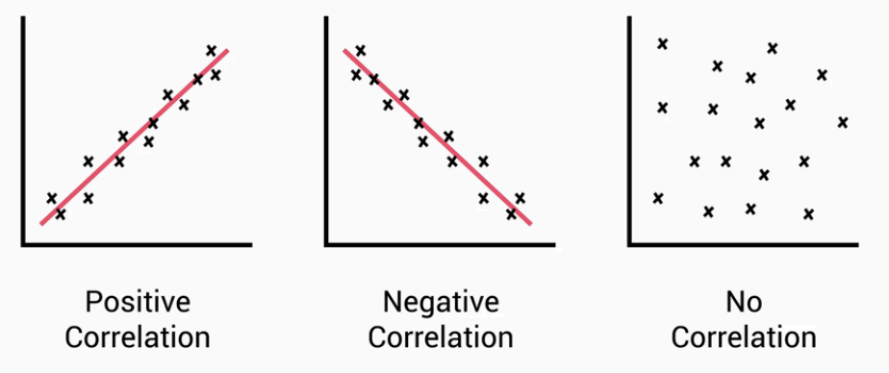
Sudhanshu Kakkar | ID - 20036779
Correlation
WHAT IS IT?
The Correlation Scale
A statistical measure that describes the relationship between two or more variables.
Range of -1 to 1
1 = strong positive correlation
0 to 1 = some positive correlation
0 = no correlation
-1 to 0 = some negative correlation
-1 = strong negative correlation
It lets us understand the relatedness between two variables, allowing for testing against models or simplification of analysis
TYPES
Positive correlation:
When one variable increases, so does the other.
Negative correlation:
When one variable increases, the other variable decreases.
No correlation:
When there is no linear relationship between variables.
APPLICATIONS
Feature Selection in Data Science
Dimensionality Reduction in case of correlated features

Slide 3
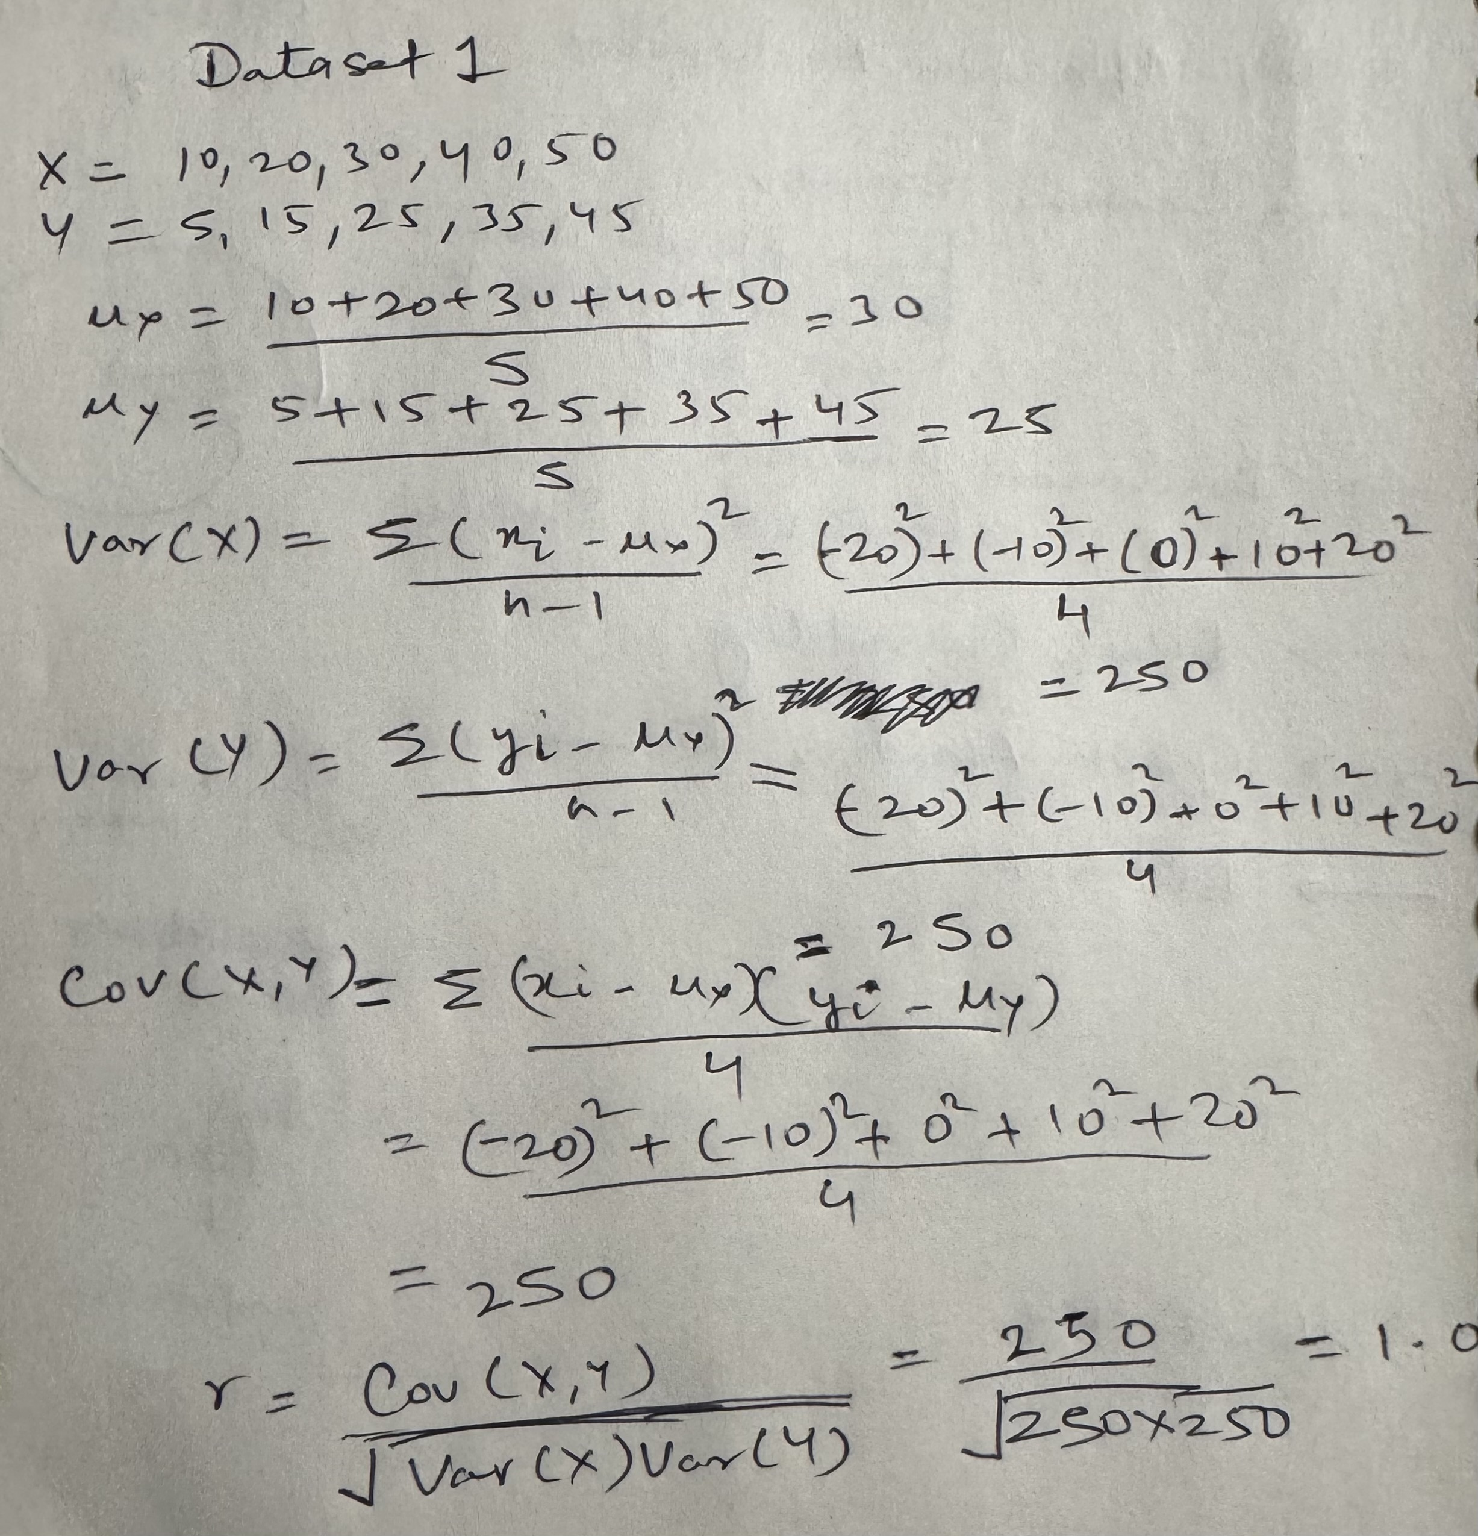
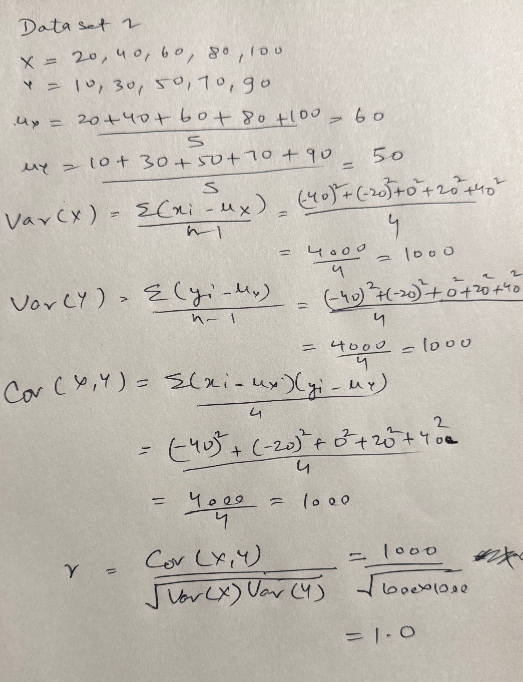
Sudhanshu Kakkar | ID - 20036779
Manual calculation of Correlation Coefficient
Solution for Dataset 1
Solution for Dataset 2

Slide 4
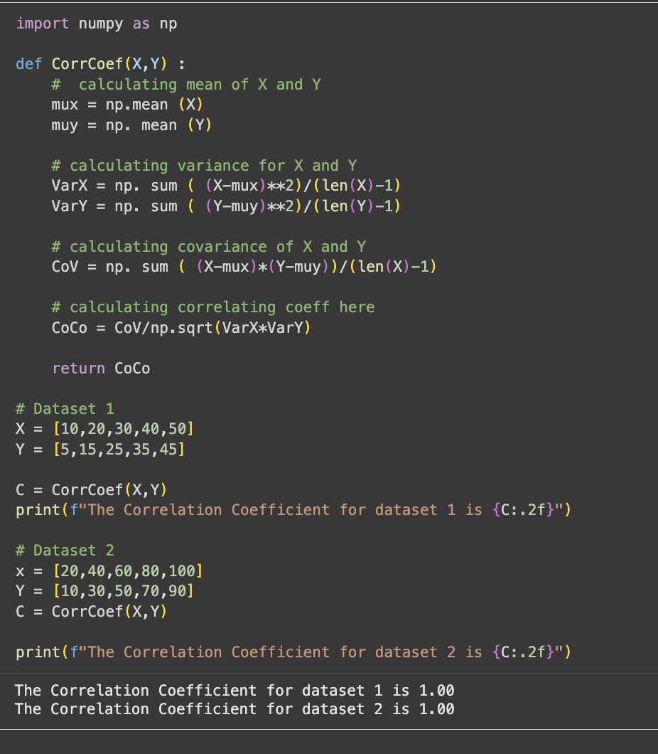
Sudhanshu Kakkar | ID - 20036779
Program to calculate:
Correlation Coefficient

