Slide 1
HW-Topic-6 Data Acquisition, Modeling and Analysis: Big Data Analytics Submitted By – Sudhanshu Kakkar CWID – 20036779

Slide 2
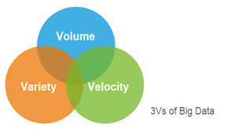



Sudhanshu Kakkar | ID - 20036779
Big Data Technologies
WHAT IS IT?
Big Data Technologies are the special computer tools and systems that let us collect, store, and understand huge amounts of fast moving, diverse information.
THE THREE V’S - THE PROBLEM
Volume: The enormous scale of data that is too massive for traditional databases to store and process.
Velocity: The extreme speed at which data is generated, collected, and must be analyzed to provide real time value.
Variety: The vast diversity of data types, including structured, semi structured, and complex unstructured formats like video and audio.
Processing Frameworks
Apache Hadoop
Apache Spark
PySpark
APPLICATIONS
Challenges
Personalized Recommendations
Fraud Detection
E-commerce Dynamic Pricing
High Cost
Shortage of skilled professionals
Collecting huge data does not guarantee value

