Slide 1
HW-Topic-8 Data Acquisition, Modeling and Analysis: Big Data Analytics Submitted By – Sudhanshu Kakkar CWID – 20036779

Slide 2
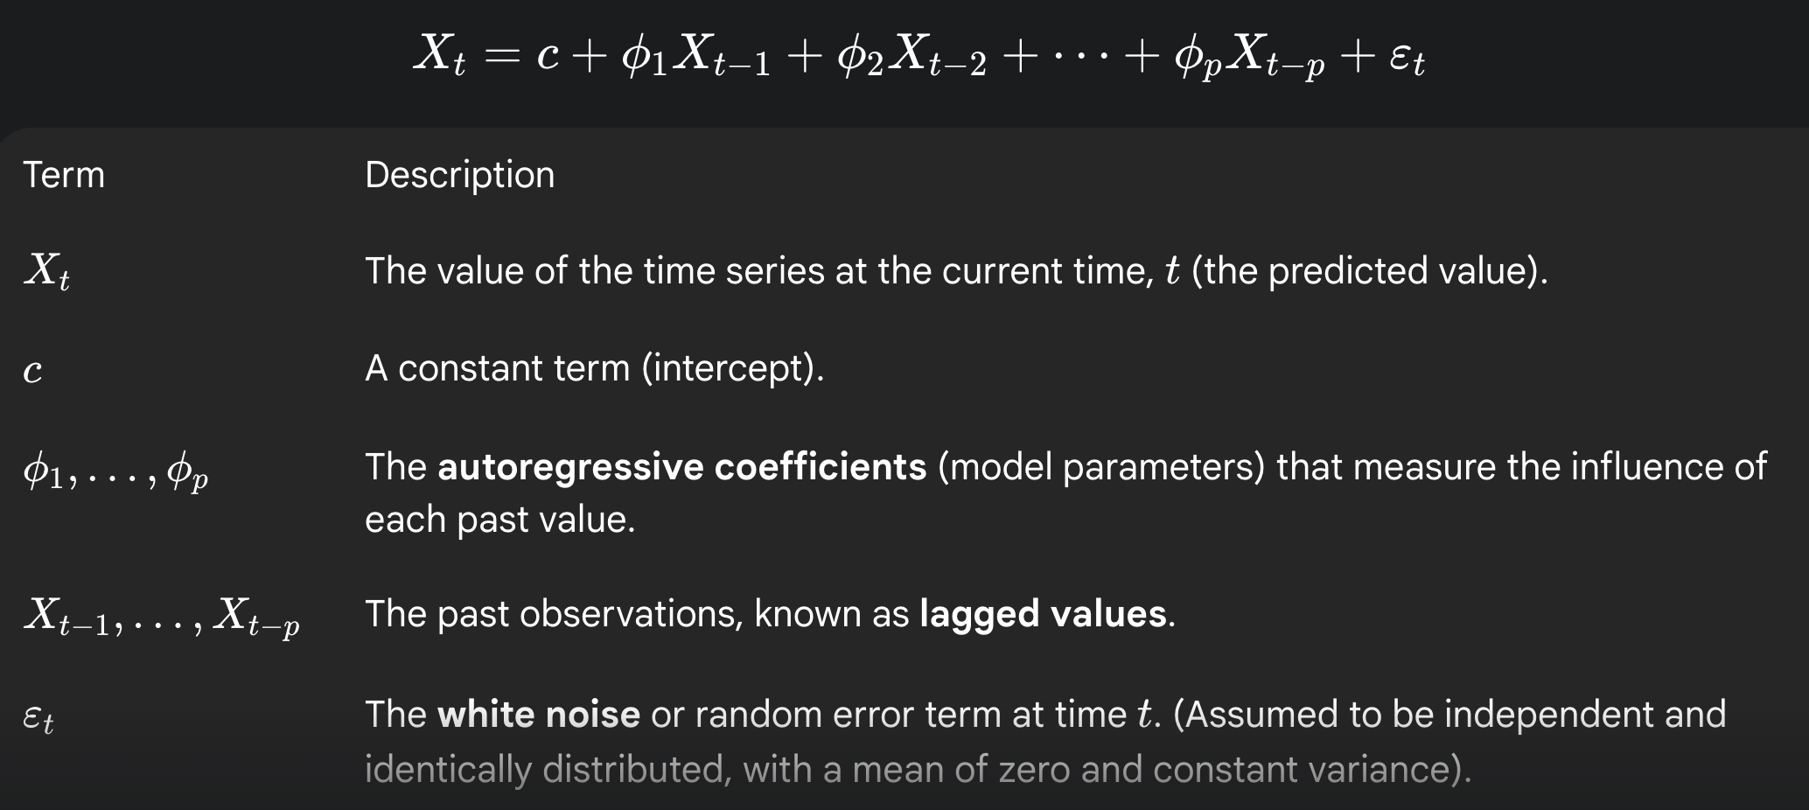
Sudhanshu Kakkar | ID - 20036779
Autoregressive (AR) Models
WHAT IS IT?
It's a way to predict the future of a time series
The main idea is that value depends only on its own past values.
The model learns the relationship a variable has with its history.
APPLICATIONS
Finance: Stock or FX forecasting
Industry: Predictive maintenance
Healthcare: ECG/EEG analysis
Climate: Weather prediction
Economics: Trend modeling
ADVANTAGES
Simplicity and Speed
Effective for Short-Term Data
Foundation for Forecasting
THE AR EQUATION
DISADVANTAGES
Sensitive to model order misspecification.
Requires stationarity
Assumes linear relationships only.

