Slide 1
HW-Topic-4 Data Acquisition, Modeling and Analysis: Big Data Analytics Submitted By – Sudhanshu Kakkar CWID – 20036779

Slide 2
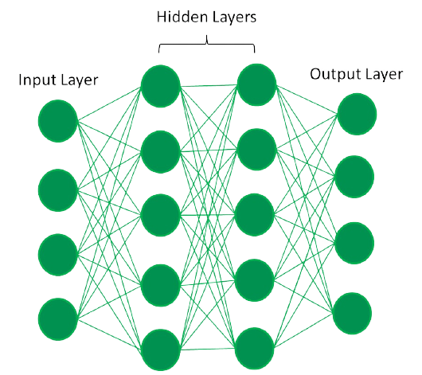
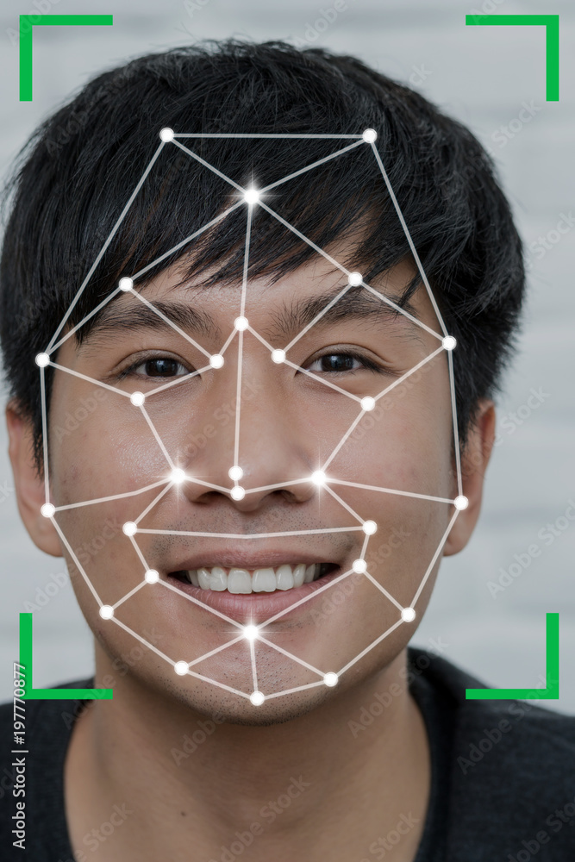

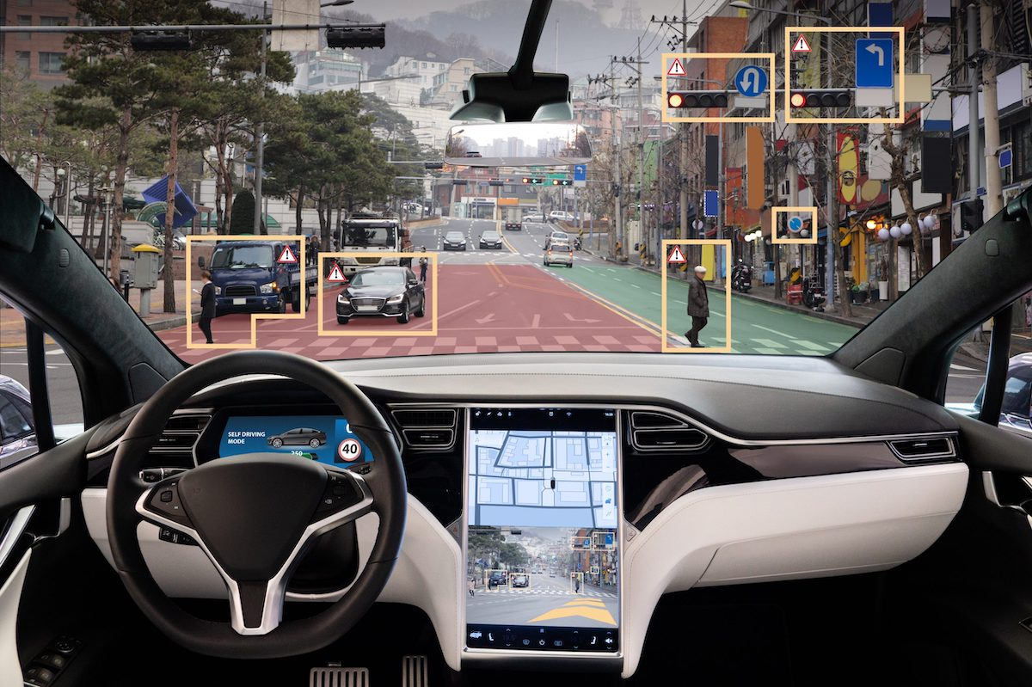
Deep Learning
WHAT IS IT?
Deep learning is a subfield of machine learning that uses artificial neural networks with multiple layers (hence "deep") to analyze data, learn patterns, and make decisions or predictions.
KEY CONCEPTS
Neural Networks: Artificial neural networks with multiple hidden layers (deep) form the computational core, inspired by the human brain.
Feature Extraction: Deep learning automatically learns the most important features directly from raw data, eliminating manual feature engineering.
THE PROCESS
Forward Propagation: The input data is processed through the network's layers, where initial weights are applied to make the model's first prediction (the "guess").
Measure Loss: A mathematical function calculates the difference (the "loss") between the model's prediction and the actual correct answer, measuring how wrong the guess was.
Backpropagation: The error signal is sent backward through the network layers, revealing how much each internal connection (weight) contributed to the total error.
Weight Adjustment: Using the error feedback, an optimizer (Gradient Descent) makes small, iterative adjustments to the weights and biases to ensure the next guess is more accurate.
APPLICATIONS
Self Driving Cars
Natural Language Processing
Movie Recommendation Systems
Natural Language Processing
Computer Vision
Financial Fraud Detection
Healthcare

Slide 3
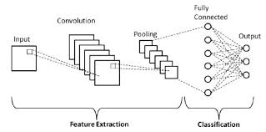



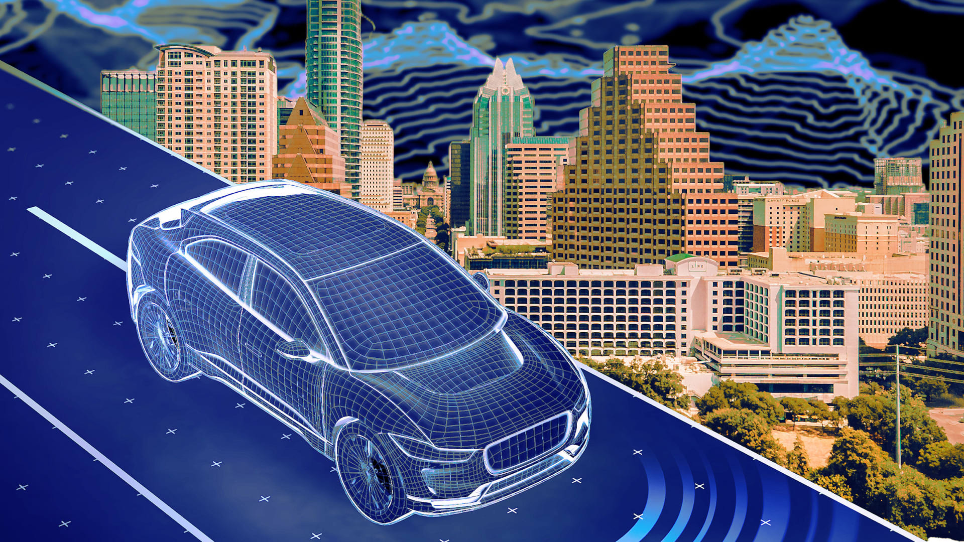

Convolution Neural Network
WHAT IS IT?
A Convolutional Neural Network (CNN) is a type of deep learning network specifically designed to process data with a known grid-like structure, such as images. Its process is specialized in automatically extracting visual features.
THE PROCESS
KEY CONCEPTS
Convolution: Filter slides over input to extract features (edges, textures).
Filter / Kernel: A small learnable weight matrix that detects one specific feature
Parameter Sharing: A single filter's weights are reused across the entire image.
Pooling (Max): Down samples feature map size, adding robustness to shifts.
Flatten: Converts 3D features into a 1D vector for final classification
THE PROCESS
Convolution: Extracts features (edges, textures, patterns) by applying a filter (kernel) across the input.
Activation (ReLU): Introduces non-linearity to the extracted features, enabling the model to learn complex data maps.
Pooling: Reduces the spatial dimensions (width and height) of the feature data.
Flattening: Transforms the 2D/3D feature maps into a single 1D vector.
Fully Connected: Learns high-level global patterns from the flattened feature vector.
Output (Softmax): Calculates the final probability for each potential class label.
APPLICATIONS
Facial Recognition
Autonomous Vehicles
Image Classification
OCR / Handwriting recognition
Product recommendation engine

Slide 4
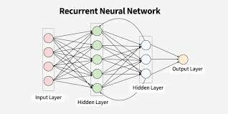

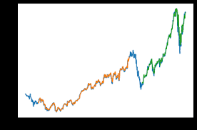

Recurrent Neural Network
WHAT IS IT?
A Recurrent Neural Network (RNN) is a type of deep learning model specifically designed to process sequential data or data where the order matters. Unlike a traditional neural network, an RNN has an internal memory that allows it to remember information from previous steps in the sequence.
THE PROCESS
KEY CONCEPTS
Contextual Understanding: Uses internal memory to process current data based on its entire history.
Variable Length Input: Naturally handles sequences of any length (e.g., short or long sentences).
Sequence Mapping: Great at mapping one sequence to another (like translation) or to a single label.
Long-Term Memory (LSTM): Advanced versions use gates to remember critical info over extended periods.
THE PROCESS
Input Embedding: Converts the sequential element (like a word) into a dense numerical vector for the network to understand.
Initial Hidden State (Old Memory): Sets the starting internal memory (context) to an empty state.
Recurrence (Calculation): Takes the old memory and the current input to compute the new, updated memory.
Weight Sharing: Reuses the same set of weights (rules) for every single time step in the sequence.
Final Hidden State (Full Context): The memory vector that holds the complete understanding of the entire sequence.
Output (Prediction): Uses the memory (from a specific step or the final one) to make a final prediction (e.g., translation, sentiment).
APPLICATIONS
Sentiment Analysis
Video Processing
Stock Prices Prediction
Text Prediction

Slide 5
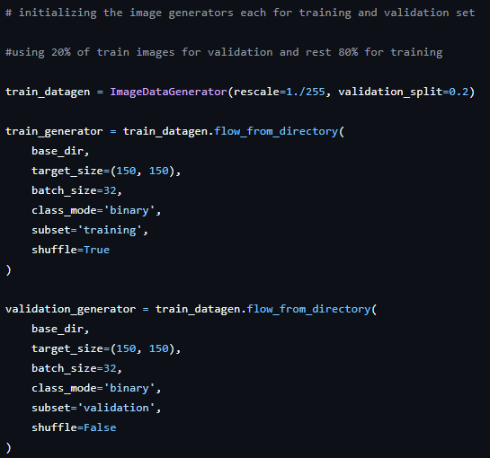
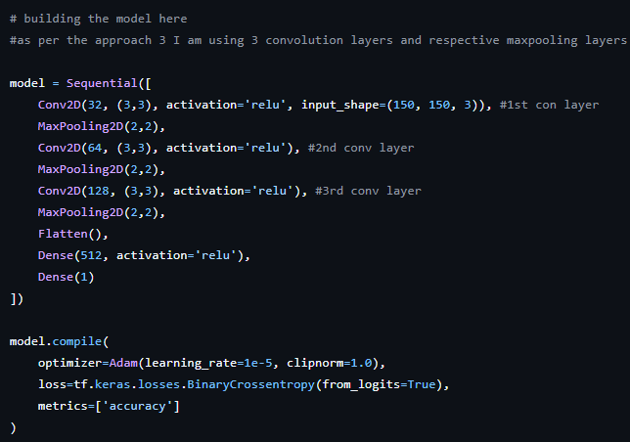
CNN Code Demo (python)
Training and Model Building Step
In the above code snippet, we are building the model with 3 convolution layers.
In the above code snippet, we are dividing the data set into 20% validation and rest 80% for training.

Slide 6
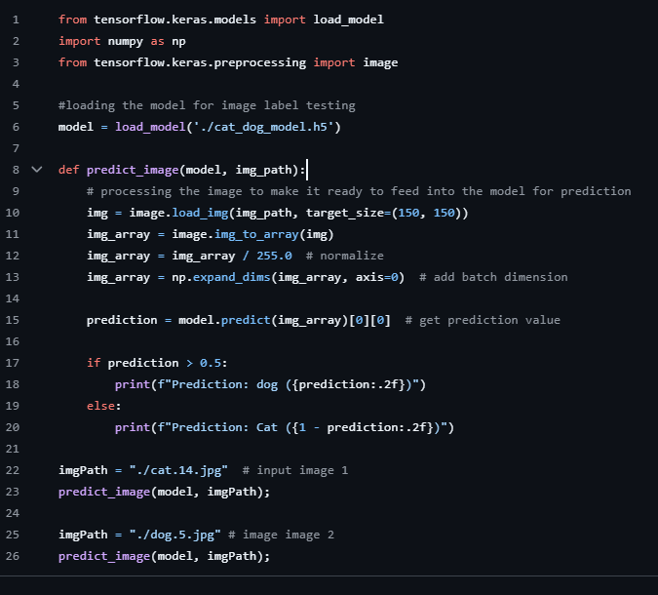

Testing Step
Input – Dog image
Output –
Prediction: dog (0.9101)
In the above code snippet, we are testing the trained model with images of cat and dog.

