Slide 1
HW-Topic-5 Data Acquisition, Modeling and Analysis: Big Data Analytics Submitted By – Sudhanshu Kakkar CWID – 20036779

Slide 2
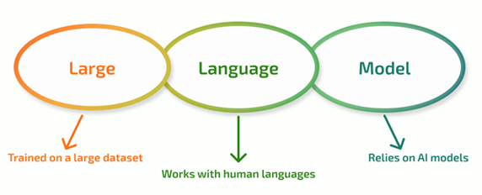

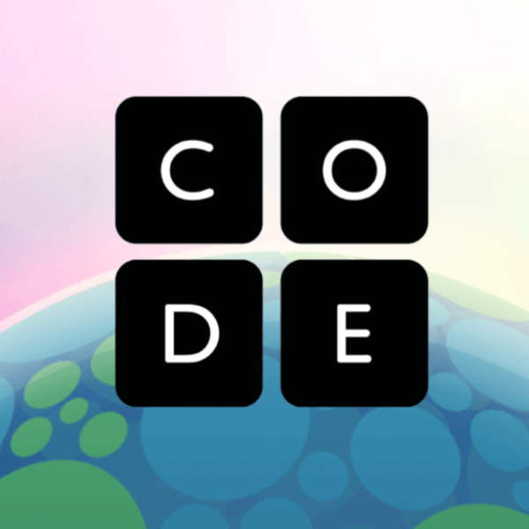

Sudhanshu Kakkar | ID - 20036779
Large Language Models (LLMs)
WHAT IS IT?
An LLM is a type of deep learning model designed to understand, generate, and interact with human language.
KEY CONCEPTS
Transformer Architecture: The neural network design enabling parallel data processing.
Attention Mechanism: A process that weighs the importance of input tokens to understand context.
Tokenization: Breaking down raw text into smaller, readable units (tokens).
Context Window: The maximum number of tokens the model can process or "remember" in one interaction.
Advantages
Increased Productivity in daily tasks
Natural Language Understanding
Code Generation
Highly Scalable
APPLICATIONS
Limitations
Code Generation
Human Like Chatbots
Content Creation
Information Summarization
Hallucinations and inaccuracies
Limited or outdated knowledge
Expensive training
Lack of transparency

Slide 3
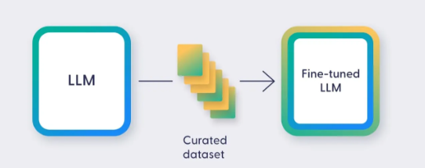
Sudhanshu Kakkar | ID - 20036779
Fine-Tuning LLM
WHAT IS IT?
Fine tuning a Large Language Model (LLM) is the process of taking a pre-trained general-purpose model and adapting it for a specific task or domain by continuing to train it on a smaller, targeted dataset
KEY CONCEPTS
Starting Point: You begin with a pre-trained LLM, which has already learned extensive language and grammar, and a wide from huge amounts of public data.
Specialization: You then introduce a smaller, task specific dataset (often a collection of labeled input/output examples).
Process: The model continues its training process, adjusting its internal parameters (weights) based on the specialization dataset.
Advantages
Industry Specific Tasks
Productivity in daily tasks
Reduced Hallucinations
APPLICATIONS
Limitations
Healthcare: Summarize clinical notes, generate patient reports.
Finance: Perform sentiment analysis on financial reports and news for market trend prediction
Legal: Analyze, summarize, and extract key clauses from legal documents
Hard to Maintain with latest data
Finding optimum data for training becomes difficult some times.

