Slide 1
HW-Topic-3 Data Acquisition, Modeling and Analysis: Big Data Analytics Submitted By – Sudhanshu Kakkar CWID – 20036779

Slide 2
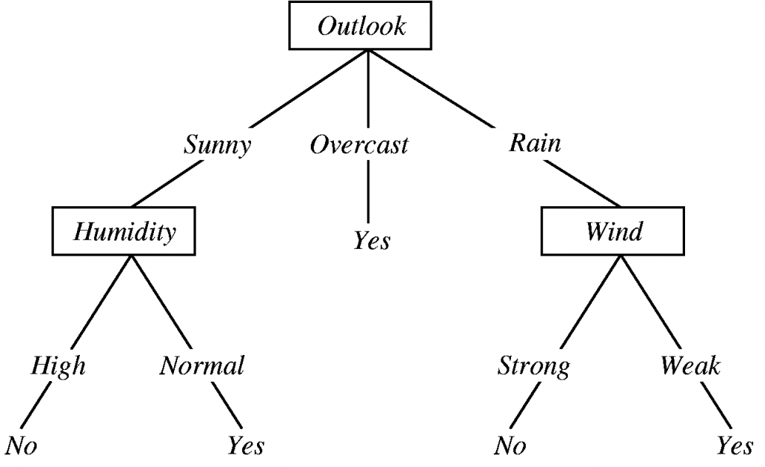
DLT – Decision Tree Learning
WHAT IS IT?
A supervised machine learning algorithm used for classification and regression.
Represents decisions as a tree structure.
KEY CONCEPTS
Splitting: Dividing dataset based on feature values.
Entropy: Measure of randomness or impurity.
Information Gain: Reduction in entropy after a split.
Pruning: Removing branches to reduce overfitting.
TYPES
Pros | Cons
Easy to understand & visualize Handles categorical & numerical data | Prone to overfitting Sensitive to small changes in data
Classification Tree: Predicts discrete labels (e.g., Yes/No)
Regression Tree: Predicts continuous values

Slide 3
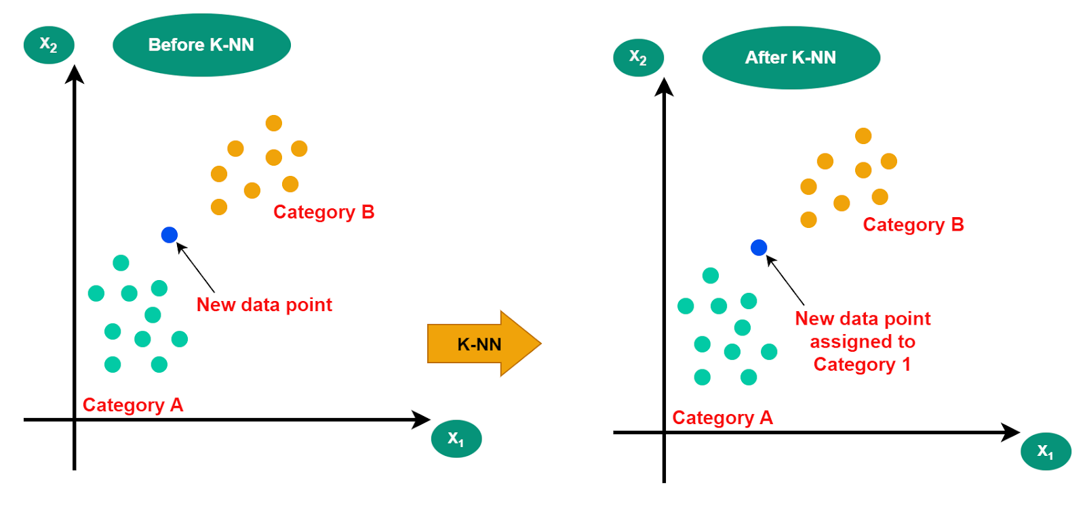
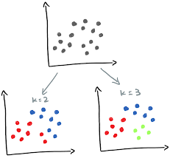
KNN – K-Nearest Neighbours
WHAT IS IT?
A supervised machine learning algorithm used for classification and regression.
Classifies a data point based on the majority class of its K nearest neighbors
KEY CONCEPTS
K Value: Number of neighbors considered
Distance Metrics: How similarity is measured
Euclidean Distance
Manhattan Distance
Pros | Cons
Simple and easy to understand Works well with small datasets | Computationally expensive for large datasets Poor performance on high-dimensional data

Slide 4
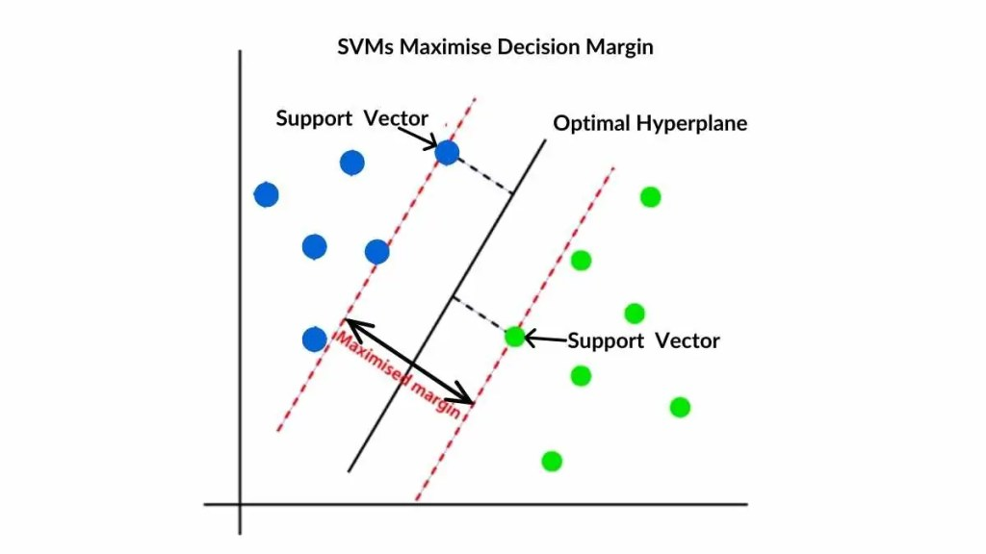
SVM – Support Vector Machine
WHAT IS IT?
A supervised machine learning algorithm used for classification and regression.
Finds the best hyperplane that separates classes with the maximum margin.
Works well for linear and non-linear data using kernel functions.
KEY CONCEPTS
Hyperplane: Decision boundary separating classes
Support Vectors: Data points closest to the hyperplane
Margin: Distance between support vectors of different classes (maximizing this improves generalization)
TYPES
Pros | Cons
Effective in high-dimensional spaces Works well for linearly and non-linearly separable data | Computationally expensive for very large datasets Choosing the right kernel can be tricky
Linear SVM: Data is linearly separable
Non-linear SVM: Uses kernels for complex datasets

Slide 5
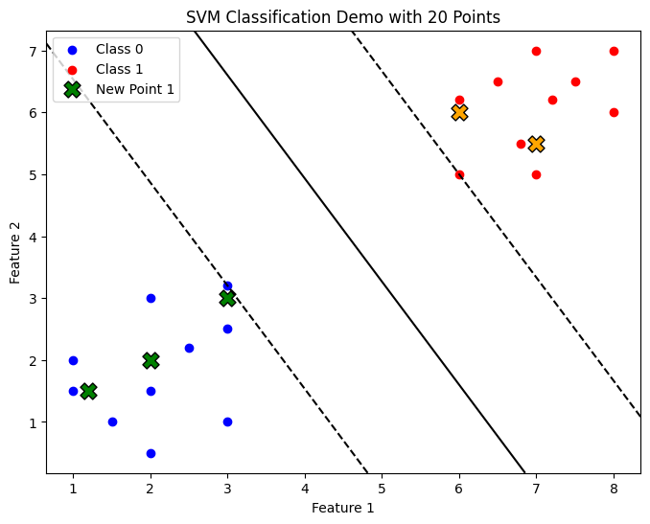
SVM Code Demo (python)
import numpy as np
import matplotlib.pyplot as plt
from sklearn import svm
# declaring points for training
X = np.array([
[1,2], [2,3], [3,1], [2,1.5], [3,2.5],
[1.5,1], [2.5,2.2], [3,3.2], [2,0.5], [1,1.5],
[6,5], [7,7], [8,6], [7,5], [6.5,6.5],
[8,7], [7.2,6.2], [6.8,5.5], [7.5,6.5], [6,6.2]
])
# declaring labels for points
y = np.array([0]*10 + [1]*10) # 0 = Class A, 1 = Class B
# Train SVM
model = svm.SVC(kernel='linear')
model.fit(X, y)
# New points to classify
new_points = np.array([
[2,2], [3,3], [6,6], [7,5.5], [1.2,1.5]
])
predictions = model.predict(new_points)
# Print classifications
for point, label in zip(new_points, predictions):
print(f"Point {point} is classified as Class {label}")
# Plot
plt.figure(figsize=(8,6))
# Plot original points
plt.scatter(X[:10,0], X[:10,1], color='blue', label='Class 0')
plt.scatter(X[10:,0], X[10:,1], color='red', label='Class 1’)
# Plot new points with classification
for i, point in enumerate(new_points):
plt.scatter(point[0], point[1], color='green' if predictions[i]==0 else 'orange',
edgecolors='k', s=150, marker='X', label=f'New Point {i+1}' if i==0 else "")
# Plot decision boundary
ax = plt.gca()
xlim = ax.get_xlim()
ylim = ax.get_ylim()
xx = np.linspace(xlim[0], xlim[1], 50)
yy = np.linspace(ylim[0], ylim[1], 50)
YY, XX = np.meshgrid(yy, xx)
Z = model.decision_function(np.c_[XX.ravel(), YY.ravel()]).reshape(XX.shape)
ax.contour(XX, YY, Z, levels=[0], colors='k') # hyperplane
ax.contour(XX, YY, Z, levels=[-1,1], colors='k', linestyles='--') # margins
plt.xlabel("Feature 1")
plt.ylabel("Feature 2")
plt.title("SVM Classification Demo with 20 Points")
plt.legend()
plt.show()

