Slide 1
HW-Topic-10
Data Acquisition, Modeling and Analysis: Big Data Analytics
Submitted By – Sudhanshu Kakkar
CWID – 20036779

Slide 2
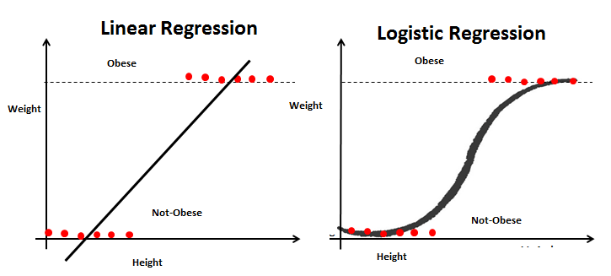
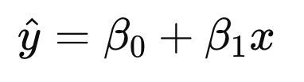
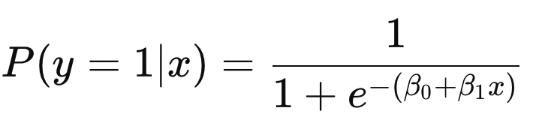
Sudhanshu Kakkar | ID - 20036779
Linear Regression & Logistic Regression
CORE IDEA
Linear: predicts a continuous numeric value using a straight-line relationship between input features and output.
Logistic: predicts a categorical outcome (like yes/no) by estimating probabilities using the logistic (sigmoid) function.
MATHEMATICAL FORM:
Advantages
  Linear:
  Logistic:
Linear:
  Simple & fast
  Easy to interpret
  Good for linear data
Logistic:
  Gives probabilities
  Good for classification
  Works well on small, separable data
APPLICATIONS
Linear: House price, temperature, sales forecasting.
Logistic: Disease detection, churn prediction, fraud detection.

