Slide 1

use case diagram of banking system

Slide 2
Group MEMBERS
Jahir Mohammod (1004040)
Asif Ibtihaj Ribath (1004041)
Rabiul Hasan Ronok (1004046)
Md. Golam Hossain (1004049)
Emtiaj Hasan (1004050)

Slide 3
Objectives
Analyzing Use Case Diagram
Briefing Use Case Narrative

Slide 4
Subsystems
Cash Subsystems
Deposit Subsystems
Foreign Exchange Subsystems
IT Subsystem
ATM Subsystems
Others

Slide 5
USE Case for Foreign Exchange Subsystem
Use Case Name | Actors
Export | Seller, SEO
Import | Buyer, SEO

Slide 6
USE Case for ATM Subsystem
Use Case Name | Actors
Query Balance | Customer
Withdraw Funds | Customer
Transfer Funds | Customer
Validate PIN | Customer, Operator
Startup | Operator
Shutdown | Operator
Maintenance | Technician
Repair | Technician

Slide 7
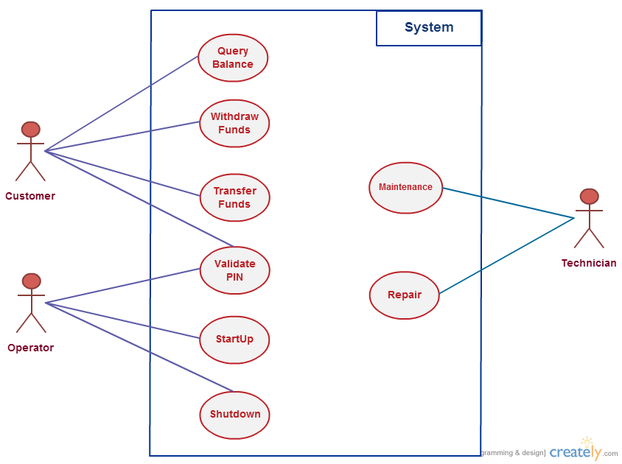
USE Case DIAGRAM for ATM Subsystem

Slide 8
Use case narrative for ATM approval
Name: ATM Approval
Priority: High
Primary Actor: Customer
Secondary Actor: Operator
Precondition: Active Network

Slide 9
Basic Flow of Events for PIN approval
Insert ATM Card
Request PIN
Enter PIN
Verify PIN
Display Approval Message

Slide 10
Use case narrative for Withdrawal
Name: Withdraw Amount
Priority: High
Primary Actor: Customer
Precondition: Sufficient Amount
Trigger: Sufficient Amount in Booth

Slide 11
Basic Flow of Events for Withdrawal
ATM Approval
Request Amount
Enter Amount
Check Amount
Verify Amount
Eject Cash

Slide 12
Thank you

