Slide 1
Any way to improve or to test your programming skill?

Slide 2
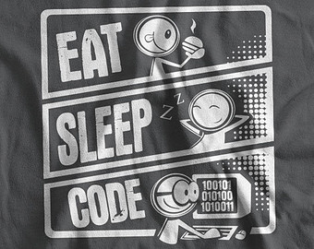
Why not?
Brace yourself & do use your brain
Do code whatever childish it may look like
Do problem solving
Do programming contest
Play with your PC & mind :D

Slide 3
Medium
Online Judge
UVA Online Judge http://uva.onlinejudge.org/
Light Online Judge www.lightoj.com/index.php
Codeforces www.codeforces.com

Slide 4
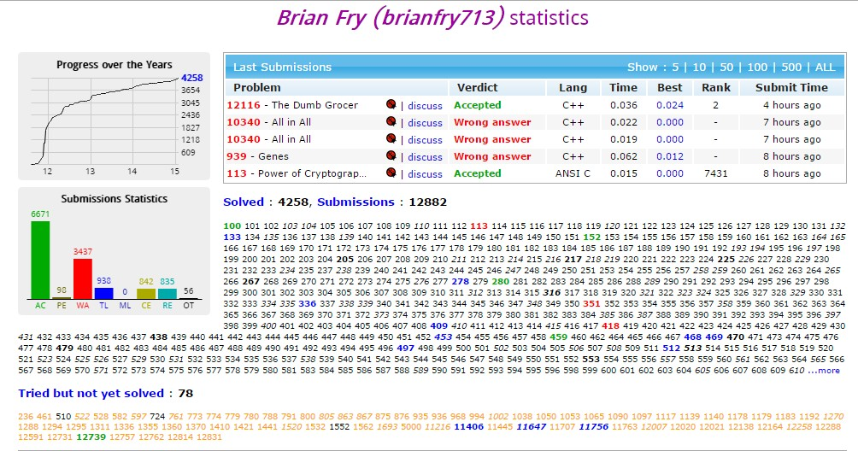

Slide 5
Before going to start..

Slide 6
N set of value to process
Input
3
1 2
12 15
123 98
Code
scanf(“%d”, &n);
for(t=0;t<n;t++){ scanf(“%d %d”, &num,&num2);
//rest of code
}

Slide 7
End of file
Input
1 2
2 5
12 -19
Code
while(scanf(“%d%d”, &a, &b)!=EOF){
//rest of code
}

Slide 8
Specific value to terminate
Input
2
12 15
3
1 56 100
-1
Code
while(scanf(“%d”,&n)){
if(n==-1) break;
for(i=0;i<n;i++)
scanf(“%d”,&num);
//rest of code
}

Slide 9
scanf() then gets()
Input
2
Joy Bangla
Bangladesh
1
Chittagong
Code
while(scanf(“%d”,&n)!=EOF){
getchar();
for(t=0;t<n;t++){
gets(str);
//rest of code
}
}

Slide 10
Some easy problem from UVA
10055
11172
11219
11332
11388
11417
11461
11479
11530
11541
11547
11577
11608
11636
11650
11677
11689
11713
11715
11716
11727
11734
11743
11764
11777
11805
11830
11854
11875

Slide 11
Read it, Please
চিন্তা করার আনন্দ
http://mukto-mona.com/bangla_blog/?p=24518
কেন আমি প্রোগ্রামিং শিখবো?
http://www.shafaetsplanet.com/planetcoding/?p=1437
প্রোগ্রামিং শিখতে ইচ্ছুকদের কিছু প্রশ্নের উত্তর
http://mukto-mona.com/bangla_blog/?p=32017
Teach Yourself Programming in Ten Years
http://www.progkriya.org/feature/norvig.html
প্রোগ্রামিং কনটেস্ট এবং অনলাইন জাজে হাতেখড়ি
http://www.shafaetsplanet.com/planetcoding/?p=1400
কোন পথে যে চলি
http://blog.subeen.com/%E0%A6%95%E0%A7%8B%E0%A6%A8-%E0%A6%AA%E0%A6%A5%E0%A7%87-%E0%A6%AF%E0%A7%87-%E0%A6%9A%E0%A6%B2%E0%A6%BF/

Slide 12


Slide 13
THANK YOU

